Slide 1
Graduation Project PRMA weekly Report 14/12/2014 – 3/1/2015
Cai Bowen
3/1/2015

Slide 2
Progress: basic web interface and restful web service
I have made the web interface for PRMA, the web page is built with HTML5, and will be hosted on Google App Engine after I find a suitable cloud SQL service. The web site will be:
http://cbw-prma.appspot.com/
Currently the backend service has not been deployed. But you can login to the administrator panel without authenticate (no password or Google ID needed)

Slide 3
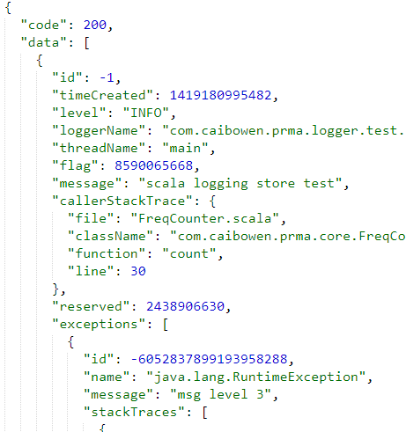
Progress: basic web interface and restful web service
The back end application is also finished, it is implemented as a JSON based web service. Example query:
http://WEB_SITE/log.json?minTime=1&maxTime=2147483647&lowLevel=TRACE&highLevel=FATAL&exceptionOnly=false
Returns:
Devices other than browser can also utilize this web service to develop native application since every thing is though HTTP and all data is JSON encoded.

Slide 4
Progress: log analyze algorithms
After two weeks researching, I decided to implement and benchmark the two methods from papers I read.
Missing event detector
Log summarization
And there are two other method I plan to explore:
Relevant logs query and retrieval
Log feature analyze for debugging

Slide 5
Problems: No enough log data for testing
As more functionalities been added and the program becoming more completed, I need log data to test and benchmark my program, but I do not have enough data.
If this problem is not addressed, I will have to write code to generate log for me, which is less real and may affect the performance of PRMA.

Slide 6
Problems: Advice for log processing
I need some advice on log processing, especially from experienced developers.
I contacted my colleagues in Alibaba, but his was too busy to spare time with my project and give more insightful ideas than log statistics and reporting.
I think my experience and understanding about server side development is not enough to achieving the original goal, so some of the idea may have to be compromised.

Slide 7
Project information
Project URL:
https://github.com/xkommando/PRMA
Active branch p2:
https://github.com/xkommando/PRMA/tree/p2
Supporting project Gplume:
https://github.com/xkommando/Gplume

Slide 8
Next:
Set up a cloud SQL server
Deploy web application to GAE
Implement the algorithms and benchmark
Preparing for demonstration

