Slide 1
Graduation Project
PRMA weekly Report
30/10/2014 – 6/11/2014
Cai Bowen
6/11/2014

Slide 2
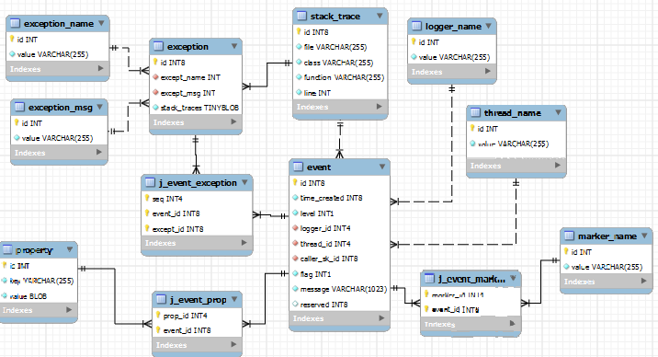
Progress:
Alter database schema, add new fields and two tables. Now a log event is stored in 12 tables.

Slide 3
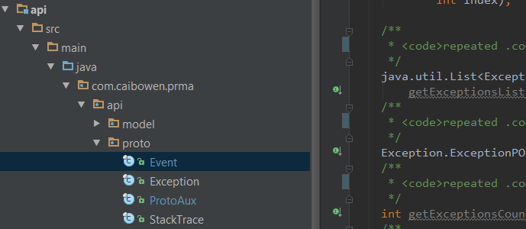
Progress:
Test store module, code refactored.
Fix and tested async appender, speed up log store by adding buffer to execution queue and switching store operation to batch mode.
Use Protocol Buffer as serialization solution, add proto API for socket logger.

Slide 4
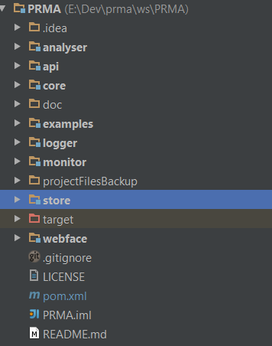
Progress:
Begin to design monitor.
Set up to Scala environment and learning Scala language, I plan to use Scala to build the analyzer module.
Add two more module: prma-examples and prma-webface

Slide 5
Project information
Project URL:
https://github.com/xkommando/PRMA
Active branch p2:
https://github.com/xkommando/PRMA/tree/p2
Supporting project Gplume:
https://github.com/xkommando/Gplume

Slide 6
Next
Finish store cache and test.
Because I am a little bit behind schedule, I will finish a simple monitor as soon as possible.
Continue develop Gplume enhance the bean assembler, build up the program context of PRMA.
Lean Scala, research into log analyzing.

