Slide 1
Graduation Project PRMA week Report 4/12/2014 – 12/1/2015
Cai Bowen
13/1/2015

Slide 2
Progress: Progress: add data virtualization and statistic functions
I learned to use morris.js to virtualize log trends, and have implemented them in the admin page
http://cbw-prma.appspot.com/charts.html
The Web interface is : /chart/statistics.json
Parameters: lower level, higher level, minTime, maxTime

Slide 3
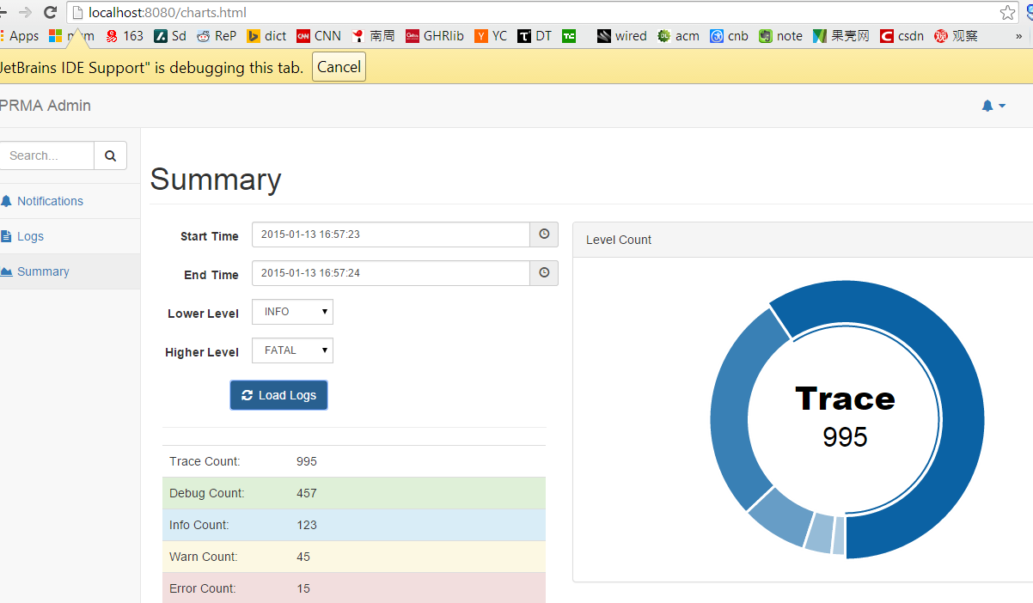
Progress: Progress: add data virtualization and statistic functions

Slide 4
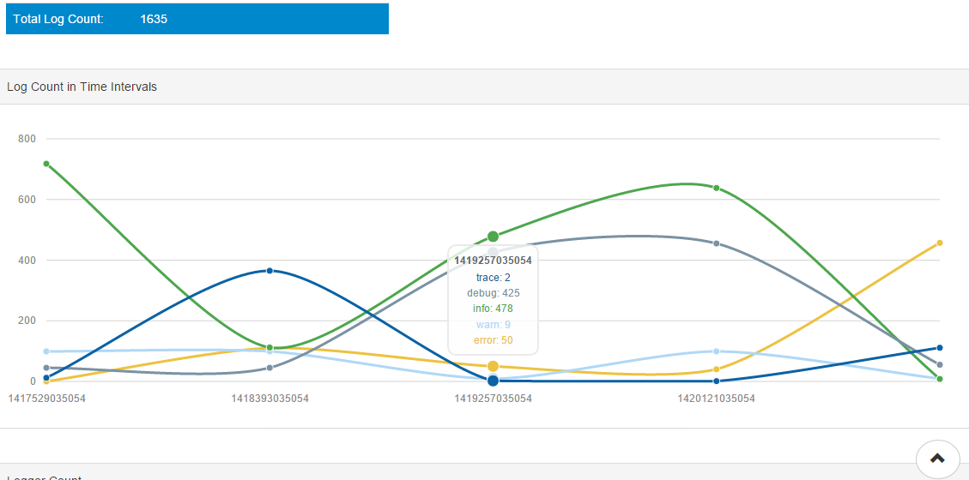
Progress: Progress: add data virtualization and statistic functions

Slide 5
Progress: Update Gplumeframework
Add better support for static resources
Improved Gplume.scala.jdbc, add more functions.

Slide 6
Project information
Active branch p2:
https://github.com/xkommando/PRMA/tree/p2
Google App Engine:
http://cbw-prma.appspot.com
Supporting project Gplume:
https://github.com/xkommando/Gplume

Slide 7
Next:
Add notification receiver on GAE
Implement and test analyze algorithm

