Slide 1
Graduation Project PRMA weekly Report 16/10/2014 – 25/10/2014
Cai Bowen
26/10/2014

Slide 2
Progress:
Scheduled:
Finish Basic Java Logger API
Finish MongoDB based log storage
Testing storage module
Progress:
Finished MongoDB logger and schema design
After a deeper insight into databases and some benchmark on MongoDB and MySQL 5.6, I change the storage solution to RDBMS, namely, H2database for embedded use and MySQL for server client use.
Finished schema design, JDBC Logger API, and log store.

Slide 3
1. The MongoDB Logger
Existing MongoDB Java logger:
Logback-contrib.mongo: logback + mongoDB 2.10
https://github.com/qos-ch/logback-contrib
Log4mongo for Java: Log4J + mongoDB 2.10
http://log4mongo.org/display/PUB/Log4mongo+for+Java
Drawbacks of Existing MongoDB Java logger:
Inactive projects, non-mainstream practice, insufficient quality.
data storage structure is messy.

Slide 4
1. The MongoDB Logger
Drawbacks of MongoDB log storage solution:
Less normalized/schemaless data structure in mongoDB does not contribute to query and storage efficiency.
No, or no significant insertion & query performance gain from MongoDB, poorer aggregation speed on MongoDB.^{[1]}
Current RDBMS are more reliable than NoSQL

Slide 5
2. NewRDBMS Solution
Store logs in RDBMS
1, Embedded mode for programs on a single machine : the log storage API, monitor and H2database are embedded in the Logger, no extra process is created, provide querying API
2, Client-Server Mode for distributed logging: a centralized server, log server, receive logs from replications and store log to MySQL server farm. Monitoring and querying program is running on the log server.
First we focus on embedded mode.

Slide 6
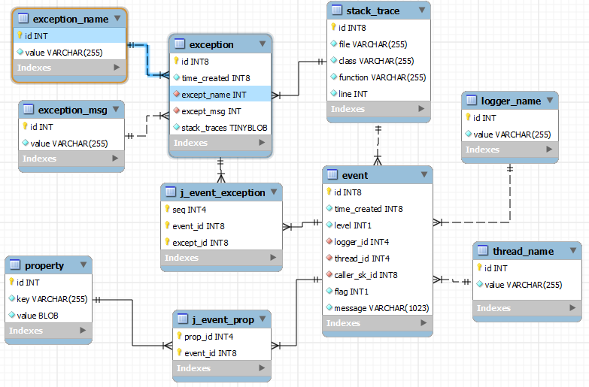
3. Data Storage Design
Originally, Logback DBAppender store logs to 3 table: logging_event, logging_event_property and logging_event_exception. I store a log to 10 tables as shown below:

Slide 7
3. Data Storage Design
Pros:
More normalized data structure, less redundancy (test data will be provided later to proof it).
Faster insertion and query.
Cons:
Extra complexity, difficult to manage transactions and failures.

Slide 8
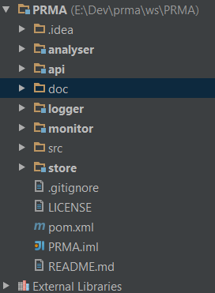
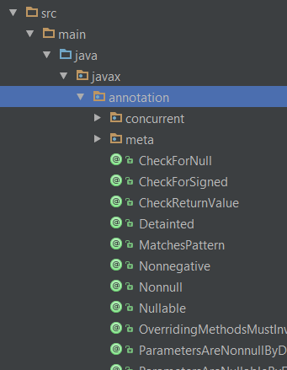
Project information
There are 6 modules:
Module 1 parent: basic class and annotations

Slide 9
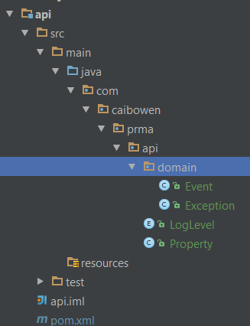
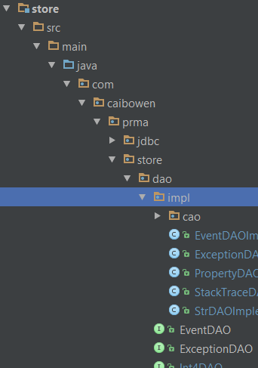
Project information
Module 2 api: domain model
and api for external system
Module 3 store: low level data storage and query api, for internal use.

Slide 10
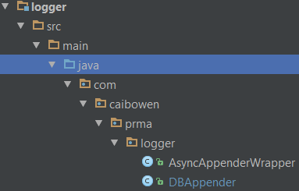
Project information
Module 4 logger: logger api adopted to logback
Module 5 monitor : log event filtering , monitor config and callback
Module 6 analyzing: high level aggregation function and built-in analyzing-reporting tools

Slide 11
Project information
Project URL:
https://github.com/xkommando/PRMA
Note that the active branch is p2:
https://github.com/xkommando/PRMA/tree/p2

Slide 12
4. Next
Transaction management, Unit Testing, basic benchmarking.
Achieving High Reliability:
Exception/failure handing system.
Higher test coverage, verify and validate program
Achieving High Speed:
Efficient data structure and algorithms
Cache system (current for single machine embedding mode)
custom aggregation build on database API, rather than complex queries

