Slide 1
Graduation Project
PRMA
Weekly Report
26/10/2014 – 30/10/2014
Cai Bowen

Slide 2
Progress
Scheduled:
Finish transaction management
Add caching in application layer (DAO layer).
Add filtering layer in storage, avoid irrelevant data.
Test store and transaction.
Benchmark storage
Progress:
1. Done.
2. Have created two kind of cache: full hash based cache and LIRS cache, but have not integrated into data layer.
3. Created filters, not yet integrated.
4. Done (without cache or filter).
5. pending

Slide 3
1. JDBC Operations
I wrote a mini yet robust JDBC framework, and integrated it into one of my previous project Gplume.
This framework borrowed ideas from springframework-jdbc and springframework-transaction.
Gplume-jdbc provide support for easy JDBC operation and declarative transaction management.
URL: Gplume-jdbc
https://github.com/xkommando/Gplume/tree/master/gplume/src/main/java/com/caibowen/gplume/jdbc

Slide 4
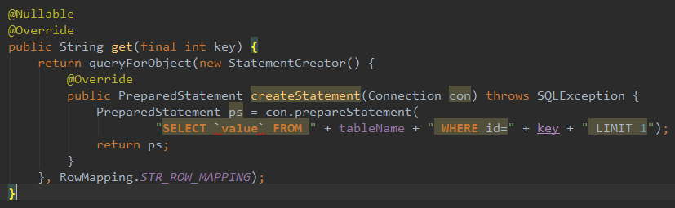
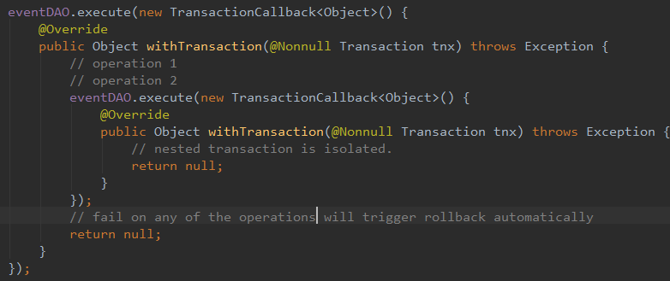
1. JDBC Operations
Example :
Query :
transaction:

Slide 5
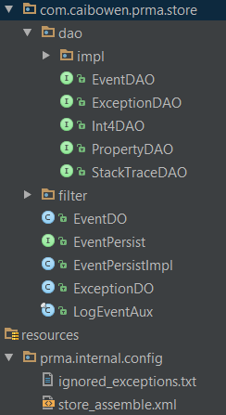
2. Storage Layer design
Log event store in PRMA
Jdbc operates are managed in one transaction
Dissemble event
Event persist
Filtering data and store
Data access object
10 tables
Database

Slide 6
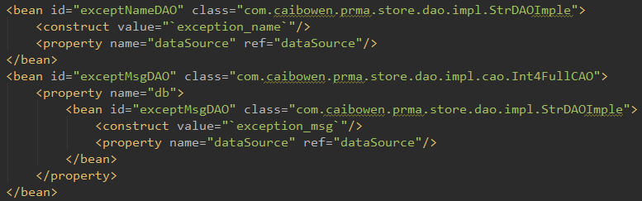
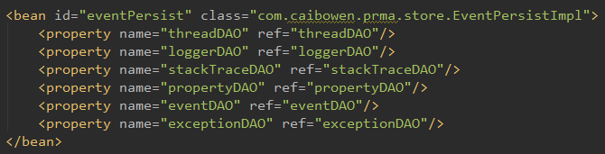
2. Storage Layer design
All components in PRMA are configurated by XML
and are assembled by Gplume XMLBeanAssembler.

Slide 7
3. Next
Integrate cache to data layer to reduce database operation, promoting insertion, as well as querying speed.
Add filters to data layer, filter out irrelevant information before stored in DB
Design monitor

