Slide 1
Mediadashboard
Overview export

Slide 2
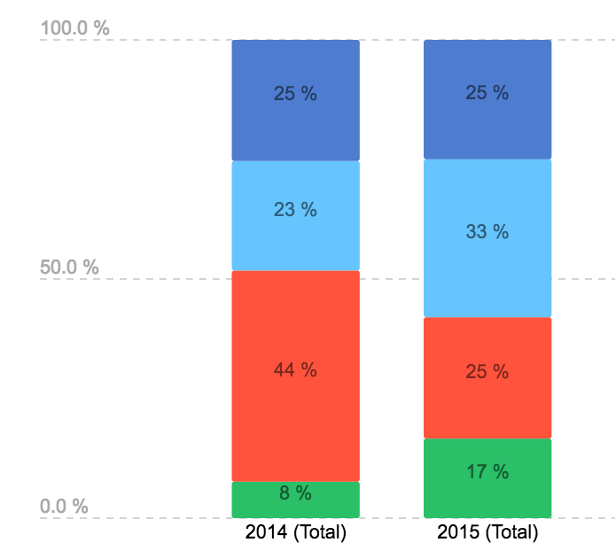
Devices
Comments
Lorem
Ipsum
Neque porro quisquam

