Slide 1
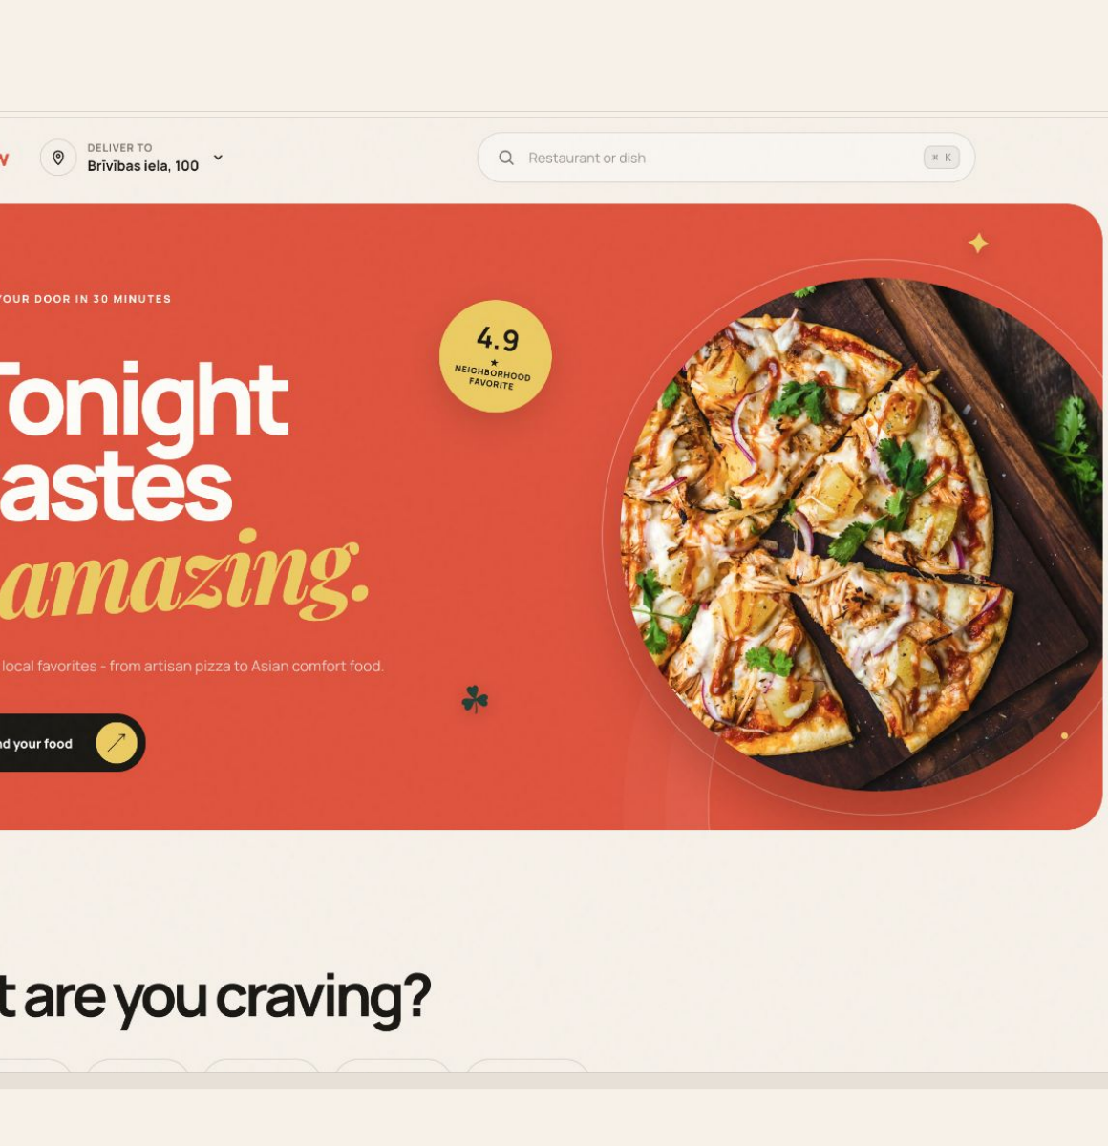
SYSTEM DESIGN / 2026
FoodFlow
One order truth.
Three coordinated experiences.
A production-oriented design for customers, restaurants, couriers, and the services that keep them in sync.
CITY-WIDE FOOD DELIVERY PLATFORM
Architecture • Contracts • Reliability • Delivery plan
FOODFLOW SYSTEM DESIGN
01
Notes:
Open with the coordination problem: three experiences must behave as one system.
[Sources]
- /Users/xkyota/Development/food-delivery/overview.md
- /Users/xkyota/Development/food-delivery/output/pdf/foodflow-ui-concept.pdf
[/Sources]

Slide 2
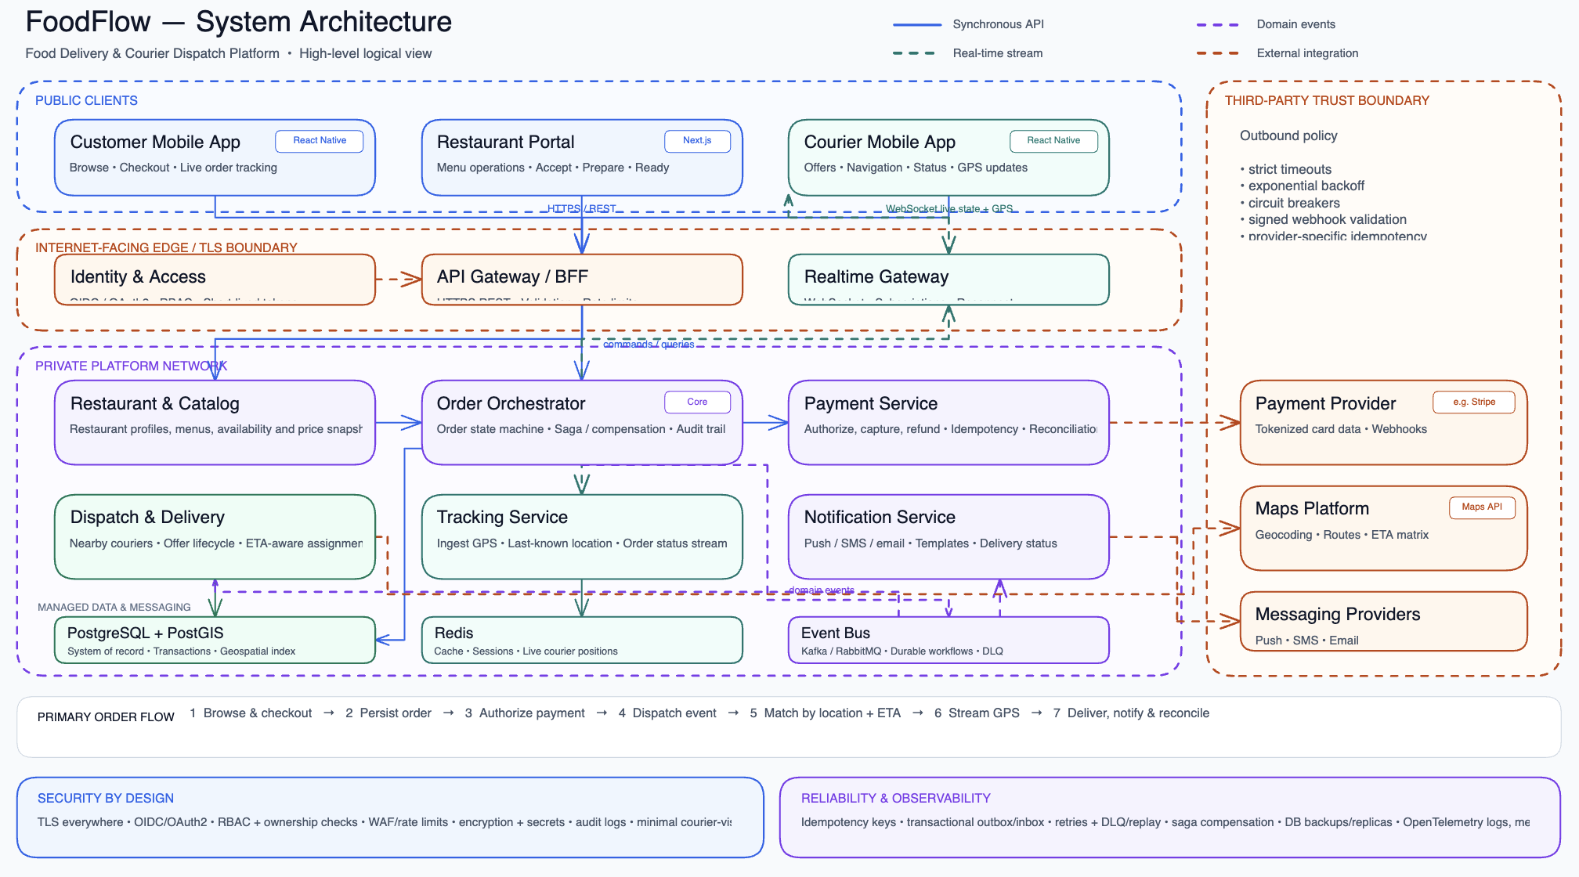
Notes:
Open with the coordination problem: three experiences must behave as one system.
[Sources]
- /Users/xkyota/Development/food-delivery/overview.md
- /Users/xkyota/Development/food-delivery/output/pdf/foodflow-ui-concept.pdf
[/Sources]

Slide 3
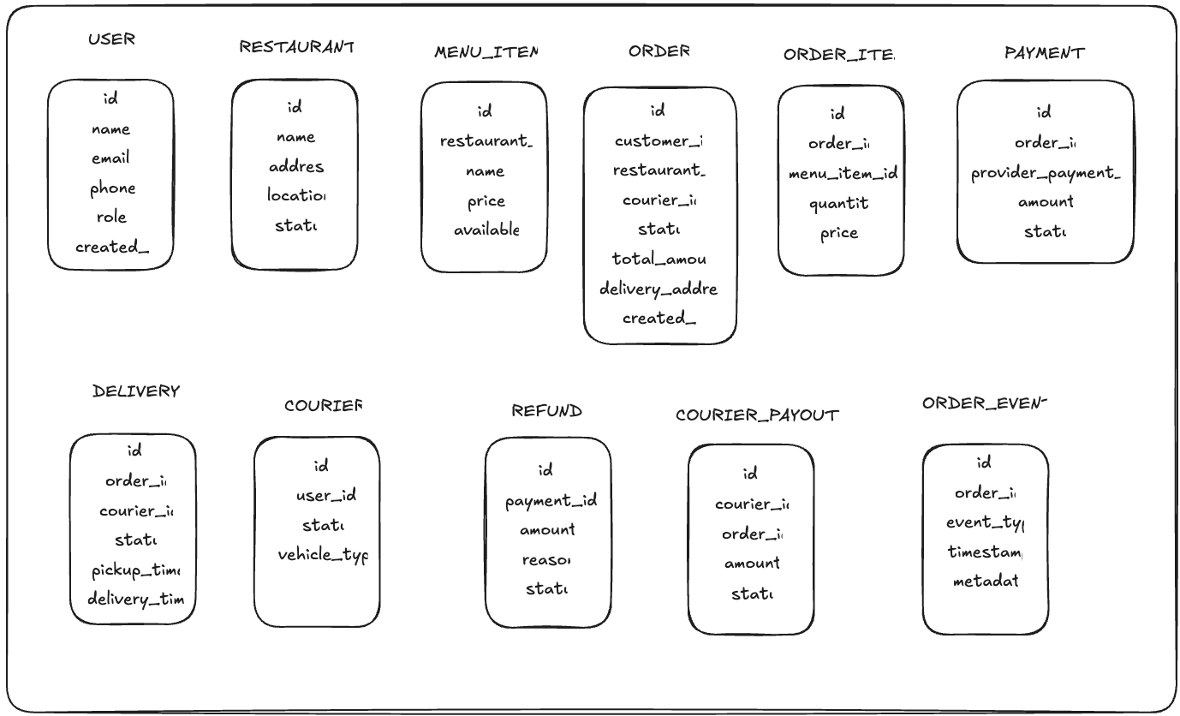
Database model
Notes:
Open with the coordination problem: three experiences must behave as one system.
[Sources]
- /Users/xkyota/Development/food-delivery/overview.md
- /Users/xkyota/Development/food-delivery/output/pdf/foodflow-ui-concept.pdf
[/Sources]

Slide 4
Delivery is a synchronized marketplace
Each actor moves independently; the order workflow keeps the promise coherent.
01
Customer
02
Restaurant
03
Courier
Discover
Pay
Track
Accept
Prepare
Hand off
Claim
Navigate
Deliver
ONE ORDER TRUTH
State, money, ownership, and ETA advance together.
PRODUCT MODEL
02
Notes:
[Sources]
- /Users/xkyota/Development/food-delivery/overview.md
- /Users/xkyota/Development/food-delivery/applications/customer-app.excalidraw
- /Users/xkyota/Development/food-delivery/applications/restaurant-portal.excalidraw
- /Users/xkyota/Development/food-delivery/applications/courier-app.excalidraw
[/Sources]

Slide 5
One state machine aligns money, food, and movement
Every transition is authorized, idempotent, versioned, and written to the audit trail.
COMMIT
FULFILL
DELIVER
01
02
03
04
05
06
07
08
Payment
pending
Payment
authorized
Restaurant
confirmed
Preparing
Ready for
pickup
Picked up
In transit
Delivered
Exception lane
PAYMENT_FAILED
REJECTED
CANCELLED
Refund remains a linked payment workflow, not a replacement for order history.
CANONICAL WORKFLOW
03
Notes:
[Sources]
- /Users/xkyota/Development/food-delivery/requirements.md
- /Users/xkyota/Development/food-delivery/service-contracts.md
[/Sources]

Slide 6
Boundaries isolate change and preserve traceability
Synchronous commands establish intent; durable events distribute the result.
PUBLIC
PRIVATE PLATFORM
Customer app
Restaurant portal
Courier app
API Gateway / BFF
Realtime Gateway
COMMAND PATH
EVENT PATH
Catalog
Order
Payment
HTTPS / REST
Kafka
Validation, authorization, rate limits, and ownership checks at the edge.
Outbox, replay, consumer inbox, and dead-letter handling.
Dispatch
Tracking
Notification
PostgreSQL
Redis
Kafka
Providers: payment • maps • push / SMS / email
LOGICAL ARCHITECTURE
04
Notes:
[Sources]
- /Users/xkyota/Development/food-delivery/foodflow-system-architecture.excalidraw
- /Users/xkyota/Development/food-delivery/tech-stack.md
- /Users/xkyota/Development/food-delivery/service-contracts.md
[/Sources]

Slide 7
Replay-safe contracts turn retries into normal behavior
The same command or provider callback can arrive more than once without repeating the effect.
COMMAND
EVENT ENVELOPE
Identity
event_id • aggregate_id • version
1
2
3
4
Client request
BFF validates
Owner commits
Outbox publishes
Causality
correlation_id • causation_id
Time
occurred_at • schema_version
Idempotency-Key
Payload
typed domain facts, never commands
Stable business key -> one order, one authorization, one capture.
At-least-once delivery + inbox deduplication = one business effect
INTEGRATION CONTRACTS
05
Notes:
[Sources]
- /Users/xkyota/Development/food-delivery/service-contracts.md
- /Users/xkyota/Development/food-delivery/requirements.md
[/Sources]

Slide 8
Data ownership protects the invariants that matter
A shared cluster can start the MVP; direct cross-service writes cannot.
PAYMENT / REFUND
RULES
Owner: Payment
Snapshot
prices + address
AGGREGATE
USER
ORDER
DELIVERY
Owner: Identity
Owner: Dispatch
Version
every transition
items
status + version
address + totals
Audit
actor + reason
RESTAURANT
COURIER / PAYOUT
Owner: Catalog
Owner: Dispatch
DATA MODEL
06
Notes:
[Sources]
- /Users/xkyota/Development/food-delivery/database-model.excalidraw
- /Users/xkyota/Development/food-delivery/service-contracts.md
[/Sources]

Slide 9
Failures degrade capability, not integrity
The order remains explainable even when a provider or projection is temporarily unavailable.
Failure | Customer experience | Control
Payment timeout | Checkout stays pending | Query by idempotency key; retry deterministically
Restaurant timeout | Order expires clearly | Void authorization; audit reason
No courier accepts | ETA is revised | Expand search in bounded waves
Maps unavailable | Last known ETA is shown | Cached results + circuit breaker
Notification outage | In-app status stays authoritative | Queue retry; channel fallback; DLQ
Consumer restart | Projection may briefly lag | Resume offset; inbox deduplication
Money and canonical order state always reconcile after recovery.
RESILIENCE
07
Notes:
[Sources]
- /Users/xkyota/Development/food-delivery/operations.md
- /Users/xkyota/Development/food-delivery/requirements.md
[/Sources]

Slide 10
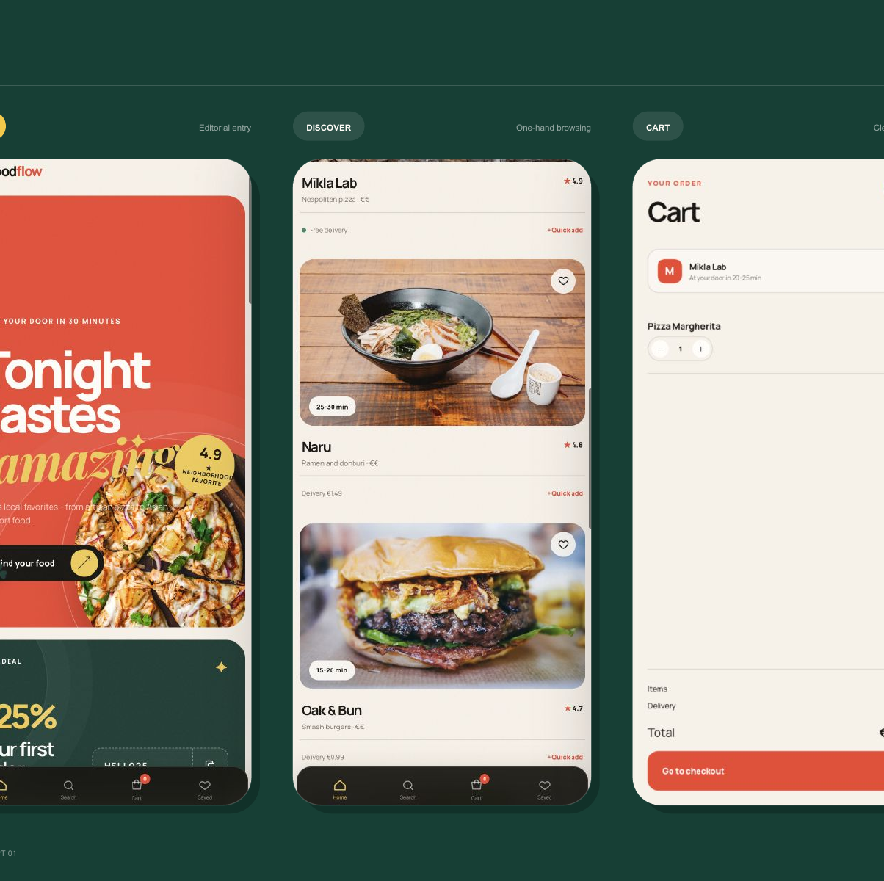
CUSTOMER EXPERIENCE
Operational complexity
stays behind the glass
The customer sees clear choices, current delivery context, and one obvious next action - while retries and reconciliation happen underneath.
1
Editorial discovery
2
Live order context
3
Focused checkout
EXPERIENCE DESIGN
09
Notes:
[Sources]
- /Users/xkyota/Development/food-delivery/output/pdf/foodflow-ui-concept.pdf
- /Users/xkyota/Development/food-delivery/applications/customer-app.excalidraw
[/Sources]

Slide 11
Release value in safe vertical slices
Each phase ends with evidence, not just feature completion.
PHASE 0
PHASE 1
PHASE 2
PHASE 3
0
1
2
3
Foundations
Order core
Delivery + live
Hardening
Auth, CI, environments, tracing
Catalog, checkout, restaurant, payment
Dispatch, courier, GPS, WebSocket
Load, chaos, restore, security
EXIT GATE
Traced command reaches DB + Kafka
EXIT GATE
Payment compensations pass
EXIT GATE
End-to-end retry path passes
EXIT GATE
Owners approve launch + rollback
IMPLEMENTATION PLAN
10
Notes:
[Sources]
- /Users/xkyota/Development/food-delivery/roadmap.md
- /Users/xkyota/Development/food-delivery/requirements.md
[/Sources]

Slide 12
Recovery evidence is the production gate
Feature completeness is necessary; operational evidence is the launch criterion.
01
End-to-end
02
Financial
Happy path and duplicate requests pass across all three apps.
Authorize, capture, void, refund, and reconciliation agree.
03
Resilience
04
Security
Failover, replay, DLQ repair, and provider outage are rehearsed.
Role boundaries, webhook replay, rate limits, and PII controls pass.
05
Performance
06
Ownership
Order, catalog, tracking, GPS, and consumer-lag targets hold.
Dashboards, alerts, runbooks, rollback, and on-call owners exist.
DECISION
Approve a staged city pilot only when all six evidence gates are green.
LAUNCH READINESS
11
Notes:
[Sources]
- /Users/xkyota/Development/food-delivery/roadmap.md
- /Users/xkyota/Development/food-delivery/operations.md
- /Users/xkyota/Development/food-delivery/requirements.md
[/Sources]

Slide 13
FOODFLOW / NEXT MOVE
Ready for staged
implementation.
The core design now connects experience, state, contracts, data, failure handling, and launch gates.
01
Confirm capacity inputs
02
Resolve policy decisions
03
Build the traced vertical slice
FoodFlow system design • 2026
12
Notes:
Close on the next executable step: a traced vertical slice, not a broad feature build.
[Sources]
- /Users/xkyota/Development/food-delivery/README.md
- /Users/xkyota/Development/food-delivery/roadmap.md
[/Sources]

Slide 14
Thank you for your attention
Notes:
Close on the next executable step: a traced vertical slice, not a broad feature build.
[Sources]
- /Users/xkyota/Development/food-delivery/README.md
- /Users/xkyota/Development/food-delivery/roadmap.md
[/Sources]

