Slide 1
How to write a review
Toby Walsh
Department of Computer Science
University of York
www.cs.york.ac.uk/~tw/phd

Slide 2
Outline
What is a review?
Why should you review?
How do you review a paper?
What not to do?
What are the dilemmas?
Case study

Slide 3
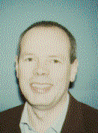
What is a review?
“Something that will ruin your day” Alan Bundy
  Even if it is good!
The stamp of scientific quality
Feedback from your peers
  Future directions?
Prof. Alan Bundy

Slide 4
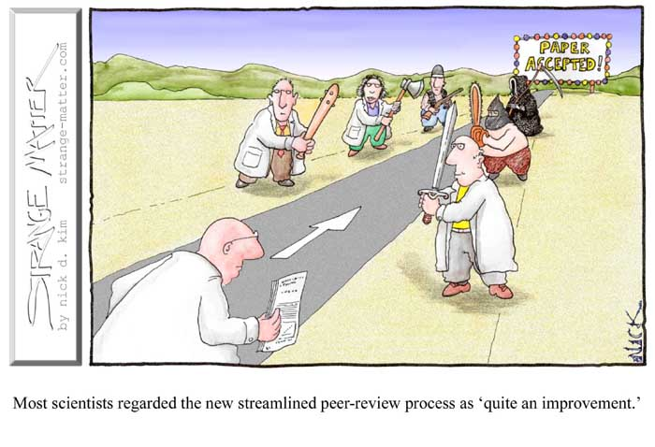
What is a review not?
Acceptance/rejection
  Editors/Program committees accept/reject
  You recommend!
A place for bias, prejudice, personal animosity, …
  Though it often appears to be so

Slide 5

Why should you review?
You’d much rather enjoy Paphos
  And so would I!
But science would grind to a halt
  Not immediately, of course

Slide 6

Reasons to review
Duty
Fairness
  2-3 reviews written/ paper written
Promotion
Education
  Good reviewers write good papers?

Slide 7

Bad reasons to review
To settle old scores
To advance your own theories/hinder rivals
To get latest results
  Unpublished papers are strictly confidential

Slide 8

How do you review?
Read the paper
Read the review form
  Useful dimensions to look at
  Novelty, Clarity, Importance, Timeliness …
Read the paper
Wait a few days
Read paper
Write review
  Everyone has their own method

Slide 9
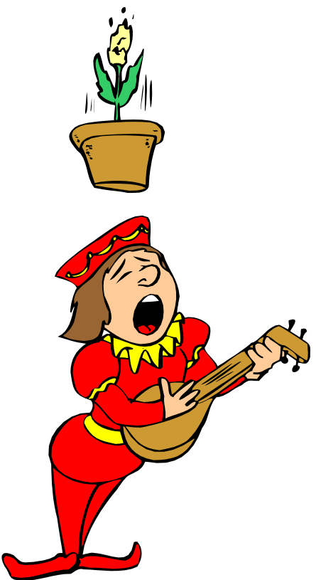
How do you review?
Put yourself in author’s shoes
  Think how you would like to read this review
Offer constructive criticism
  Don’t just tell them something is inadequate!
  Tell them how they might fix it

Slide 10

What not to do?
Miss the deadline
  We all hate late reviews
Display partiality, bias, animosity, …
Destructively criticize
  Always work out what they would need to do to fix problems

Slide 11

Collect and share reviews
Learn if others agree with your opinions
Thicken your skin
    Clearly, the author fails to understand the work of Walsh in this area …
    Since they mention no related work, this paper cannot be original …
    This idea is too simple not to exist already …
    This work is good but I don’t understand why Bundy hasn’t done this already?

Slide 12
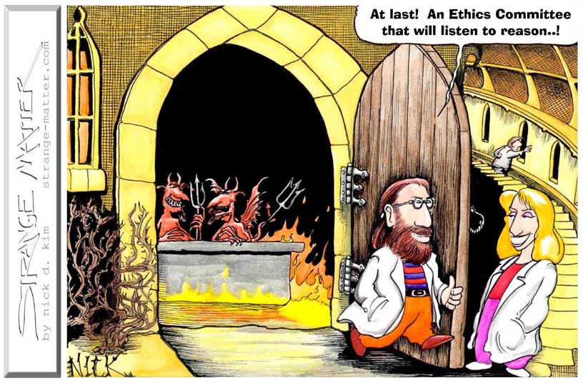
Ethical dilemmas
You are working on the same problem
  Talk to Editor/Program Chair
You already reviewed and rejected paper
  Look for changes

Slide 13
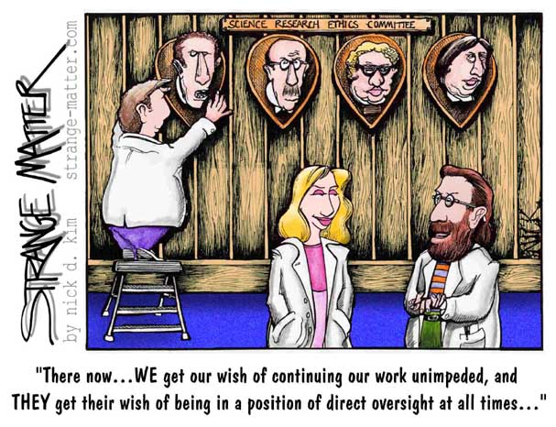
Ethical dilemmas
This journal submission already appeared at a conference
  Does it extend previous appearance?
An almost identical paper already appeared
  Unless it was at a workshop, inform Editor/Chair

Slide 14

Case study
“Stochastic Constraint Programming”
  By Toby Walsh
  Be frank, the feedback is good!
What do you think?

Slide 15
What did reviewer 1 think?
Appears to like it
Main criticisms:
  Relationship to influence diagrams
  Algorithm performance
  Phase transition too preliminary
“The paper reads well. … I have a number of
remarks though. First, from a probabilistic reasoning
viewpoint, I wonder about the relationship between this
framework and influence diagrams (or decision
diagrams). It appears to me that what you have
defined here is very closely related …Second, from a
constraint satisfaction viewpoint: you gave us no
indication of how well the different algorithms you
presented work in practice. … Third, I think the
discussion on phase transition cannot be left at this
level. It is not surprising that we have a phase transition
here, but what is interesting is the nature of this
transition… I think this topic is too serious to sum it up
in a small Section … [it] deserves a dedicated and more
thorough treatment. I would have preferred to see this
space dedicated to experimental results on the
performance of presented algorithms”

Slide 16
What did reviewer 2 think?
Appears to like it
  Very relevant
  Moderately significant/original
  Good readability/English
Minimal comments
Total of their written comments:
“It would be nice to include the
exact syntax of one SCprogram,
as accepted by your system (?),
say, for the example of Section 3.”

Slide 17
What did reviewer 3 think?
Again appears to like it
  Very relevant, very original, moderately significant
Main criticisms
  Relationship to influence diagrams
  Phase transition too preliminary
“Clearly, one could just add constraints to influence
diagram representation and extend algorithms to exploit
them (my preferred approach) but the approach here is
still very valid and could motivate researchers in MDPs
and influence diagrams to treat constraints as special
creatures … so that their special … algorithms
can be exploited.
I think the experimental portion of the paper should have
been to compare the performance of the algorithms with
the performance of traditional MDPs or influence
diagram algorithms applied to this class of problems
and I speculate that gain can be shown.
I don’t find the phase transition experiments of much
value at this stage. So, there may be a phase transition,
so what?
I recommend that the author will carefully analyze their
model against standard influnce diagrams or factored
MDPs and discuss the pros and cons.”

Slide 18

What did the IJCAI PC think?
Paper was rejected
  Along with 75% of the other submissions
  A less good paper (my and reviewers’ opinions) was accepted!
Some compensation
  $150,000 to be precise
IJCAI 2001 logo

Slide 19
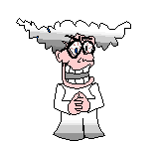
Conclusions
Reviewing can be rewarding
  Both to authors and to reviewers
Be constructive
  Think how you would react to the review
Take on board your reviews
  Reviewers hate most being ignored!

