Slide 1
Analysis of New Jersey Business Licenses
Lu Xuan and Ruohan Hong

Slide 2
Project overview and dataset
Our project aims to uncover insights from the licensing data of businesses operating in New Jersey.
We've utilized SQL queries to analyze patterns and trends in licensing, business, and industries.
The dataset is from NYC Open data, within a subset of business licensure registration data that only includes all licenses created in 2017 in New Jersey, which can be found here: https://data.cityofnewyork.us/Business/Legally-Operating-Businesses/w7w3-xahh

Slide 3

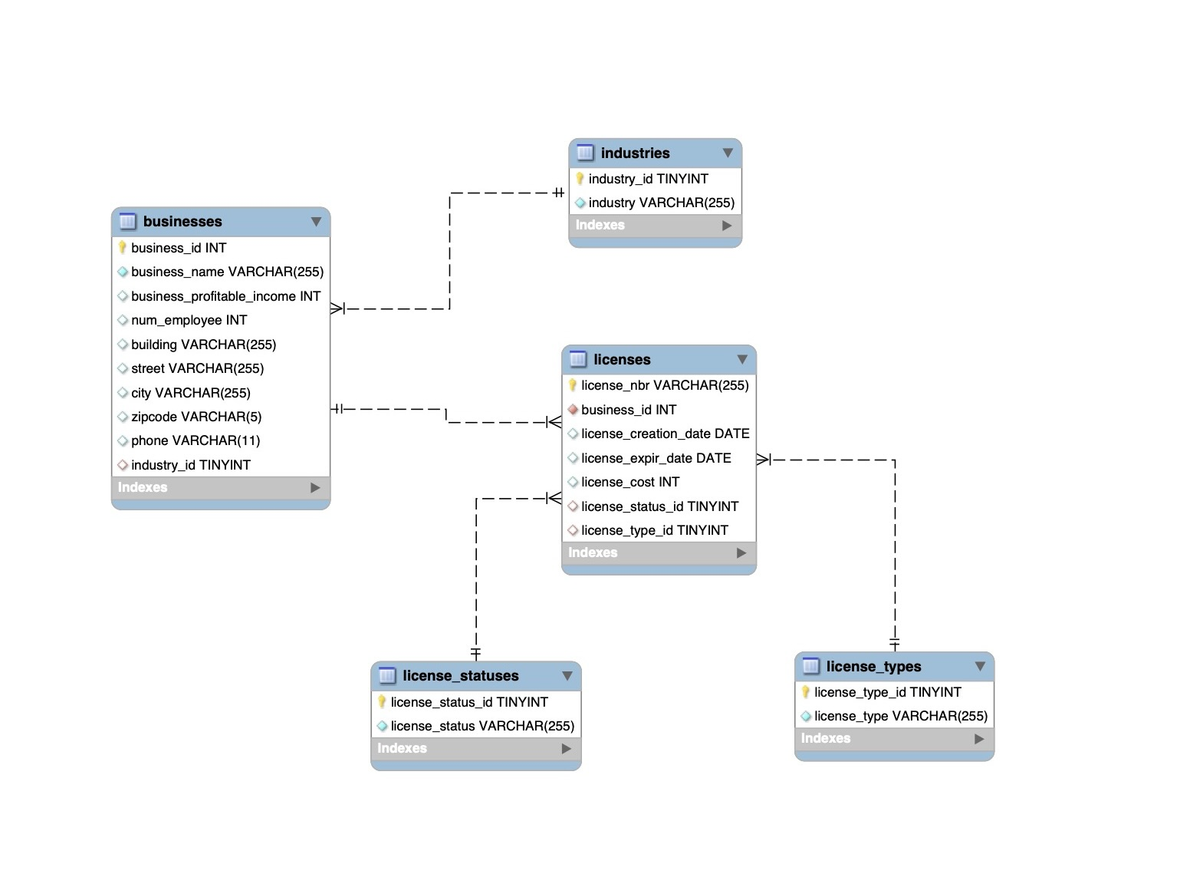
EER diagram
Notes:
Using the data, we created five tables. Businesses is our parent table, licenses is our child table, and industries, license_statuses, and license_types are our lookup tables. We removed some variables from the original dataset that contained unrelated information. To ensure that we have sufficient numeric variables to perform meaningful queries, we added num_employee and business_profitable_income to the businesses table, and we added license_cost to the licenses table.

Slide 4
Our queries and results
Query 1: Companies with More Than One License
Our first query identified companies with multiple licenses, indicating business expansion or diversification.
Credit Bureau of Napa County holds two licenses.
Query 2: License Duration Analysis
We compared the duration of each license against the average within its license type.
Output table allows us to quickly observe all licenses, their types, their duration of validity, and whether they're 'shorter', 'average', or 'longer' than the mean duration within its license type.
Query 3: License Type Frequency Analysis
The third query ranked license types by count, revealing 'Sales' as the type with the most issued licenses.
Query 4: Businesses with Active Licenses in the Most Employed Industry
This query allows us to identify all businesses with an active license in the most employed industry.
We identified Pedicab Business as the most employed industry, and within this industry, BENDAHAME DRISS hold active license, providing insight into market dynamics.

Slide 5
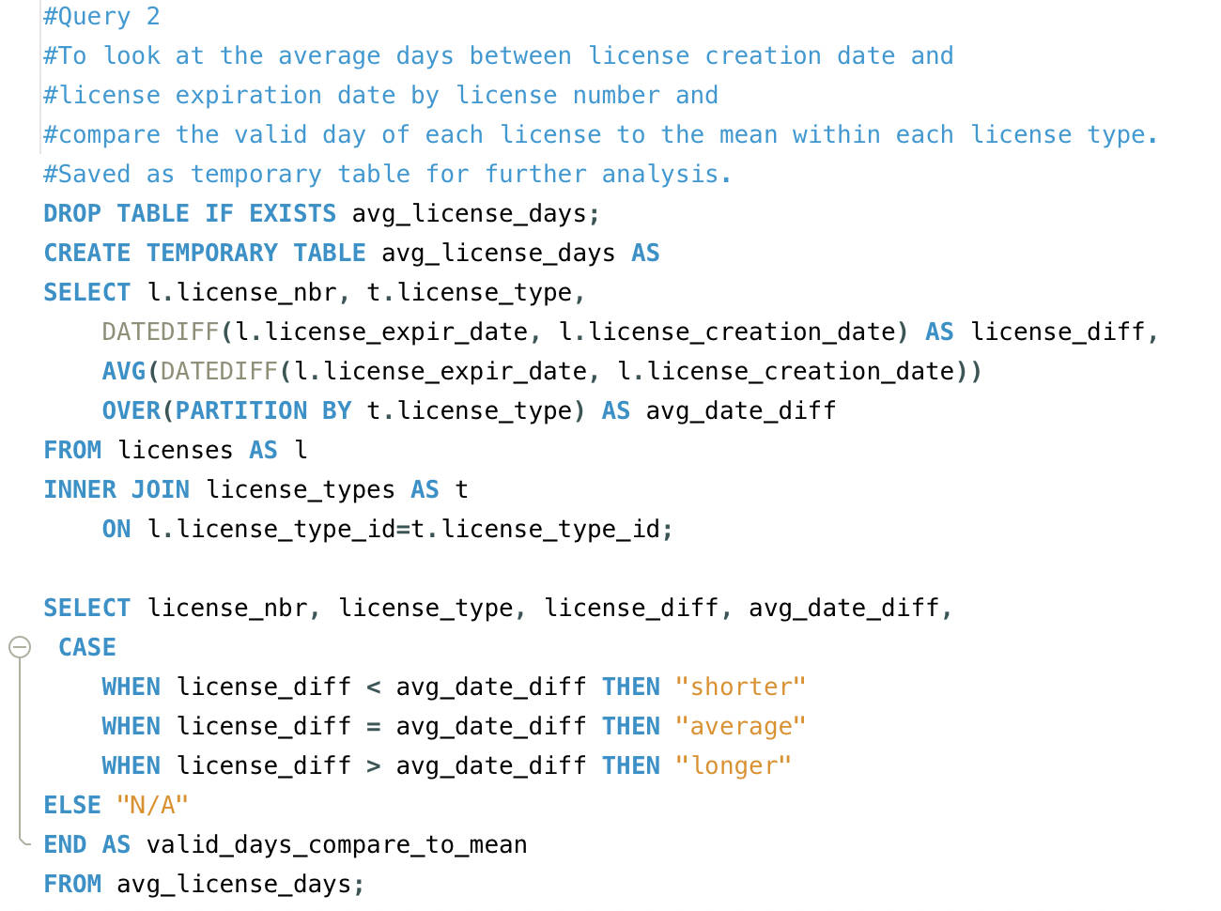
Sample Query

Slide 6
Insights, Conclusions, and Future Enhancements
The variance in license durations across types suggests regulatory differences or varying business activities.
The 'Sales' license type's prevalence indicates a robust retail sector.
Further study could include predictive analysis for license renewals and expirations.
Integrating demographic data could offer deeper insights into the impact of business activities on local communities.

Slide 7
Thank you!

