Slide 1
CS6240 Parallel Data Processing in MapReduce Final project - NC Tracer
Group Member: Yang Cai, Jingchao Cao, Li Xie

Slide 2
Outline
Introduction
Parameter Selection and Speed-Up Discussion
Pseudo-Code
Result Discussion
Conclusion and Future Work

Slide 3
Introduction
Training
Bagging (Logistic Regression / Random Forest / Naïve Bayes) Each Model - Best parameter searched by paramGrid
Prediction
Each Pixel - 3 models votes for majority label

Slide 4
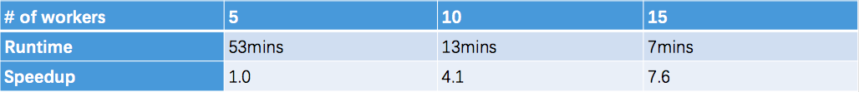
Model and Parameter Selection
Logistic Regression
- Speed-Up
- Parameter Exploration Maximum iteration: highest accuracy between iteration of 8 and 10, and stays stable after 20.
Regularization: highest accuracy when reg param is 0.2, after 0.2, accuracy keeps decreasing.
Threshold: (10, 0.2, 0.18) for (maximum iteration, regularization, threshold).

Slide 5

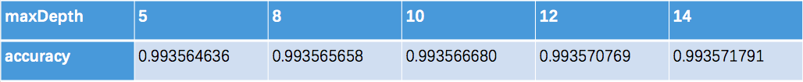
Model and Parameter Selection
Random Forest - Speed-Up
- Parameter Exploration MaxBins & NumTrees: No much effect on the accuracy. Thresholds:
MaxDepth:

Slide 6

Model and Parameter Selection
Naïve Bayes - Speed-Up
Ideal Speed-Up and balanced load by data distribution and parallel training
- Parameter Exploration
Smoothing Parameter λ:
Set default prob. for absence case.
No much effect on the accuracy.
Thresholds:
Adjust probability of classes by originalProb/classThreshold.
Best at [0.0,1.0]

Slide 7
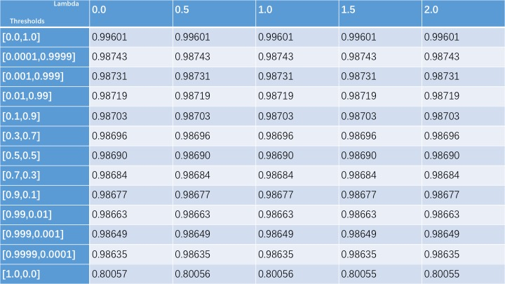
Model and Parameter Selection
Naïve Bayes

Slide 8
Pseudo-Code
Preprocess
- Training
// NOTE: rotation & mirror are in Induction section) trainingData = sc.textFile(image1.csv,image2.csv,image3.csv,image6.csv) .map(toTrainRecord) .toDS() .sample(0.6) .repartition(400) validationData = sc.textFile(image4.csv) .map(toTrainRecord) .toDS()
- Prediction
predictionData = sc.textFile(image5.csv) .zipWithIndex() .map(toIndexedRecord) .toDS()

Slide 9
Pseudo-Code
Training
modelNames = ["LR","RF","BY"] modelNames.par.map(modeName => // construct (ModelEstimator, ParamGrid, TrainingData) metaData = { if (modelName == "LR") { diversifiedData = trainingData.map(mirrorAndRotate(0,0)) lr = new LogisticRegression() paramGrid = new ParamGridBuilder() .addGrid(lr.maxIter, Array[MaxIter]) .addGrid(lr.regParam, Array[RegParam]) .addGrid(lr.threshold, Array[Threshold]) .build() (lr, paramGrid, diversifiedData) } else if (modelName == "RF") { ... } else { //modelName == "BY" ... } } bestModel = validateToFindBestModel(metaData, validationData) bestMode.save() )

Slide 10
Pseudo-Code
Prediction
modelNames = ["LR","RF","BY"] results = modelNames .par.map(modelName => model = loadModel(modelName) model .transform(predictionData) .withColumnRenamed("prediction", modelName) ) .reduce((d1, d2) => d1.join(d2, "index")) .map{r => votes = modelNames.map(modelName => r.getCol(modelName).reduce(_+_) predictLabel = if(votes > modelNames.size()/2) 1 else 0 PredictRecord(r.getCol("features"), predictLabel) } results.save()

Slide 11
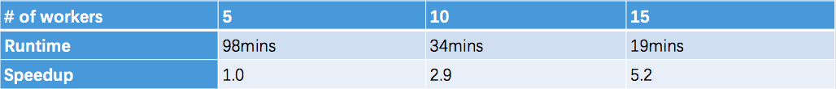
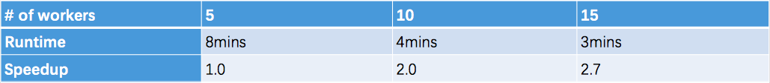
Result Discussion
Speed-Up
- Training
- Prediction

Slide 12

Result Discussion
Accuracy
Training on 6G training data sampled from image1, 2, and 3,
Validation on whole image6
Prediction on whole image4
Evaluator metrics for both validation and prediction are based on ACCURACY

Slide 13
Conclusion and Future Work
Conclusion - Spark & Mllib has good load balance on large dataset - We implemented a new feature to support different models ensembling, which provides good accuracy in this case.
Future Work - More models to explore and include (SVM, GBT…) - Comparison with default ensembling (RF, GBT…) - Explore evaluation by AreaUnderROC

