Slide 1
Introduction to Numerical Methods
Zhang Yunong (ZYN)
Introduction & Course Overview

Slide 2
Lecture’s Goals
Introduce computer methods for the solution of civil engineering problems, including:
General Introduction to Computer Applications in Engineering and Construction
Why do we need to be able to write and understand computer program and numerical methods?
Matlab - Mathematical Laboratory

Slide 3
Topics
Matlab - Mathematical Program (Vectors)
Computer Errors - Recognition and solutions
Roots f(x) = 0
  Linear Methods
  Nonlinear Methods

Slide 4
ZYN research:
Roots finding of f(x,t) = 0
[J80] Yunong Zhang, Chenfu Yi, Dongsheng Guo, and Jinhuan Zheng, Comparison on Zhang neural dynamics and gradient-based neural dynamics for online solution of nonlinear time-varying equation, Neural Computing and Applications 20 (2011) 1-7
[C72] Yunong Zhang, Peng Xu, Ning Tan, Solution of Nonlinear Equations by Continuous- and Discrete-time Zhang Dynamics and More Importantly Their Links to Newton Iteration, ICICS 2009
[C61] Yunong Zhang, Peng Xu, Ning Tan, Further Studies on Zhang Neural-Dynamics and Gradient Dynamics for Online Nonlinear Equations Solving, IEEE ICAL, Shenyang, China, August 2009
[C56] Yunong Zhang, Chenfu Yi, Weimu Ma, Comparison on Gradient-Based Neural Dynamics and Zhang Neural Dynamics for Online Solution of Nonlinear Equations, ISICA 2008, pp. 269–279, 2008

Slide 5
Topics
Linear Systems - Setting up multiple sets of equations and solution techniques.
LU Decomposition - Technique to decompose matrices
Eigen-analysis - finding the eigenvalues and eigenvectors

Slide 6
Topics
Fitting Data
  Interpolation
  Curve Fitting
Numerical Differentiation*
Numerical Integration
*[J44] 张雨浓, 郭东生, 徐思洪, 李海林, 未知目标函数之一阶数值微分公式验证与实践, 甘肃科学学报, 2009年3月, 第21卷第1期, 13-18

Slide 7

Topics
ODE’s (ordinary differential equations)
  Initial Value Problems
  Systems of ODE’s of IVP
  Boundary Value Problems
  Systems of ODE’s of BVP
Partial Differential Equations (PDE’s)

Slide 8
Grading
Home Assignment + Midterm Exam + Others
        ---- 40%
Final-term Exam ---- 60%
[J70] 张雨浓, 岳帅, 杨逸文,《数值方法》课程理论与实践教学方法探析, 数学教育学报, 2009年10月, 第18卷第5期, 91-93
[J53] 张雨浓, 陈轲, 过晓娇, 指导本科生从事科学研究的尝试、经验与探讨, 科技成果管理与研究, 2009年, 总第32期第6期, 19-22
[C35] 张雨浓, 李巍, 马伟木, 用创新、奖惩、帮带、及早入题之帆推动毕业设计教改大船, 教学研究与实践：教师论文集, 中山大学出版社, 2007年11月

Slide 9
Why do we need to know how to use numerical analysis and methods?
You are not going to be given a nice neat exact solution in the “real world”.
Applications
Numerical Errors
Computer Types
Computer Software

Slide 10
Applications
Signal Processing
CFD (Computational Fluid Dynamics)
Structural Analysis
Finite Element Analysis

Slide 11
Applications
Interpolation - Handling data
Optimization - Design and estimation
CAD (Computer Aided-Drafting)
Data Collection

Slide 12
Numerical Errors
Computers are only as good as
the person running them.

Slide 13
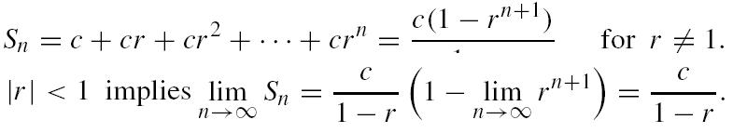
Numerical Errors
Precision Limits
Stability
  Convergence
  Divergence

Slide 14

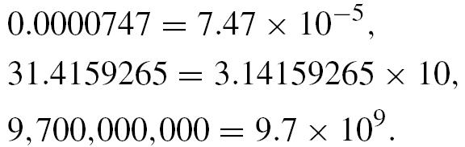
Numerical Errors
Round-off Errors
    3.1415926 → 3.1416
Truncation Errors - Code dependent
Machine Precision

Slide 15
Computer Hardware Types
Personal Computer
Supercomputers
Vector Processors*
Array Processors
Parallel Processor

Slide 16
Software
Operating Systems (OS)
Windows - NT, ME, Windows
Unix
VMS - VAX
Linux

Slide 17
Software
Languages
  Fundamental Assembler (Bit manipulations)
  Engineering Languages
    Fortran
    Cobol
    Pascal
    C++ ( J++ )
    Basic
  HTML and Java

Slide 18
Software
Higher-Order Programming
  Maple - Mathematical Programming Language
  Mathematica - Mathematical Programming Language
  Java - Internet Programming Language
  Matlab - Matrix Laboratory

Slide 19
Software
Tools
  Word Processors
  Database Management
  Graphics
  Mathematical Computer Codes

Slide 20
Matlab -Matrix Laboratory
Currently Matlab 2014a is available.

Slide 21
MatLab
The Matlab program can be run using command line, batch commands, and programs.

Slide 22
What is a program?
Program consist of three main components:
Input
Main Program - Numerical methods and analysis and/or evaluation.
Output - Results.

Slide 23
Inputs
Numerical values
Initialization of the variables
Conditions
Equations

Slide 24
Main Program
Using flow charts, the programs can be designed to perform a task. Using:
  Loops (for do while)
  Conditions ( if then elseif etc.. )
  Error Convergence (while )

Slide 25
Output
Outputs are the results of the program. They can go through a series of post-processing methods.
  Numerical Values
  Decisions
  Graphs and Plots

Slide 26
MatLab
Variable Types
  Integers
  Real Values (float and double)
  Complex Numbers (a + ib)
    a - real value
    b - imaginary value (“i” is the square root of -1)

Slide 27
Matlab
Data types
  Numerical
    Scalars
    Vectors
    Matrices
  Logic Types

Slide 28
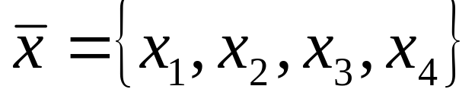
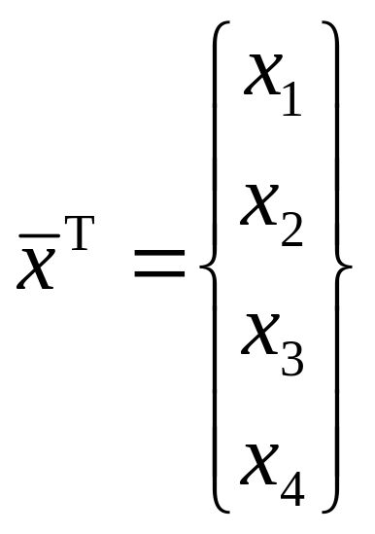
Matlab
A scalar value is the simple number, a, 2, 3.14157…,
A vector is a union of a
Transpose vector

Slide 29
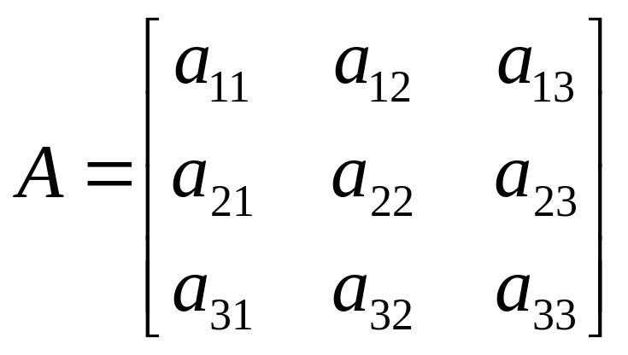
Matlab
Matrix is a combination of vectors and scalars. Scalar and vectors are subsets of matrices.
Matlab uses matrix to do mathematical methods.
A=[a11 a12 a13; a21 a22 a23; a31 a32 a33];

Slide 30
Matlab
Set of computer functions
  Trigonometric functions - sin(x),cos(x), tan(x), asin(x), acos(x), atan(x)
  Hyperbolic functions - sinh(x), cosh(x), tanh(x)
  Logarithmic functions - ln(x), log(x), exp(x)
  Complex functions - abs(x), real(x), imag(x)

Slide 31
Matlab
Simple commands
  clc - clears window
  clg - clear graphic window
  clear - clears the workspace
  who - variable list
  whos - variable list with size
  help - when doubt use it!

Slide 32
Matlab
Simple commands and symbols
  ^C - an escape from a loop
  inf - infinity
  NaN - No numerical value

Slide 33
Matlab - Scalar Operations
Addition - a + b
Subtraction - a - b
Multiplication - a * b
Division - a / b
Exponential - a^b
Matlab - Vector Operations
Matlab - Matrix Operations

Slide 34
Order of Precedence of Arithmetic Operations
Precedence
  ( 1 ) - Parenthesis
  ( 2 ) - Exponential from left to right
  ( 3 ) - Multiplication and division from left to right.
  ( 4 ) - Addition and subtraction from left to right.

Slide 35
Reading:
Page 10 – Horner’s method
Page 25 – significant digits
Page 31 – big Oh

Slide 36
Home assignment:
Page 13 – exercise 14
Page 37 – exercises 1, 3, 9

Slide 37
ZYN books:
[13] 张雨浓, 杨逸文, 李巍, 神经网络权值直接确定法, 中山大学出版社, 2010年11月
[12] 张雨浓, 蔡炳煌（编）, 人工神经网络研究进展及论文发表过程论辩, 电子工业出版社, 2010年6月
[7] 邹阿金, 张雨浓, 基函数神经网络及应用, 中山大学出版社, 2009年4月

Slide 38
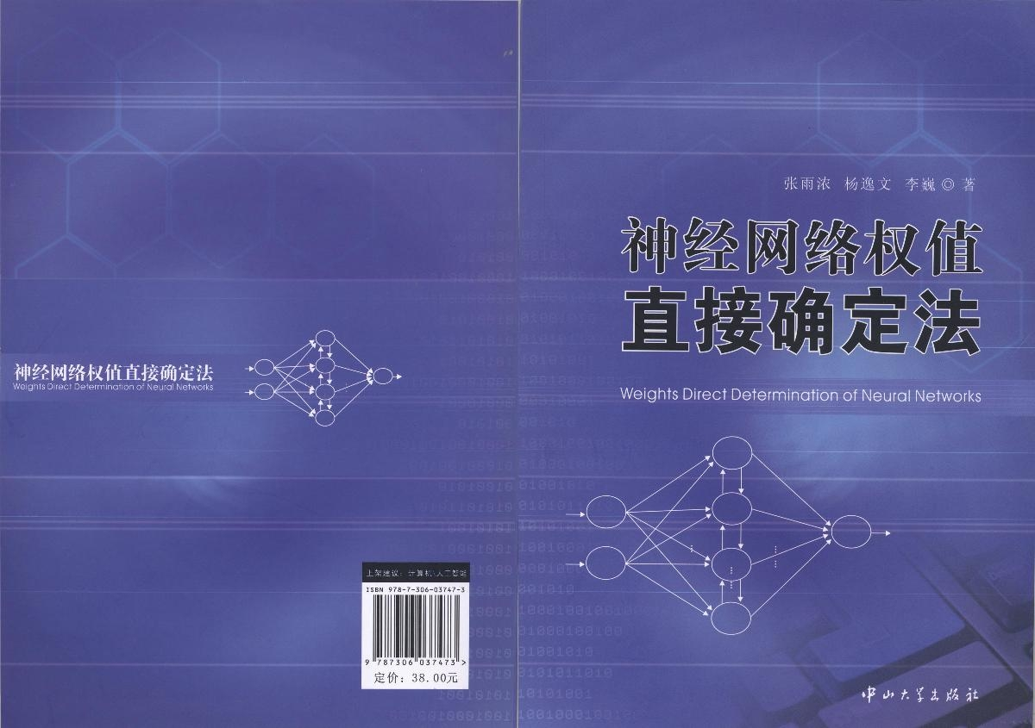
ZYN book [13]

Slide 39

ZYN book [12]

Slide 40

ZYN book [7]

