Slide 1
Autofocals
Xavier Lebec
CSE 592: Human Computer Interaction

Slide 2
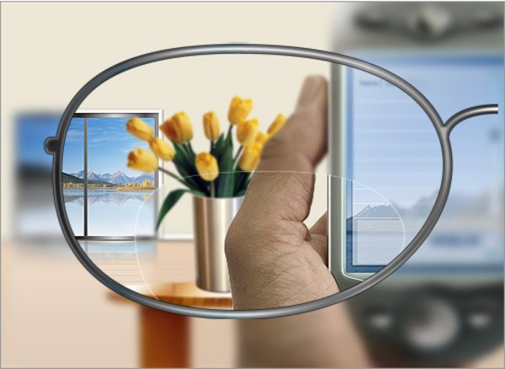
Problem
People with both myopia and presbyopia have to compromise on their eyewear.
How do I know this is annoying? People complain!

Slide 3
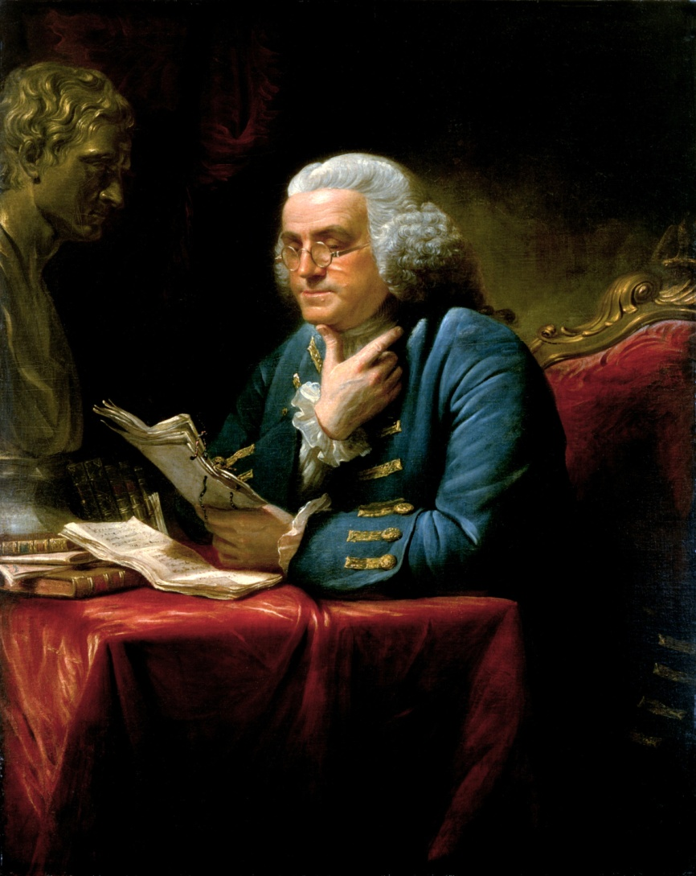
“Current” Solutions
Reading glasses
Bifocals
Gradient lenses
These require the user to adjust to the solution.

Slide 4
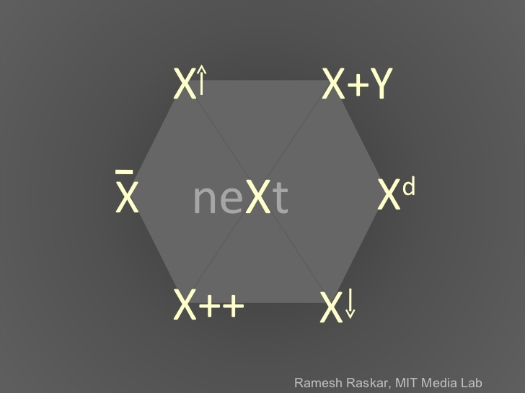
Ideation: Raskar’s Idea Hexagon
Bifocals++ = Gradient
Gradient lenses++ = N/A
Gradient lenses^{d} = …
3rd dimension: distance
4th dimension: time
Glasses + Camera = Mechanical focus

Slide 5
Ideation: Creative Pause

Slide 6
Proposed Solution
Mechanically focusing lenses.
HCI:
Prototype: Focus on what’s in front of glasses
Concept: Focus based on user’s focus

Slide 7
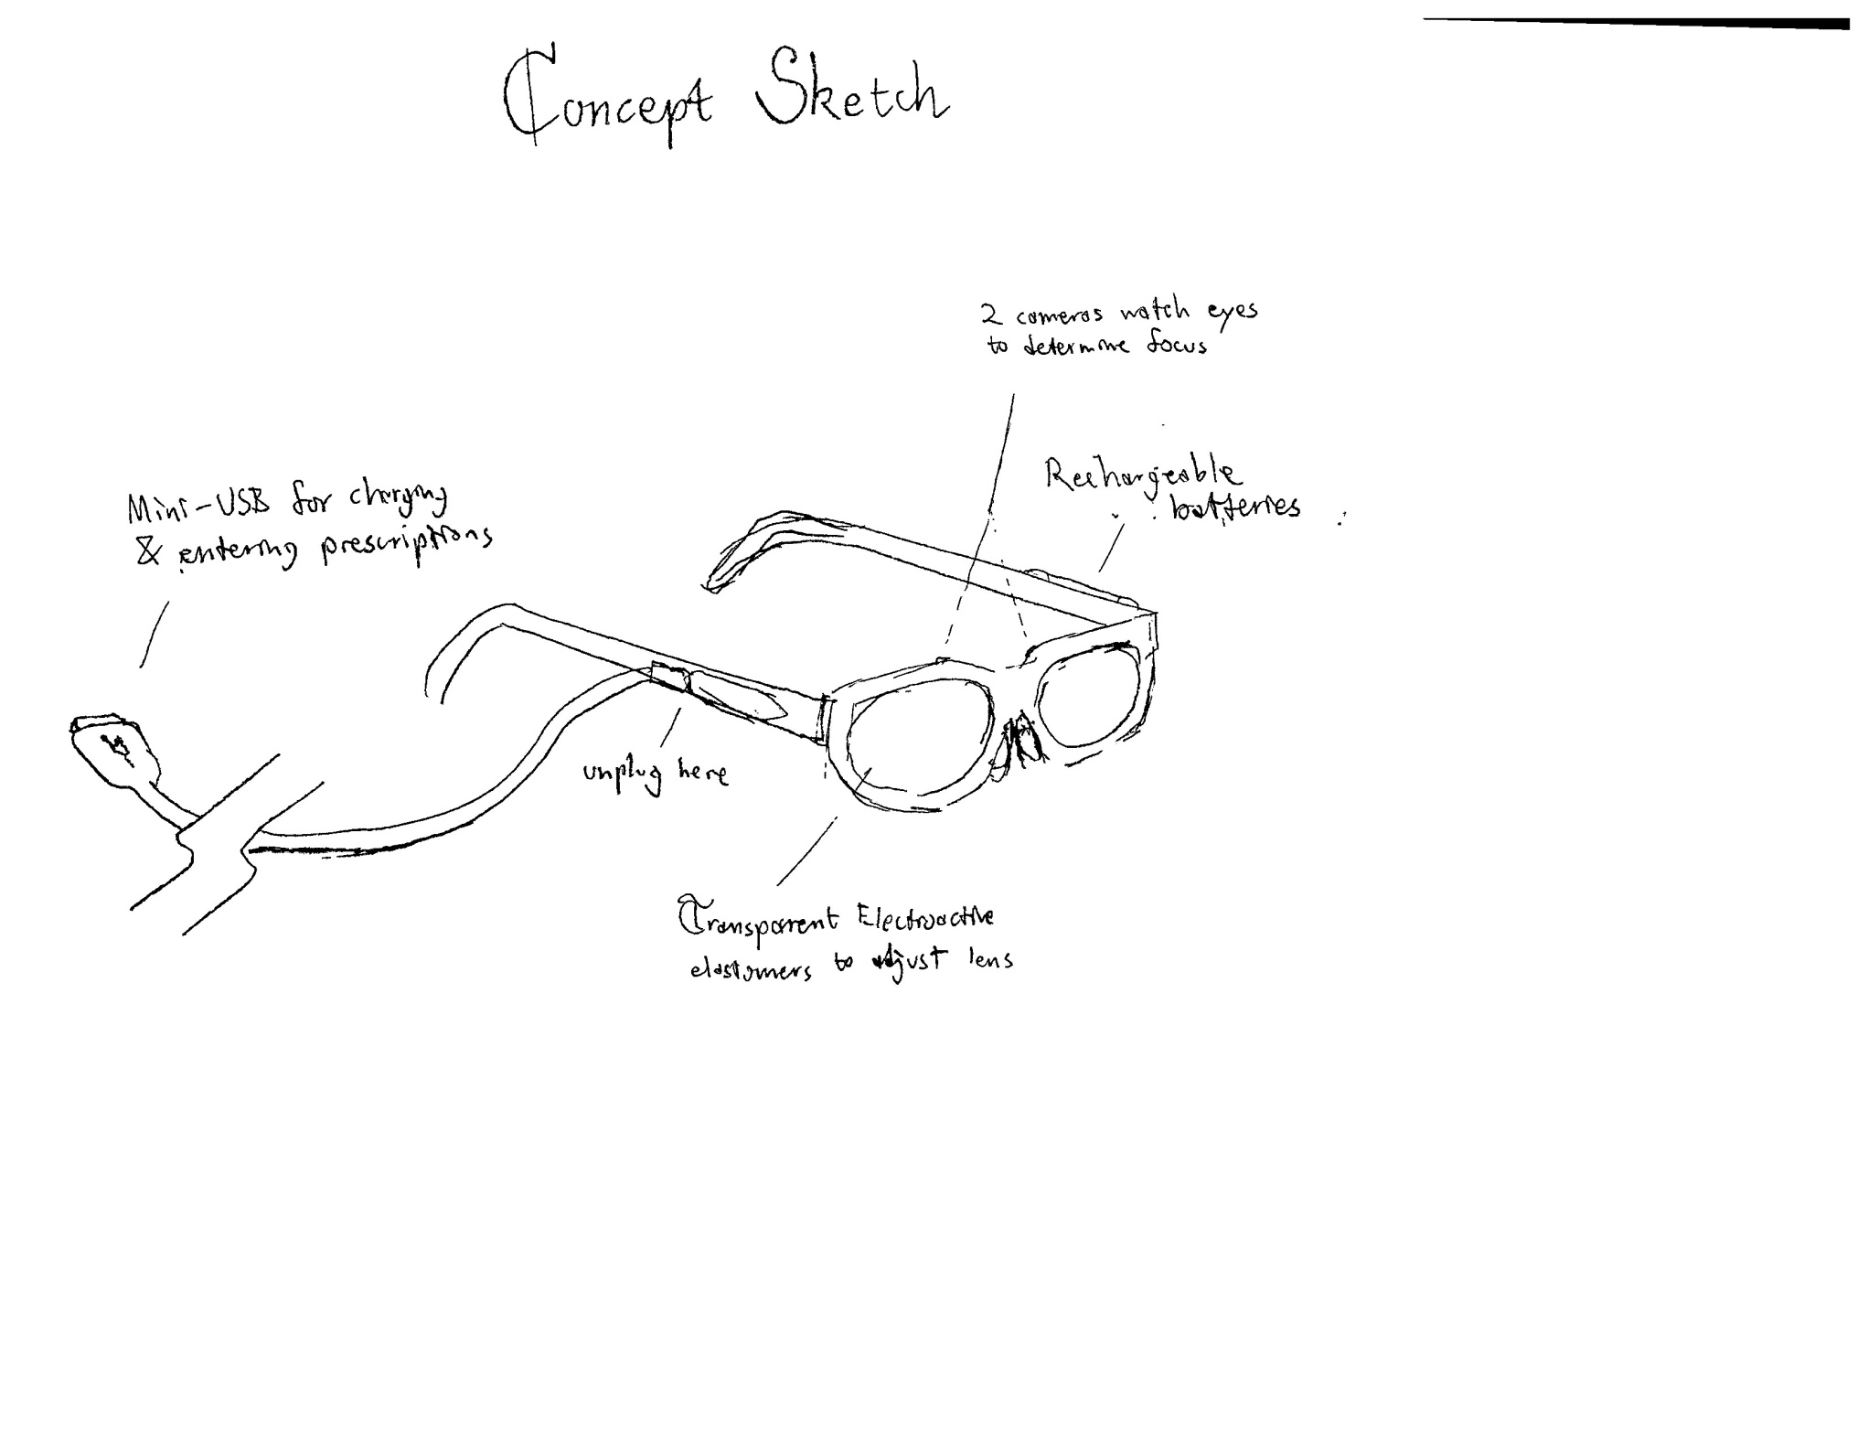

Slide 8
