Slide 1
Azure Data Factory
Hands on Lab
https://aka.ms/mtcs-adfhol

Slide 2
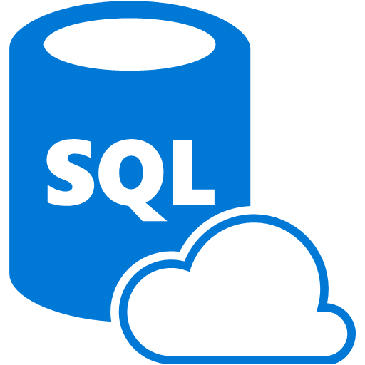

https://aka.ms/mtcs-adfhol
Sqldbdev##
Azblobdev##
devtest-rg
subscription

Slide 3

Adfv2dev##
Sqldbdev##
Azblobdev##
devtest-rg
subscription

Slide 4
Adfv2dev##
Sqldbdev##
Azblobdev##
Sqldbprd##
Azblobprd##
devtest-rg
prod-rg
subscription

Slide 5
Adfv2dev##
Adfv2prd##
Sqldbdev##
Azblobdev##
Sqldbprd##
Azblobprd##
devtest-rg
prod-rg
subscription

Slide 6

LogAnalytics
Adfv2dev##
Adfv2prd##
Sqldbdev##
Azblobdev##
Sqldbprd##
Azblobprd##
devtest-rg
prod-rg
monitor-##-rg
subscription

Slide 7

LogAnalytics
Adfv2dev##
Adfv2prd##
LogicApp
Sqldbdev##
Azblobdev##
Sqldbprd##
Azblobprd##
devtest-rg
prod-rg
monitor-##-rg
subscription

Slide 8

LogAnalytics
Adfv2dev##
Adfv2prd##
LogicApp
Sqldbdev##
Azblobdev##
Sqldbprd##
Azblobprd##
KeyVault
devtest-rg
prod-rg
monitor-##-rg
subscription

