Slide 2




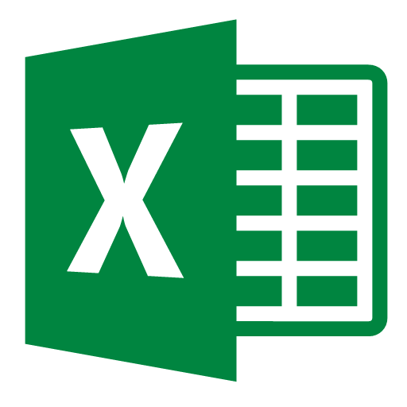




Lab Architecture
Ingest
Store
Prep & Train
Model & Serve
Intelligence
Web Service
Data Factory
Blobs
Databricks
Azure ML Service
AKV
AAD

Slide 3
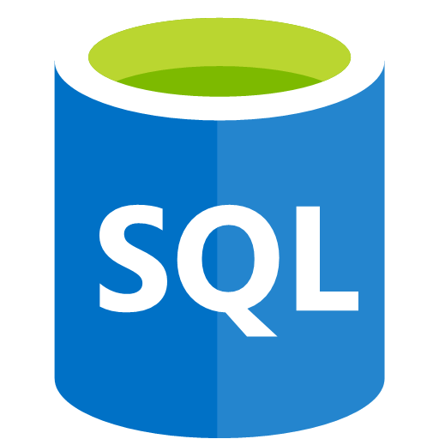
0. Lab Environment
Ingest
Store
Prep & Train
Model & Serve
Intelligence
Blobs
SQL Database
AKV

Slide 4

3. Azure Data Factory
Lab Architecture
Source
Ingest
Store
Prep & Train
Model & Serve
Intelligence
SQL Database
Data Factory
ADLSg2
AKV

Slide 5
4. Azure Databricks
Lab Architecture
Source
Ingest
Store
Prep & Train
Model & Serve
Intelligence
SQL Database
Data Factory
ADLSg2
Databricks
AKV

Slide 6
5. Azure Machine Learning Service
Lab Architecture
Source
Ingest
Store
Prep & Train
Model & Serve
Intelligence
SQL Database
Data Factory
ADLSg2
Databricks
Azure ML Service
AKV

Slide 7
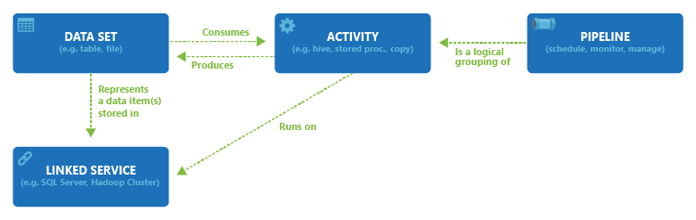
1. Ingest Data
Pipeline
Source
Linked Service
IN
Source
Dataset
Produce
/
Concume
Runs on
Activity
Logical
Group
Pipeline
Destination
Linked Service
IN
Destination
Dataset
Produce
/
Concume

Slide 8
1. Ingest Data
Pipeline
Source
Linked Service
IN
Source
Dataset
Produce
/
Concume
Runs on
Activity
Logical
Group
Pipeline
Destination
Linked Service
IN
Destination
Dataset
Produce
/
Concume

Slide 9
2. Data Wrangling
Ingest
Store
Prep & Train
Model & Serve
Intelligence
Web Service
Data Factory
Blobs
Databricks
SQL Database
AKV

Slide 10
3. Modeling
Ingest
Store
Prep & Train
Model & Serve
Intelligence
Web Service
Data Factory
Blobs
Databricks
SQL Database
Machine Learning Studio
AKV

Slide 11

4. Operationalization
Ingest
Store
Prep & Train
Model & Serve
Intelligence
Web Service
Data Factory
Blobs
Databricks
SQL Database
Machine Learning Studio
ML Web Service
AKV

Slide 12
5. Run ML in a Batch
Ingest
Store
Prep & Train
Model & Serve
Intelligence
Web Service
Data Factory
Blobs
Databricks
SQL Database
Machine Learning Studio
ML Web Service
AKV

Slide 14



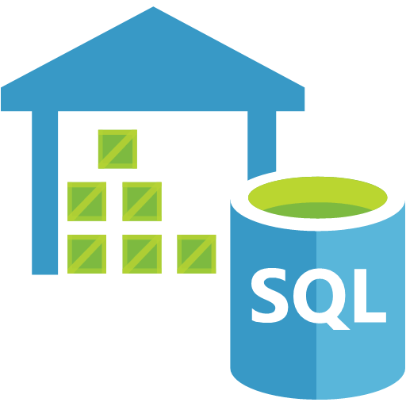
Subscription
AAD
Data Factory
AKV
Databricks
…
Machine Learning Studio
Virtual Network
(Managed) Virtual Machine
Blob
SQL DW

Slide 15
Subscription
AAD
Databricks
…
AKV
Machine Learning Studio
Virtual Network
Blob

Slide 16
Subscription
AAD
Databricks
…
AKV
Machine Learning Studio
Virtual Network
Blob

