Slide 1
Packing Information Entry user manual 2014-10-28 MIS – ling.xie

Slide 2
Intelligent Document Recognition IDR Solution workflow
MFG/PRO
(5.13.14.1)
Check /Book IN
Packing List Maintain
Carton ID Maintain
Print Carton Label
Scan Carton Label
PI Reports

Slide 3
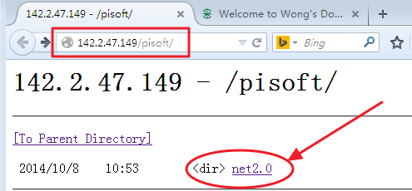
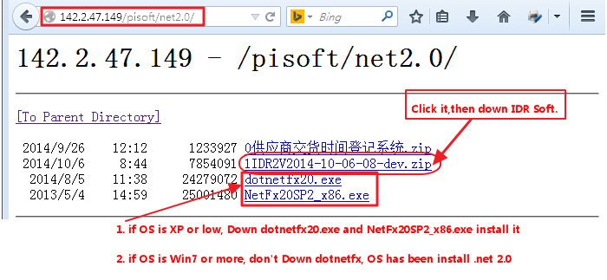
Download IDR Soft 1
DownLoad URL: http://142.2.47.149/pisoft/
3.zip idr soft

Slide 4
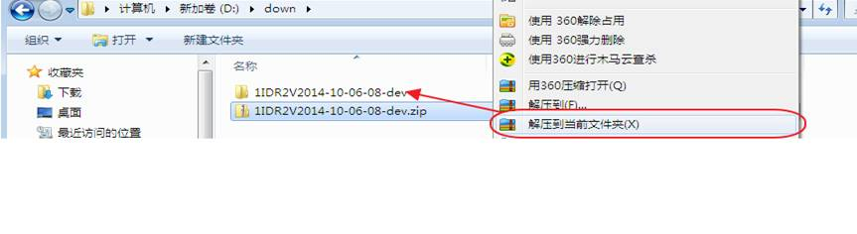
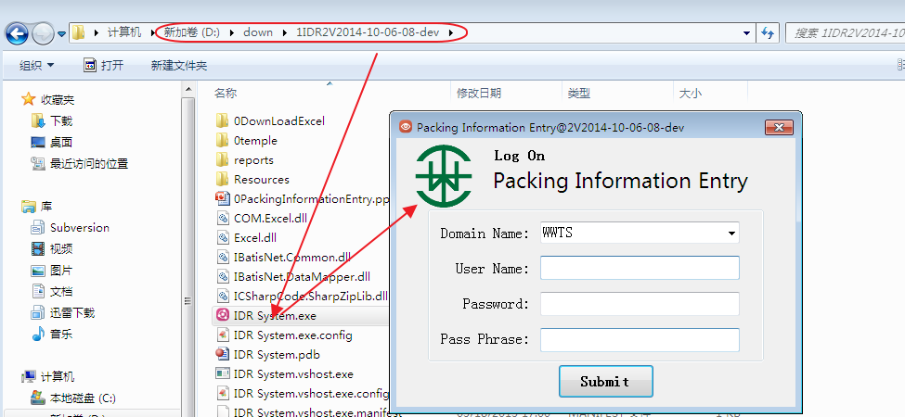
Download IDR Soft

Slide 5
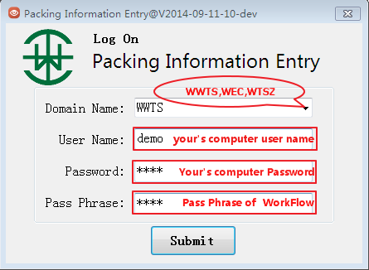
Log On (IDR System.exe)

Slide 6
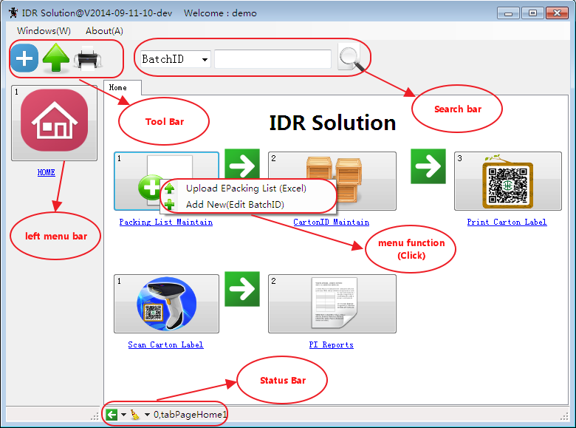
Main View

Slide 7
Packing List Maintain
1.Upload e-Packing List (Excel)[KYCA]
2.Add New(Edit Batch ID)

Slide 8
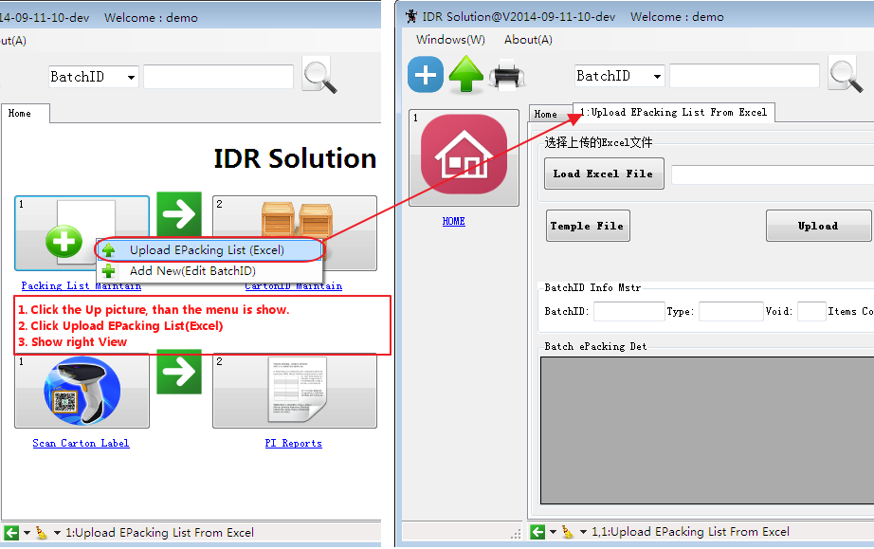
1.01 Upload e-Packing List (Excel)

Slide 9
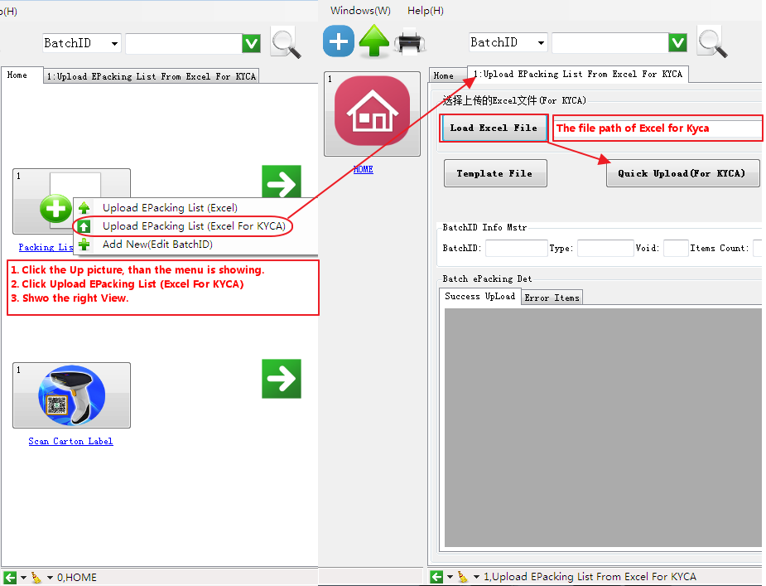
1.02 Upload e-Packing List (Excel for KYCA)

Slide 10
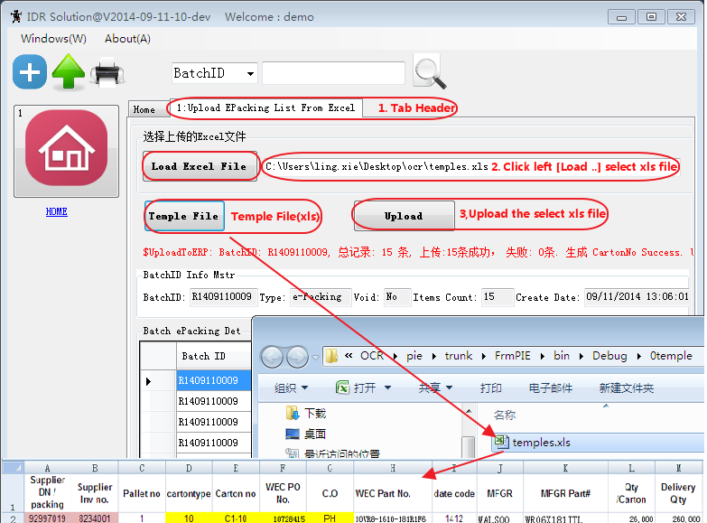
1.03 Upload e-Packing List (Excel)[KYCA]

Slide 11
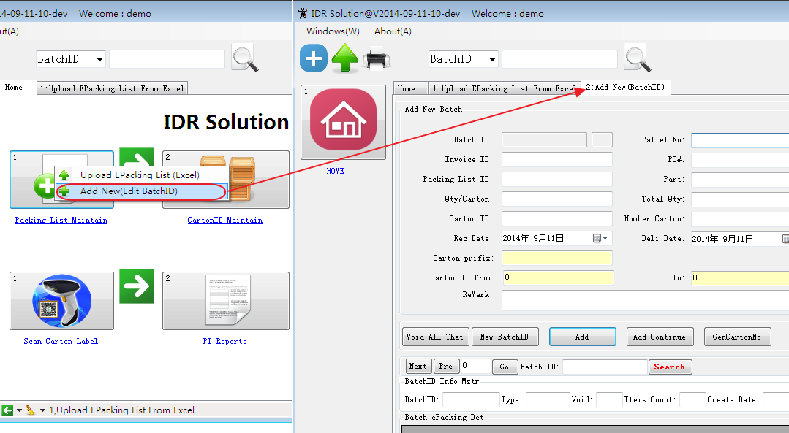
1.2. Add New(Edit Batch ID)

Slide 12
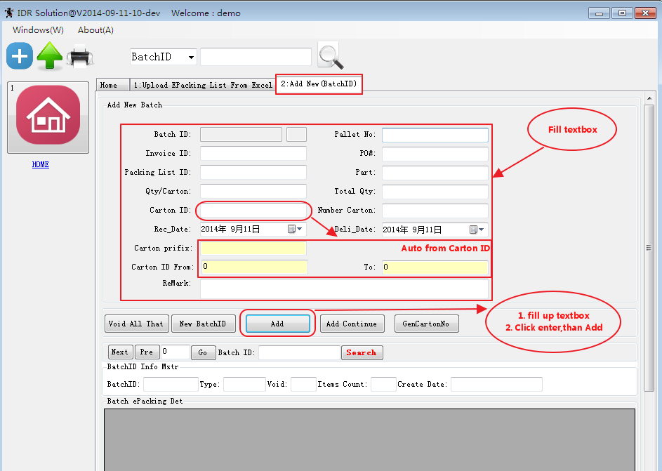
1.2.1 Add a New Batch ID

Slide 13
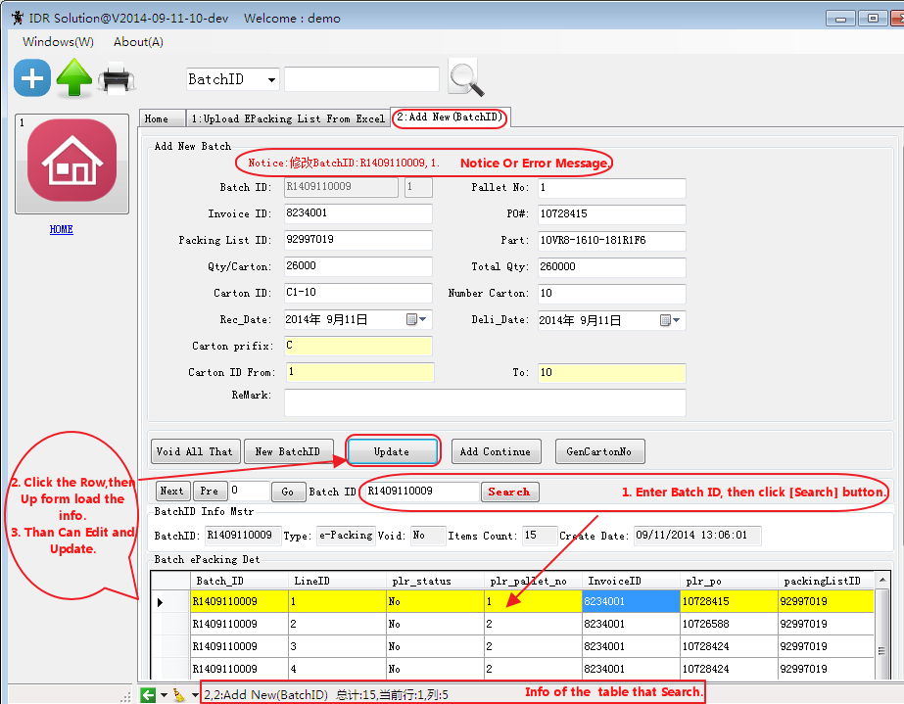
1.2.2 Edit Batch ID

Slide 14
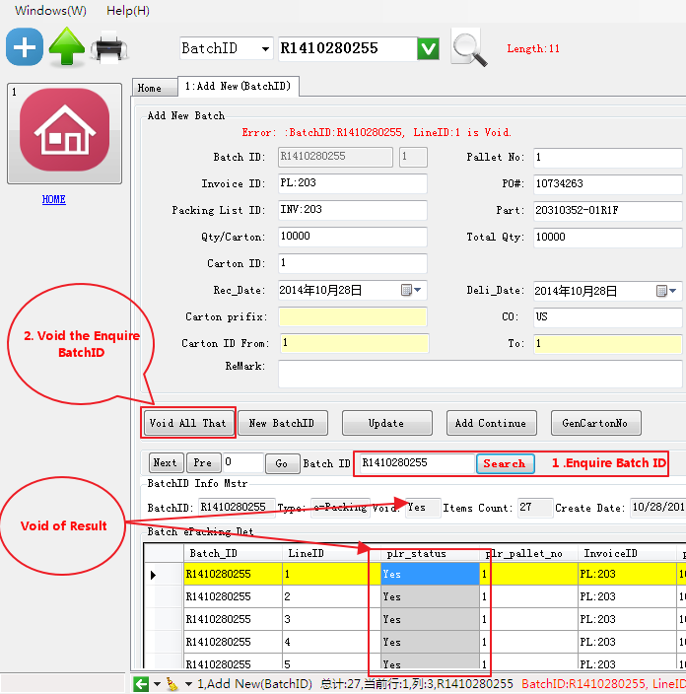
1.2.3 Void Batch ID

Slide 15
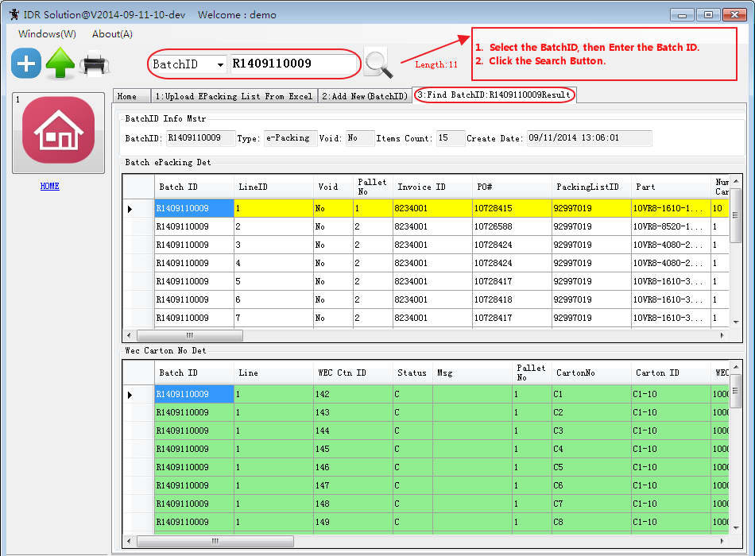
1.2.4 Search Batch ID

Slide 16
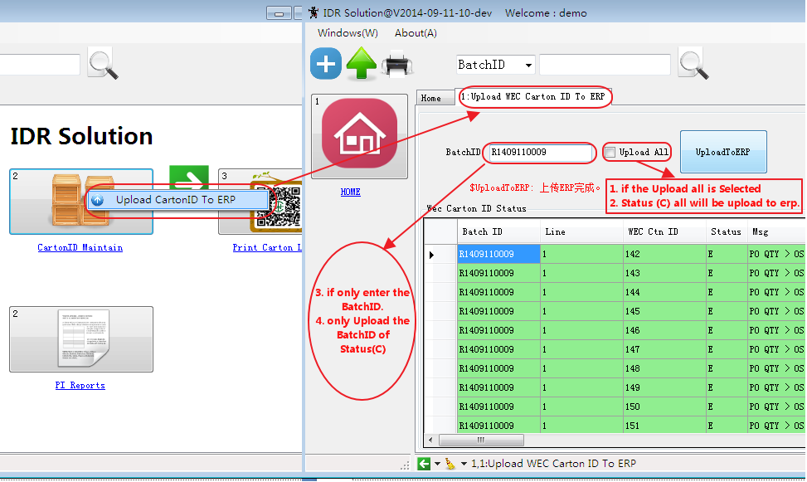
2. Carton ID Maintain (upload to ERP)

Slide 17
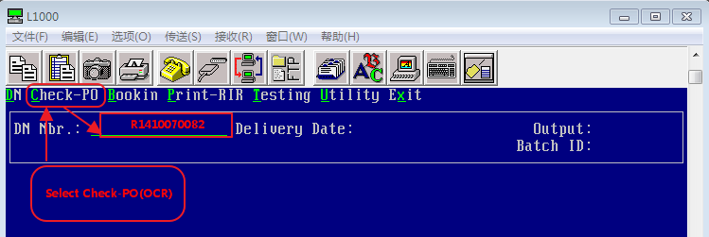
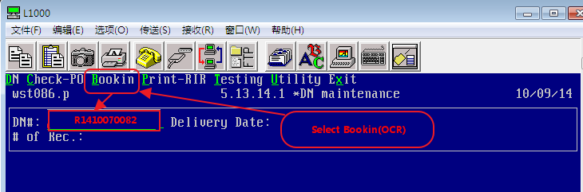
MFG/PRO (ERP) Check (IDR)/Book IN(IDR)[5.13.14.1]

Slide 18
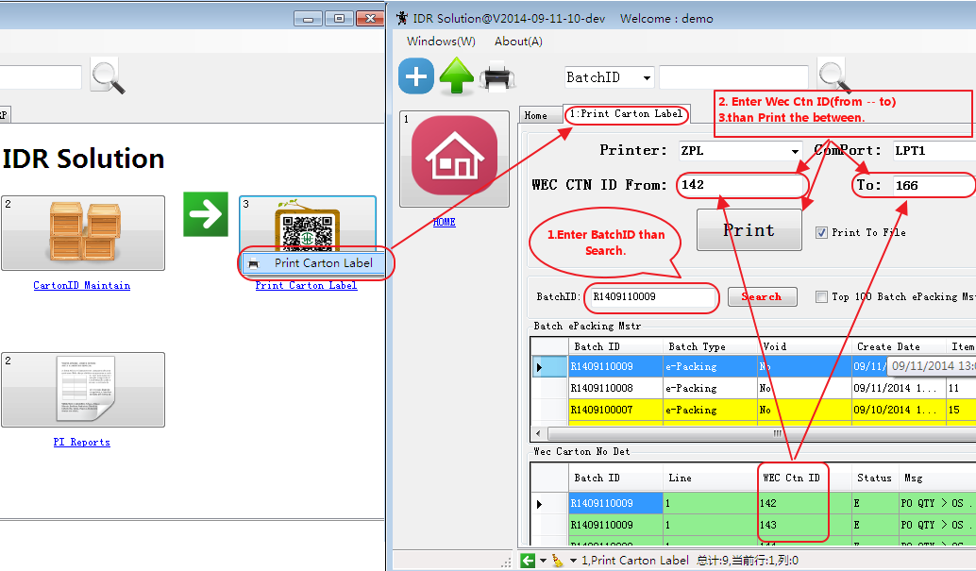
3. Print Carton Label

Slide 19
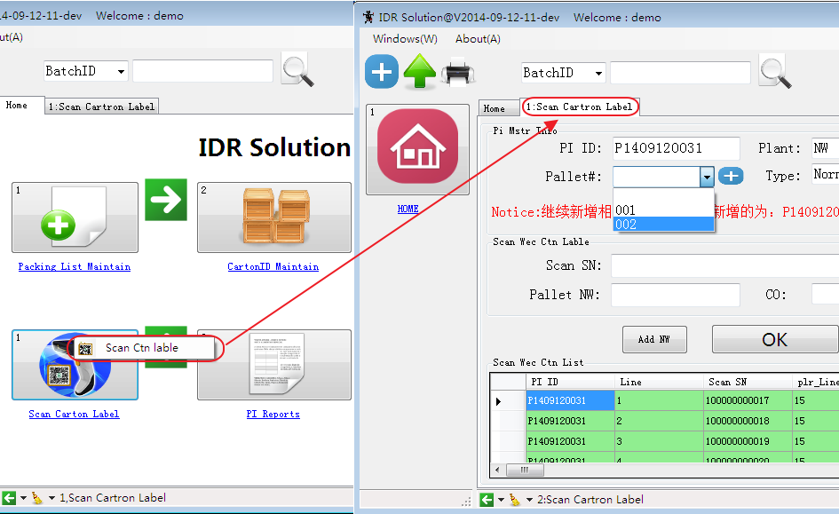
4. Scan Carton Label

Slide 20
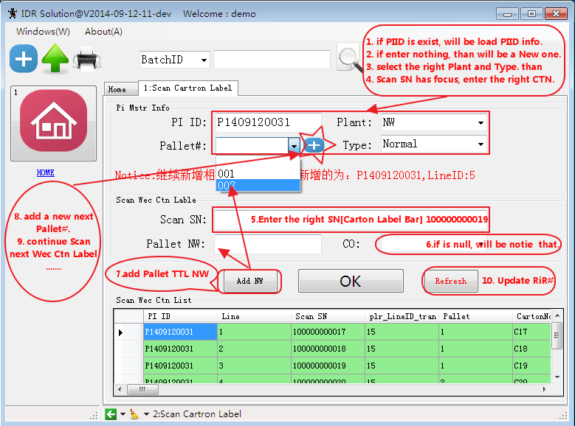
4. 1 Scan Carton Label Maintain

Slide 21
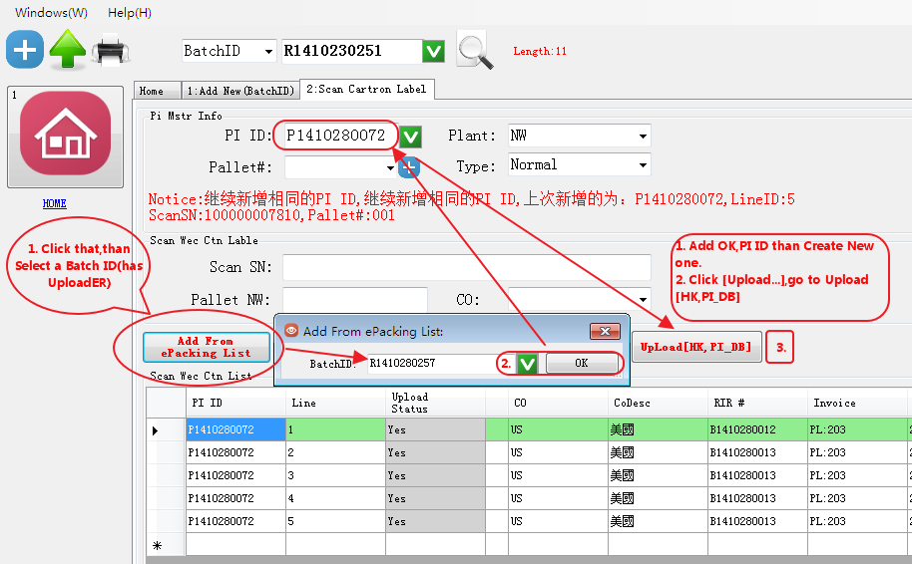
4. 2 Add From ePacking List

Slide 22
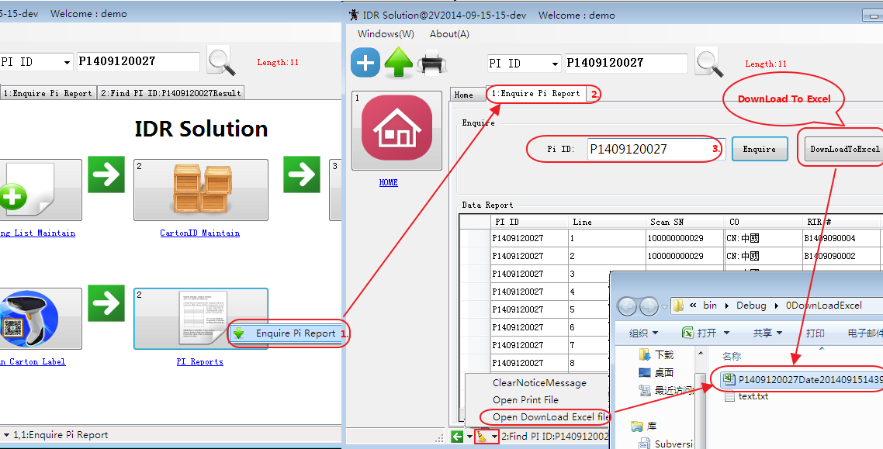
5. PI Reports

Slide 23
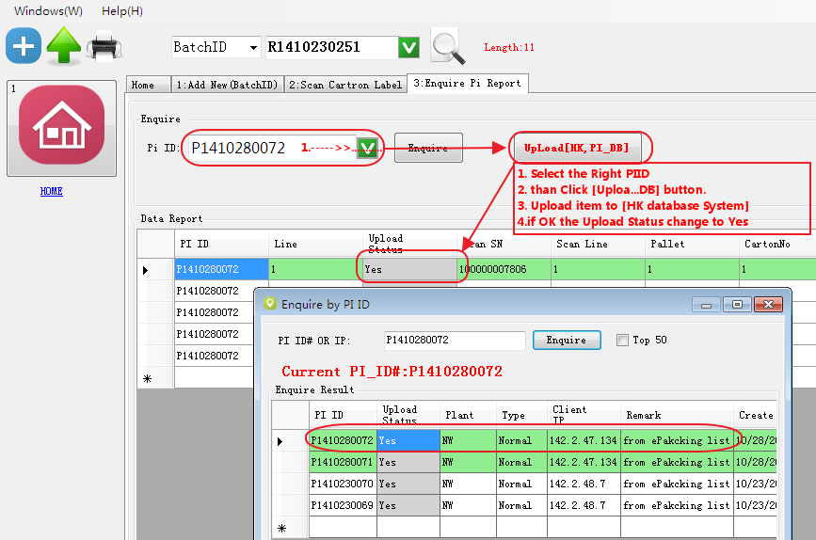
5.1 PI Reports UpLoad[HK PI_DB]

Slide 24
--END--

