Slide 1
Packing Information Entry user manual MIS – ling.xie

Slide 2
Intelligent Document Recognition IDR Solution workflow
MFG/PRO
Check /Book IN
Packing List Maintain
Carton ID Maintain
Print Carton Label
Scan Carton Label
PI Reports

Slide 3
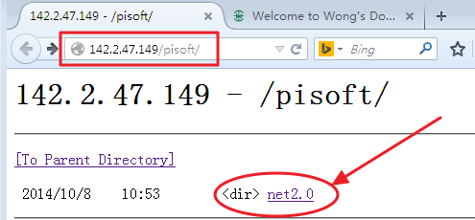
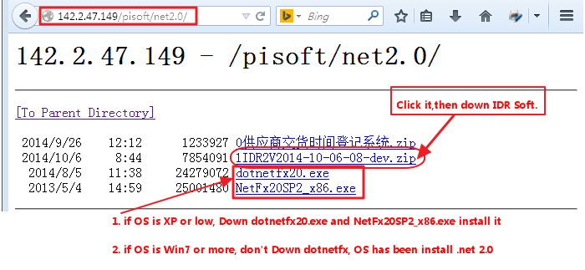
Download IDR Soft 1
DownLoad URL: http://142.2.47.149/pisoft/
3.zip idr soft

Slide 4
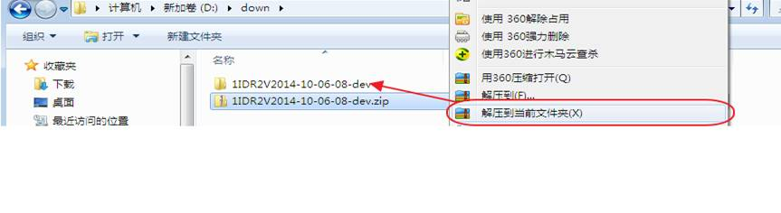
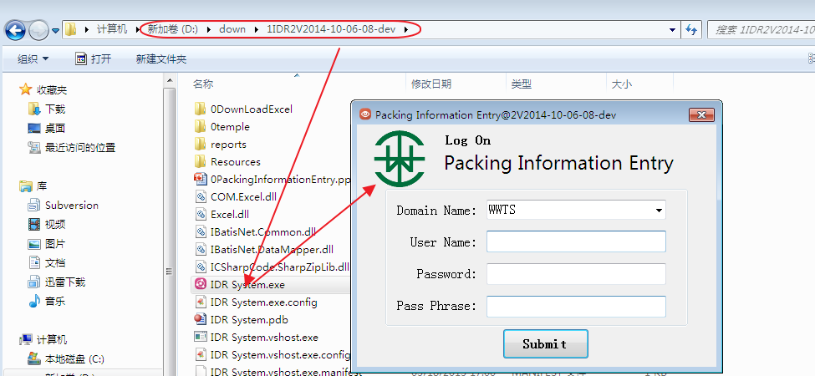
Download IDR Soft

Slide 5
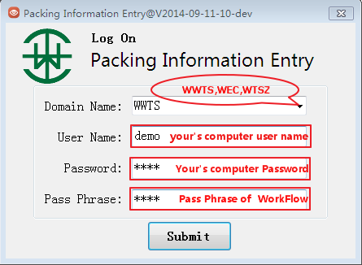
Log On (IDR System.exe)

Slide 6
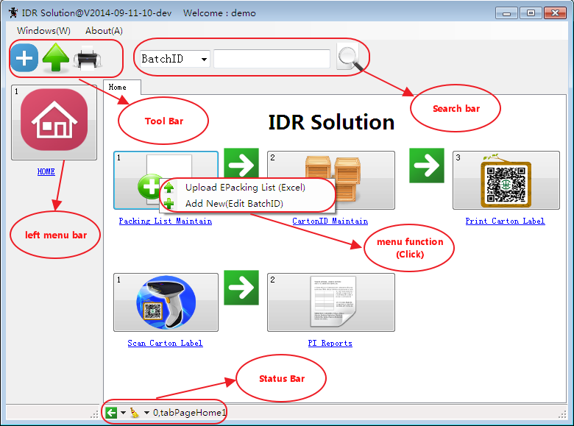
Main View

Slide 7
Packing List Maintain
1.Upload e-Packing List (Excel)
2.Add New(Edit Batch ID)

Slide 8
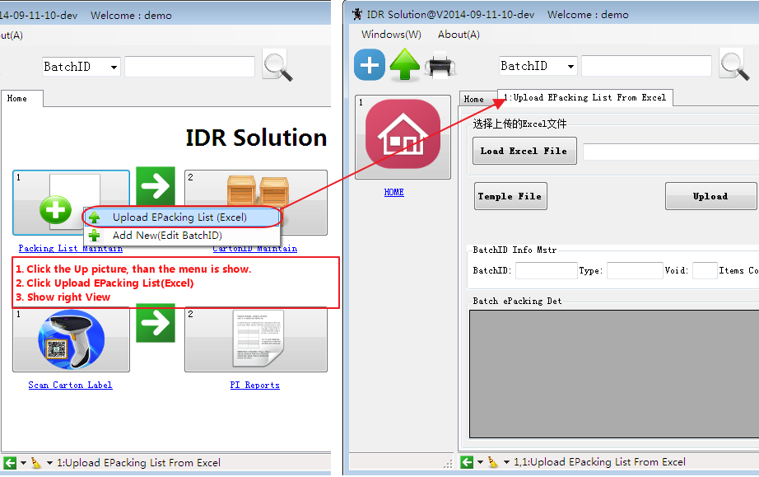
1. Upload e-Packing List (Excel)

Slide 9
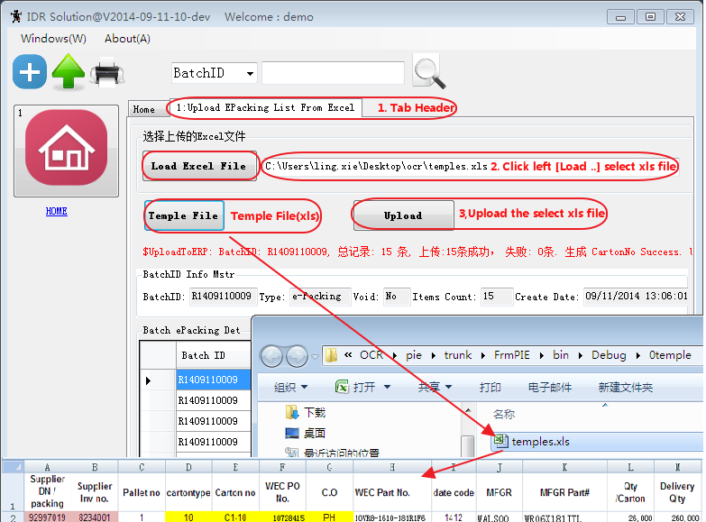
1.1 Upload e-Packing List (Excel)

Slide 10
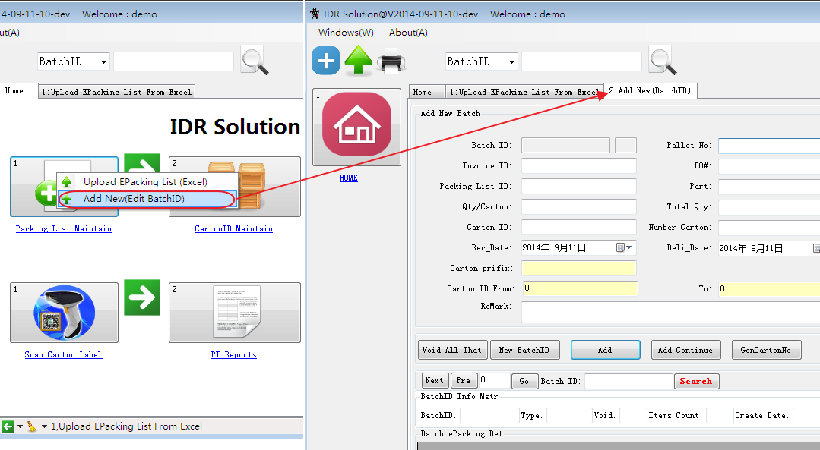
1.2. Add New(Edit Batch ID)

Slide 11
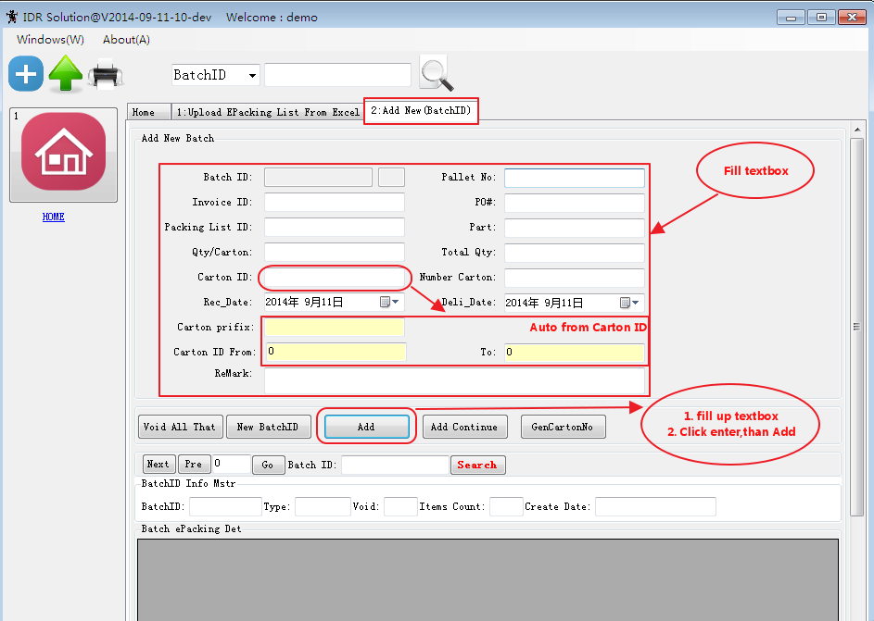
1.2.1 Add a New Batch ID

Slide 12
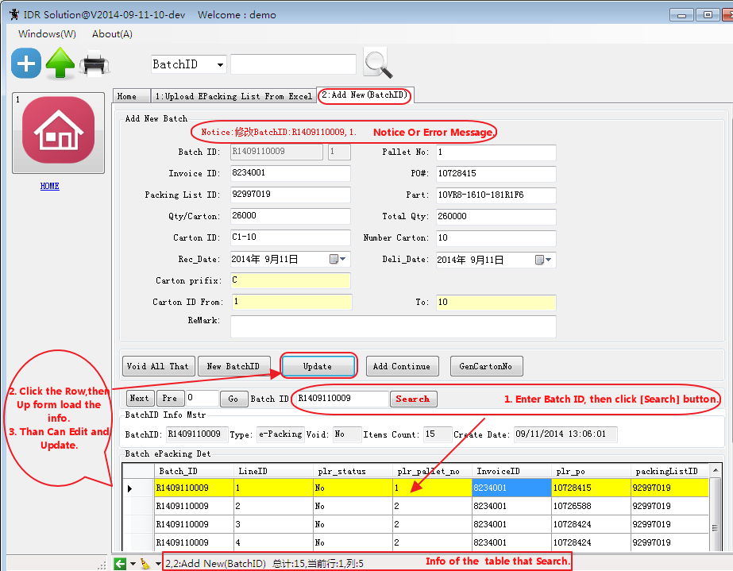
1.2.2 Edit Batch ID

Slide 13
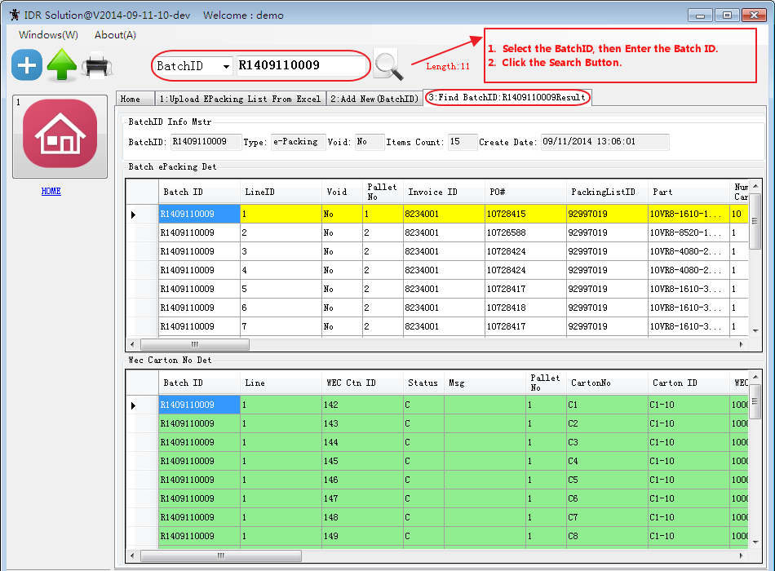
1.2.3 Search Batch ID

Slide 14
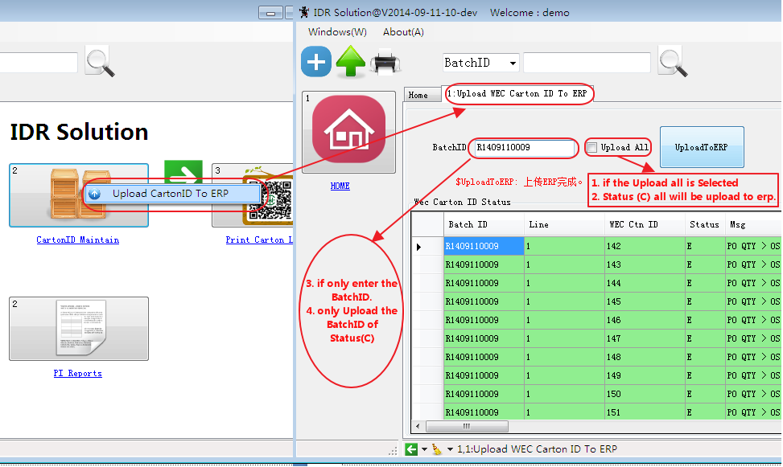
2. Carton ID Maintain (upload to ERP)

Slide 15
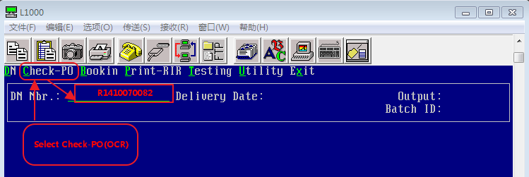
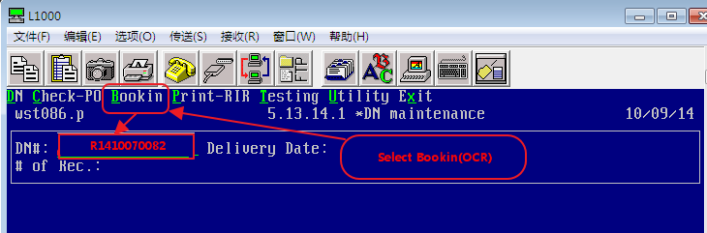
MFG/PRO (ERP) Check (OCR)/Book IN(OCR)

Slide 16
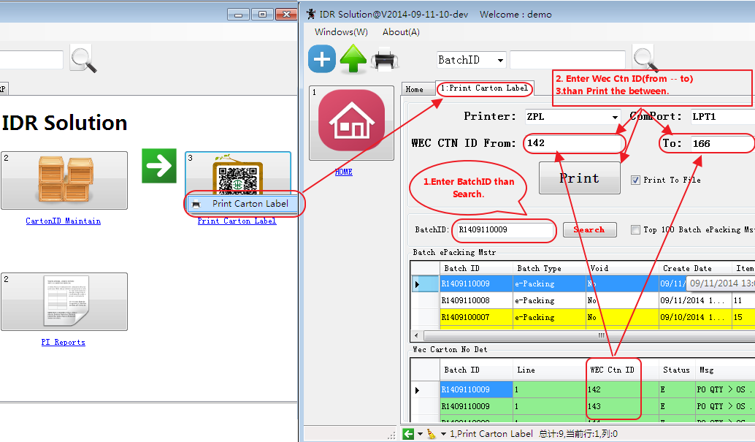
3. Print Carton Label

Slide 17
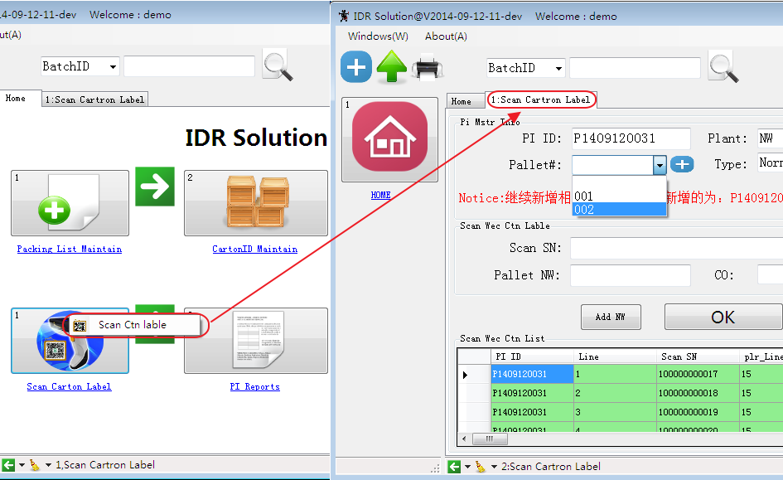
4. Scan Carton Label

Slide 18
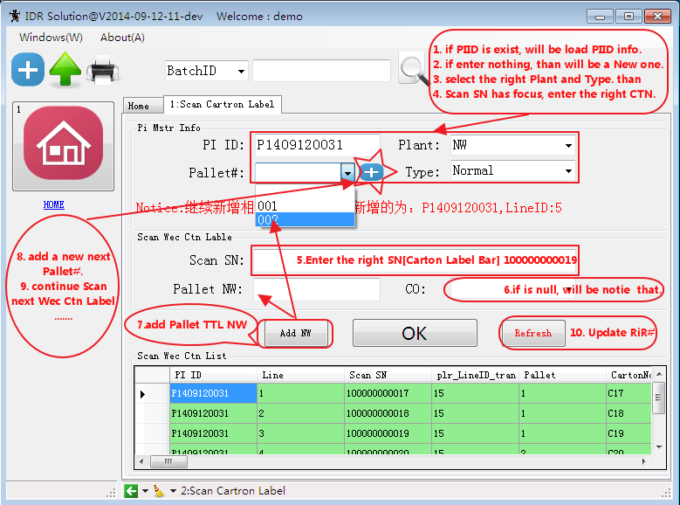
4. 1 Scan Carton Label Maintain

Slide 19
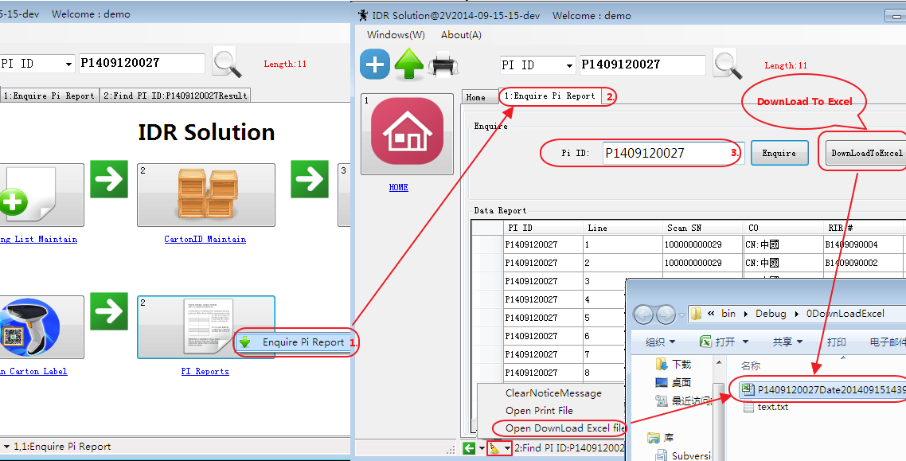
5. PI Reports

Slide 20
--END--

