Slide 1
Packing Information Entry user manual MIS – ling.xie

Slide 2
Intelligent Document Recognition IDR Solution workflow
Packing List Maintain
Carton ID Maintain
Print Carton Label
Scan Carton Label
PI Reports

Slide 3
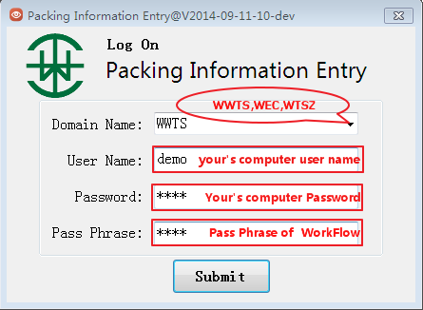
Log On (IDR System.exe)

Slide 4
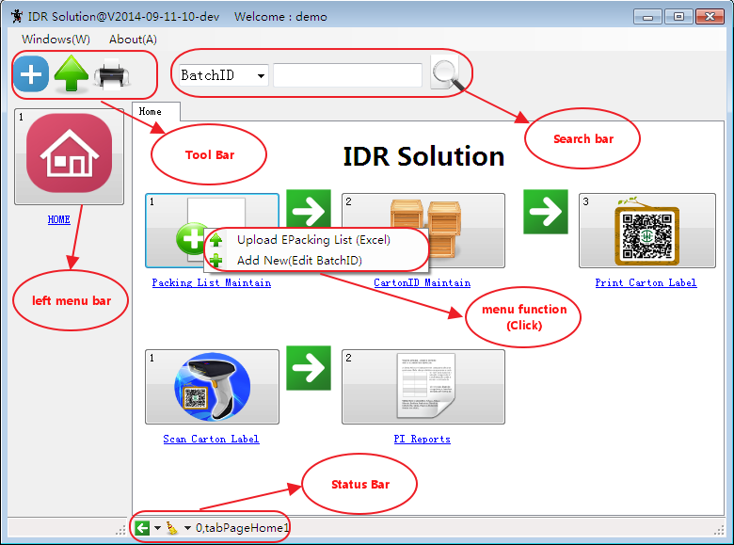
Main View

Slide 5
Packing List Maintain
1.Upload e-Packing List (Excel)
2.Add New(Edit Batch ID)

Slide 6
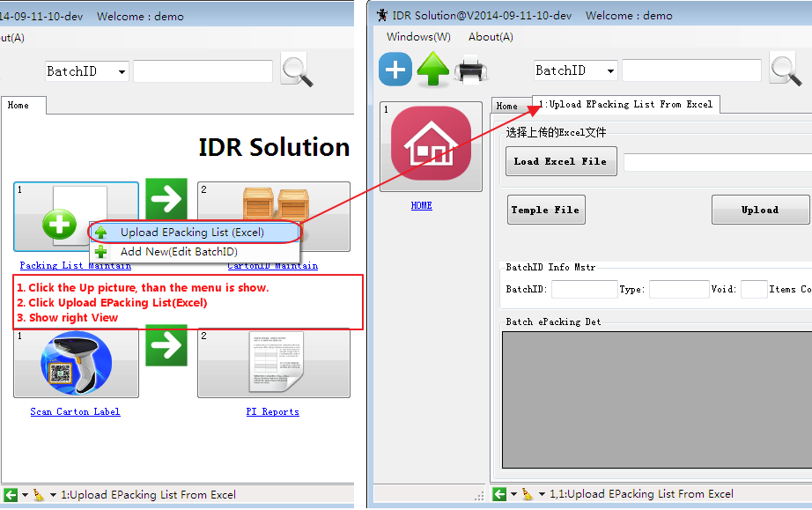
1. Upload e-Packing List (Excel)

Slide 7
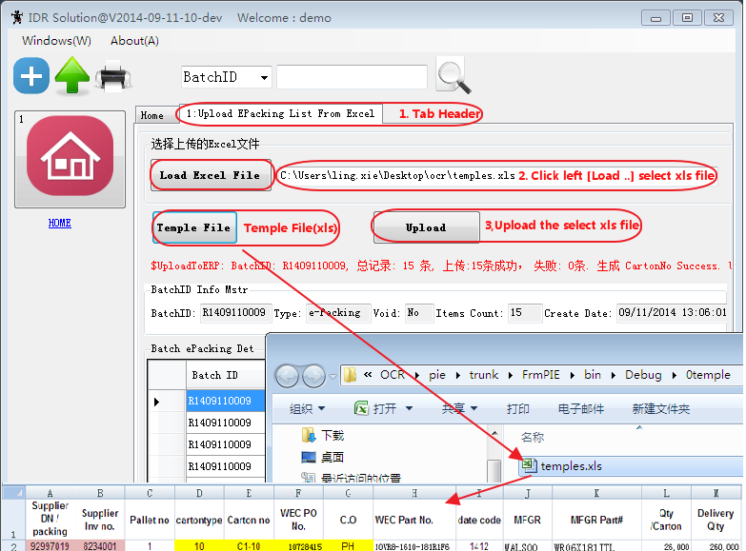
1.1 Upload e-Packing List (Excel)

Slide 8
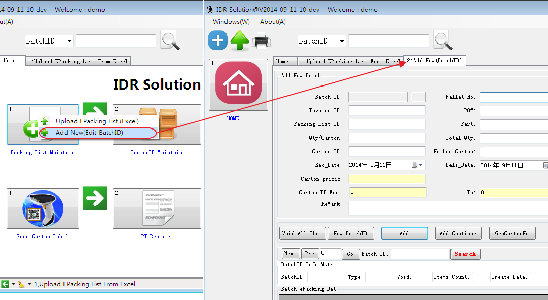
1.2. Add New(Edit Batch ID)

Slide 9
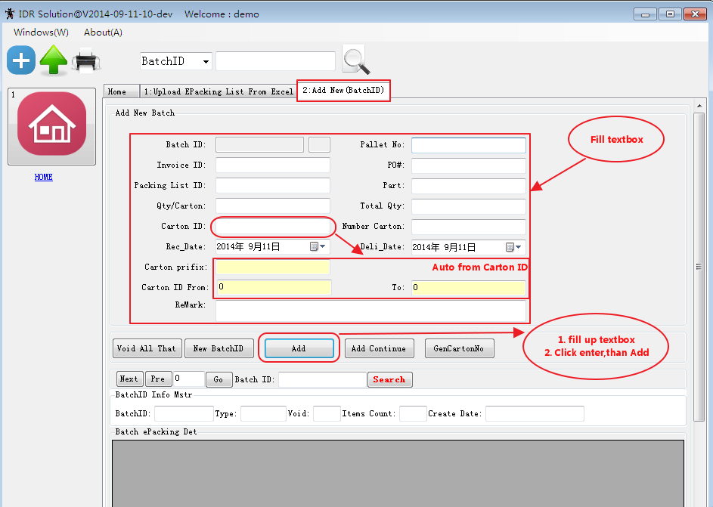
1.2.1 Add a New Batch ID

Slide 10
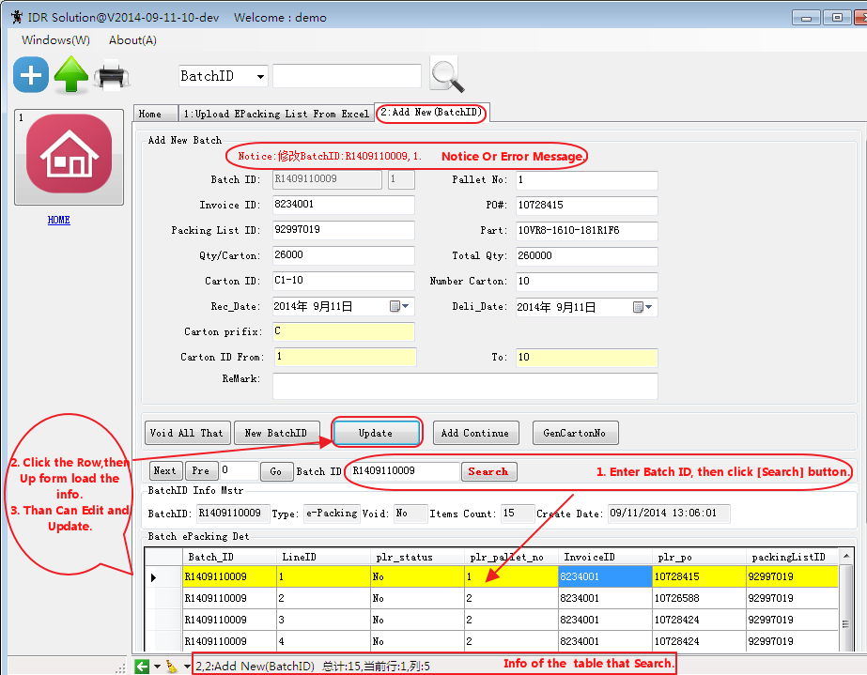
1.2.2 Edit Batch ID

Slide 11
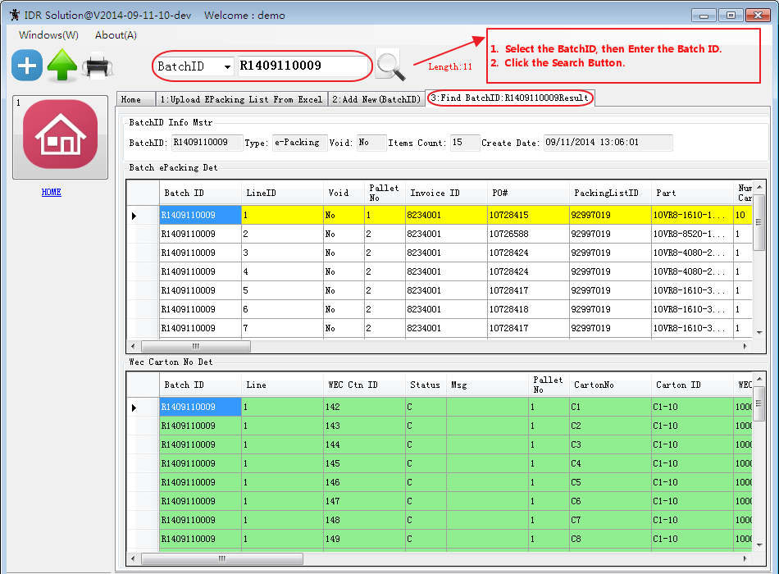
1.2.3 Search Batch ID

Slide 12
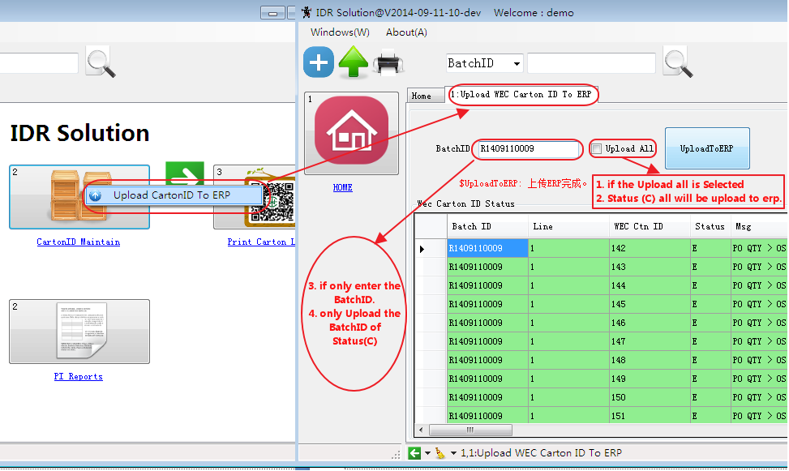
2. Carton ID Maintain (upload to ERP)

Slide 13
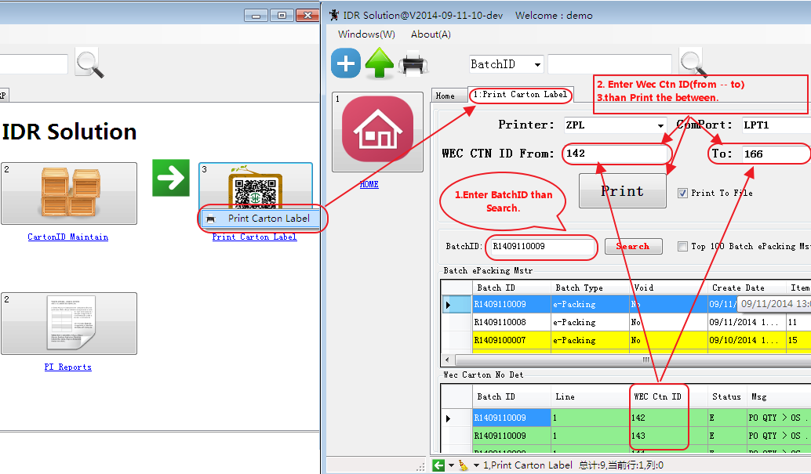
3. Print Carton Label

Slide 14
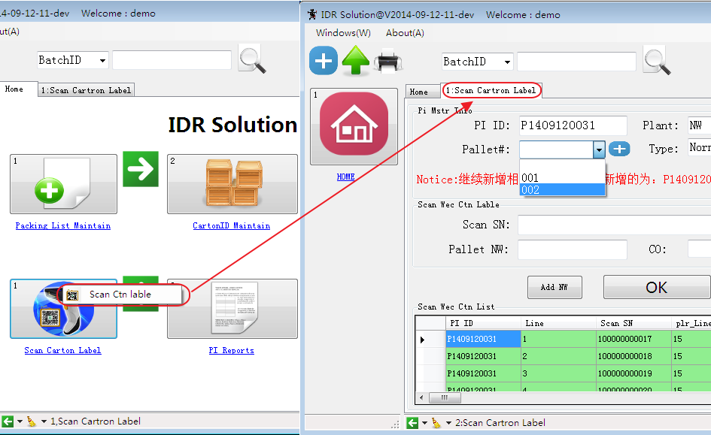
4. Scan Carton Label

Slide 15
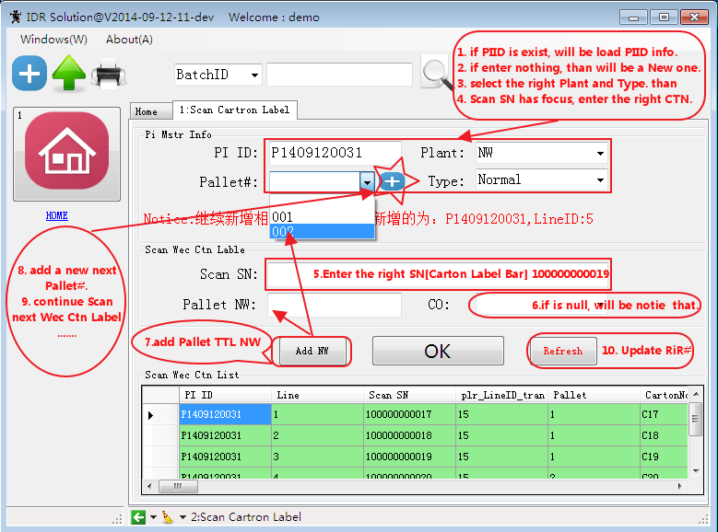
4. 1 Scan Carton Label Maintain

Slide 16
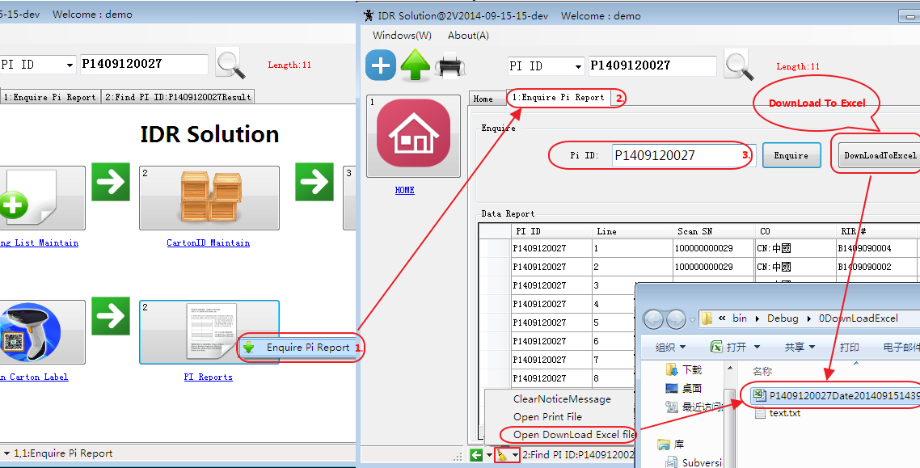
5. PI Reports

Slide 17
--END--

