Slide 1
Prediction of stocks through different Neural Networks
--Group 52 Xiaochen Li, Yifan Liao, Jun Zhi

Slide 2
Overview
Brief consists of 4 methods to predict the stock price.
  MLP
  CNN
  RNN
  ANN

Slide 3
Contribution
Brief consists of 4 methods to predict the stock price.
  EDA ------- Zhijun
  MLP ------- Zhijun
  CNN ------- Yifan Liao
  RNN ------- Xiaochen Li
  ANN ------- Xiaochen Li, Yifan Liao

Slide 4
Background
The team had decided on the idea of predicting stock price through various neural networks.
Although it is not rare to use neural networks to work on such task, we would like to implement it ourselves. Get our hands dirty and explore the possibilities and potential problems/strategy we could adopt , and learn with what we could from this valuable experience.

Slide 5
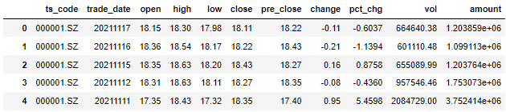
Background
Data API: Tushare
Data Collection:
Outline: The main idea would be to predict the stock price based on the past records of closing price.
However, we also performed some other relevant approach to explore the use of neural networks further ( to be elaborate)

Slide 6
Exploratory data analysis
EDA is an important step before actual training of data and the neural networks.
Good EDA would allow us to have more insight into data and their relationships with each other.
In this project, we first analyse the relationships between different features to the feature ‘Close’, since our original idea was to predict stock closing price and ‘Close’ would be our label.
Note: This EDA process is to provide us options to perform alternative approach from the initial main idea – to predict closing price from the closing price of last 60 days.

Slide 7
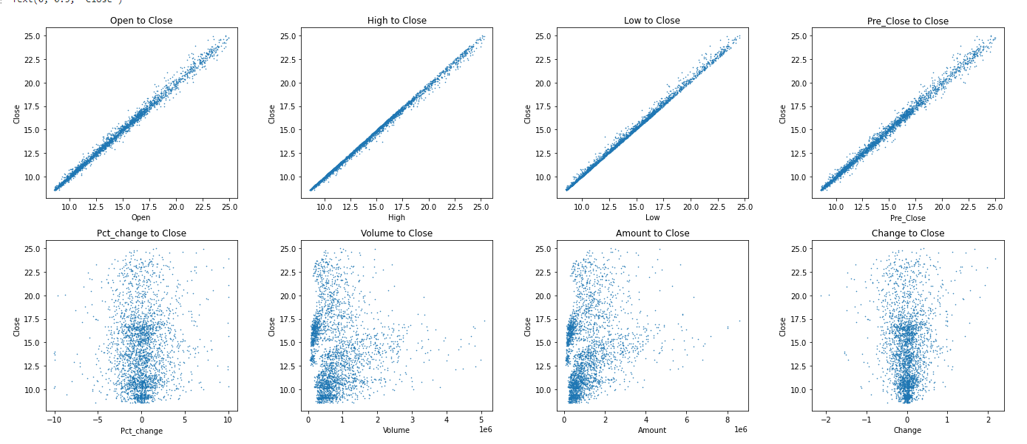
Exploratory data analysis

Slide 8
Exploratory data analysis
In the previous slides, we can clearly see the positive linear relationship between features – ‘open’, ‘high’ , ‘low’, ‘pre_close’ to close.
They could be good features to train our network for a strong linear regression task.
Also, the two pairs, namely, ‘pct_change’ and ‘change_to_close’ , ‘volume’ and ‘amount’. Shares similar traits and almost similar in the spread of data.
Which bring us to the next point : correlation.

Slide 9
Exploratory data analysis
Since we noticed that certain features has rather high correlations with each other, for example, ‘ high’ and ‘low’.
We would like to avoid selecting these features that are correlated to each other and only pick one from each category.
We can plot a heatmap to visually compare the correlation between each features. (Shown in next slides)

Slide 10
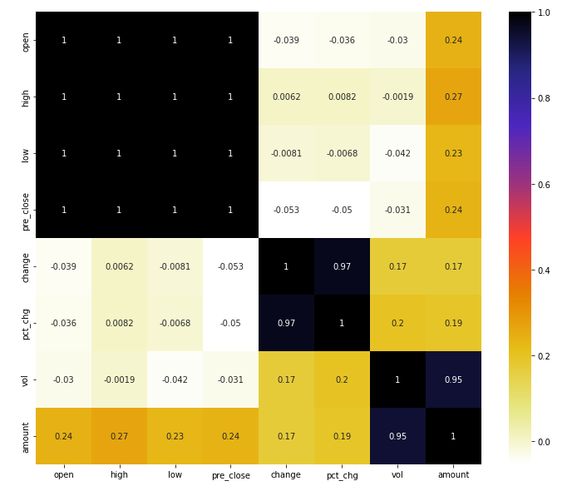
Exploratory data analysis

Slide 11
Exploratory data analysis
Black signals high correlation between features and white signals low correlations.
As we would expect, the black region consist the combination of ‘open’, ‘high’ , ‘low’ and ‘pre_close’. Vol and amount is also highlighted in dark colour to show their high correlations.
Now that we had found our correlated features, we would like to drop most of them, the dropping criterial we had set is that if the correlation is higher than 0.7, we append them to a list and drop them from the dataset.
A modified database correlations is shown in the next slides.

Slide 12
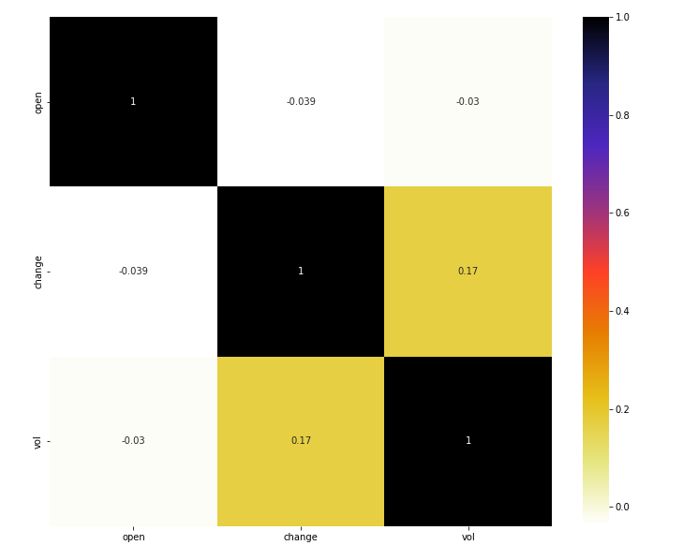
Exploratory data analysis

Slide 13
Exploratory data analysis
As we can see, now the database only consist of open,change and vol features as our training data ( training label – ‘close’ had already been exported earlier).
The correlation is much less tightening.
Now that we have our features ready, we would normal proceed to next step, that is to check for outliers within datasets.
However, in this case, we have decided not to do that. The reason is that because we are dealing with stock predictions and stock prices could varies greatly, if we consider these high variance number as outliers and remove them, we could lose valuable information.

Slide 14
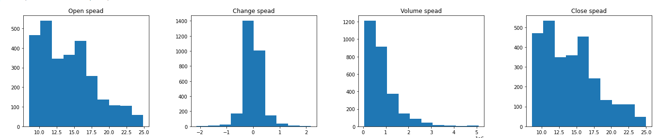
Exploratory data analysis
Nonetheless, variance in stock data is normal, however, if we have values that are too far off, say 9999999 for one day, then that might be an actual outlier and just to be safe than sorry, we check for them anyways using histograms.
Although there’s some unevenness among these diagrams, they are within reasonable range and we would allow them.

Slide 15
Implementation
Now that we had done with our EDA, we would proceed to the actual implementation process.
For MLP, we implemented it using two ways, the first is to stick to our initial idea, that is to find the close price of the stock from the past 60 days of close price.
The second would be using the information we had gather from EDA and choose selected features to perform close price prediction.

Slide 16
MLP
Initial approach:
The training of MLP using initial approach – using the close price from the previous 60 days to predict the next close price.
The network layer and hyperparameters as below.
Total 50 epoch, initial learning rate at 0.01 and divides itself by 1.5 every 7 epochs and batch size at 10.
Straight-forward where your data and software are inside your machine
Depending on what you need, e.g. access to NUS Staff Portal, SharePoint, etc. you need to connect to nVPN
Layer | Input Shape | Output Shape | Batch Normalization | Activation | Dropout p
Input layer | 60 | 1024 | True | ReLU | 0.2
Hidden layer 1 | 1024 | 1024 | True | ReLU | 0.2
Hidden layer 2 | 1024 | 1024 | True | ReLU | 0.2
Output layer | 1024 | 1 | - | - | -
Prediction of stock by convolutional neural network

Slide 17
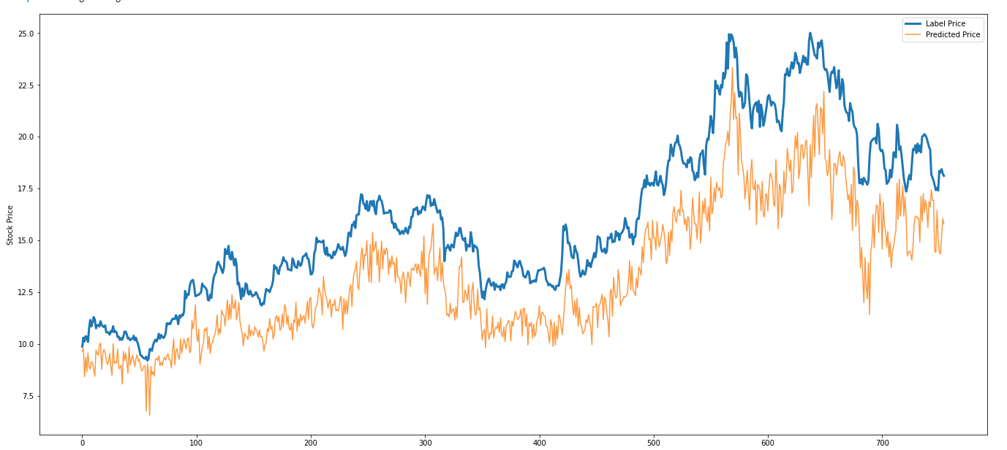
MLP
Total loss: 1.92
Total accuracy: 0.22

Slide 18
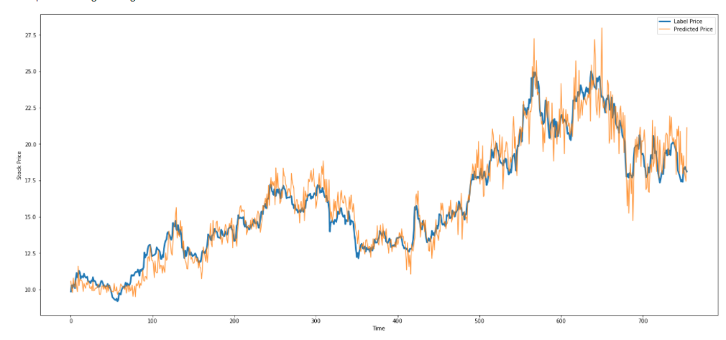
MLP
By modifying the bias value in the third hidden layer by multiplying these values by 1.8, we get a graph as below

Slide 19
MLP
The results were better than expected as we initially predicted a really bad fitting results.
However, we are not yet satisfied, we want to explore more implementation by using the features we gathered from EDA.
The next slides shows the different results from using labels – ‘open’, ‘vol’ and ‘change’, and labels – ‘open’ and ‘change’ and label ‘open’.
The neural network and hyperparameters stay the same as the initial implementation, only this time that the epochs are 100.

Slide 20
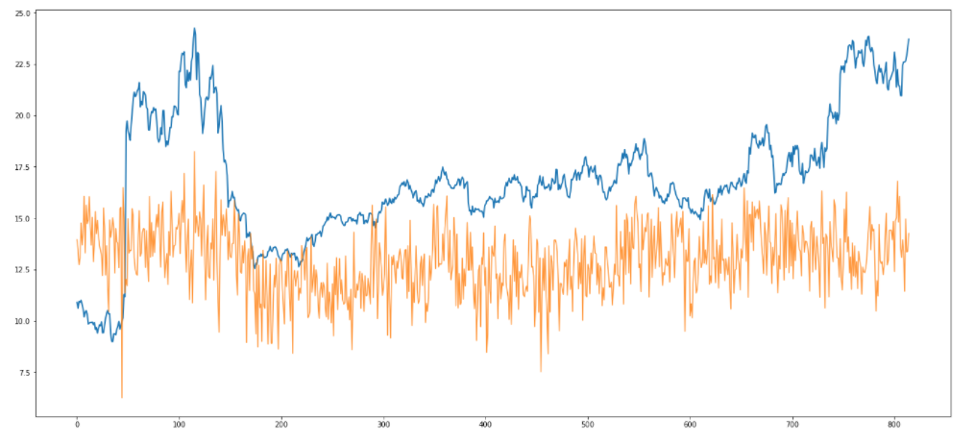
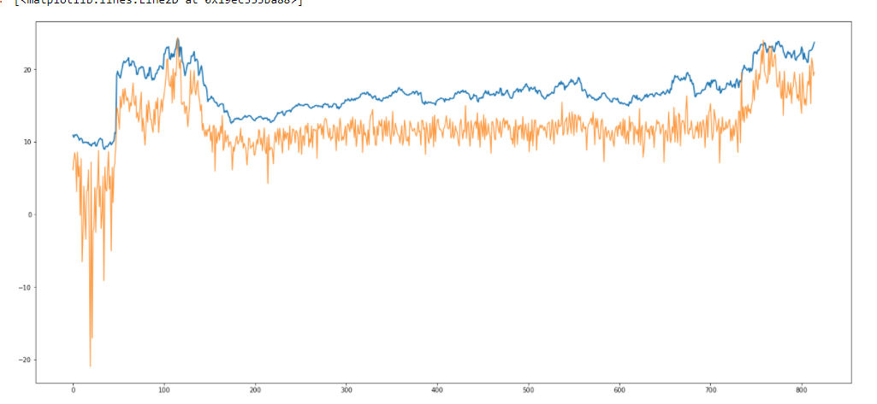
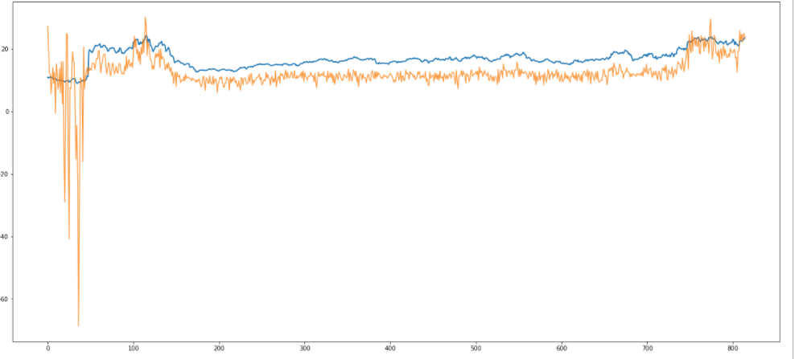
MLP
Labels – ‘open’, ‘change’ , ‘vol’
Labels – ‘open’, ‘change’
Label – ‘open’

Slide 21
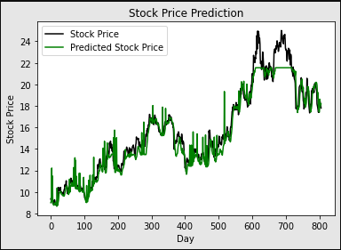
CNN
Network Structure:
Network Setting
(1, num_filter = 3, kernel_size=(1, 10))
2 Convolution layers:
2 Two relu activation functions
1 Maximum pooling layer:
1 Full connection layer
(3, num_filter = 3, kernel_size=(1, 3))
Criterion: MSELoss
Optimizer: SGD

Slide 22
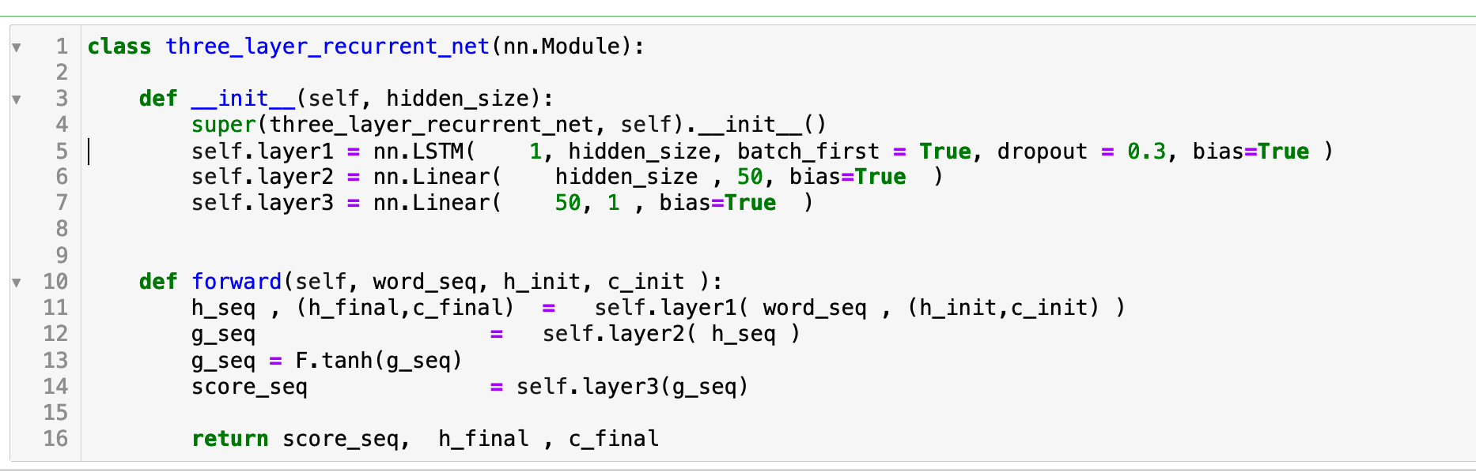
RNN
Network Structure:
Network Structure:
Network Setting
LSTM: 1 x 30
1 LSTM layers
2 FC layers
FC1: 30 x 50
FC2: 50 x 1
Totally 5561 parameters
Criterion: MSELoss()
Optimizer: SGD
Normalization: StandardScaler

Slide 23
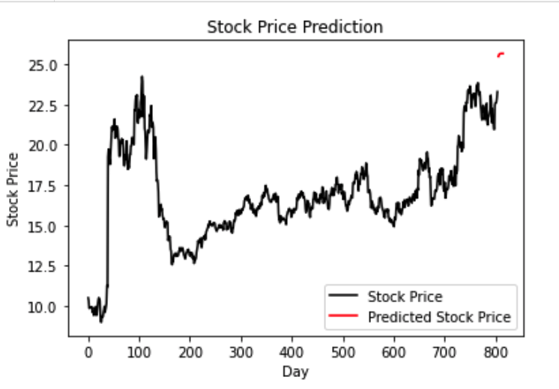
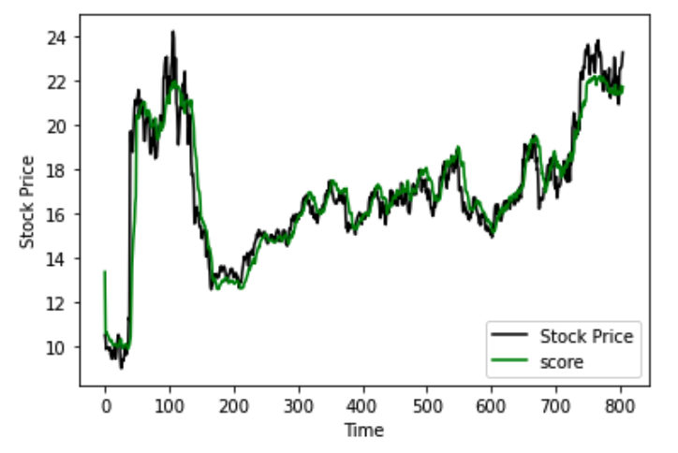
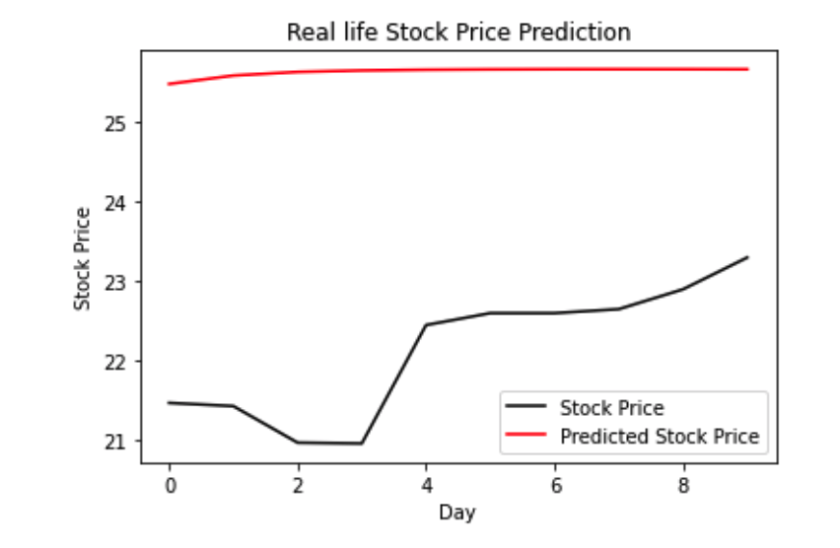


LSTM Performance
Test dataset
Test data and prediction of 10 days
Ground truth 10 days data

Slide 24
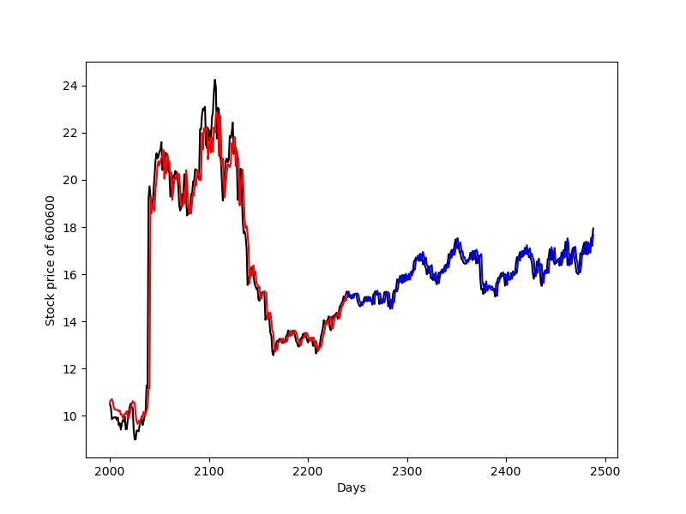
ANN
Network Structure:
Network Setting
Encoder:
1 LSTM layer
2 attention layer
Decoder:
1 attention layer
1 LSTM layer
2 full connection layer
Criterion: MSELoss()
Optimizer: SGD
Normalization: StandardScaler

Slide 25
Summary
Result analysis:
ANN the best performance: 99% accuracy
RNN: 91% accuracy
CNN: 85 % accuracy
MLP: 23 % accuracy

Slide 26
THE END

