Slide 1
ENR145 Computational Methods
Digital toolbox: GitHub and webpage hosting
Xiang Li
Spring 2026

Slide 2
Brain storming session:
What site would be fun to build in class?
Let’s generate a list of 3~5 together.

Slide 3


Portals to detailed guides and documentation:
GitHub docs
GitHub pages
https://docs.github.com/en/get-started
https://docs.github.com/en/pages/

Slide 4
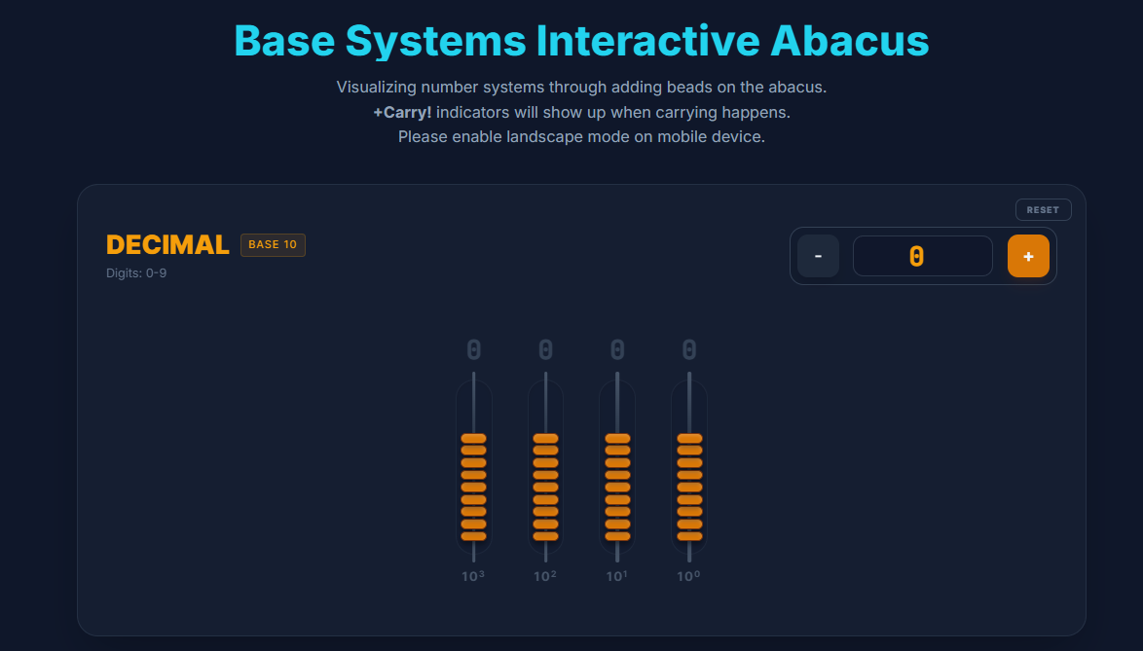
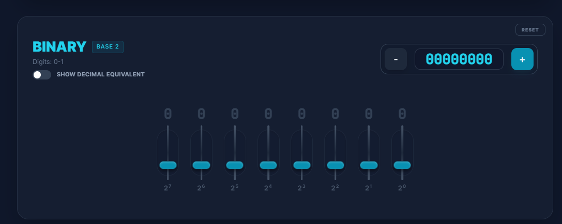
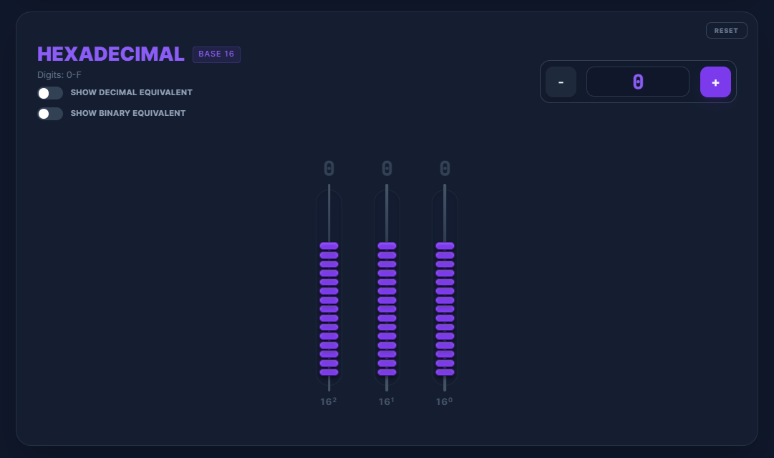
Backstage of a GitHub site:
GitHub Pages is a static site hosting service that takes
HTML
CSS
and JavaScript
straight from a repository on GitHub, optionally runs the files through a build process, and publishes a website.
You can see examples of GitHub Pages sites in the GitHub Pages examples collection.
https://xlicoe.github.io/Base_Systems_Abacus/

Slide 5
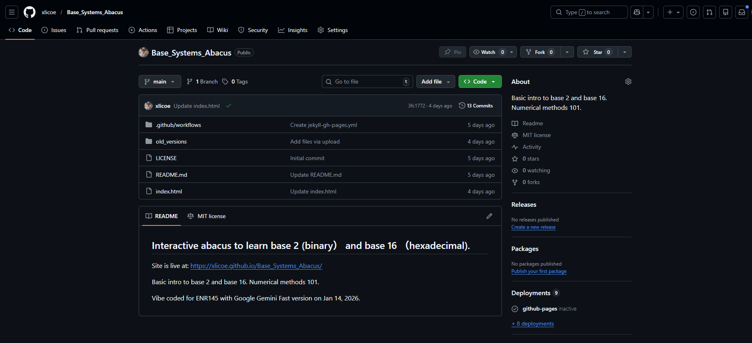
Backstage of a GitHub site:
Build related…
Repo
Documentation
Version control
Files
HTML

Slide 6
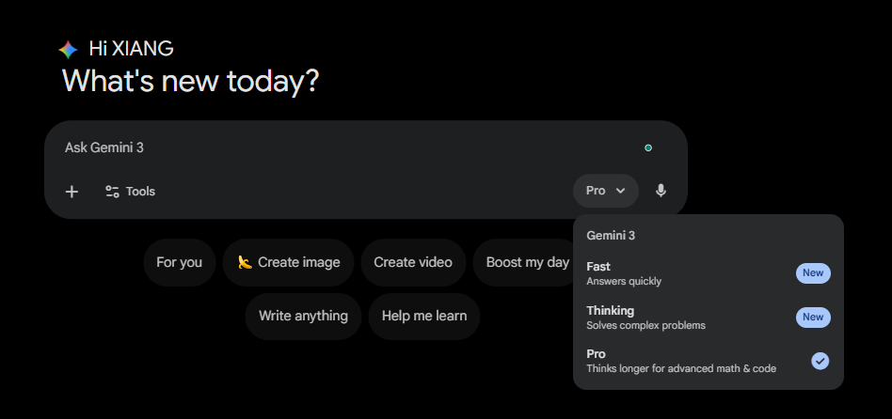
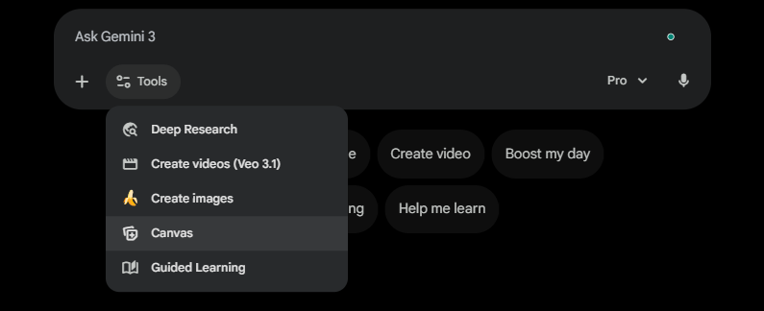
Vibe coding session (1/2):
Prompting and getting a working html code from Gemini:
Step 1: Pick a model
Step 2: Pick a tool (Canvas)

Slide 7
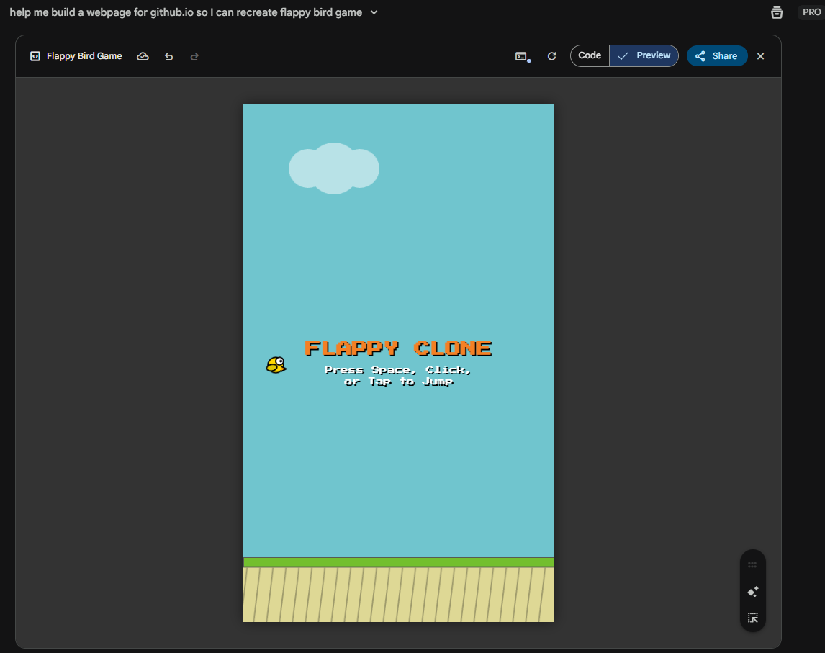
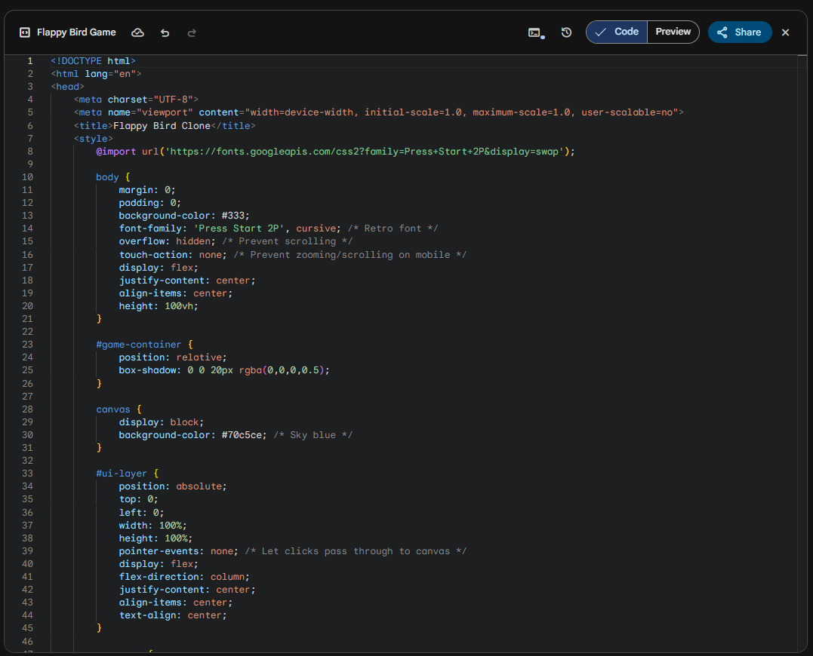
Vibe coding session (2/2):
Prompting and getting a working html code from Gemini:
Step 3: Prompt:
Step 4: Iteration

Slide 8
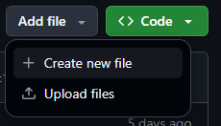
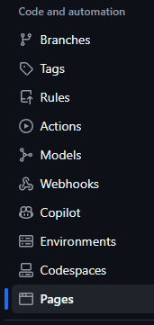
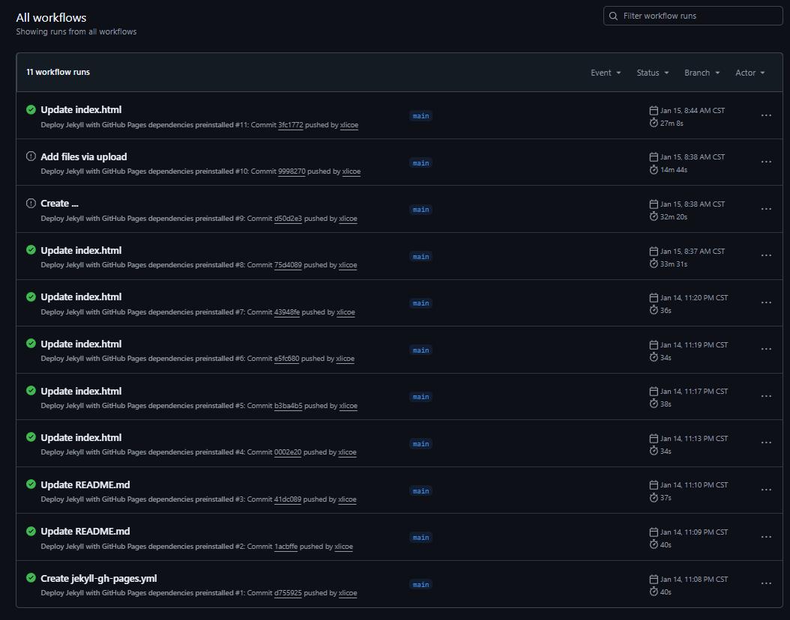

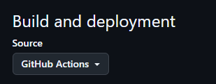

Workflow of publishing a site

Slide 9
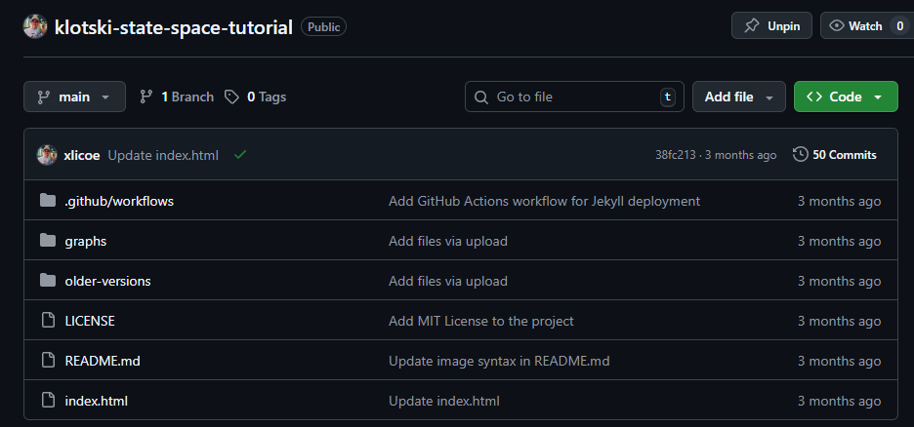
Some sites don’t publish, but have a good README file to explain everything:
https://github.com/xlicoe/klotski-state-space-tutorial

Slide 10
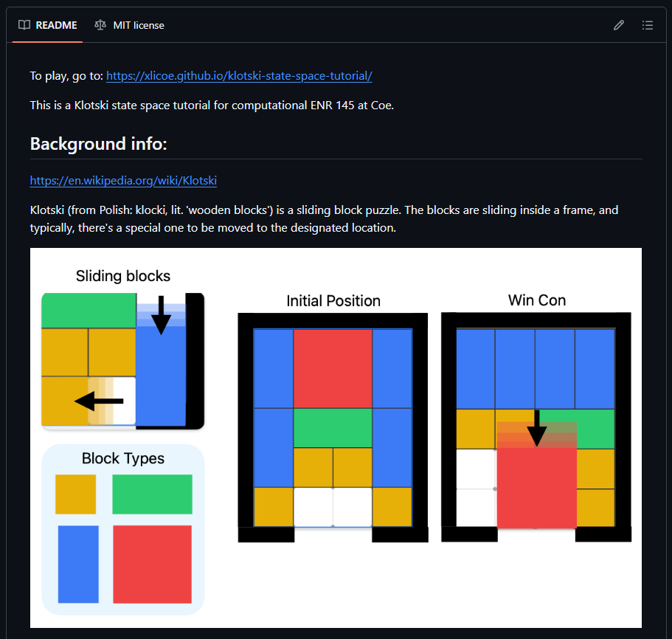
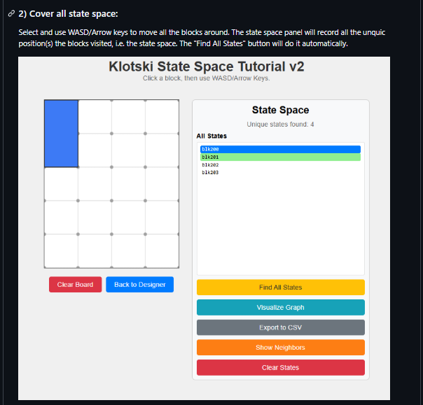
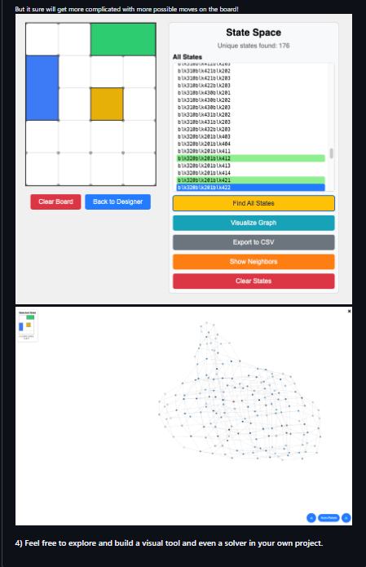
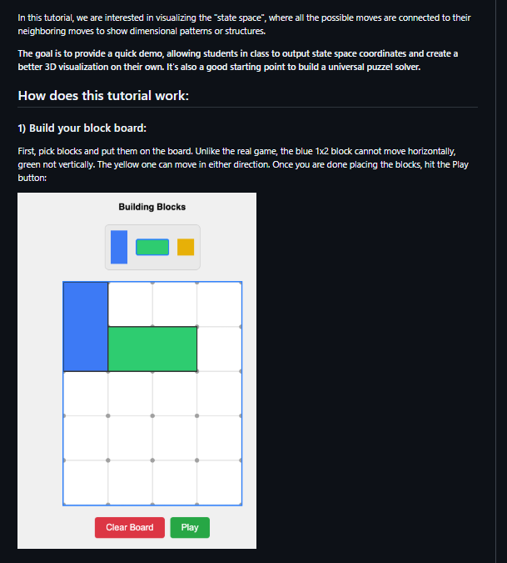
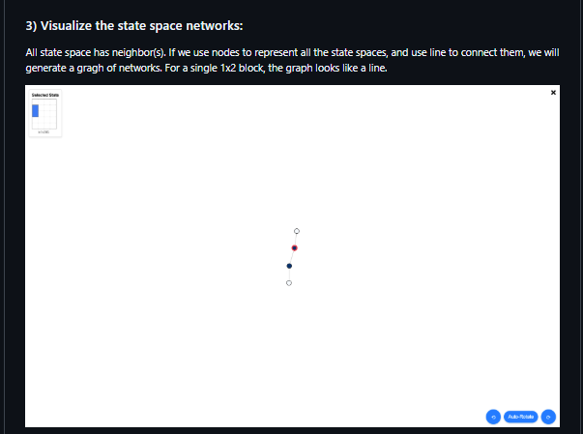

Some sites don’t publish, but with a good README file to explain everything:
https://github.com/xlicoe/klotski-state-space-tutorial
Basic writing and formatting syntax:
https://docs.github.com/en/get-started/writing-on-github/getting-started-with-writing-and-formatting-on-github/basic-writing-and-formatting-syntax

Slide 11
What if?
Get your own site up as assignment?

