Slide 1

Structural Bioinformatics Training Workshop & Hackathon 2017
Introduction to BioJava
Aleix Lafita
European Bioinformatics Institute
Structural Bioinformatics Laboratory
San Diego Supercomputer Center
UC San Diego

Slide 2
PART 1 BioJava Project
History
Resources
Setup

Slide 3

BioJava
BioJava is an open-source project dedicated to
providing a Java framework for
processing biological data
File parsers
Algorithms
Data models
FASTA
PDB
MMTF
MMCIF
Resources
Protein structures
Biological sequences
Sequence and structure alignment
Protein domains: SCOP, CATH, ECOD
BLAST
Symmetry
DSSP

Slide 4
History of BioJava
2009
Port to SVN
2013
Port to Git (GitHub)
Java 4
Java 5
Java 6
Nov 7
Java 7
Java 8
Dec 20
6 days
Today
18 days
24 days
16 days
25 days
2000
Biojava born
Pocock et al
2008
BioJava legacy
Holland et al
2012
BioJava 3
Prlić et al
2015
BioJava 4
2017
BioJava 5

Slide 5
BioJava Resources
Website: https://biojava.org
Source code: https://github.com/biojava/biojava/
Wikipedia: https://en.wikipedia.org/wiki/BioJava
General information about the project
Tutorial: https://github.com/biojava/biojava-tutorial
Educational introduction into the tools provided by BioJava
Cookbook: http://biojava.org/wiki/BioJava:CookBook
Collection of “How do I…?” recipes for common tasks

Slide 6
Setting up BioJava
Project Object Model (POM): XML file that contains information about the project and configuration details
Maven
Java source
pom.xml

Slide 7
Setting up BioJava
BioJava modules
alignment
structure
structure-gui
core
protein-
disorder
genome
sequencing

Slide 8
Demo 1
Create a new Maven repository in Eclipse

Slide 9
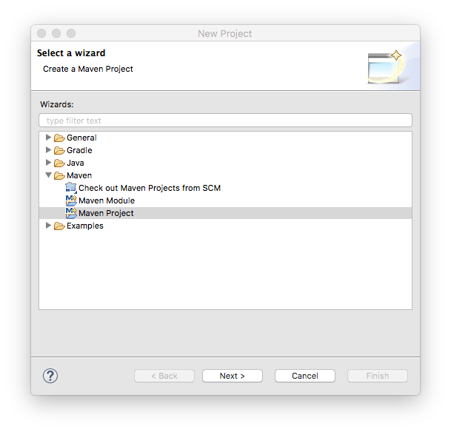
Demo 1
Create a new Maven repository in Eclipse
File > New > Project
Maven Project

Slide 10
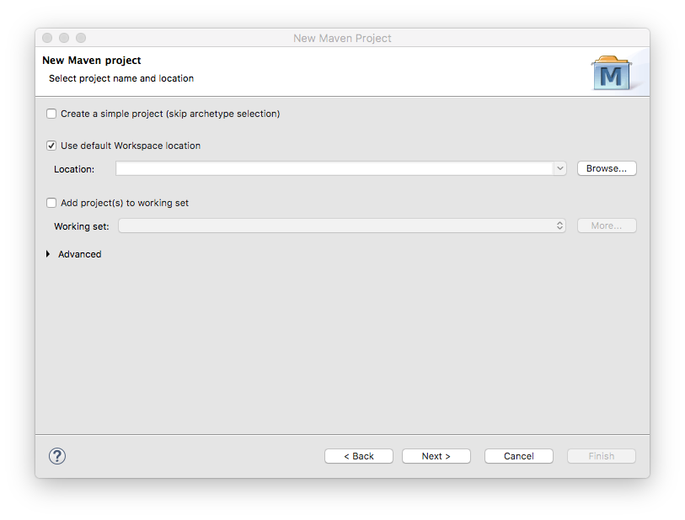
Demo 1
Create a new Maven repository in Eclipse
File > New > Project
Maven Project
Use defaults

Slide 11
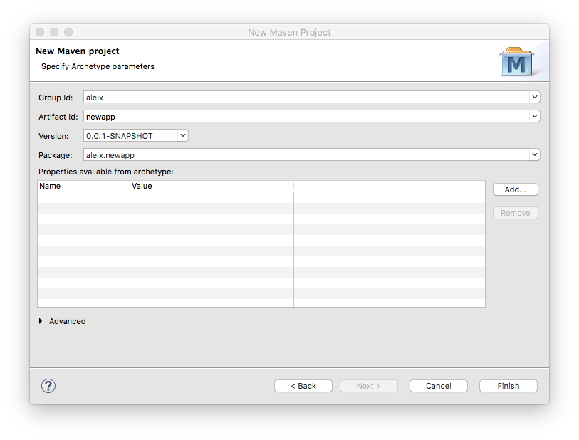
Demo 1
Create a new Maven repository in Eclipse
File > New > Project
Maven Project
Use defaults
Choose your group
and project id

Slide 12
Problem 1
Configure the new Maven repository and add the BioJava dependency
Task 1: fill in the URL field (replace the default URL)
Task 2: configure the Java 8 JDK. Insert these properties in the POM:
Task 3: insert the biojava-stucture-gui dependency (hint: https://github.com/biojava/biojava-tutorial/blob/master/installation.md)
Task 4: ensure BioJava version is the latest (5.0.0-alpha8)
<jdk.version>1.8</jdk.version>
<maven.enforcer.jdk-version>1.8</maven.enforcer.jdk-version>
<maven.compiler.source>1.8</maven.compiler.source>
<maven.compiler.target>1.8</maven.compiler.target>

Slide 13
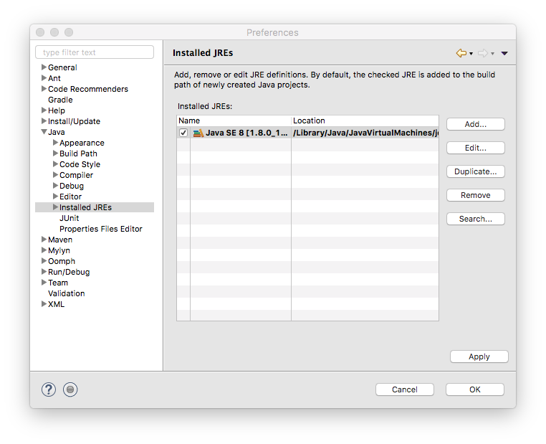
Demo 1
Configure the BioJava environment
Eclipse > Preferences > Java > Installed JREs
Edit…

Slide 14
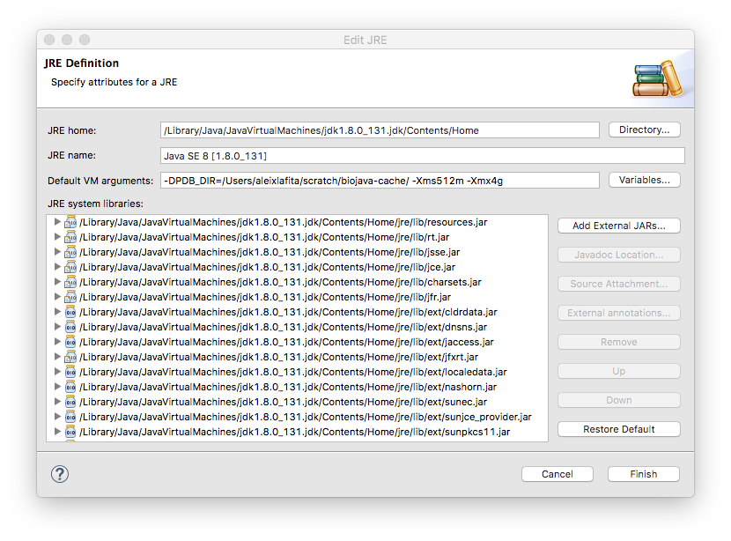
Demo 1
Configure the BioJava environment
Eclipse > Preferences > Java > Installed JREs
Edit…
Add -DPDB_DIR=
directory

Slide 15
PART 2 BioJava Structures
Structure objects
Loading and writing
Operations

Slide 16
Structure Objects
Structure
Model
Model
Chain
Chain
Chain
Chain
Structure = List<Model>
Model = List<Chain>
Chain = List<Group>
Group = List<Atom>
Atom = coordinates (X,Y,Z)
Group
Group
Atom
Atom

Slide 17
Group Types
BioJava uses the Chemical Component Dictionary to assign group types
Amino Acid (L-peptides)
Nucleotide (DNA or RNA)
Waters
Hetatoms
https://github.com/biojava/biojava-tutorial/blob/master/structure/chemcomp.md

Slide 18
Loading Structure Objects
AtomCache
PDB ids (2HHB)
Structural ranges (2HHB.A:1-20)
SCOP, CATH & ECOD ids (d2hhba_)
Many configuration options
StructureIO

Slide 19
Demo 2
Load a structure in different formats
Write a structure from BioJava to a file

Slide 20
Problem 2
Traverse BioJava structures
Task 1: number of models. Hint: nrModels
Task 2: number of polymer chains. Hint: PolyChains
Task 3: number of amino acids in a chain.
Take a look at the GroupType class first
Hint: use one method from the Chain object
Task 4: number of oxygens in the amino acids of a chain.
Take a look at the Element class
Hint: use a double loop iteration over List of Groups and Atoms

Slide 21
PART 3 BioJava Applications
Biological assemblies
Visualization in Jmol

Slide 22
Biological Assemblies
Important concepts
Asymmetric Unit (AU)
Unit cell
Crystal lattice
Resource:
https://pdb101.rcsb.org/learn/guide-to-understanding-pdb-data/biological-assemblies

Slide 23
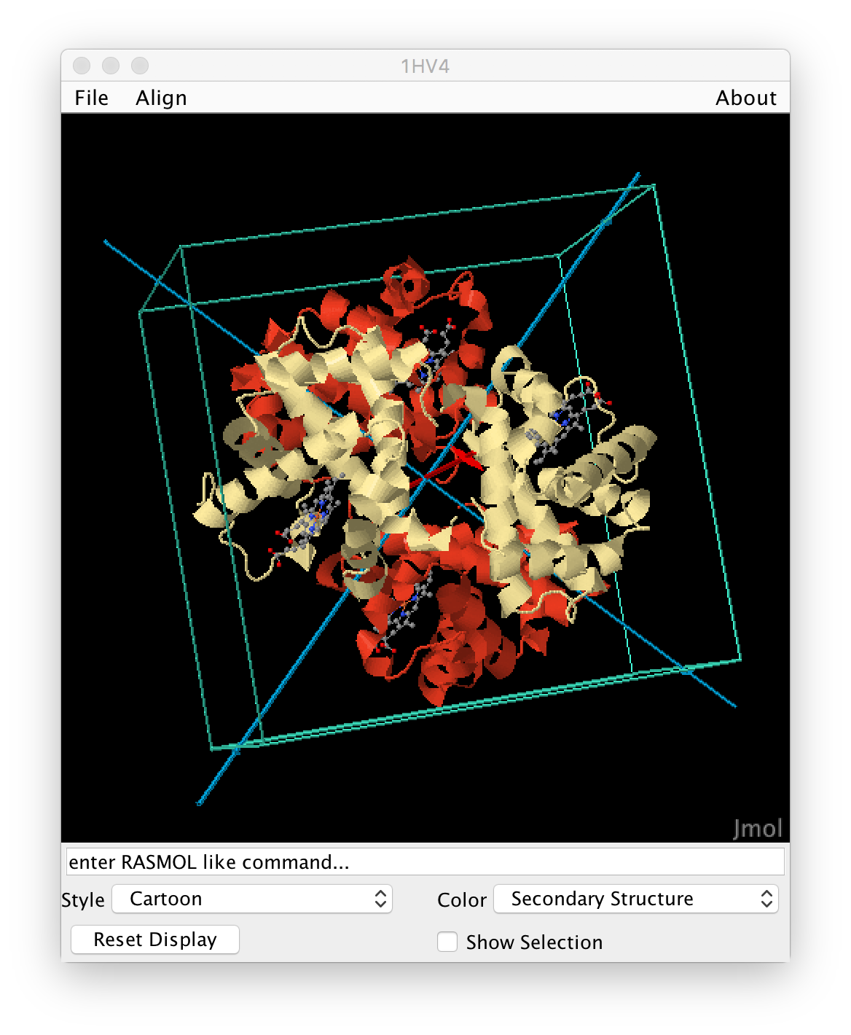
Visualization in Jmol
Interface for quick and simple visualization of structures in Jmol
Start a JFrame
Insert a Jmol panel
Convert the BioJava structure to a structure file (PDB, MMTF)
Send the structure file to the Jmol panel

Slide 24
Problem 3
Display the symmetry of a biological assembly
Task 1: download a biological assembly.
Hint: use the StructureIO class directly.
Warning: set the multiModel option to true (false is default) to be able to visualize the results (due to limitation of single letter chains in PDB format)
Task 2: change the parameters for pseudo-symmetry analysis.
Hint: structural clustering instead of sequence.
Task 3: obtain the symmetry and stoichiometry from the result.
Hint: use getter methods.

Slide 25
Thank you!

Slide 26
Contributing
Do you want to use BioJava for your project?
Do you have any ideas?
Would you like to stay tuned?
Join us at:
GitHub issues: https://github.com/biojava/biojava/issues
Mailing list: http://biojava.org/wiki/BioJava%3AMailingLists
Gitter: https://gitter.im/biojava/biojava

