Slide 1
Node.JS Metrics

Slide 2
1st Workshop
Node.JS / Hello World

Slide 3



Node.JS – Hello World
User make a Web Request,
http://IP-Address/
Request
Response
Node.js Response
Hello World

Slide 4
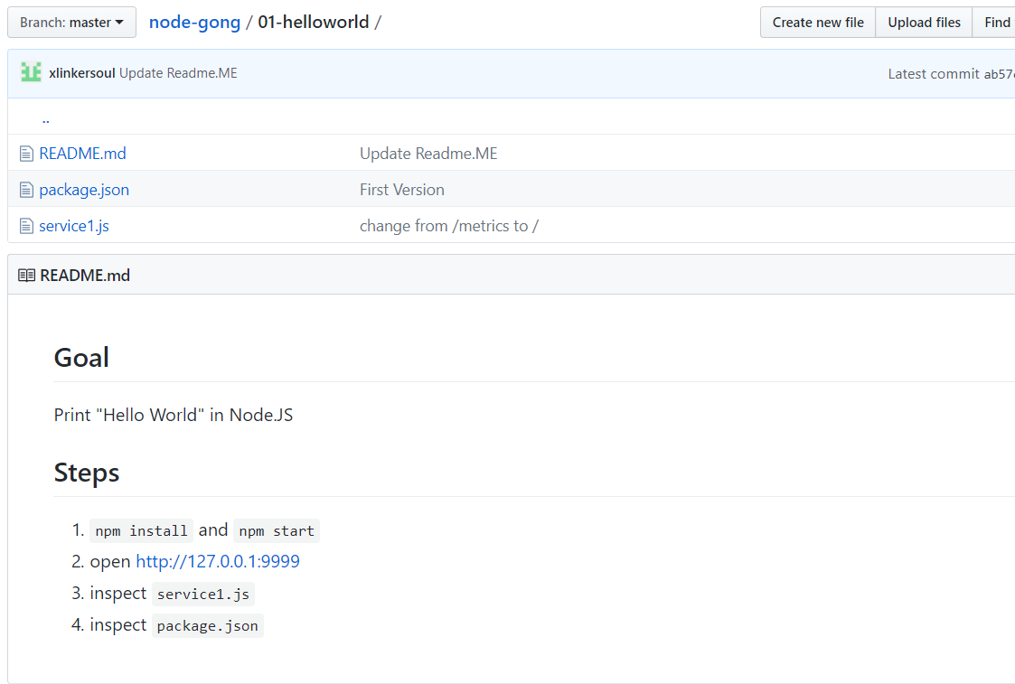
Node.JS – Hello World
https://github.com/xlinkersoul/node-gong/tree/master/01-helloworld

Slide 5
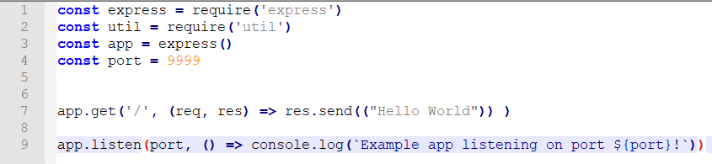
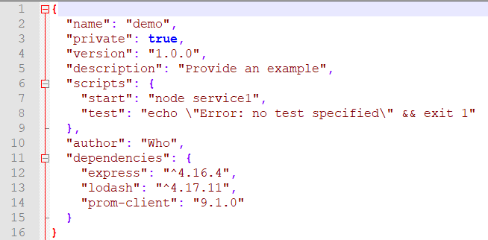
Node.JS – Hello World
Inspect Service1.js
Inspect Package.json

Slide 6
Node.JS – Hello World
Inspect Service1.js
Inspect Package.json

Slide 7
1st Workshop
Node.JS / Hello World from Function

Slide 8
Node.JS – Hello World
User make a Web Request,
http://IP-Address/
/
Request
Response
Call
my_function()
Node.js Response
Hello World

Slide 9
1st Workshop
Node.JS / Prometheus Metrics

Slide 10
Node.JS – Metrics
User make a Web Request,
http://IP-Address/
/
Request
Response
Call
my_function()
Node.js Response
Hello World

Slide 11

Node.JS – Metrics
User make a Web Request,
http://IP-Address/metrics
/metrics
Request
Response
Call
.gen_stat()
Node.js Response Metrics

Slide 12
1st Workshop
Node.JS / Generate Sine Graph

Slide 13
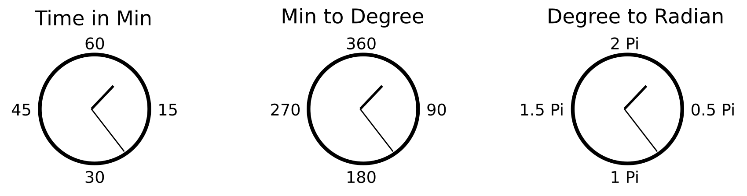
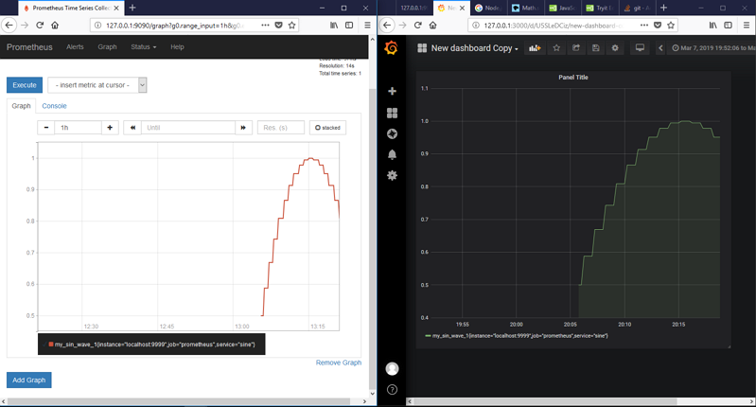
Node.JS – Sine Graph
Multiply by 6
Multiply by 0.017

