Slide 1
Prometheus & Grafana in 1 Hour

Slide 2
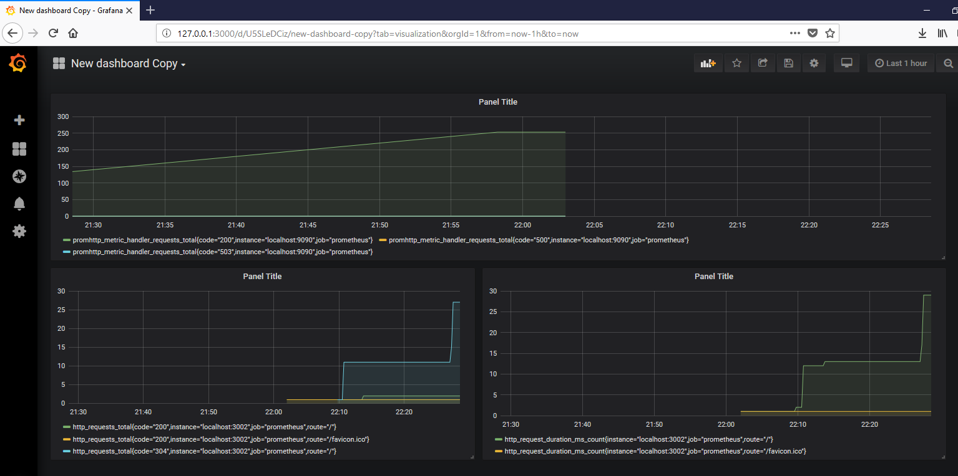
Prometheus & Grafana in 1 Hour

Slide 3
Software Requirement
Download Prometeus https://prometheus.io/download/
Download Grafana https://grafana.com/grafana/download?platform=windows
Git Portable https://git-scm.com/download/win
Download Node.JS https://nodejs.org/en/download/
Set Proxy Node.JS https://superuser.com/questions/347476/how-to-install-npm-behind-authentication-proxy-on-windows

Slide 4
Download Prometheus

Slide 5
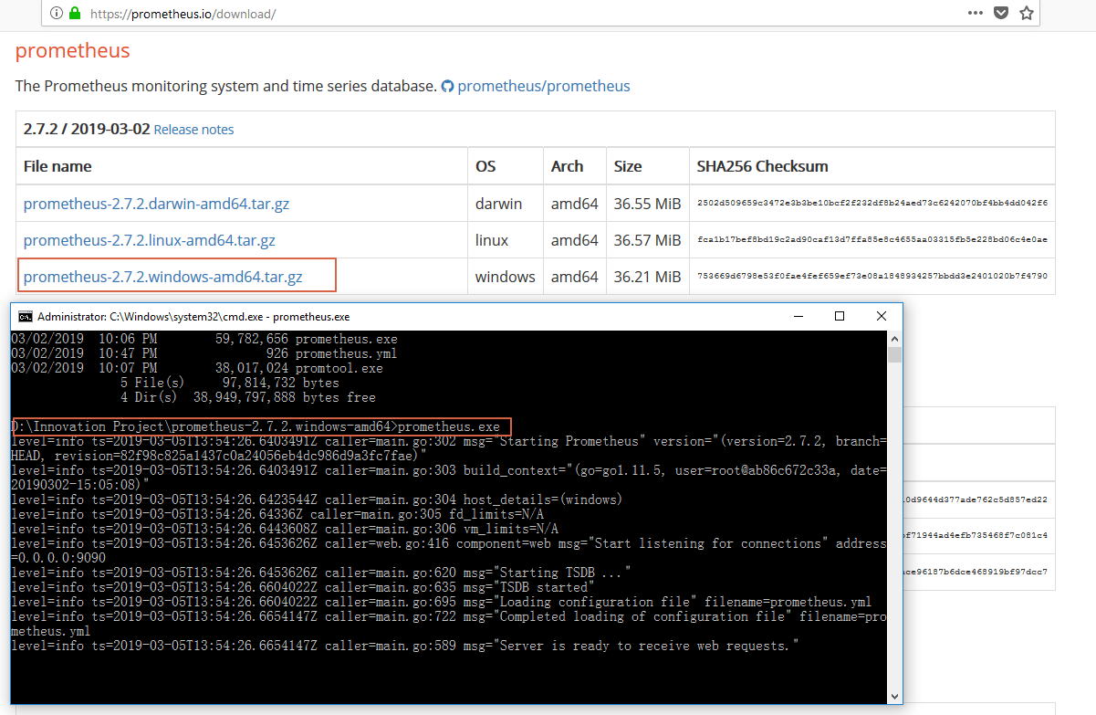

Slide 6
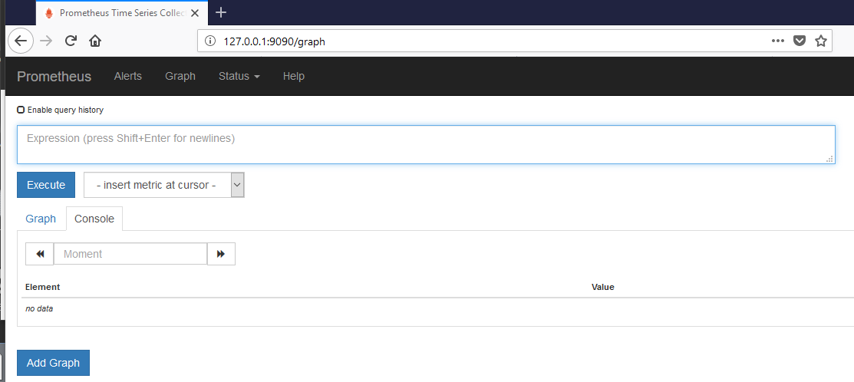

Slide 7
Download Grafana

Slide 8
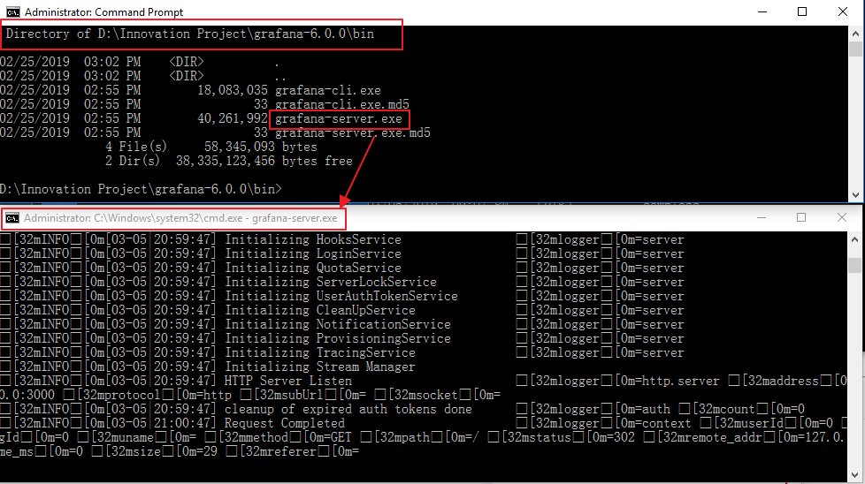

Slide 9
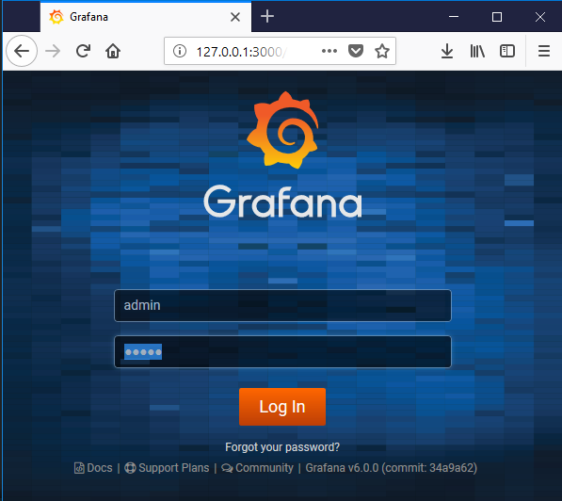

Slide 10
Download Git

Slide 11
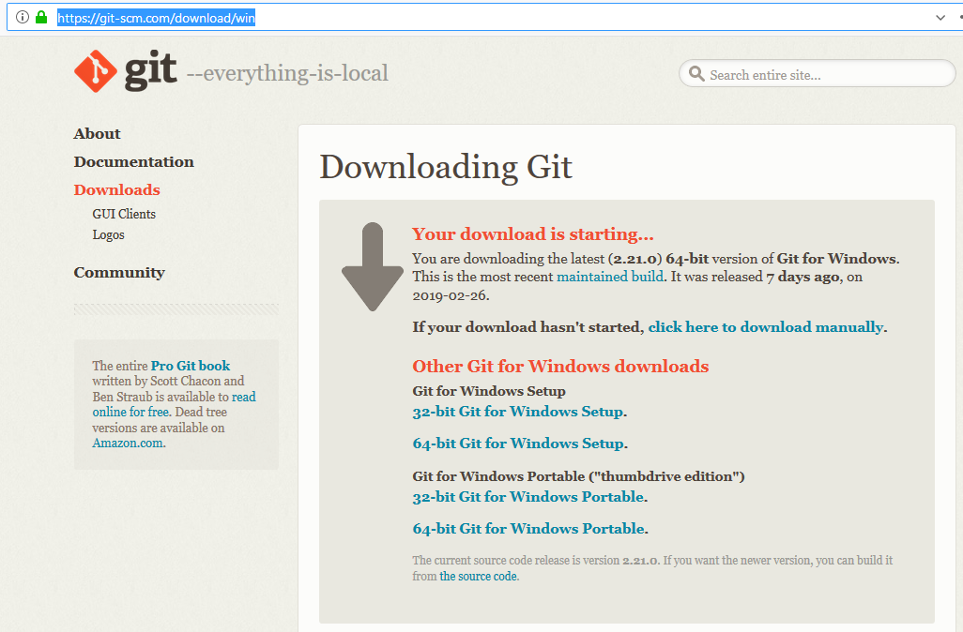

Slide 12
Download Node.JS

Slide 13
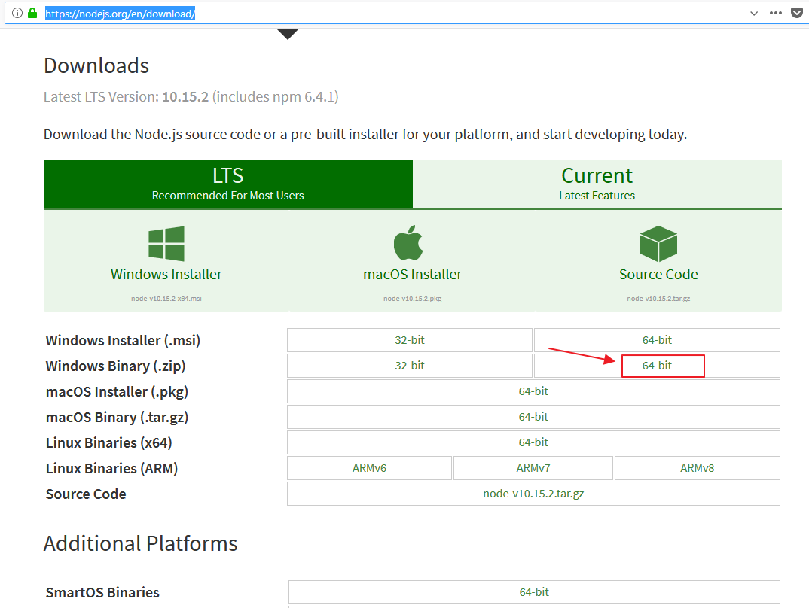

Slide 14
1st Workshop

Slide 15
Clone Source Code from GITHUB
Folder : /UP1/Microservice-workshop

Slide 16
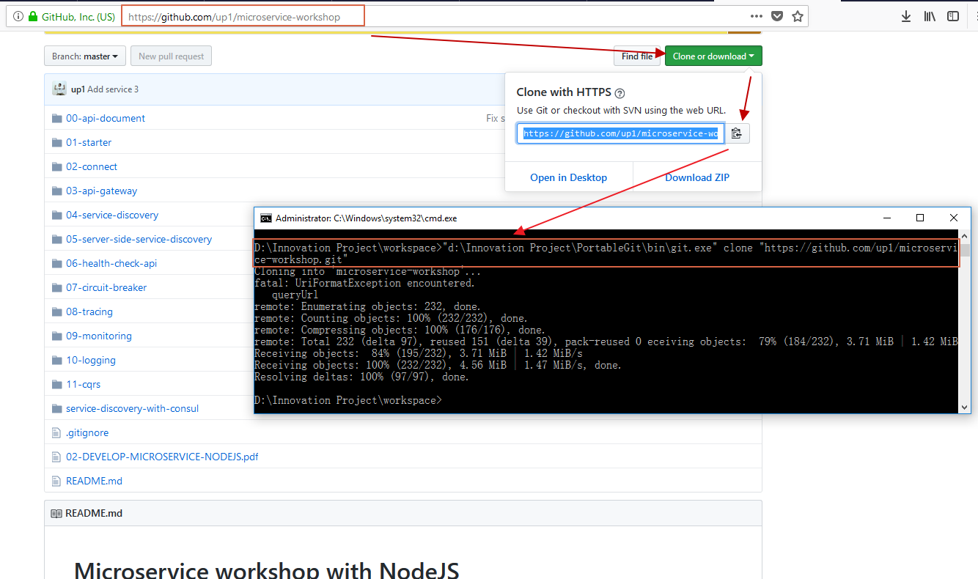

Slide 17
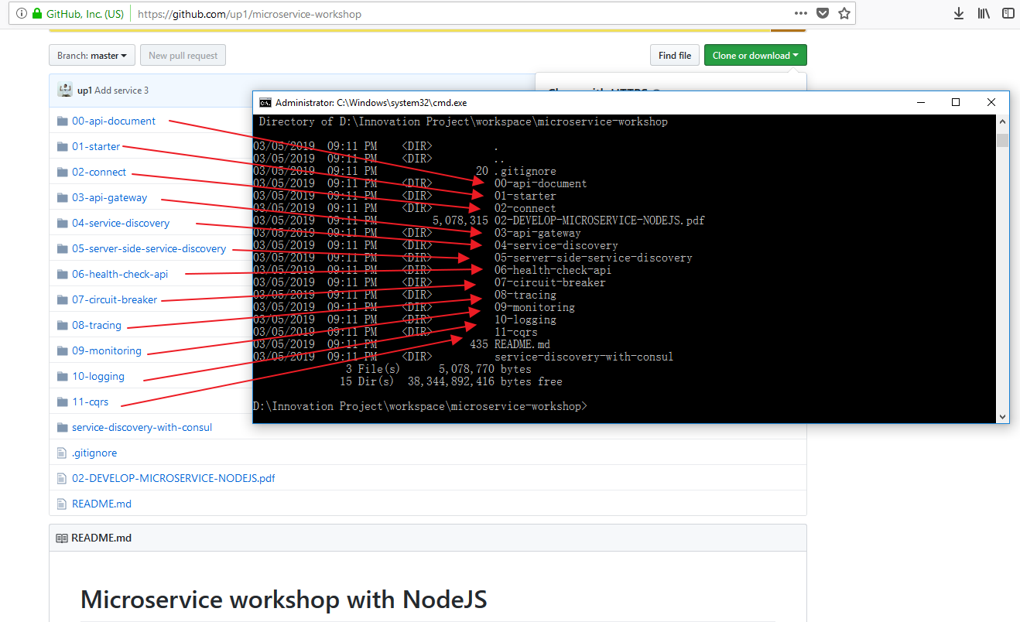

Slide 18
Start Node.JS Scripts using code from GITHUB-UP1
Folder : /UP1/MicroServcice-workshop
SubFolder : 09-monitoring

Slide 19
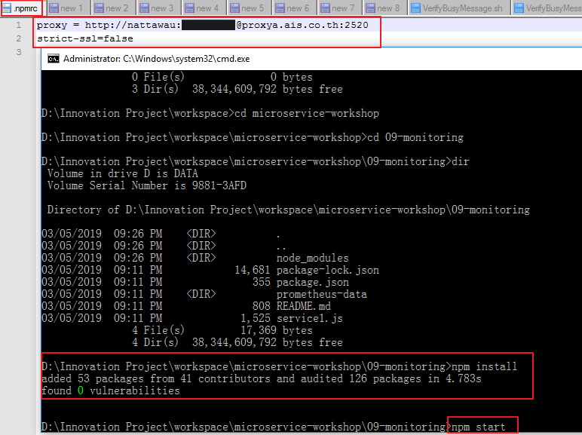

Slide 20
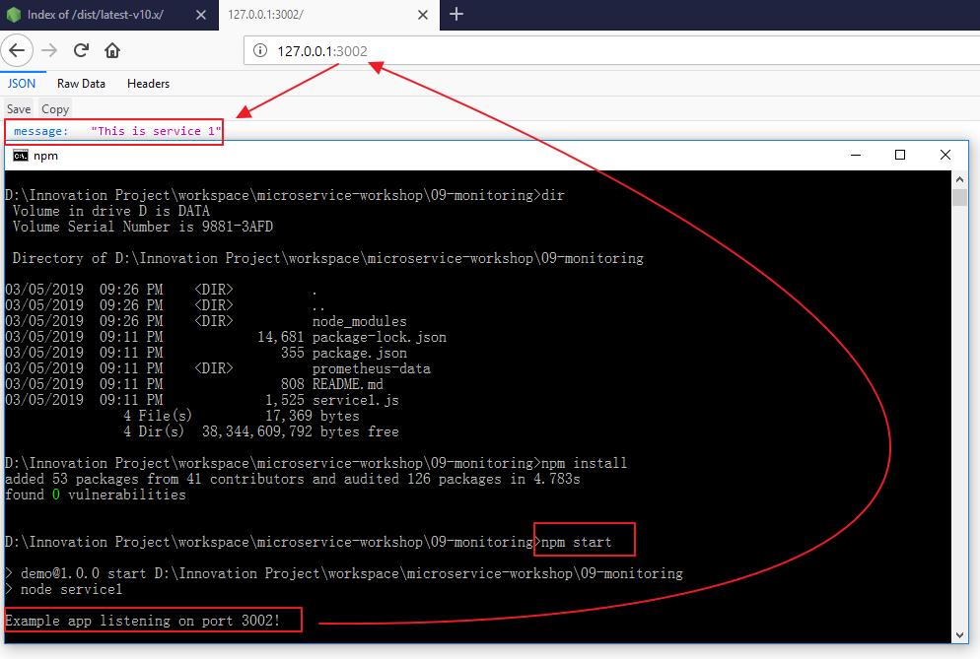

Slide 21
Setup Prometheus

Slide 22
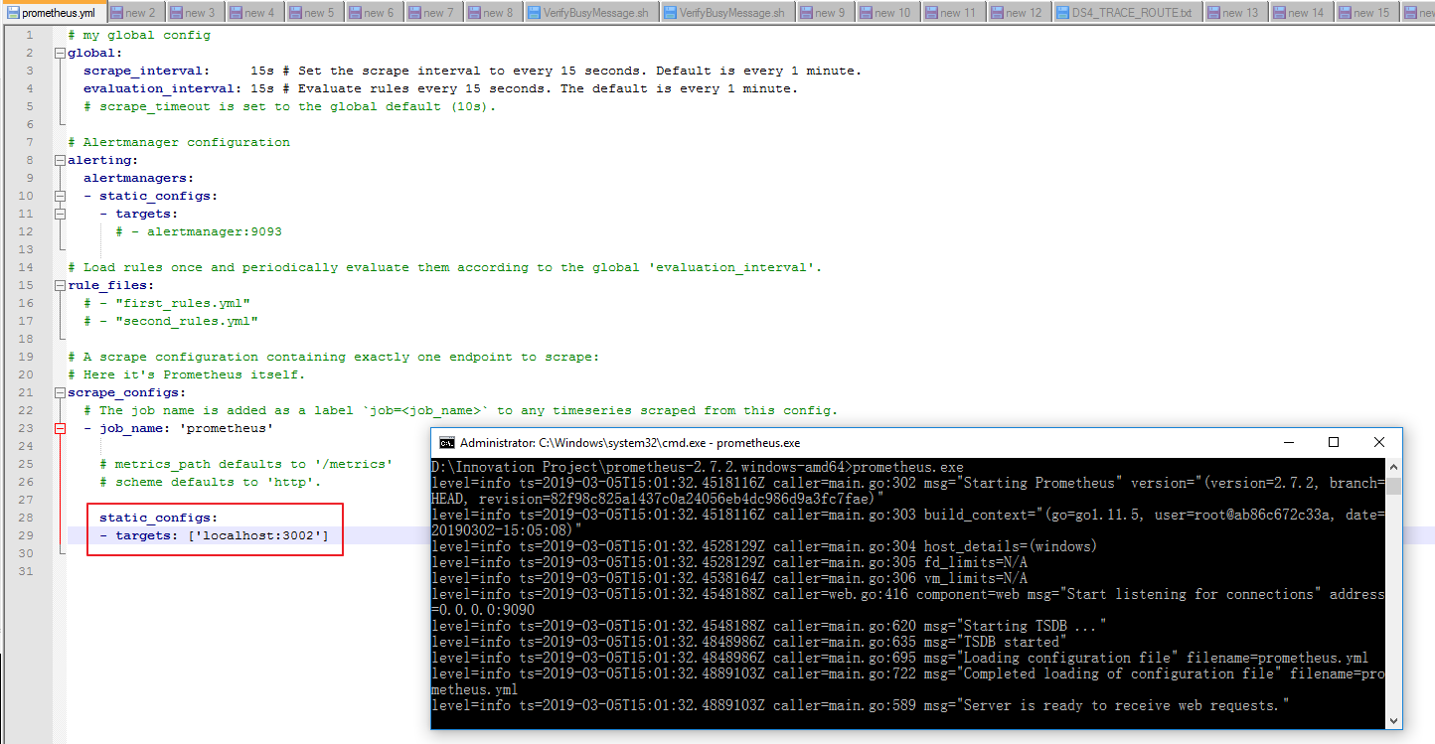

Slide 23
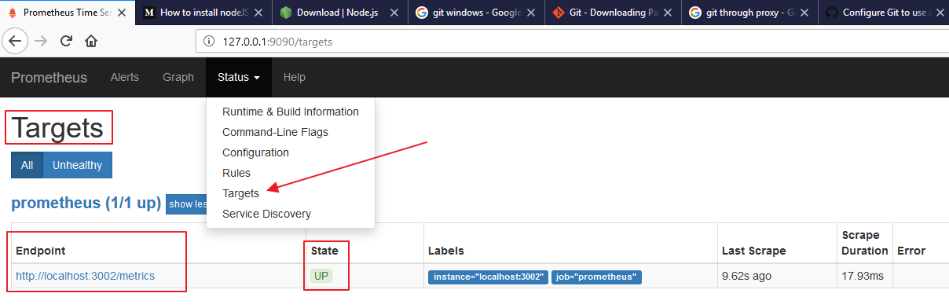

Slide 24
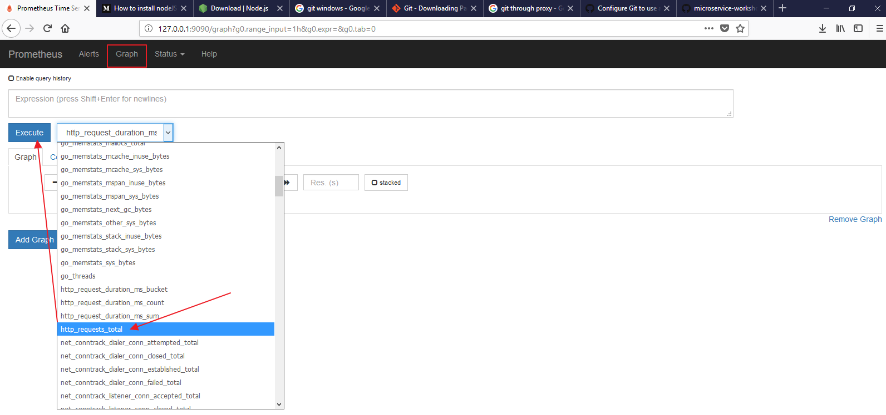

Slide 25
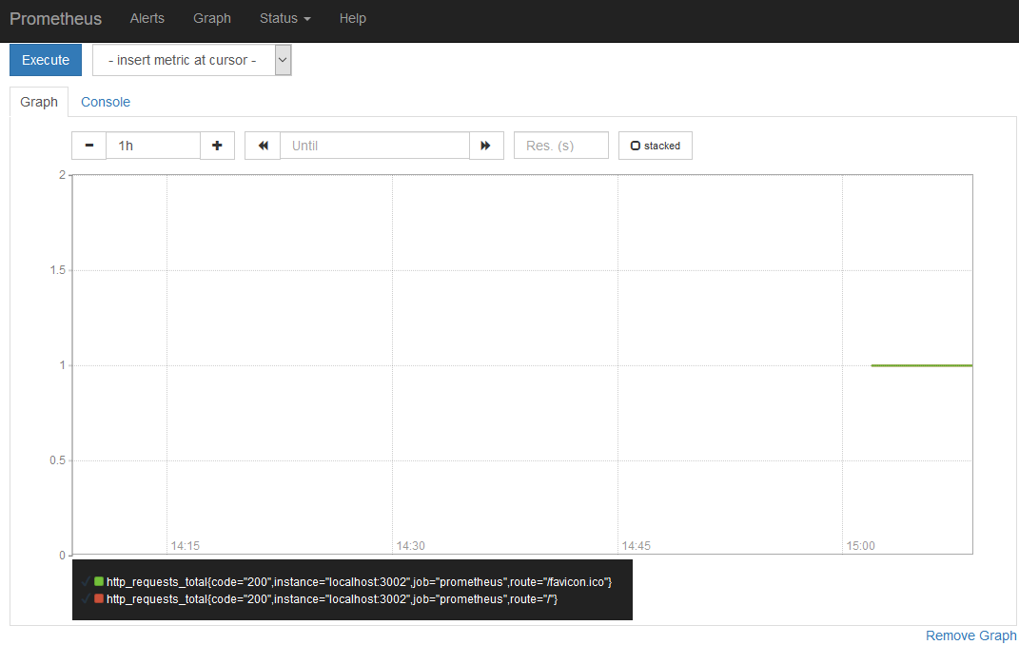

Slide 26
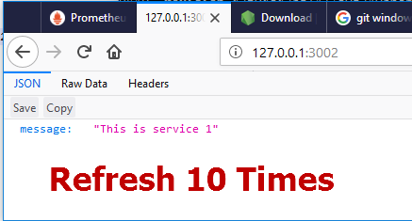

Slide 27
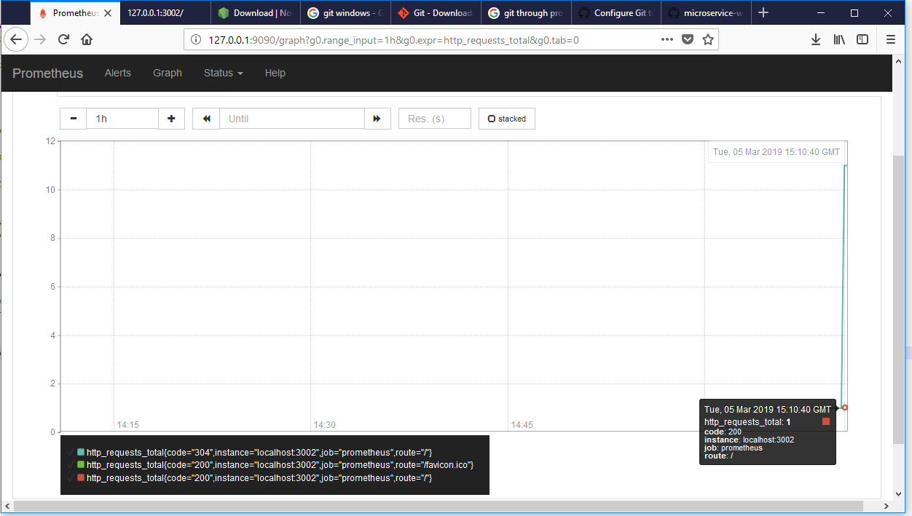

Slide 28
Setup Grafana

Slide 29
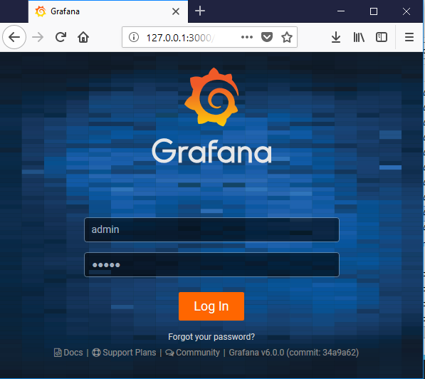

Slide 30
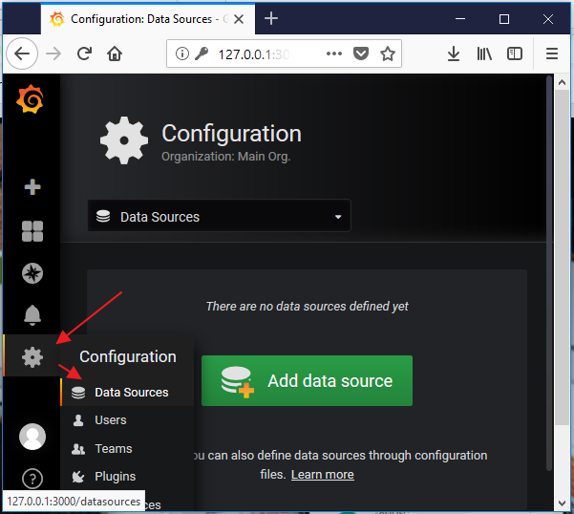

Slide 31
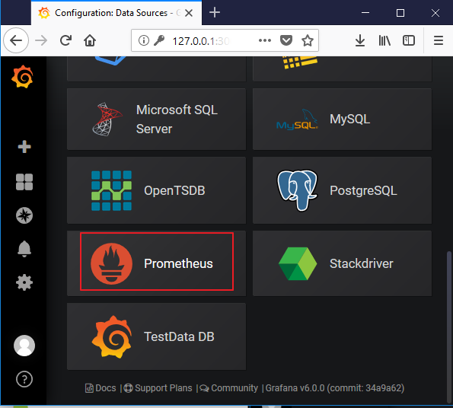

Slide 32
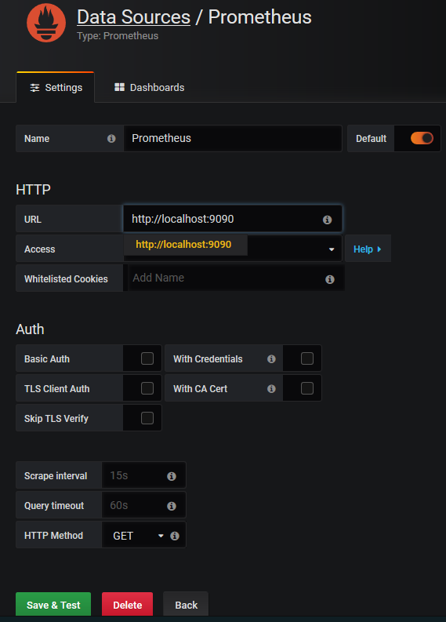
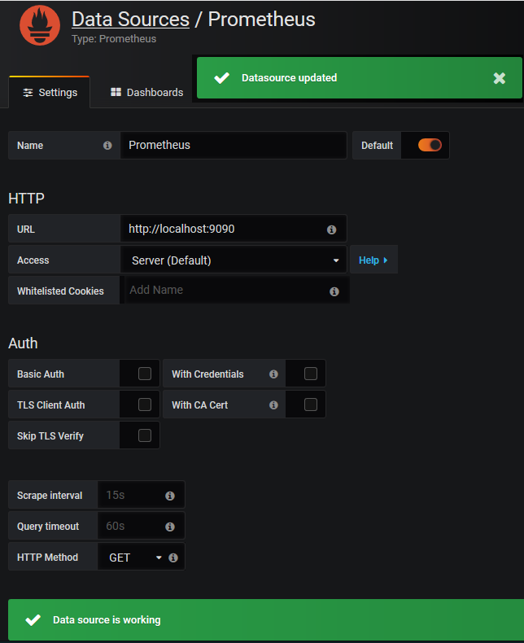

Slide 33
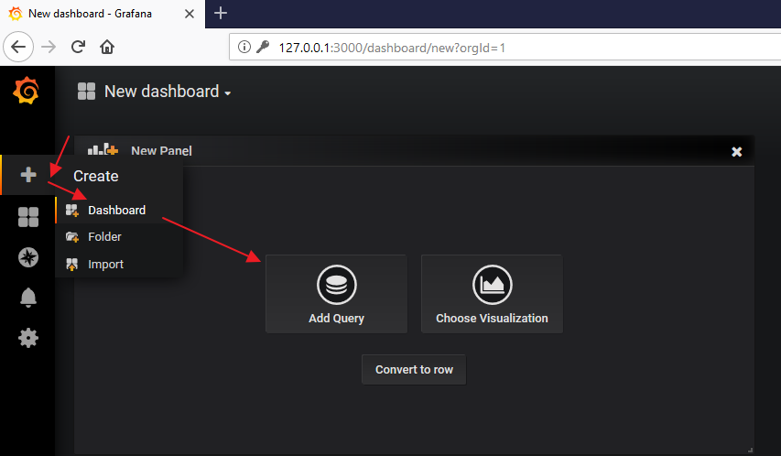

Slide 34
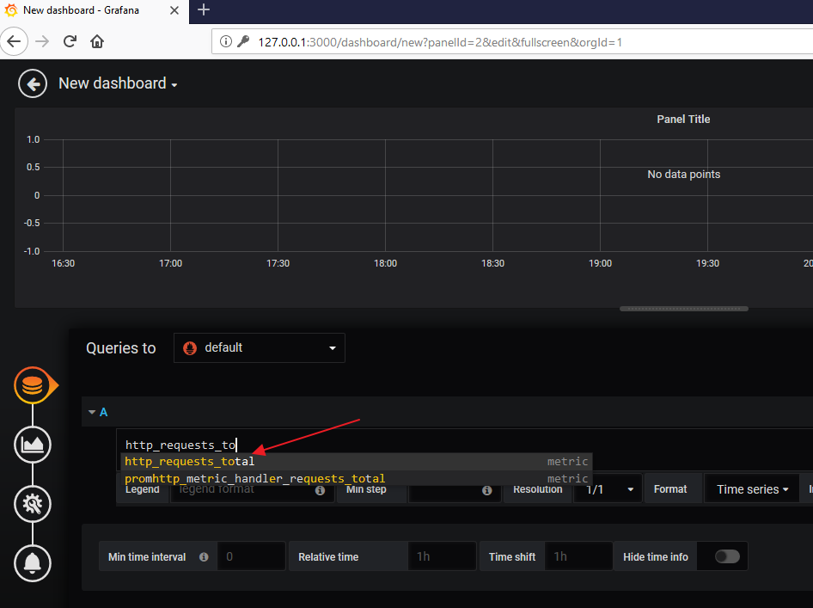

Slide 35
