Slide 1
Spotify:
Music Recommendation System
LIVE PRESENTATION
Ximena Lisouski

Slide 2
GOAL AND SOLUTION DEFINITION
GOAL
SOLUTION
IMPACT
Design a personalized music recommendation system that adapts to different user behavior profiles.
Segment users based on listening patterns and apply tailored recommendation strategies (content-based, collaborative, or hybrid) for each group.
Higher engagement
Better retention
More satisfying music discovery experience
Happy users = more profitable users

Slide 3
SOLUTION APROACH
PERSONALIZED RECOMMENDATION STRATEGIES
BEHAVIOR CLUSTERS
Number of plays
Number of songs
Number of plays per song
Preferences for certain artists or songs
Popularity-Based
Content-Based
User-User Similarity Model
SVF - Matrix Factorization
Clustering-Based Model

Slide 4
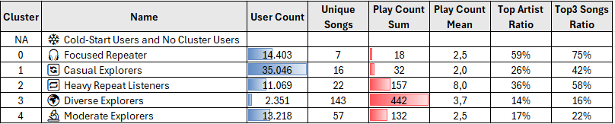
USER BEHAVIOR
76K
Users
26
Songs / User
78
Play Count/ User
3
Play Count/ Song / User
32%
Top Artist Ratio
46%
Top 3 Songs Ratio
User Behavior by Cluster:

Slide 5
RECOMMENDATION STRATEGIES
❄️ Cold-Start Users and No Cluster Users
Popularity Based Recommendation
Cluster
🎧 Focused Repeater
🔄 Casual Explorers
🔁 Heavy Repeat Listeners
🌍 Diverse Explorers
🔬 Moderate Explorers
Content Based Recommendation
Popularity Based Recommendation
Content Based +
Similarity Based
Recommendation (SVD)
Content Based +
Similarity Based
Recommendation
(SVD)
Popularity Based +
Similarity Based
Recommendation
(User - User)

Slide 6
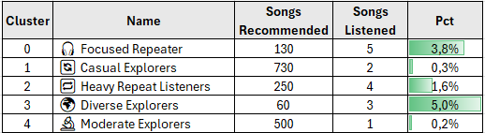

VALIDATION ANALYSIS
🚨
⚠️
🚨
Casual and Moderate Explorers are the two groups with the lowest percentage of recommended songs listened to.
Diverse Explorers and Focused Repeaters are the segments with the highest accuracy in recommendations.

Slide 7
NEXT STEPS
Explore advanced techniques to improve recommendation accuracy.
Incorporate comprehensive user and song data (demographic, behavioral) for personalized recommendations.
Include contextual information (time of day, day of week, user activity) to tailor recommendations.
Propose additional metrics to evaluate recommendation effectiveness.
Conduct A/B testing with control and strategy groups to measure the impact of recommendations on user behavior.

Slide 8
BENEFITS, COSTS AND RISKS
BENEFITS
User Satisfaction.
Loyalty: Stronger engagement with users.
Conversion: Better uptake of new features or content.
COSTS
Computational costs.
Initial Investment: Resources needed for implementation and testing.
RISKS
Behavioral Shifts: Dynamic re-clustering and adaptive models.
Cold-Start Problem: Difficulty in classifying new users.
Model Maintenance.

Slide 9
APPENDIX

Slide 10
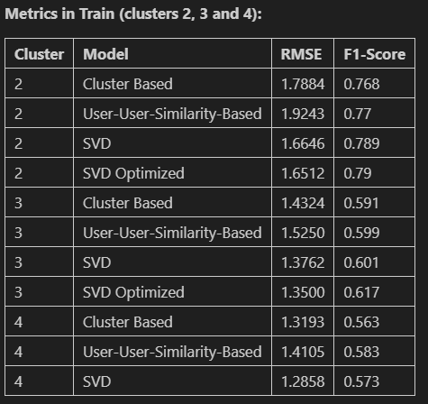
MODEL METRICS COMPARISION

Slide 11
Cluster | Name | Recommendation | Name of Models
NA | ❄️ Cold-start users and No Cluster Users | Popularity-Based Recommendation Systems - General | top_songs_info
0 | 🎧 Focused Repeater | Content-Based Recommendation Systems using top 3 of more listening songs | Function songs_recommendations
1 | 🔄 Casual Explorers | Popularity-Based Recommendation Systems in Cluster 1 with min_interaction = 100 | top_songs_info_c1
2 | 🔁 Heavy Repeat Listeners | SVD + Content-Based Recommendation Systems using top 3 of more listening songs | svd_optimized_c2 + Function songs_recommendations
3 | 🌍 Diverse Explorers | SVD + Content-Based Recommendation Systems using top 3 of more listening songs | svd_optimized_c3 + Function songs_recommendations
4 | 🔬 Moderate Explorers | User-User + Popularity-Based Recommendation Systems in Cluster 4 with min_interaction = 100 | sim_user_user_c4 + top_songs_info_c4
Detail of recommendation system techniques used in each cluster.

