Slide 1



Reciprocal Hash Tables for Nearest Neighbor Search
Xianglong Liu¹, Junfeng He^{2,3}, and Bo Lang¹
¹Beihang University, Beijing, China
²Columbia University, New York, NY, USA
³Facebook, Menlo Park, CA, USA
Notes:
Hi, everyone. Due to some personal affairs the first author cannot attend the conference as planned. I will present the work for him.

Slide 2
Outline
Introduction
Nearest Neighbor Search
Motivation
Reciprocal Hash Tables
Formulation
Solutions
Experiments
Conclusion
Notes:
Here we list the outline of the presentation. First I will introduce the definition of the nearest neighbor search, and give our motivation to build multiple hash tables. Then I will present the details of our proposed reciprocal hash tables. Finally we show the efficiency of the proposed method by experiments.

Slide 3
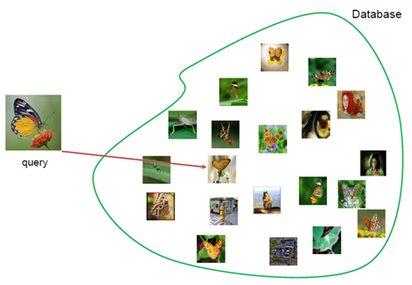
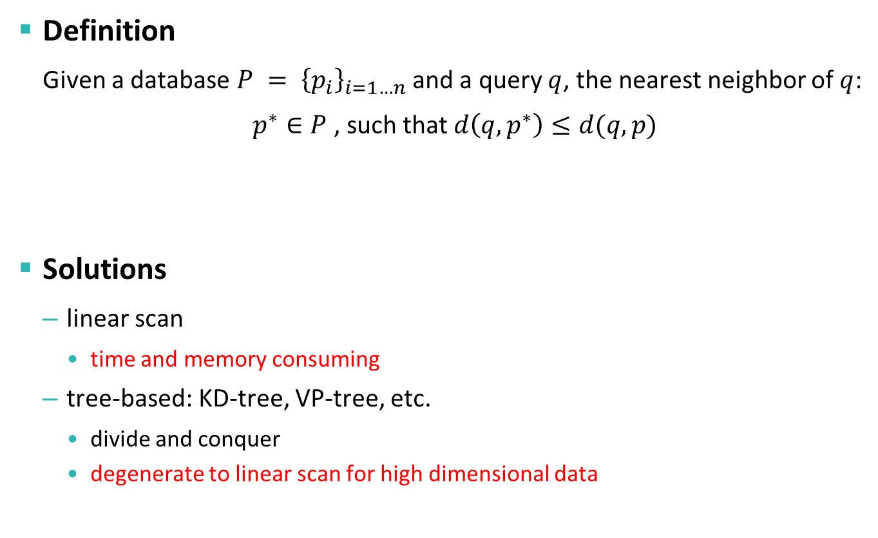
Introduction: Nearest Neighbor Search (1)
Definition
Given a database $P = {\left\{p_{i}\right\}}_{i=1…n}$ and a query $q$, the nearest neighbor of $q$:
$p^{∗}∈P$, such that $d\left(q,p^{∗}\right)≤d(q,p)$
Solutions
linear scan
time and memory consuming
tree-based: KD-tree, VP-tree, etc.
divide and conquer
degenerate to linear scan for high dimensional data
Notes:
What is the nearest neighbour search? It is a key technique that widely used in information retrieval, classification, optimization, and so on. For instance, here we have a large database of images like millions of web images in Internet. From the database, we want find the most similar images to the query image. It can be formulated as a nearest neighbour search problem.
We give the formal definition of nearest neighbours: that given a database P and query q, the nearest neighbour of q is defined as the closest one in P to q. There are various solutions for nearest neighbour search. The naïve solution is to linearly scan the database. But it is usually both time and memory consuming. Tree based methods like k-D tree have been proposed to find the NN efficiently using the technique of divide and conquer. However, when the data dimension goes to hundreds, these methods will degenerate to linear scan and even worse.

Slide 4

Introduction: Nearest Neighbor Search (2)
Hash based nearest neighbor search
Locality sensitive hashing [Indyk and Motwani, 1998]: close points in the original space have similar hash codes
$$h\left(x\right)=sgn(w^{T}x+b)$$
h₂
h₁
X | x₁ | x₂ | x₃ | x₄ | x₅
x₁
h₁ | 0 | 1 | 1 | 0 | 1
x₃
h₂ | 1 | 0 | 1 | 0 | 1
x₄
… | … | … | … | … | …
h_{k} | … | … | … | … | …
x₂
x₅
010…
100…
111…
001…
110…
Notes:
Recently, hash based nearest neighbor search has shown attractive performance. Such methods first learn a bunch of hash functions, each of which can map data points into binary codes as shown in this slide. They follow the concept of locality sensitive hashing, that means, points that are close to each other or nearest neighbors in the original space should have very similar hash codes after mapped by hash functions. With these hash functions, all data points can be encoded by some compact hash codes.

Slide 5















Introduction: Nearest Neighbor Search (3)
Hash based nearest neighbor search
Compressed storage: binary codes
Efficient computations: hash table lookup or Hamming distance ranking based on binary operations
Hashing
Hash Table
Bucket
Indexed Image
w_{k}
0010…
0/-1
1
0110…
…
…
1111…
Notes:
These hash codes can not only compress the storage, but also achieve efficient computation using hash table lookup or hamming distance ranking based on binary operations. Here we illustrate how the hash table is built, where the hash code serves as the bucket key, and points with same hash codes fall into the same bucket.

Slide 6
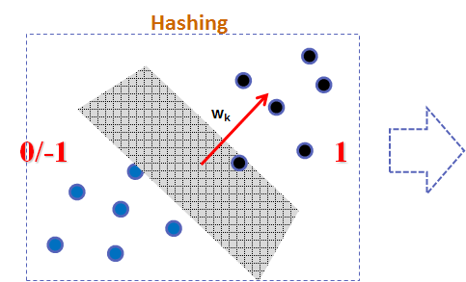
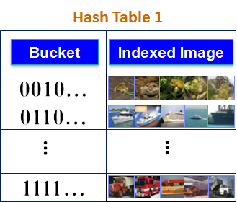
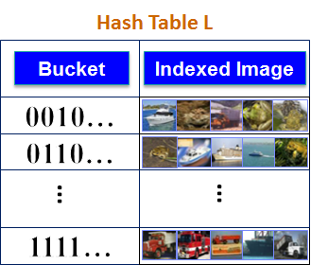
Introduction: Motivation
Problems
build multiple hash tables and probe multiple buckets to improve the search performance [Gionis, Indyk, and Motwani, 1999; Lv et al. 2007]
not much research studies the general strategy for multiple hash table construction
random selection: widely-used general strategy, usually need a large number of hash tables
Motivation
Similar to the well-studied feature selection problem, select the most informative and independent hash functions
support various types of hashing algorithms, different data sets and scenarios, etc.
Search results
Search results
…
Notes:
A piratical approach to further improve the search performance is building multiple hash tables and probe multiple buckets. Usually these tables are constructed by randomly selecting hash functions. However, due to the redundancy between tables, usually lots of tables are required to obtain a satisfying performance. But till now there is not much research studying the general strategy to construct multiple complementary hash tables. Similar to the well-known feature selection, we address the problem by selecting the most informative and independent hash functions, meanwhile considering the relations between tables. The proposed method can support various types of hashing algorithms, different data sets and scenarios.

Slide 7
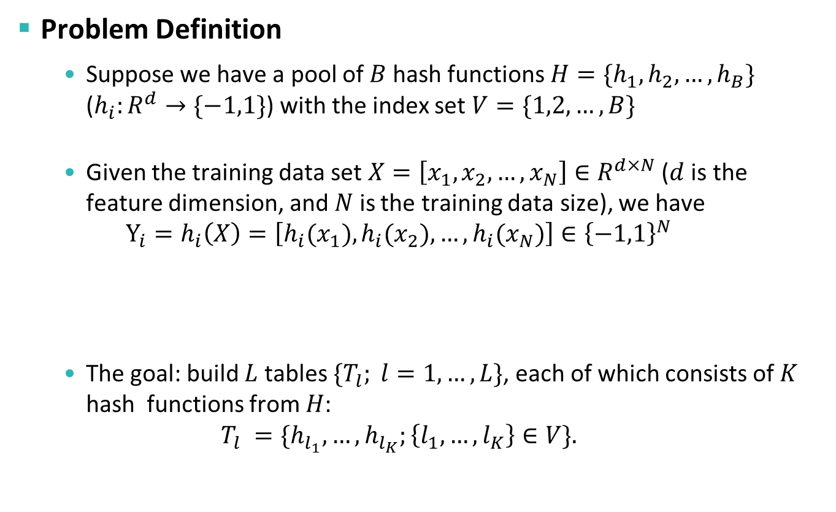

Reciprocal Hash Tables: Formulation (1)
Problem Definition
Suppose we have a pool of $B$ hash functions $H=\{h_{1},h_{2},…,h_{B}\}$ ($h_{i}:R^{d}→\{−1,1\}$) with the index set $V=\{1,2,…,B\}$
Given the training data set $X=\left[x_{1},x_{2},…,x_{N}\right]∈R^{d×N}$ ($d$ is the feature dimension, and $N$ is the training data size), we have
$$Y_{i}=h_{i}\left(X\right)=\left[{h_{i}(x}_{1}),{h_{i}(x}_{2}),…,{h_{i}(x}_{N})\right]∈{\left\{−1,1\right\}}^{N}$$
The goal: build $L$ tables ${\{T}_{l}; l=1,…,L\}$, each of which consists of $K$ hash functions from $H$:
$$T_{l} =\{h_{l_{1}},…,h_{l_{K}};\left\{l_{1},…, l_{K}\right\}∈V\}.$$
$N$ samples of $y_{i}$
Random Binary Vector $y$: $y_{i}=h_{i}()$
Notes:
Next we will give the details of the proposed method for reciprocal hash tables construction. First, we formally define the problem. Suppose we have a pool of hash functions, named hash function set H, whose elements are indexed by 1 to B respectively. Each hash function maps the data point to binary value (-1 or 1).
Given the training set X, their generated hash codes by the i-th hash function are denoted by Y_i, which can be regarded as the samples of the binary variable y_i.
Our goal is to build L complementary tables, each of which contains K hash functions from H

Slide 8
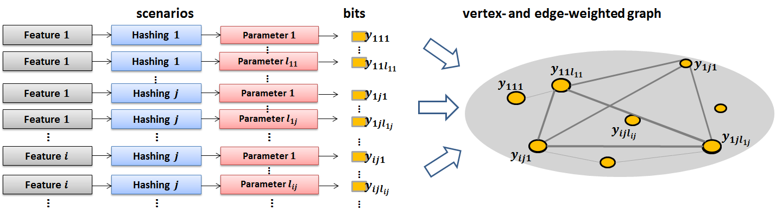
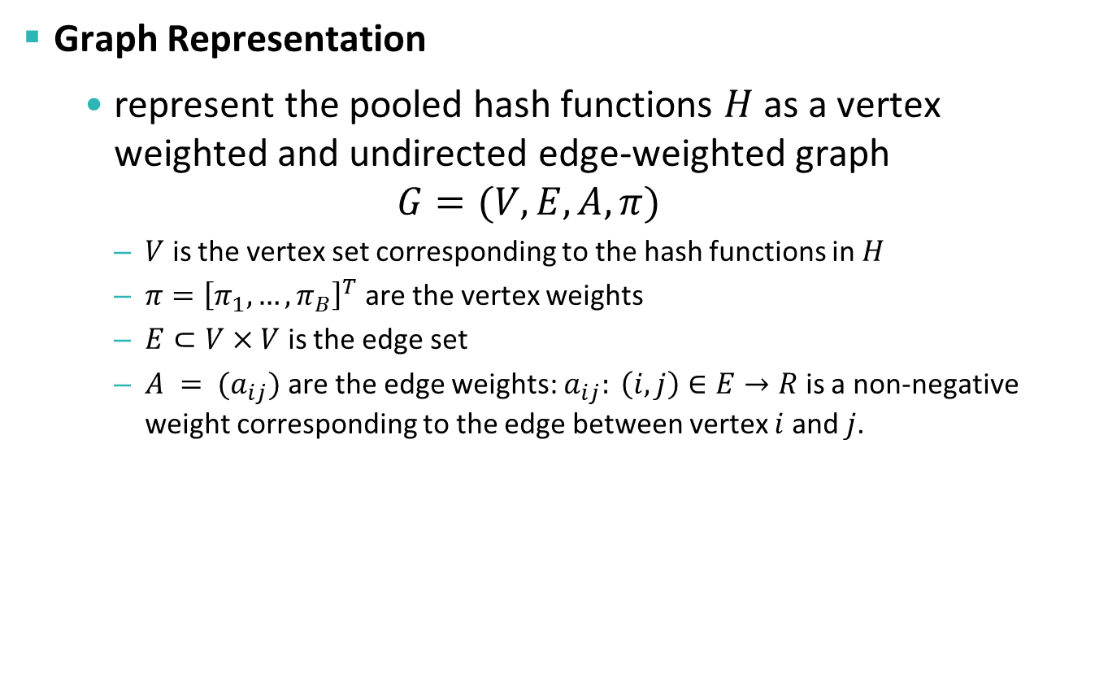
Reciprocal Hash Tables: Formulation (2)
Graph Representation
represent the pooled hash functions $H$ as a vertex weighted and undirected edge-weighted graph
$$G=(V,E,A,π)$$
$V$ is the vertex set corresponding to the hash functions in $H$
$π={\left[π_{1},…,π_{B}\right]}^{T}$ are the vertex weights
$E⊂V×V$ is the edge set
$A = (a_{ij})$ are the edge weights: $a_{ij}: \left(i,j\right)∈E→R$ is a non-negative weight corresponding to the edge between vertex $i$ and $j$.
Notes:
First, we represent all the pooled hash functions as a graph, where each vertex corresponds to a hash function. Both the edge and vertex are associated with certain weights. As the figure below shows, we can generate a number of hash functions using different existing hashing algorithms with different parameter settings or feature types, and then represent them as a vertex and edge weighted graph. Note that here we can tailor these weights according to the application scenarios of hash tables.

Slide 9
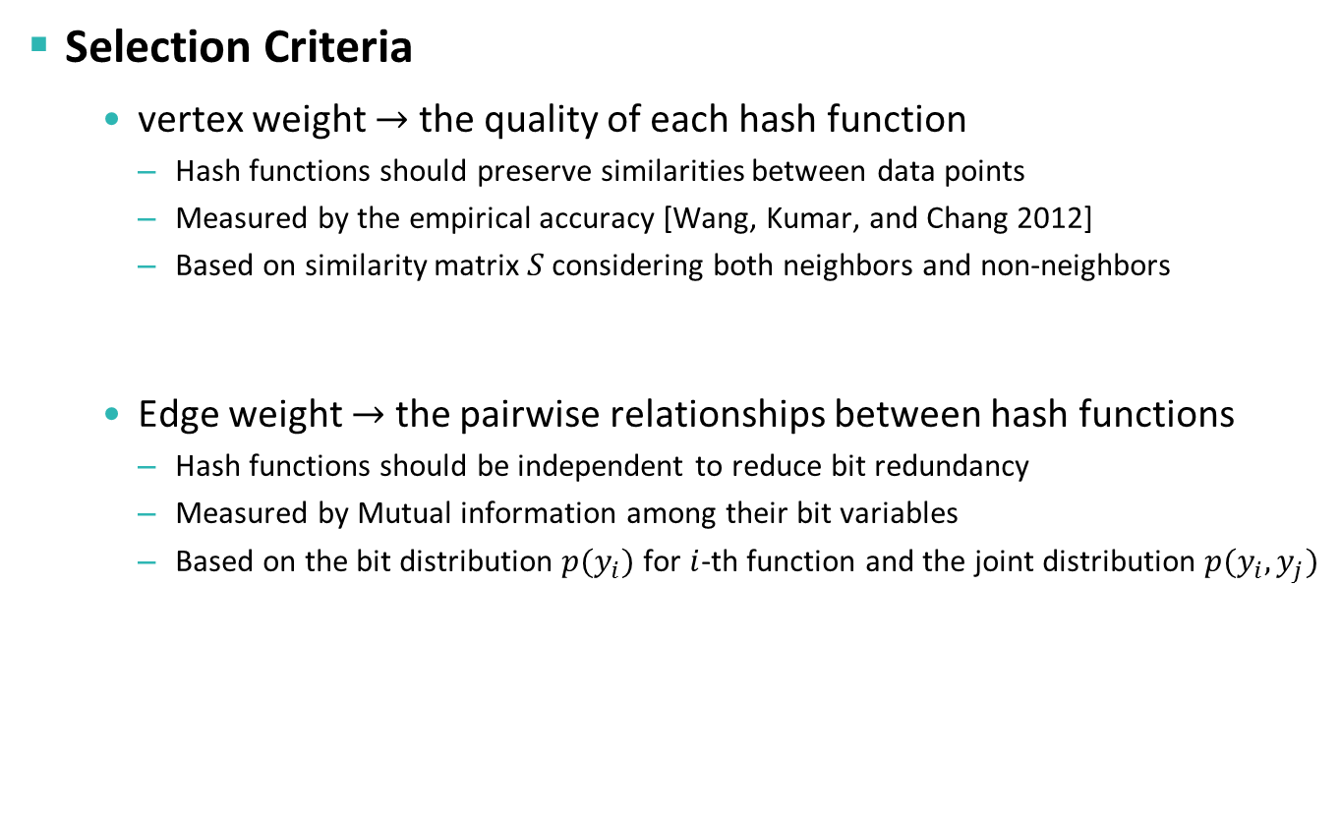
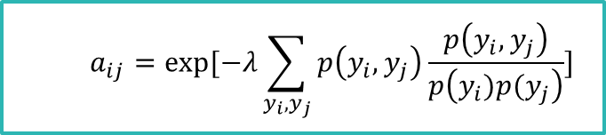

Reciprocal Hash Tables: Formulation (3)
Selection Criteria
vertex weight $→$ the quality of each hash function
Hash functions should preserve similarities between data points
Measured by the empirical accuracy [Wang, Kumar, and Chang 2012]
Based on similarity matrix $S$ considering both neighbors and non-neighbors
Edge weight $→$ the pairwise relationships between hash functions
Hash functions should be independent to reduce bit redundancy
Measured by Mutual information among their bit variables
Based on the bit distribution $p(y_{i})$ for $i$-th function and the joint distribution $p(y_{i},y_{j})$
$$π_{i}=exp⁡(γY_{i}SY_{i}^{T})$$
$$a_{ij}=exp⁡[−λ\sum_{y_{i},y_{j}}{p\left(y_{i},y_{j}\right)}\frac{p\left(y_{i},y_{j}\right)}{p\left(y_{i})p(y_{j}\right)}]$$
Notes:
Now we discuss how to set the weights by introducing two important criteria for hash function selection. The first one is the quality of each hash function which can serve as the vertex weight. Since hash functions should preserve similarities between data, we use the empirical accuracy proposed in Wang’s work to define the measure of the quality. The higher the accuracy is, the higher the vertex weight will be.
Another important criteria is the independence among hash functions, which can help to avoid the redundancy among functions and tables. We choose the mutual information between any two functions to approximately model the relations among functions. As the formula shows, the more impendent the two hash functions, the higher their edge weight will be.

Slide 10
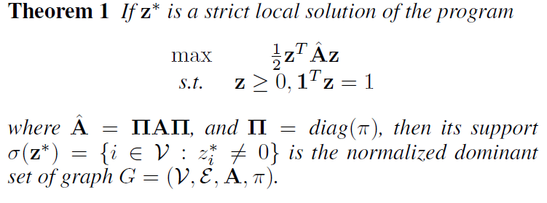
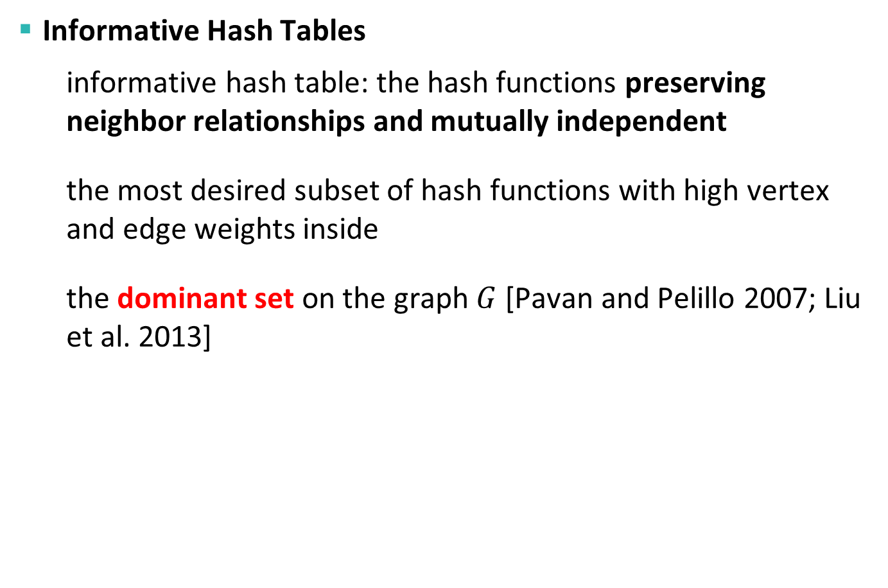
Reciprocal Hash Tables: Solutions (1)
Informative Hash Tables
informative hash table: the hash functions preserving neighbor relationships and mutually independent
the most desired subset of hash functions with high vertex and edge weights inside
the dominant set on the graph $G$ [Pavan and Pelillo 2007; Liu et al. 2013]
Notes:
Based on the graph representation, the most informative and independent hash functions turn to be the most dense subgraph with high vertex and edge weights inside. According to previous research, the discovery of such sugraph is equivalent to the dominant set problem on the graph G, which can be solved efficiently by the quadratic programming as shown in the theorem.

Slide 11
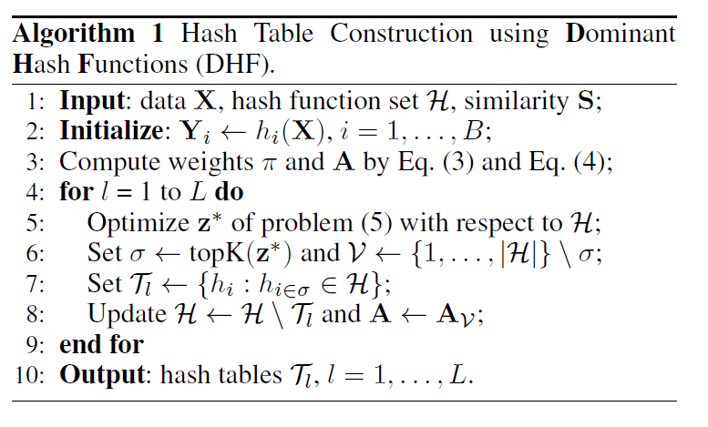
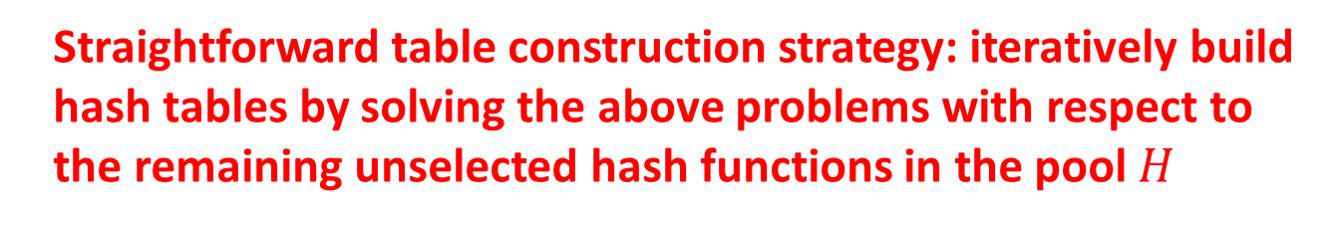
Reciprocal Hash Tables: Solutions (2)
Straightforward table construction strategy: iteratively build hash tables by solving the above problems with respect to the remaining unselected hash functions in the pool $H$
Notes:
Based on the dominant set technique, we give a straightforward method named DHF for short to construct multiple hash tables. The basic solution is to iteratively build hash tables by solving the above problems with respect to the remaining unselected hash functions in the pool $H$

Slide 12
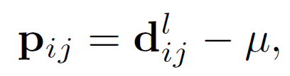
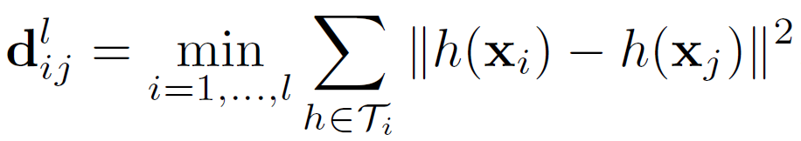

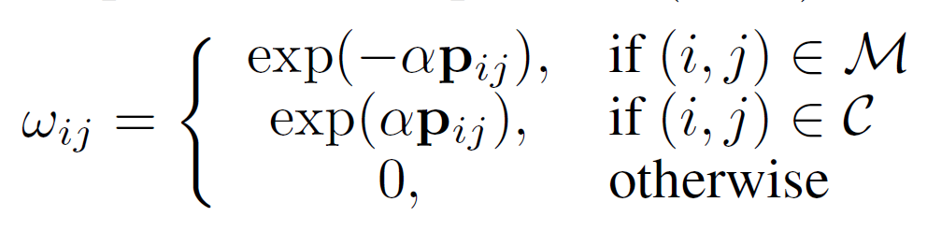
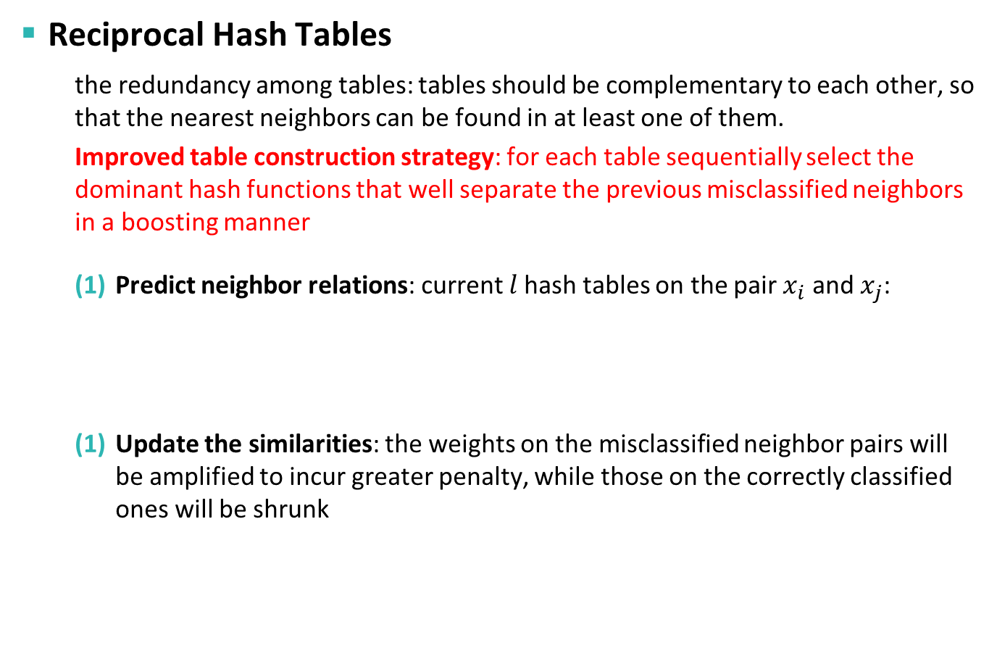
Reciprocal Hash Tables: Solutions (3)
Reciprocal Hash Tables
the redundancy among tables: tables should be complementary to each other, so that the nearest neighbors can be found in at least one of them.
Improved table construction strategy: for each table sequentially select the dominant hash functions that well separate the previous misclassified neighbors in a boosting manner
Predict neighbor relations: current $l$hash tables on the pair $x_{i}$ and $x_{j}$:
Update the similarities: the weights on the misclassified neighbor pairs will be amplified to incur greater penalty, while those on the correctly classified ones will be shrunk
Notes:
Although the above solution can build individually informative hash tables, but it ignores the redundancy among tables. In practice, tables should be complementary to each other, so that the nearest neighbors can be found in at least one of them. We give an improved table construction strategy. For each table sequentially we select the dominant hash functions that well separate the previous misclassified neighbors in a boosting manner. There are mainly two steps in each round: first we predict the neighbor relations according to the Hamming distances using the currently built hash tables, and then we update the similarity matrix by amplifying the weights on the misclassified neighbor pairs and shrinking those on the correctly classified ones.

Slide 13



Sequential Strategy: Boosting
Boosting style: try to correct the previous mistakes by updating weights on neighbor pairs in each round
> 0
< 0
= 0
similarities
prediction error
updated similarities
x₁
x₂
x₃
x₄
x₅
x₆
x₇
…
x₁
x₂
x₃
x₄
x₅
x₆
x₇
…
x₁
x₂
x₃
x₄
x₅
x₆
x₇
…
…
…
…
x_{l1}
x_{l1}
x_{l1}
x_{l2}
x_{l2}
x_{l2}
x_{l3}
x_{l3}
x_{l3}
…
…
…
$$S$$
$${S◦p}_{ij}^{l}$$
$$S◦ω$$
Notes:
Here we give an illustration of the similarity updating. The blue blocks indicate neighbors, and yellow ones indicate nonneighbors. By such updating strategy, the new constructed hash tables can complementary to the previous ones.

Slide 14
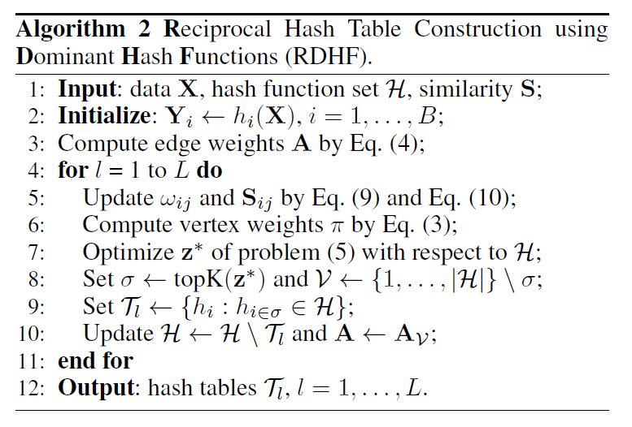
Reciprocal Hash Tables: Solutions (4)
Notes:
The whole algorithm for the reciprocal hash table construction is listed here. We name it RDHF for short.

Slide 15
Experiments
Datasets
SIFT-1M: 1 Million 128-D SIFT
GIST-1M: 1 Million 960-D GIST
Baselines:
Random selection
Setting:
10,000 training samples and 1,000 queries on each set
100 neighbors and 200 non-neighbors for each training sample
The groundtruth for each query is defined as the top 5‰ nearest neighbors based on Euclidean distances
Average performance of 10 independent runs
Notes:
Now we talk about the experiments. We adopted two popular large scale dataset for nearest neighbor search: SIFT-1M and GIST-1M, containing 1 million SIFT and GIST features respectively. We used the widely-used and generic construction method named random selection as the baseline.
In all experiments, we randomly sampled 10,000 and 1,000 points as the training set and testing set on each data set. For each training sample we computed its 100 nearest neighbors and 200 nearest non-neighbors, where the 5‰ nearest neighbors based on Euclidean distances are regarded as the nearest neighbor groundtruth. We reported the averaged performance of 10 independent runs to suppress the randomness

Slide 16
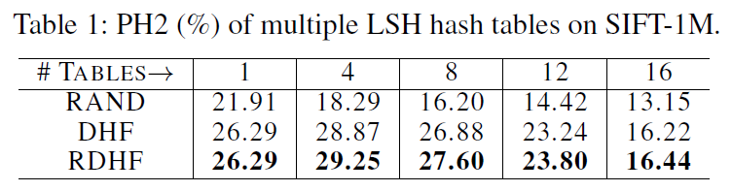
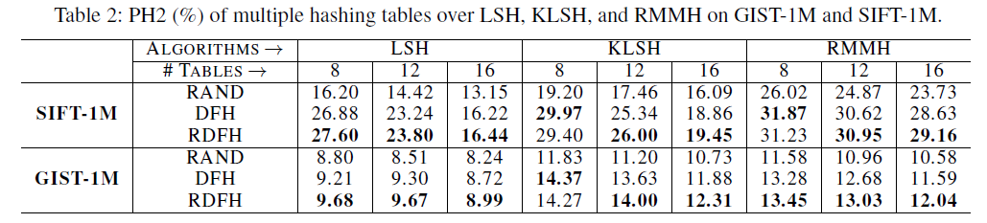
Experiments: Over Basic Hashing Algorithms (1)
Hash Lookup Evaluation
the precision of RAND deceases dramatically with more hash tables, while (R)DHF increase their performance first and attain significant performance gains over RAND
both methods faithfully improve the performance over RAND in terms of hash lookup.
Notes:
First, we evaluated the performance of the proposed method under the scenario that the hash functions are generated by a single basic hashing algorithm.
Multiple hash tables using random selection can retrieve more desired points, however usually it sharply reduces the search accuracy due to a large portion of irrelevant points contained in them. Table 1 show the precision using 1 to 16 LSH tables, where although the recall performance of random method increases from 7.03% to 31.94%, but the precision decreases from 21.91% to 16.20%. But using our reciprocal way, the performance degeneration is relieved significantly.
In addition to LSH, we also investigated the hash table lookup performance over other basic hashing algorithms including Kernelized LSH and Random Maximum Margin Hashing in Table 2. Table 2 shows their PH2 performance using 8, 12, and 16
hash tables on SIFT-1M and GIST-1M. In all cases the proposed methods faithfully improve the performance over RAND.

Slide 17
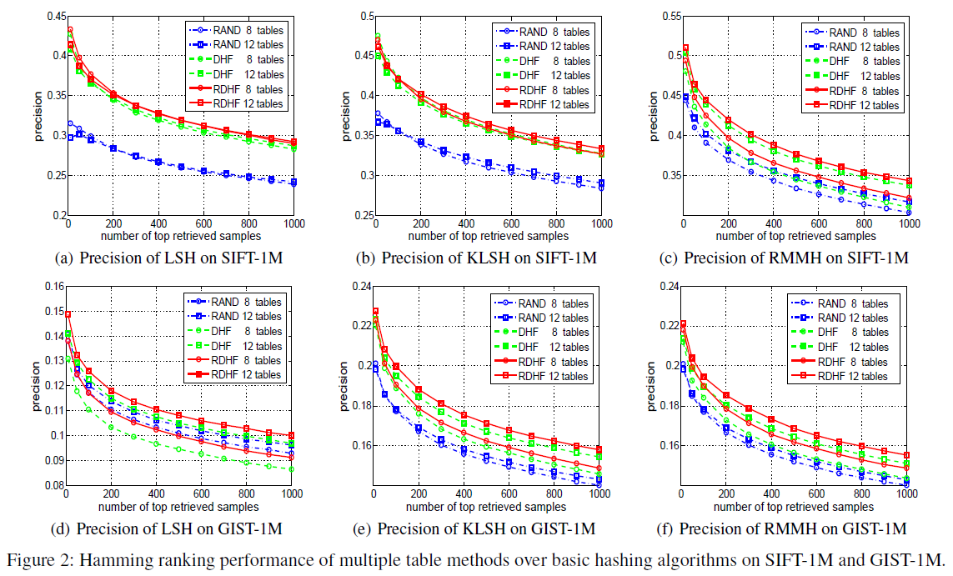
Experiments: Over Basic Hashing Algorithms (2)
Hamming Ranking Evaluation
DHF and RDHF consistently achieve the best performance over LSH, KLSH and RMMH in most cases
RDHF gains significant performance improvements over DHF
Notes:
We also studied the Hamming ranking performance of all three construction methods.
From the figure, it can be easily observed that DHF and RDHF, considering similarity preservation and mutual independence of hash functions, consistently achieve the best performance over LSH, KLSH and RMMH in most cases. For instance, on SIFT-1M, DFH using 12 tables respectively gets 18.73%, 11.86%, and 7.58% precision gains over RAND.
Moreover, RDHF gains significant performance improvements over DHF by exploiting the mutual benefits between tables

Slide 18
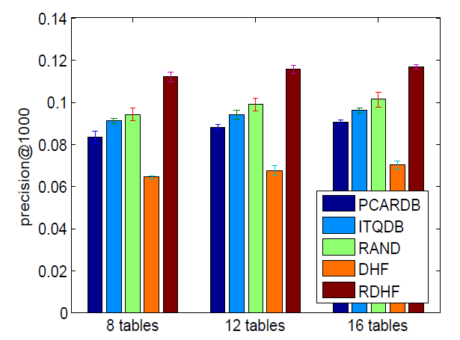
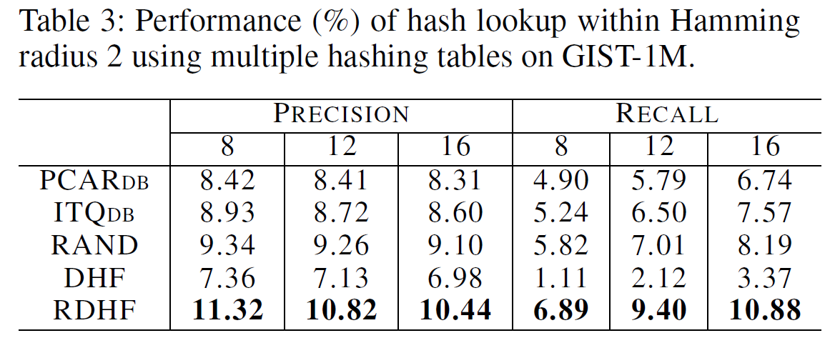
Experiments: Over Multiple Hashing Algorithms
build multiple hash tables using different hashing algorithms with different settings, because many hashing algorithms are prevented from being directly used to construct multiple tables, due to the upper limit of the hash function number
double bit (DB) quantization [Liu et al. 2011] on PCA-based Random Rotation Hashing (PCARDB) and Iterative Quantization (ITQDB) [Gong and Lazebnik 2011].
Notes:
In practice, many hashing algorithms can only generate a limited number of hash functions, which is not enough for tens of hash tables. The problem can be addressed using the table construction over multiple double-bit hashing algorithms, which generate multiple hash functions along a single projection. But the function quality varies in a wide range.
Here on the GIST-1M experiments, we show that our method in this scenario can efficiently pick the high quality hash functions to construct reciprocal hash tables. For both hash table lookup and Hamming ranking, we obtain the same conclusion that RDFH significantly outperforms others using a varying number of hash tables

Slide 19
Conclusion
Summary and contributions
a unified strategy for hash table construction supporting different hashing algorithms and various scenarios.
two important selection criteria for hashing performance
formalize it as the dominant set problem in a vertex- and edge-weighted graph representing all pooled hash functions
a reciprocal strategy based on boosting to reduce the redundancy between hash tables
Notes:
Finally, we summarize the contributions of the paper:
We proposed a unified strategy for hash table construction supporting different hashing algorithms and various scenarios.
We gave two important selection criteria for hashing performance
We formalized the problem as the dominant set problem in a vertex- and edge-weighted graph representing all pooled hash functions
We proposed a reciprocal strategy based on boosting to reduce the redundancy between hash tables

Slide 20


Thank you!
Notes:
Thanks for your attention.

