Slide 1
CH10 Control Hardware Driver

Slide 2

Application and Hardware
Application
Library
C library
System Call
User Space
Device Driver
Linux kernel
Kernel Space
Hard ware

Slide 3
User Space and Kernel Space
Test Application
User Space
Device Node
Kernel Space
Linux Char Driver
Hardware
Device

Slide 4
SysFS
Allows kernel code to export information to user processes
SysFS is an in-memory file system
It provides two components
  A kernel programming interface for exporting these items via sysfs
  User interface to view and manipulate these items that maps back to the kernel objects which they represent

Slide 5

LED and SysFS
User-space
SysFS
Kernel-space
LED Driver
Trigger driver
led-class.c
led-triggers.c
switch
led-core.c
leds-gpio.c
led driver
Hardware
LED

Slide 6
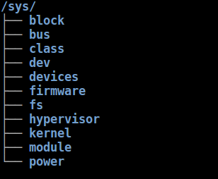
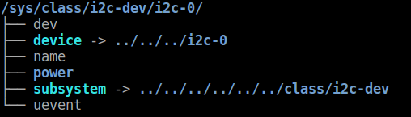
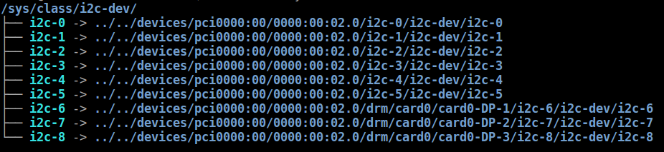
Sys File System
# tree -L 1 /sys/
# tree -L 1 /sys/class/i2c-dev/i2c-0/
# tree -L 1 /sys/class/i2c-dev

Slide 7
LED Drivers

Slide 8
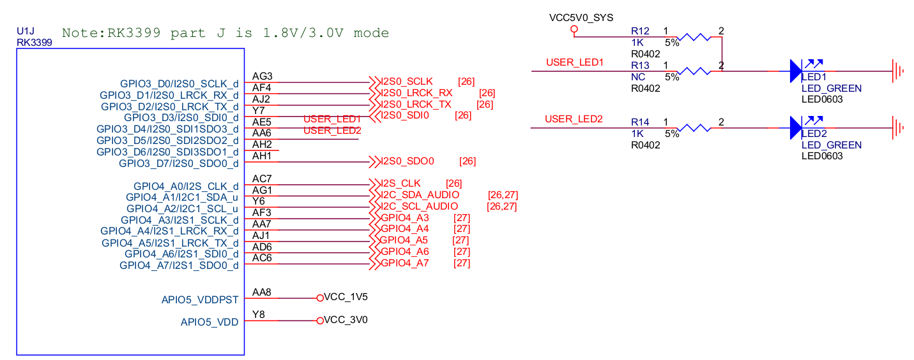
LED Schematic
GPIO3_D4/I2S0_SDI1SDO3_d → LED1
GPIO3_D5/I2S0_SDI2SDO2_d → LED2

Slide 9
LED Subsystem
Control LED convenient with SysFS
  For example
    echo 1 > /sys/class/leds/user-led2/shot
Switch different LED trigger type in SysFS
  For example
    echo "gpio" > /sys/class/leds/user-led2/trigger
    echo "1" > /sys/class/leds/user-led2/brightness
    echo "0" > /sys/class/leds/user-led2/brightness

Slide 10
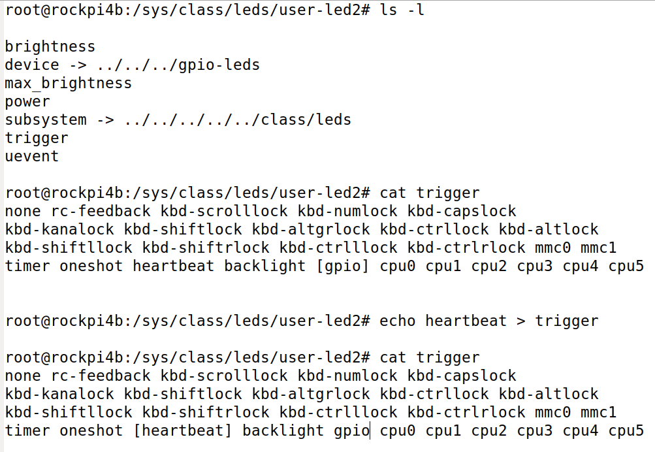
LED SysFS
Check trigger type
Switch trigger type

Slide 11
GPIO Control

Slide 12
Driver LED in User Space
Paths in Sysfs
/sys/class/gpio:
  Control interfaces used to get userspace control over GPIOs;
  GPIOs themselves
  GPIO controllers("gpio_chip" instances)
/sys/class/gpio/
  "export" : ask the kernel to export GPIO to userspace by writing
    "echo 19 > export"
    create a "gpio19" node in /sys/class/gpio
  "unexport" : Reverses the effect of exporting to userspace
    "echo 19 > unexport"
    remove "gpio19" node from /sys/class/gpio

Slide 13
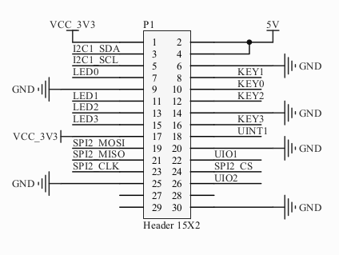
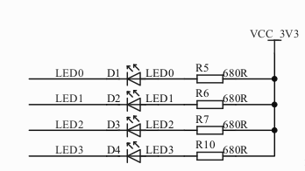
Cadtc Ext Board LED

Slide 14
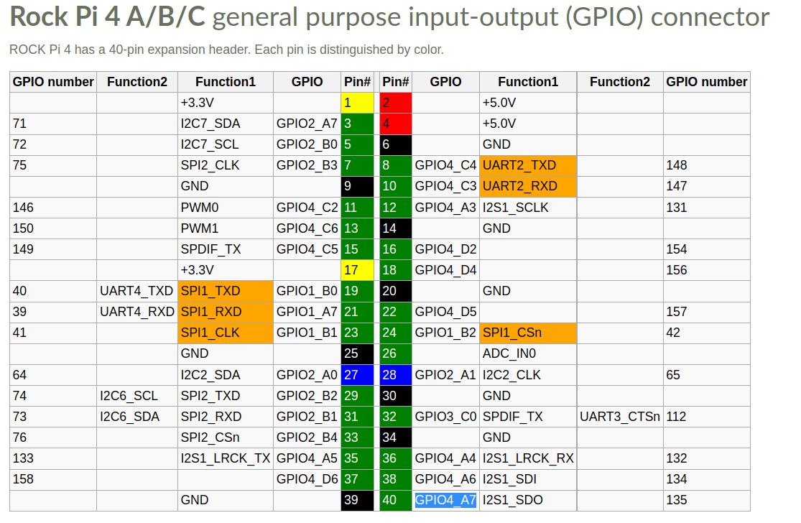
RockPi4B HEAD

Slide 15
PWM Sub System

Slide 16
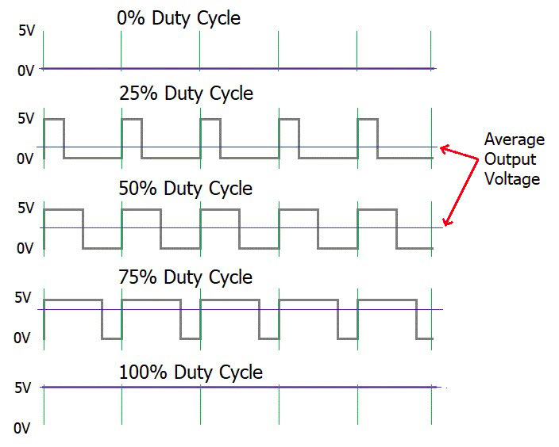
PWM
PWM : Pulse Width Modulation
https://circuitdigest.com/tutorial/what-is-pwm-pulse-width-modulation

Slide 17
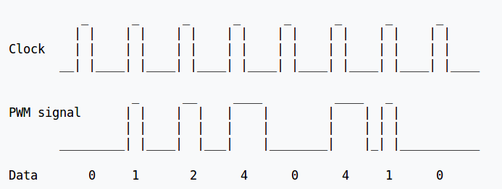
PWM
https://en.wikipedia.org/wiki/Pulse-width_modulation

Slide 18
PWM Parameter in Linux
Period
  The total period of the PWM signal
  Value is in nanoseconds
  sum of the active and inactive time of the PWM
duty_cycle
  The active time of the PWM signal
  Value is in nanoseconds
  must be less than the period.

Slide 19
PWM Parameter in Linux
Polarity
→ The polarity of the PWM signal
Enable
→ Enable PWM Signal

Slide 20
PWM Driver
$(KERNEL_SRC)/Documentation/pwm.txt
Platform Driver
  drivers/pwm/
  drivers/pwm/core.c
  drivers/pwm/pwm-rockchip.c

Slide 21
PWM Subsystem
Application 1
Application 2
User Space
/sys/class/pwm
/dev/dev-mg996rs
Kernel Space
core.c
cadtc_mg996r.c
Callback implement
and register
pwm-rockchip.c
MG996R

Slide 22
RockPi4B HEAD

Slide 23
PWM SYSFS
/sys/class/pwm/pwmchip0
device export npwm power subsystem uevent unexport
echo 0 > export
capture enable polarity uevent duty_cycle period power
echo “20000000” > period
//20ms, 50 Hz
echo "2000000" > duty_cycle
//2ms
echo 1 > enable
//Enable

Slide 24
Hwmon Subsystem

Slide 25
Hwmon Subsystem
User
SysFS
attr_show
Hwmon.c
attr_store
Hwmon driver
Kernel
Hardware
Hwmon driver

Slide 26
SHT21
Simple interface
Bus interface
  I2C, GPIO, SPI
Sensors
  Temperature
  Voltage
  Humidity
  Fan speed
  PWM control

Slide 27
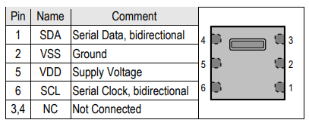
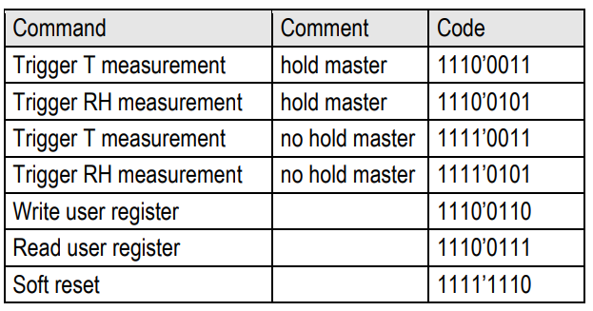
SHT21
SHT21
RockPi4B

Slide 28
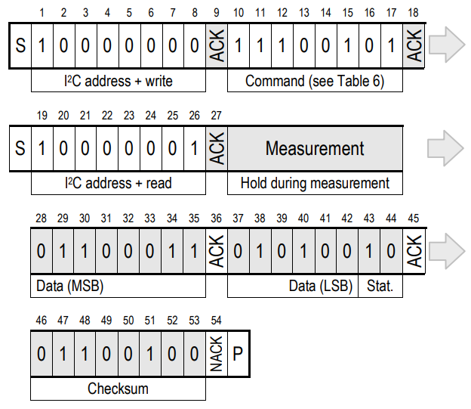
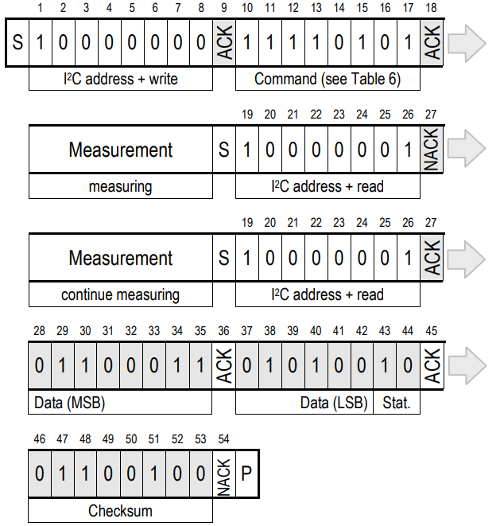
SHT21
Hold master communication sequence
No Hold master communication sequence

Slide 29
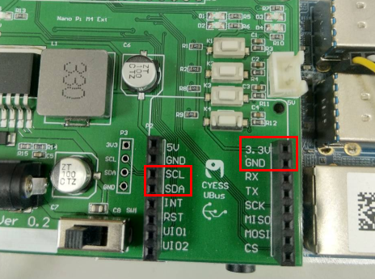
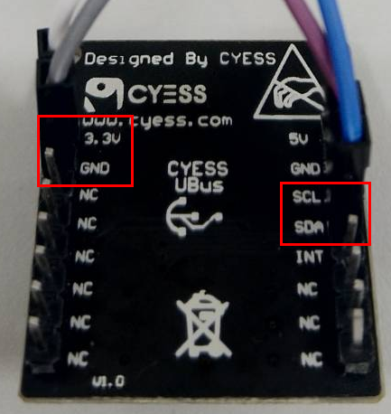
SHT21
I2C
I2C

Slide 30
SHT21
Hwmon Sysfs
# ls /sys/class/hwmon/hwmon0
device name subsystem uevent
humidity1_input power temp1_input
temperature
# cat /sys/class/hwmon/hwmon0/temp1_input
32279
humidity
# cat /sys/class/hwmon/hwmon0/humidity1_input
34512

