Slide 1
RK3399 and SOC

Slide 2
RockPi WiKi
Rock Pi4 Wiki
  https://wiki.radxa.com/Rockpi4
Rock Pi 4 Feature
  https://wiki.radxa.com/Rockpi4/getting_started
Rock Pi 4 Debin
  https://wiki.radxa.com/Rockpi4/Debian
  https://wiki.radxa.com/Rock4/downloads

Slide 3

Application and IO
Application
Library
C library
System Call
User Space
Device Driver
Linux kernel
Kernel Space
Hard ware IO

Slide 4
User Space and Kernel Space
Test Application
User Space
Device Node
Kernel Space
Linux Char Driver
Hardware
Device

Slide 5
SysFS
Allows kernel code to export information to user processes
SysFS is an in-memory file system
It provides two components
  A kernel programming interface for exporting these items via sysfs
  User interface to view and manipulate these items that maps back to the kernel objects which they represent

Slide 6

LED and SysFS
User-space
SysFS
Kernel-space
LED Driver
Trigger driver
led-class.c
led-triggers.c
switch
led-core.c
leds-gpio.c
led driver
Hardware
LED

Slide 7
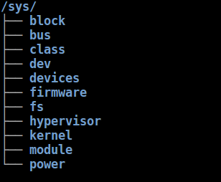
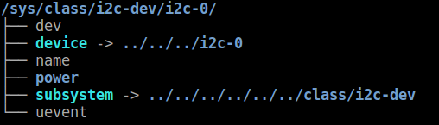
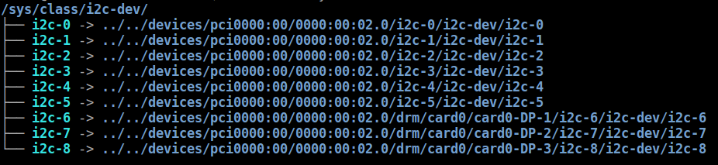
Sys File System
# tree -L 1 /sys/
# tree -L 1 /sys/class/i2c-dev/i2c-0/
# tree -L 1 /sys/class/i2c-dev

Slide 8
CPU

Slide 9
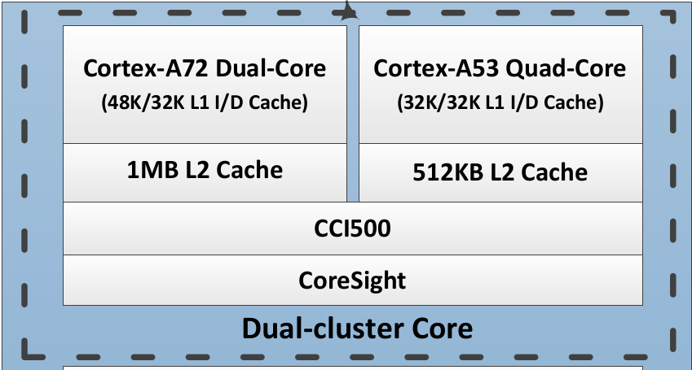
CPU (1)
Two CPU clusters
  Big cluster with dual-core Cortex-A72
    high-performance
  Little cluster with quad-core Cortex-A53
    low power

Slide 10
CPU (2)
Arm big.LITTLE technology
  ”LITTLE” processors are designed for maximum power efficiency
  ”big” processors are designed to provide maximum compute performance.
big
LITTLE
https://www.arm.com/zh-TW/technologies/big-little

Slide 11
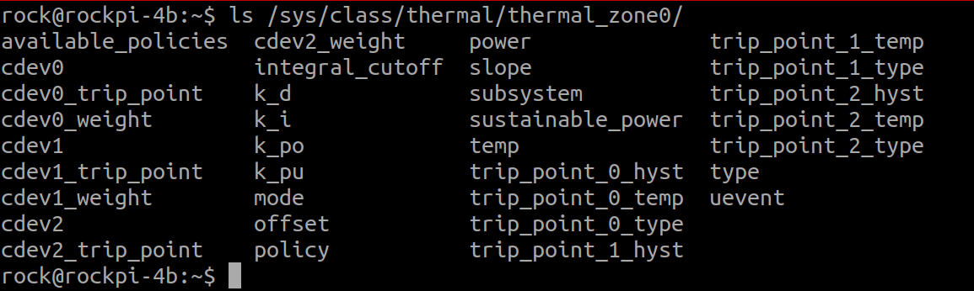
CPU and Thermal
/sys/class/thermal/thermal_zone0
/sys/class/thermal/thermal_zone1

Slide 12
Memory

Slide 13
Memory
Internal ROM
  Internal BootRom (Size : 32KB)
  boot from
    SPI, eMMC, SD/MMC
Internal RAM
  200KB
External
  DDR3/DDR3L/LPDDR3/LPDDR4
  SPI NOR/NAND Flash
  EMMC5.1
  SD3.0/MMC4.51

Slide 14
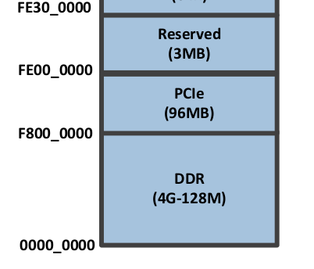
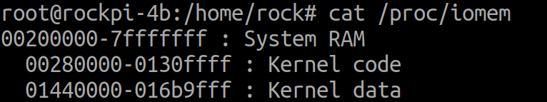
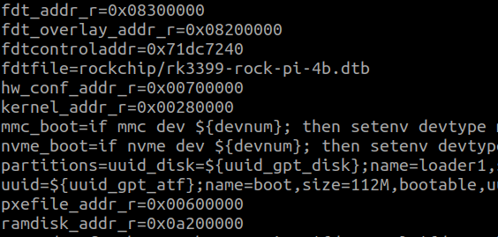
Dynamic Memory IO Address
cat /proc/iomem
U-boot environment

Slide 15
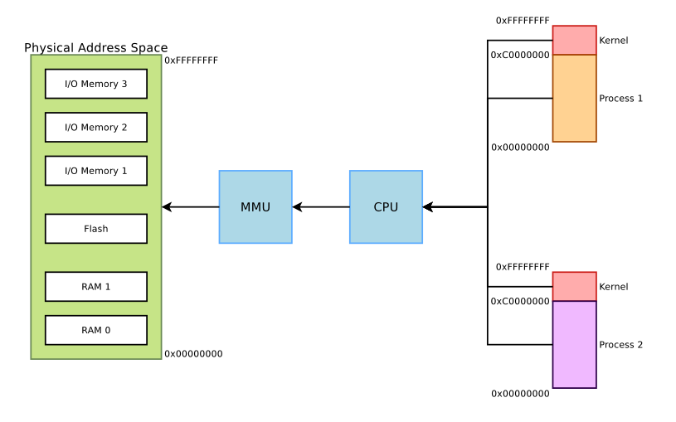
MMU (1)
32 Bit CPU
Physical Address
Virtual Address

Slide 16
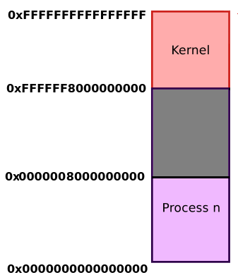
MMU (2)
64 Bit CPU
AArch64 Linux memory layout with 4KB pages + 3 levels
512GB
reserved for
kernel-space
512GB
reserved for
user space

Slide 17
MMU (3)
The MMU divides memory into 4KB pages
2-level page table structure
  The First level
    Page Directory consists of 1024 Directory Table Entries (DTEs)
    Each pointing to a Page Table.
  The Second level
    The Page Table consists of 1024 Page Table Entries (PTEs)
    Each pointing to a page in memory

Slide 18
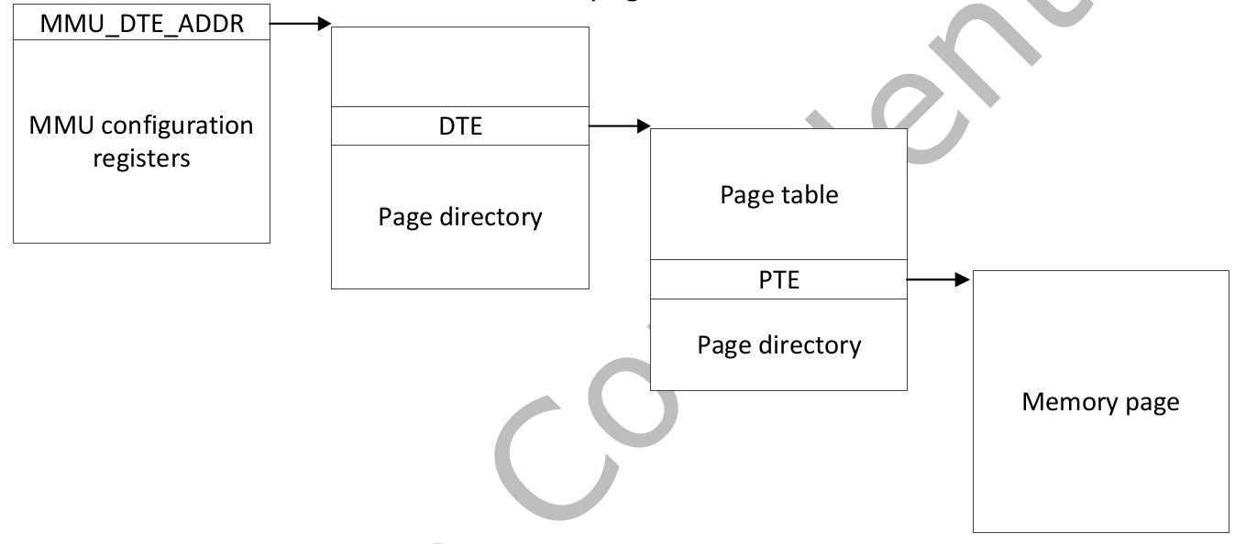
MMU (4)
31
22
21
12
11
0
DTE index
PTE index
Page Offset

Slide 19
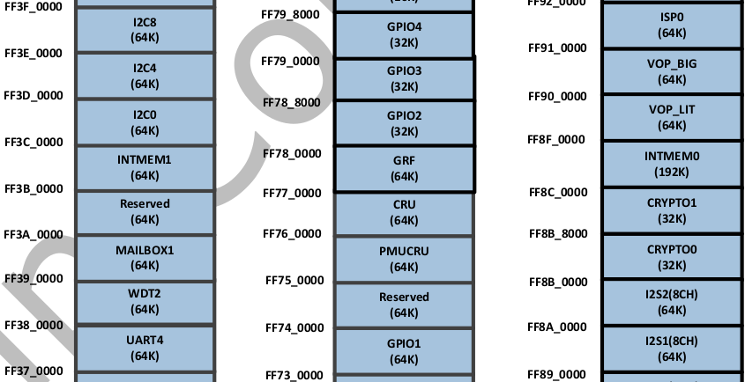
MMU (5)
Physical
memory address
I/O Address Mapping
can’t use
physical memory
address direct
Rockchip_RK3399TRM_V1.3_Part1.pdf

Slide 20
Interconnect Connect

Slide 21
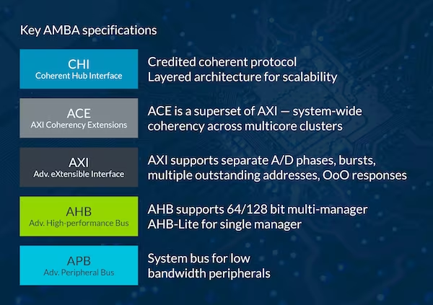
Bus Architecture
AMBA : Advanced Microcontroller Bus Architecture
  AXI
  AHB
  APB
https://www.arm.com/zh-TW/architecture/system-architectures/amba

Slide 22
GPU

Slide 23
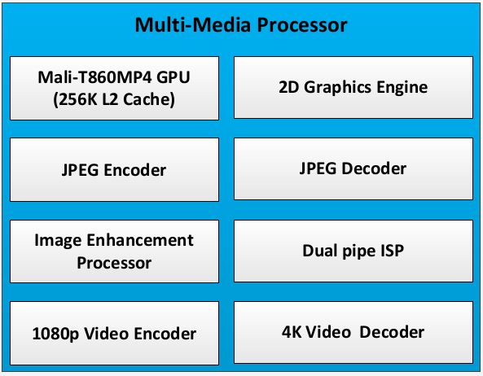
GPU

Slide 24
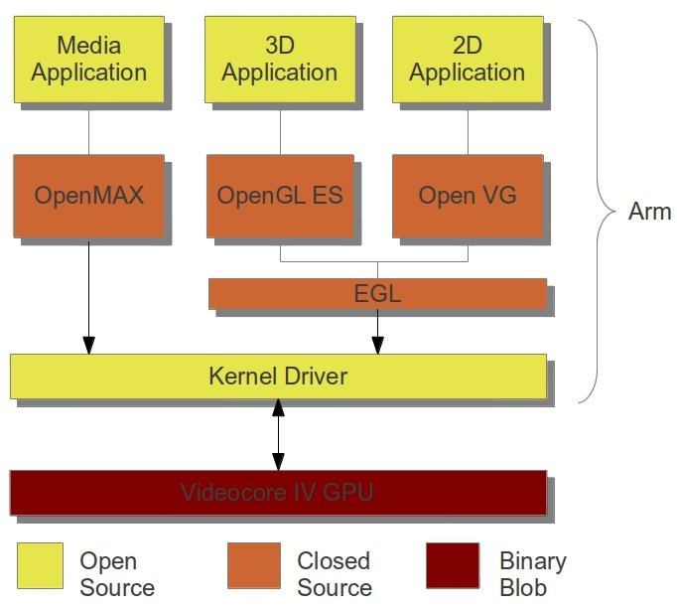
Graphics Engine (1)
https://www.cnx-software.com/2012/02/01/raspberry-pi-codecs-and-graphicsvideo-api/

Slide 25
Graphics Engine (2)
Graphics Process Unit
Mali-T860MP4 GPU
  OpenGL ES1.1/2.0/3.0, OpenCL1.2,
  3DGraphics Engine
  2D Graphics Engine
Rockchip_RK3399TRM_V1.3_Part1.pdf

Slide 26
Graphics Engine (3)
OpenGL
  Open Graphics Library
    實現 OpenGL Library 一般由顯示裝置廠商提供，而且非常依賴於該廠商提供的硬體
    開放原始碼函式庫Mesa是一個純基於軟體的圖形API，它的代码兼容於OpenGL
OpenGL ES
  OpenGL for Embedded Systems
EGL (Embedded Graphics Library)
  Native Platform Graphics Interface
https://zh.wikipedia.org/wiki/OpenGL
https://www.khronos.org/egl

Slide 27
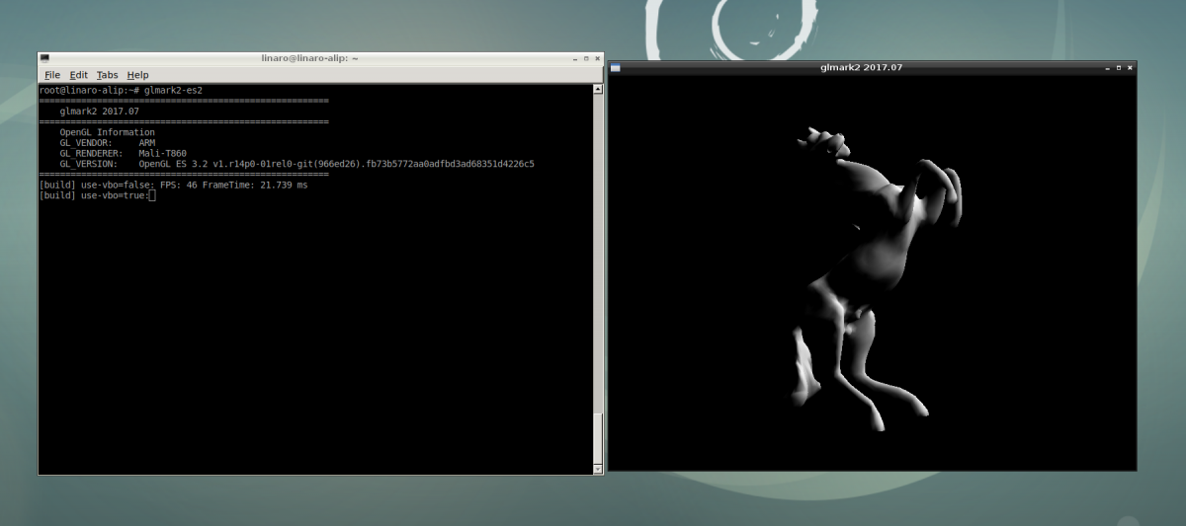
GPU Test
glmark2-es2

Slide 28
USB

Slide 29
USB (1)
USB Host
  RK3399
  OHCI : 1.1. Hardware Complex
  UHCI : 1.0, 1.1 Software Complex
  EHCI : 2.0
  XHCI : 3.0
USB Device
  USB Storage

Slide 30
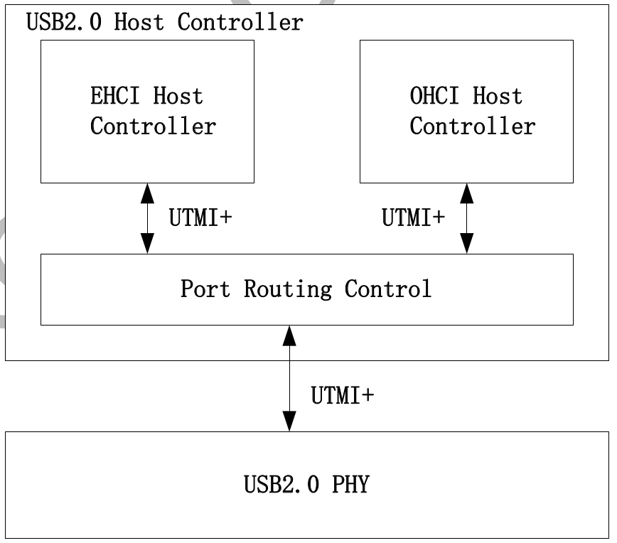
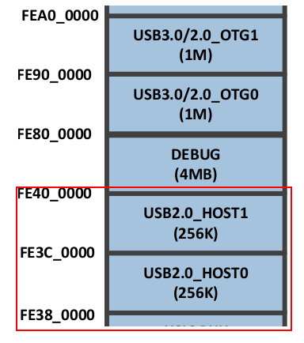
USB 2.0
USB2.0 Host Controller Block Diagram
USB2.0 Host Controller Address Map

Slide 31
USB 2.0
EHCI Host Controller
  High-speed (480Mbps)
OHCI Host Controller
  Full-speed (12Mbps)
  Low-speed (1.5Mbps)

Slide 32
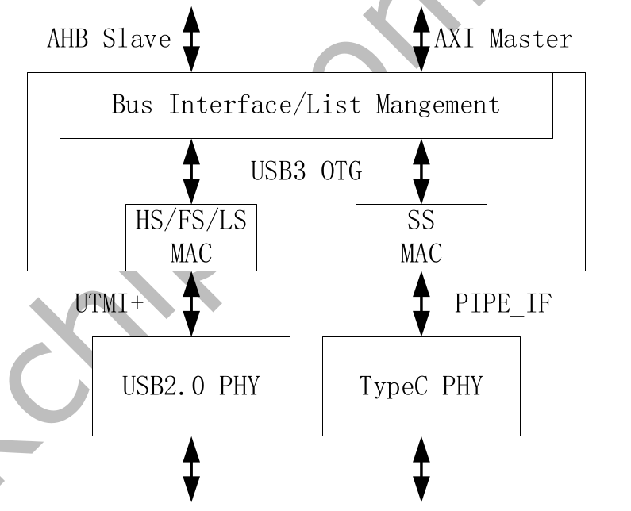
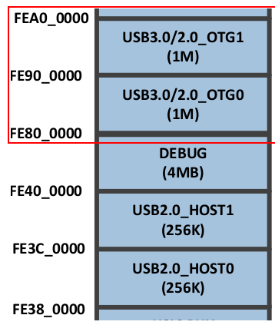
USB 3.0
USB3.0 Host Controller Block Diagram
USB3.0 Host Controller Address Map

Slide 33
USB Topology
USB
Host Controller
USB Host Driver
Virtual
Root Hub
RK3399
USB Host Ctrl Driver
Device
HUB
USB Hub Driver
USB Storage Driver
Device
HUB
USB VID
USB PID
Device
USB Device Driver

Slide 34
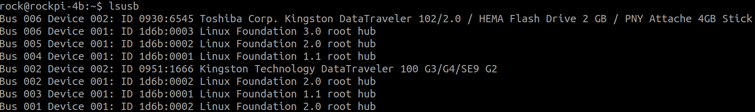
USB VID_PID
IdVendor : 0930
IdProduct : 6545

Slide 35
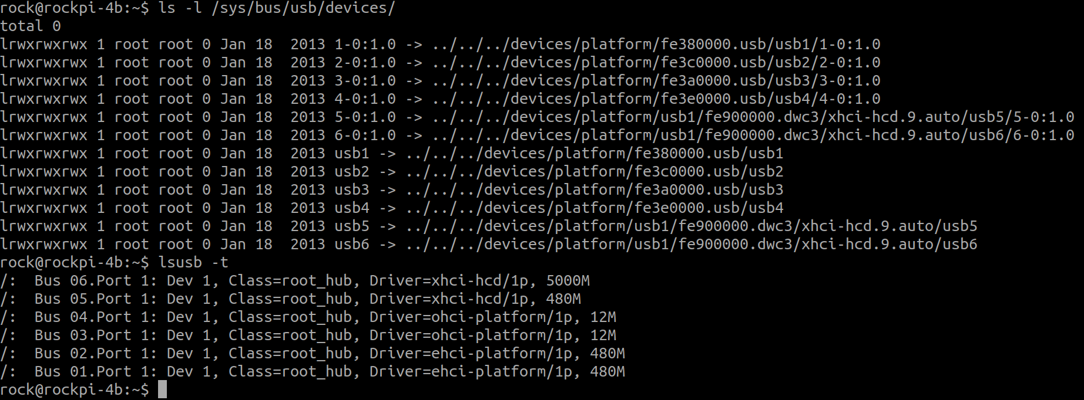
USB SysFS

Slide 36
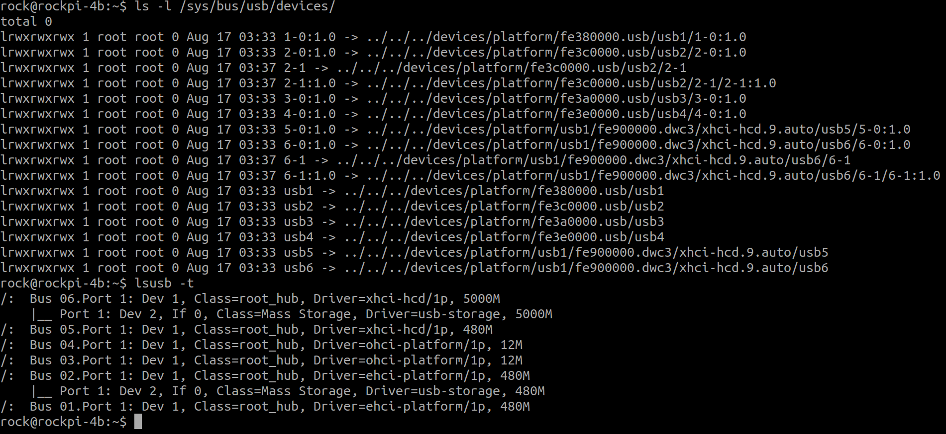
USB SysFS and USB Storage

Slide 37
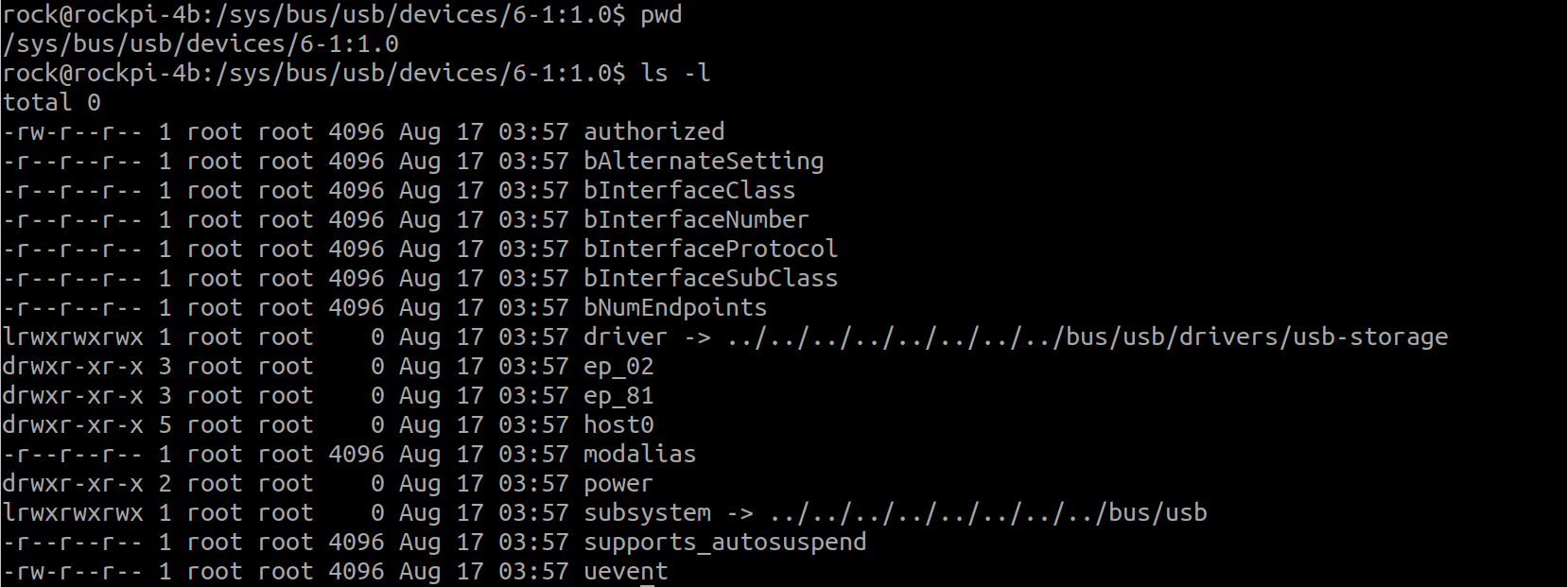
USB SysFS and USB Storage

Slide 38
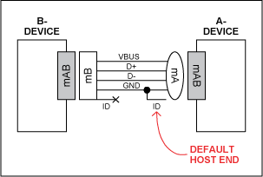
USB On The Go
USB OTG
  USB_ID信號爲低時，該設備應作爲Host
  USB_ID信號爲高時，該設備作爲Slave

Slide 39
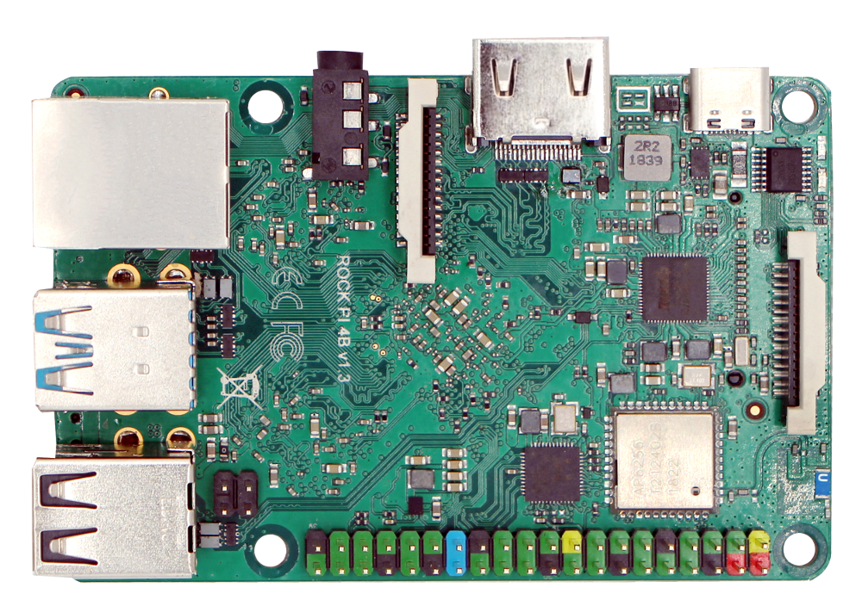

USB On The Go
RockPi4B
x86PC
USB Device
USB Host
Storage
Ethernet
CDC

Slide 40
Block Device

Slide 41
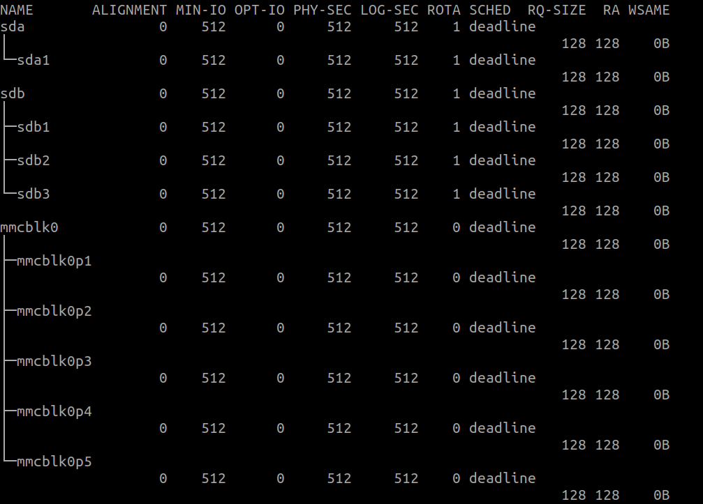
Block Device

Slide 42
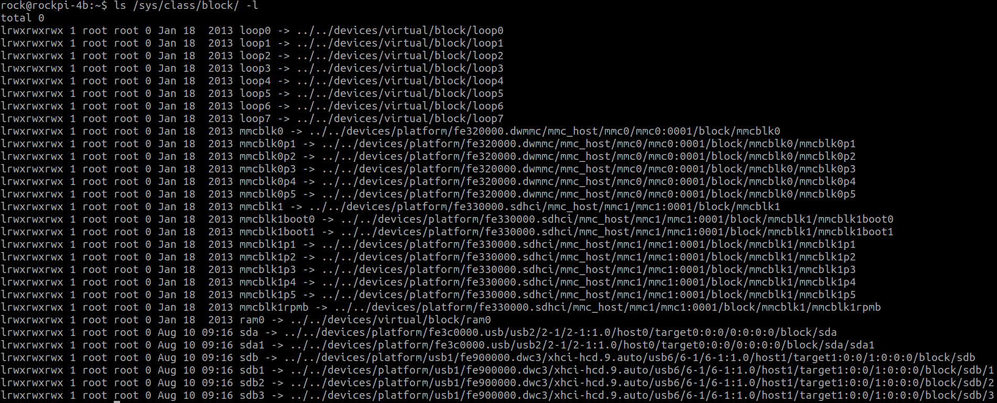
Block Device and SysFS

Slide 43
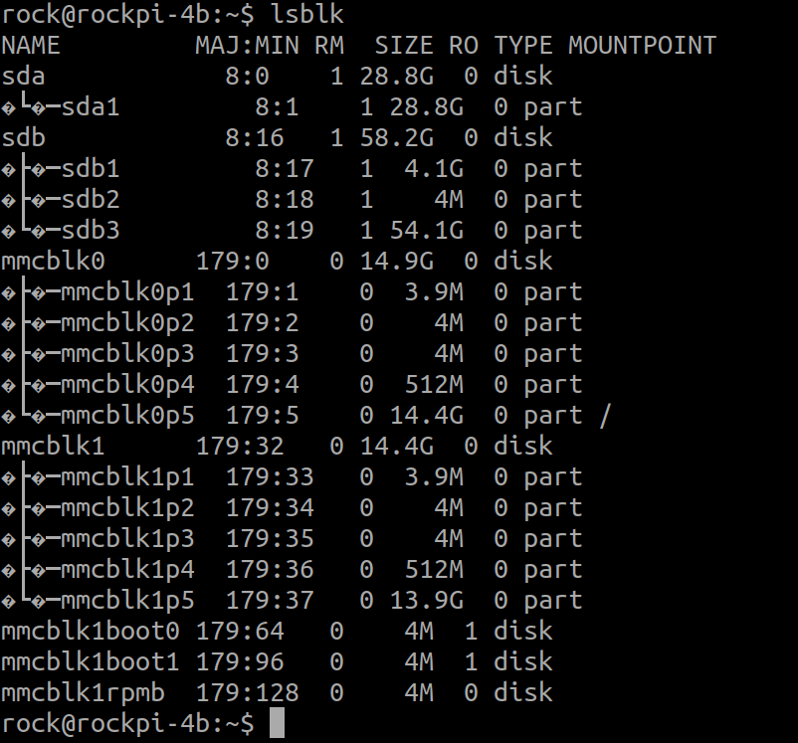
Block Device
sda → USB Disk Device
mmcblk0 → SD Card Device
mmcblk1 → eMMC Device
sda1
USB Disk Device Partition 1
mmcblk0p1
SD Card Device Partition 1
mmcblk1p1
eMMC Device Partition 1
mmcblk1boot0
eMMC Device boot Partition 1

Slide 44
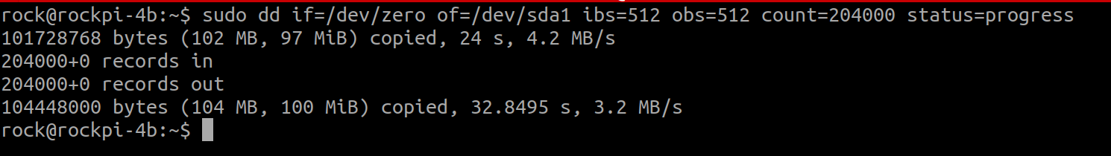
Throughput Test
sudo dd if=/dev/zero of=/dev/sda1 ibs=512 obs=512 count=204000 status=progress

Slide 45
Real Time Clock

Slide 46
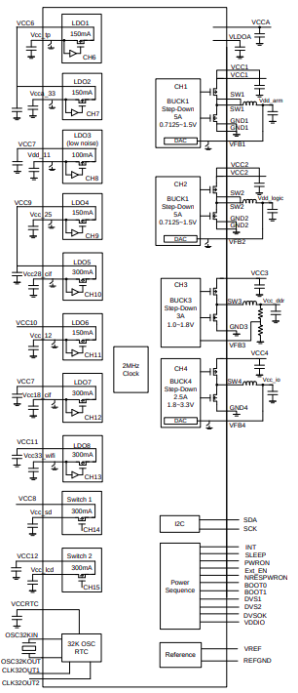
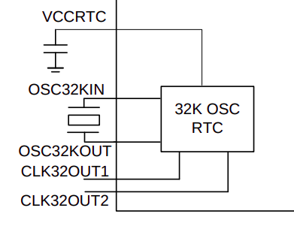
RK808 and RTC
RK808Functional Block Diagram

Slide 47
RTC Setting
Hwclock (RTC)
  Read RTC time
  [CMD] hwclock -r
date (System)
  Set System Time
  [CMD] date -s “21:21”
set the RTC from the system time
  [CMD] hwclock -w
set the system time from the RTC
  [CMD] hwclock -s

Slide 48
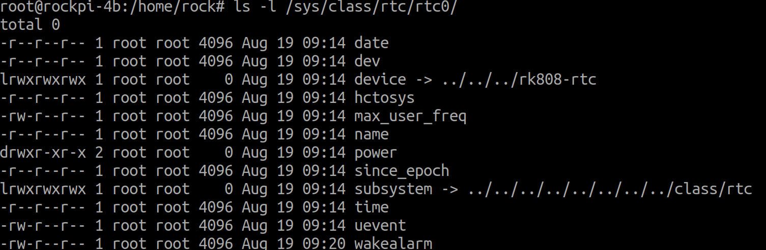
RTC and SysFS

Slide 49
RTC and STR
Suspend To RAM (STR)
Alarm Setting
echo $(date +%s -d "now + 1 minutes") > /sys/class/rtc/rtc0/wakealarm
Enter
Suspend
sudo echo mem > /sys/power/state

Slide 50
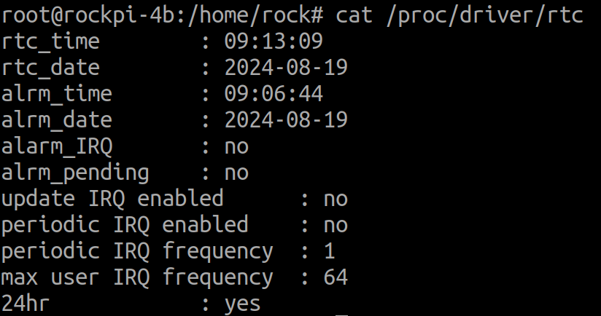
RTC and ProcFS
cat /proc/driver/rtc

Slide 51
Serial Port

Slide 52
Serial Port
The Universal Asynchronous Receiver/Transmitter
  Write Data
    CPU → Data → APB → UART
  Read Data
    Data → UART → APB → CPU
RockPi4B
PC
TX
TX
RX
RX
GND
GND
Rockchip_RK3399TRM_V1.3_Part2.pdf

Slide 53
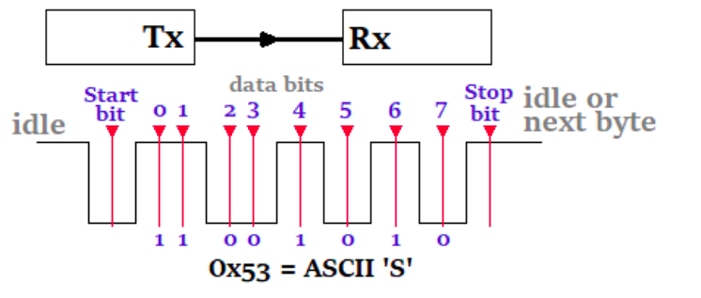
Serial Protocol

Slide 54
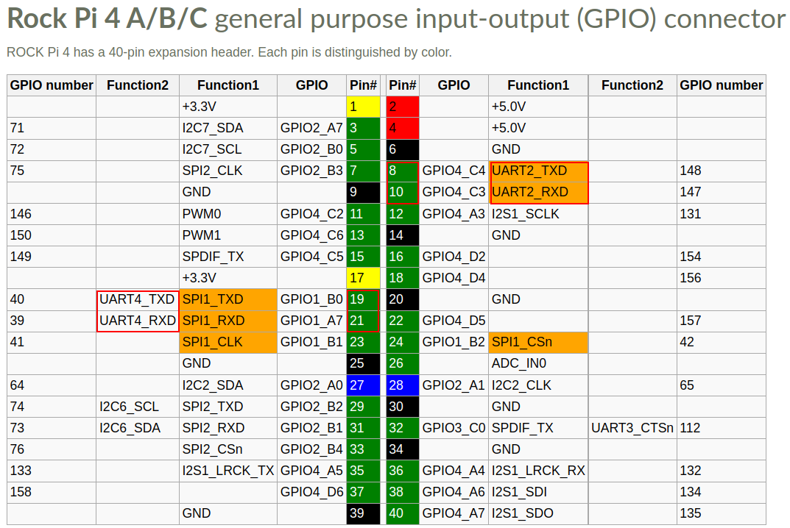
Serial Port Pin

Slide 55
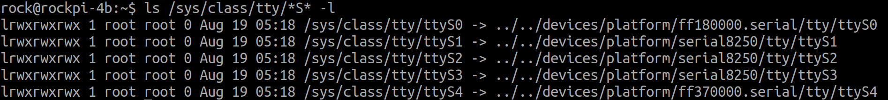
Serial Port and SysFS
ls /sys/class/tty/*S* -l
Serial IO Address

Slide 56
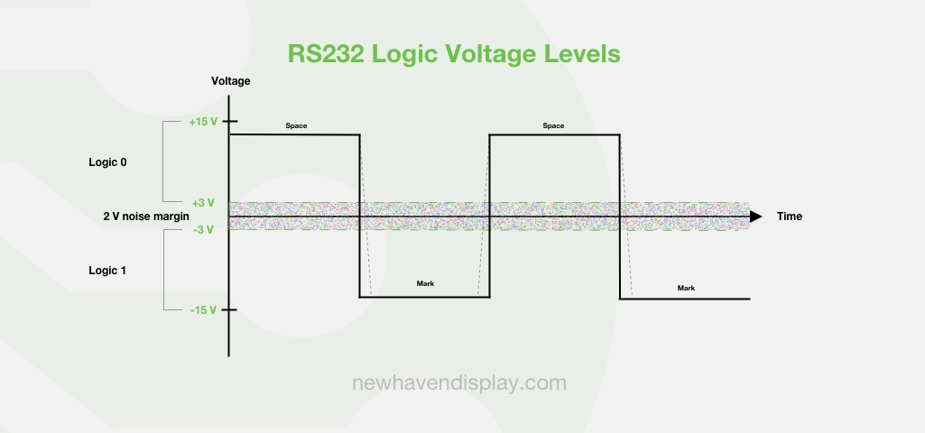
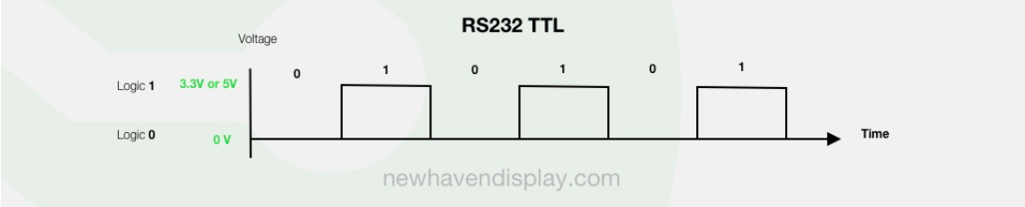
Serial Port and RS232
https://newhavendisplay.com/blog/rs232/

Slide 57
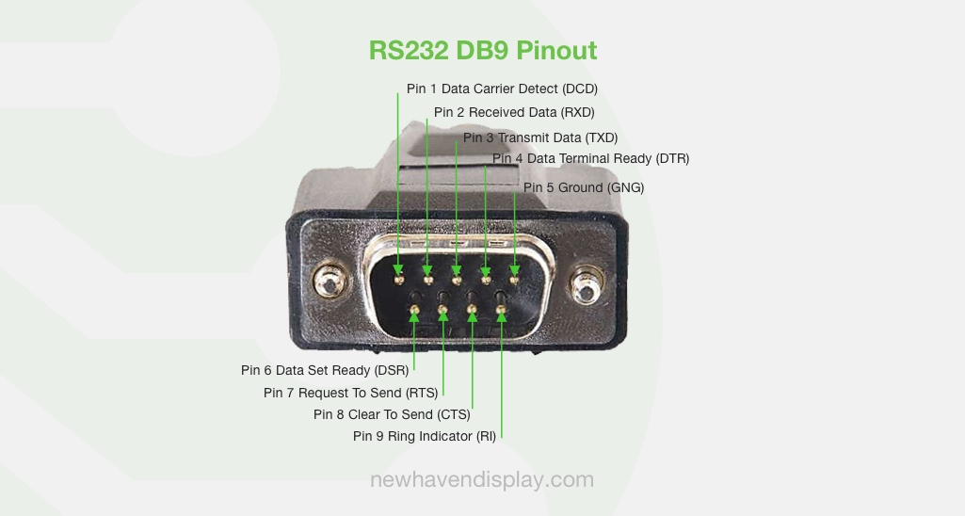
Serial Port and RS232
https://newhavendisplay.com/blog/rs232/#specifications

Slide 58
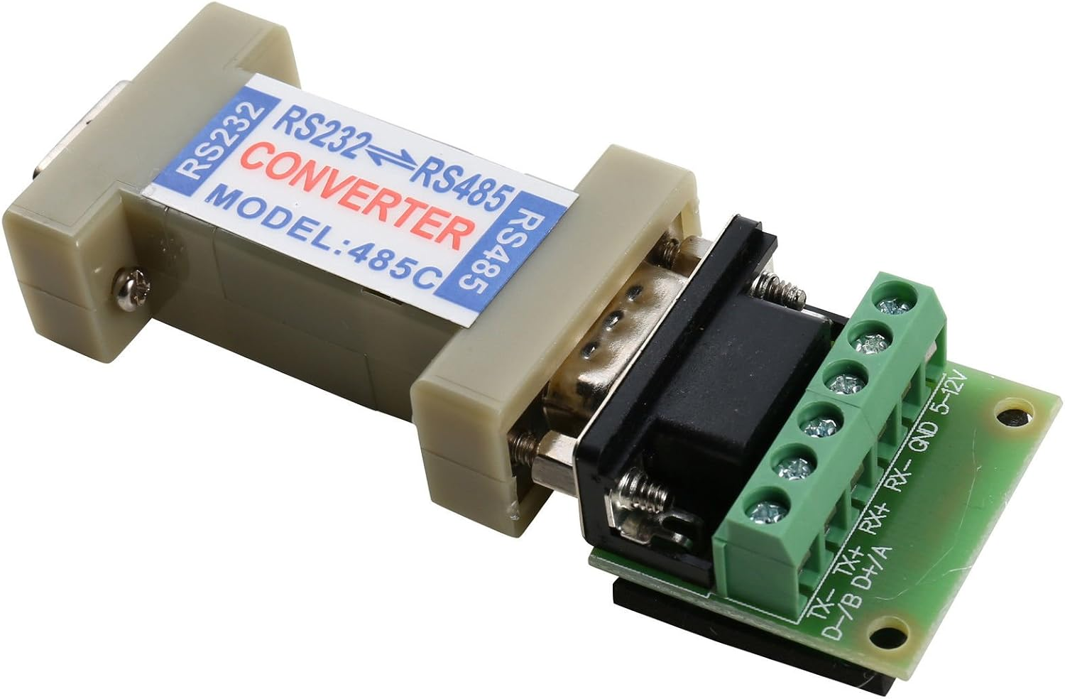
Serial Port and RS485

Slide 59
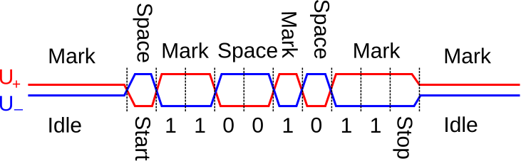
Serial Port and RS485
https://newhavendisplay.com/blog/rs232/

Slide 60
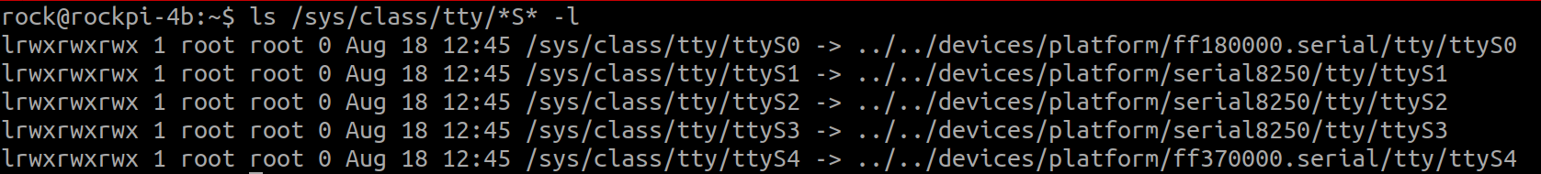
UART4 LoopBack Test
Send : sudo su
echo “12345” > /dev/ttyS4
Receive : sudo su
cat /dev/ttyS4 > /tmp/test.txt
cat /tmp/test.txt

Slide 61
I2C

Slide 62
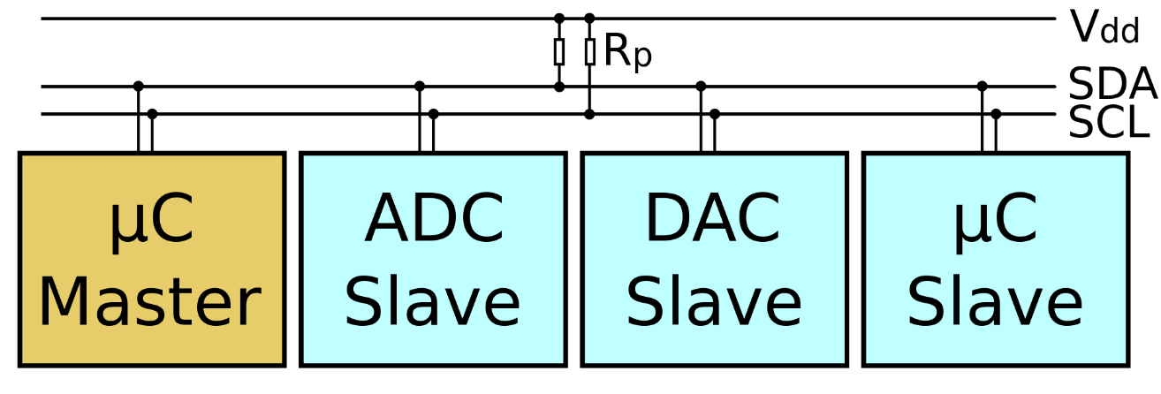
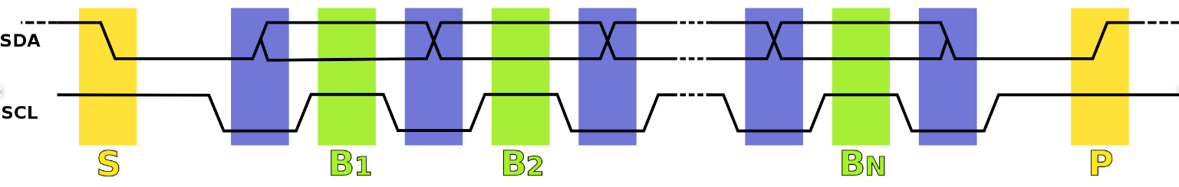
I2C (1)
Serial bus
  SDA data line
  SCL clock line
Protocol
https://en.wikipedia.org/wiki/I%C2%B2C

Slide 63
I2C (2)
Master and Client
RK3399 SOC
SHT21 sensor
I2C Master
SCL
I2C Client
SDA

Slide 64
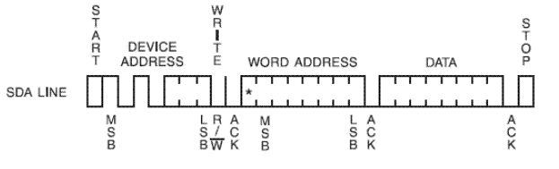
I2C protocol - Write
Write
  byte write
  page write
Device address
Read/write bit : 0
ACK

Slide 65
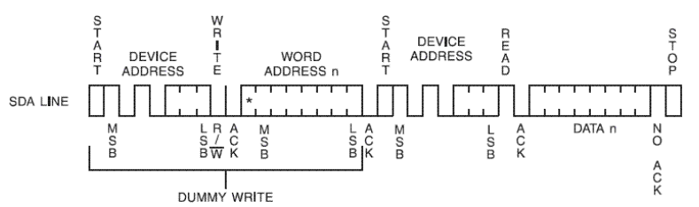
I2C protocol - Read
Read
  byte read
  page read
Device address
Read/write bit : 1
ACK

Slide 66
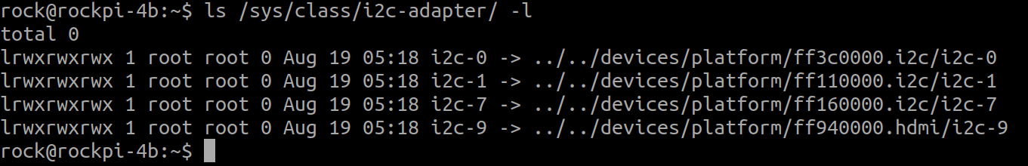
I2C and SysFS
ls -l /sys/class/i2c-adapter/
ls -l /sys/class/i2c-dev

Slide 67
I2C SysFS
ls -l /sys/class/i2c-adapter/
ls -l /sys/class/i2c-dev

Slide 68
I2C Adapter
ls -l /sys/class/i2c-adapter/
I2C Adapter IO Address
I2c device mount on i2c adapter bus 0

Slide 69
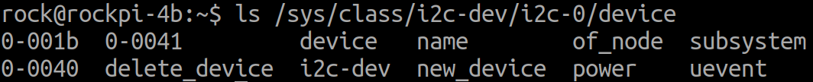
I2C Device
I2c device mount on i2c adapter bus 0
Device I2C address

Slide 70
I2C utility
i2cdetect : detect I2C chips
i2cdump : examine I2C registers
i2cset : set I2C registers
i2cget : read from I2C/SMBus chip registers
I2ctransfer : send concatenated i2c messages

Slide 71
GPIO

Slide 72
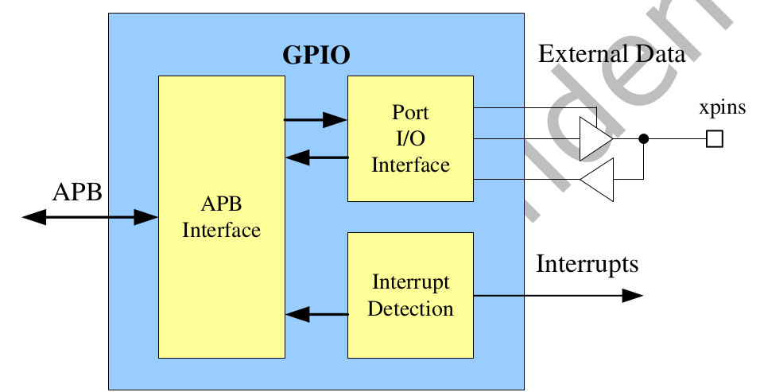
GPIO
General Purpose Programming I/O
GPIO controls the output data and direction of external I/O pads
https://wiki.radxa.com/Rockpi4/hardware/gpio

Slide 73


GPIO_OUT and LED

Slide 74


GPIO_IN and Key

Slide 75

RockPi4B HEAD

Slide 76
GPIO and SysFS
/sys/class/gpio:
  Control interfaces used to get userspace control over GPIOs;
  GPIOs themselves
  GPIO controllers("gpio_chip" instances)
/sys/class/gpio/
  "export" : ask the kernel to export GPIO to userspace by writing
    "echo 19 > export"
    create a "gpio19" node in /sys/class/gpio
  "unexport" : Reverses the effect of exporting to userspace
    "echo 19 > unexport"
    remove "gpio19" node from /sys/class/gpio

Slide 77
LED

Slide 78

LED Schematic
GPIO3_D4/I2S0_SDI1SDO3_d → LED1
GPIO3_D5/I2S0_SDI2SDO2_d → LED2

Slide 79
LED Subsystem
Control LED convenient with SysFS
  For example
    echo 1 > /sys/class/leds/user-led2/shot
Switch different LED trigger type in SysFS
  For example
    echo "gpio" > /sys/class/leds/user-led2/trigger
    echo "1" > /sys/class/leds/user-led2/brightness
    echo "0" > /sys/class/leds/user-led2/brightness

Slide 80

LED SysFS
Check trigger type
Switch trigger type

Slide 81
PWM

Slide 82

PWM
PWM : Pulse Width Modulation
https://circuitdigest.com/tutorial/what-is-pwm-pulse-width-modulation

Slide 83

PWM
https://en.wikipedia.org/wiki/Pulse-width_modulation

Slide 84
PWM Parameter in Linux
Period
  The total period of the PWM signal
  Value is in nanoseconds
  sum of the active and inactive time of the PWM
duty_cycle
  The active time of the PWM signal
  Value is in nanoseconds
  must be less than the period.

Slide 85
PWM Parameter in Linux
Polarity
→ The polarity of the PWM signal
Enable
→ Enable PWM Signal

Slide 86
RockPi4B HEAD

Slide 87
PWM SysFS
/sys/class/pwm/pwmchip0
device export npwm power subsystem uevent unexport
echo 0 > export
capture enable polarity uevent duty_cycle period power
echo “20000000” > period
//20ms, 50 Hz
echo "2000000" > duty_cycle
//2ms
echo 1 > enable
//Enable

Slide 88
Hwmon Subsystem

Slide 89
Hwmon Subsystem
User
SysFS
attr_show
Hwmon.c
attr_store
Hwmon driver
Kernel
Hardware
Hwmon driver

Slide 90
SHT21
Simple interface
Bus interface
  I2C, GPIO, SPI
Sensors
  Temperature
  Voltage
  Humidity
  Fan speed
  PWM control

Slide 91


SHT21
SHT21
RockPi4B

Slide 92


SHT21
Hold master communication sequence
No Hold master communication sequence

Slide 93


SHT21
I2C
I2C

Slide 94
SHT21
Hwmon Sysfs
# ls /sys/class/hwmon/hwmon0
device name subsystem uevent
humidity1_input power temp1_input
temperature
# cat /sys/class/hwmon/hwmon0/temp1_input
32279
humidity
# cat /sys/class/hwmon/hwmon0/humidity1_input
34512

