Slide 1
WiFi and Network

Slide 2
Network Tool
ifconfig → Network setting
ping → Network package test
iperf3 → perform network throughput tests
dhcpc → used for automatic retrieving of

Slide 3
WIFI
NetworkManager Command Line Tool
  nmcli
Show / manipulate wireless devices and their configuration
  iw
For connecting to a WPA/WPA2 network
  wpa_supplicant

Slide 4
WiFi Basic

Slide 5
WIFI – 802.11 (1)
IEEE 802.11 – 無線區域網路
Application
Presentation
ISO
OSI
7-layer
model
Session
IEEE 802
standards
Transport
Network
Logical Link Control
Data Link
Medium Access (MAC)
Physical
Physical (PHY)
https://ptolemy.berkeley.edu/projects/ofdm/ergen/docs/IEEE-802.11overview.ppt

Slide 6
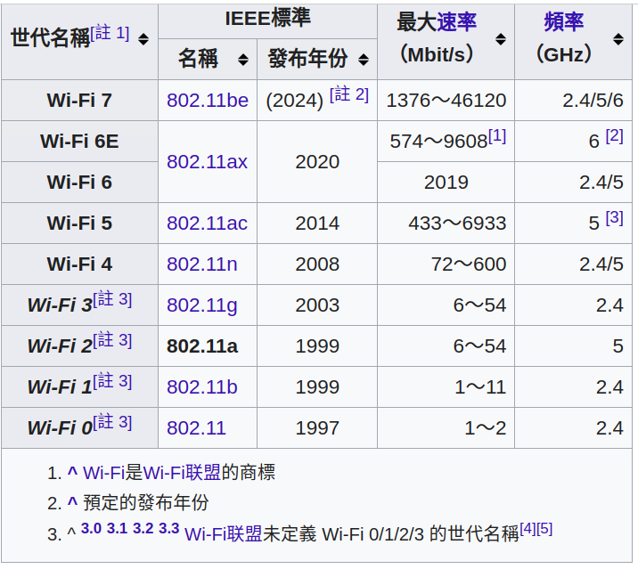
WIFI – 802.11 (2)
https://zh.wikipedia.org/wiki/IEEE_802.11a-1999

Slide 7
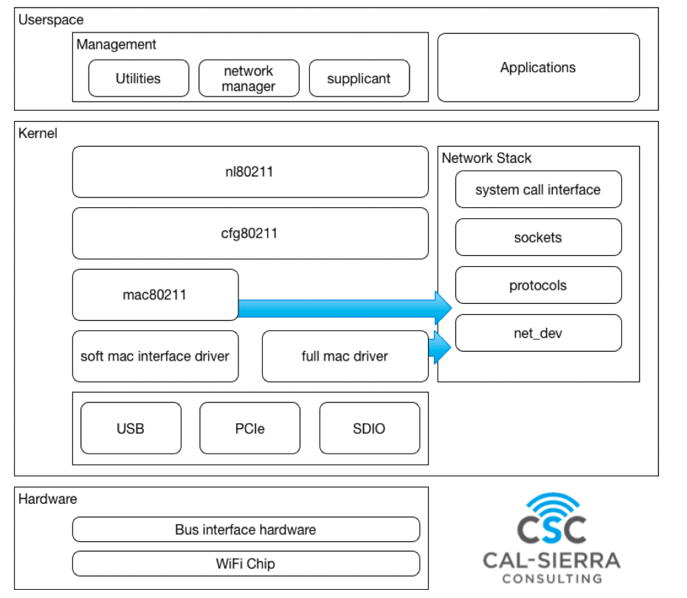
WIFI – Linux & 802.11 (1)
https://hackmd.io/@0xff07/BJkDzazVK#iwd

Slide 8
WIFI – Linux & 802.11 (2)
mac80211
  most associated to hardware offloading
  the 802.11 protocol state machine lives here
cfg80211
  middle-layer Handles Everything Configurable
nl80211
  The API between user-land and kernel-land
  Relies on the netlink protocol to exchange messages between the two worlds
https://www.linuxembedded.fr/2020/05/emulating-wlan-in-linux-part-i-the-80211-stack

Slide 9
WIFI – Tool
Show / manipulate wireless devices and their configuration
  iw
For connecting to a WPA/WPA2 network
  wpa_supplicant

Slide 10
RF Tool
rfcomm
  used to set up, maintain, and inspect the RFCOMM configuration of the Bluetooth subsystem
rfkill
  tool for enabling and disabling wireless devices

Slide 11
rfkill and SysFS
ls /sys/class/rfkill/ -l

Slide 12
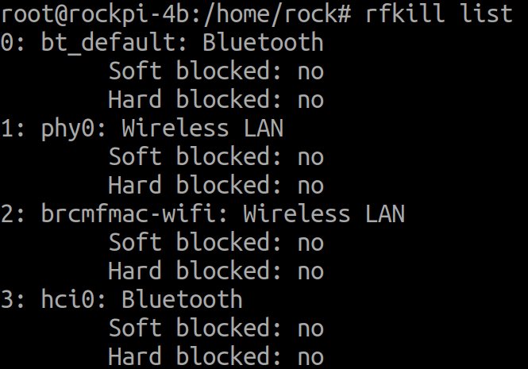
rfkill

Slide 13
SSH

Slide 14

SSH
Secure SHell protocol
SSH Client
SSH Server
SSH Client
SSH Server

Slide 15
SSH
SSH Client
  # sudo apt-get install ssh
  References

Slide 16
NFS

Slide 17
NFS
Network File System
NFS Client
NFS Server
NFS Client
NFS Server

Slide 18
Bluetooth Basic

Slide 19
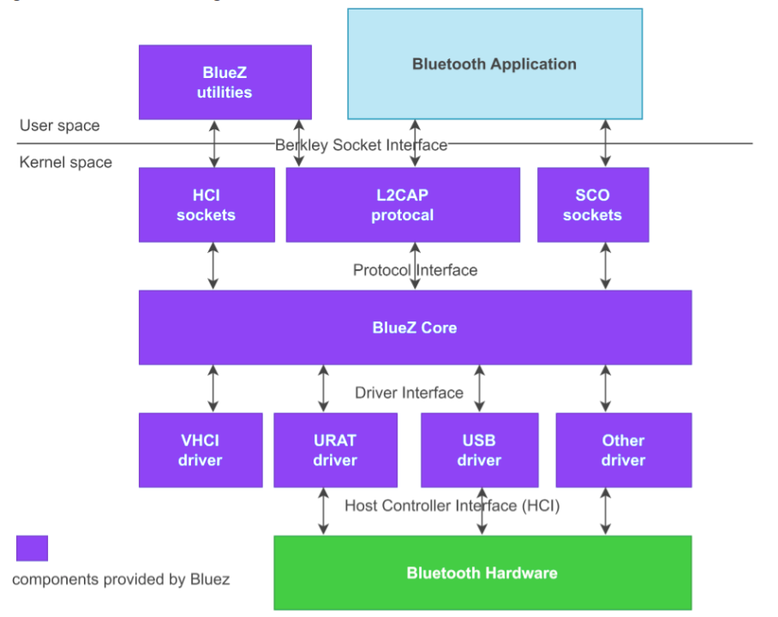
Linux and BlueZ

Slide 20
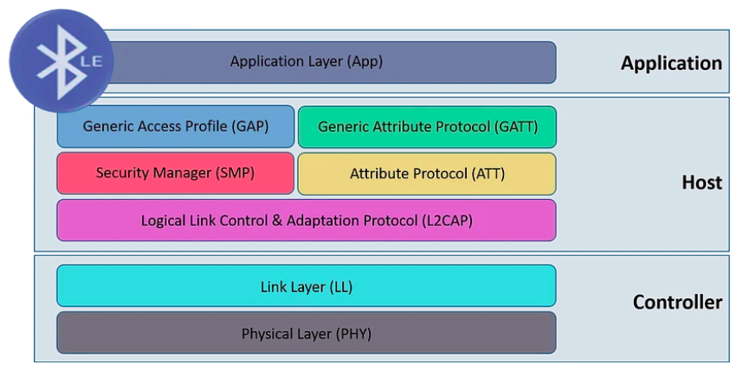
BLE Protocol Stack

Slide 21
HCI Tool
Bluetool Tool
  bluetoothctl
HCI Tool
  hciconfig
    HCI device configuration utility
  hcitool
    configure Bluetooth connections

Slide 22
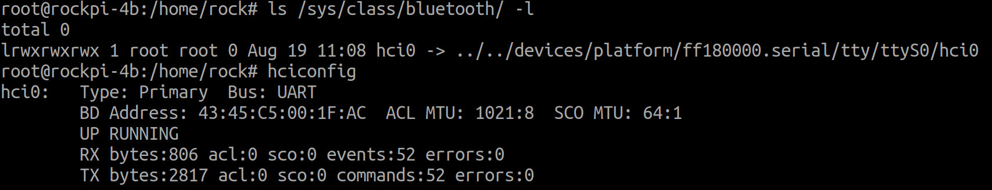
Bluetooth and SysFS

Slide 23
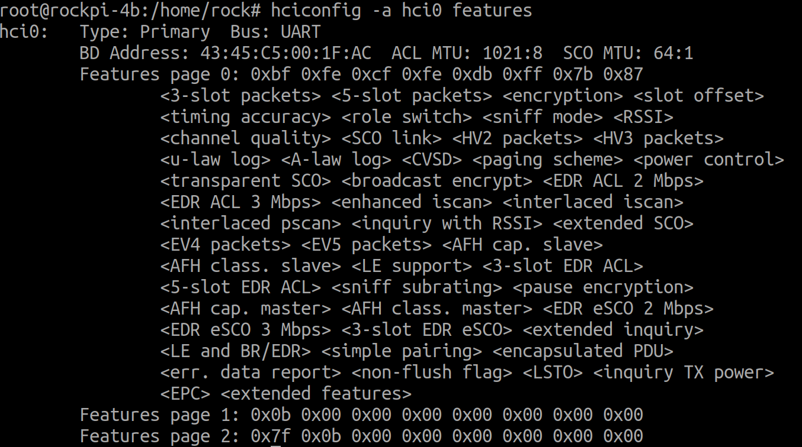
hciconfig and hcitool (1)
hciconfig

Slide 24
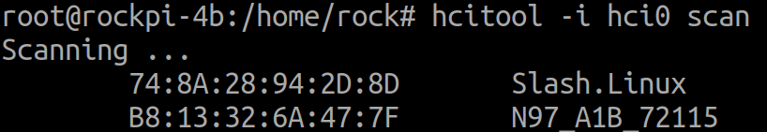
hciconfig and hcitool (2)
hcitool

Slide 25
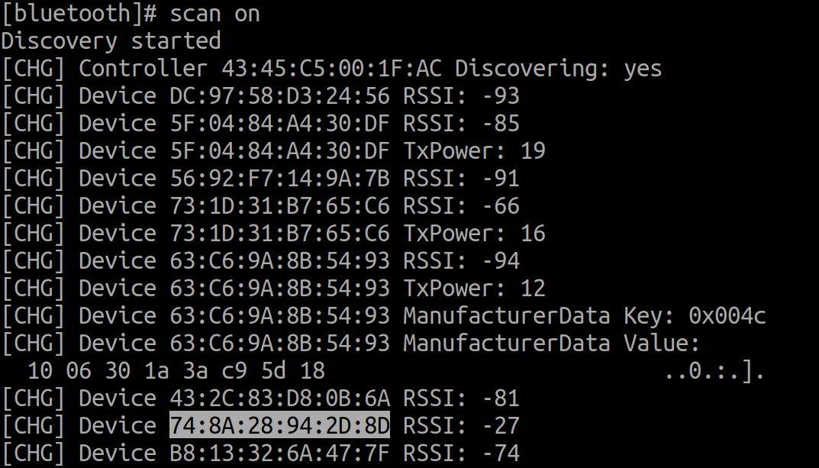
bluetoothctl

Slide 26
Linux Display Subsystem

Slide 27
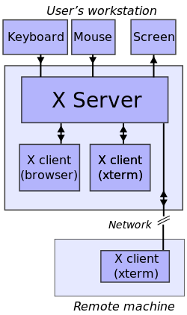
Linux Windows System (1)
https://en.wikipedia.org/wiki/File:X_client_sever_example.svg

Slide 28
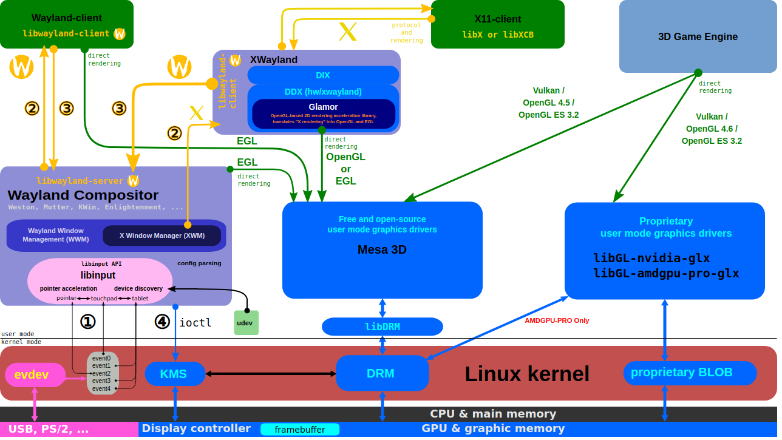
Linux Windows System
https://upload.wikimedia.org/wikipedia/commons/2/2d/The_Linux_Graphics_Stack_and_glamor.svg

Slide 29
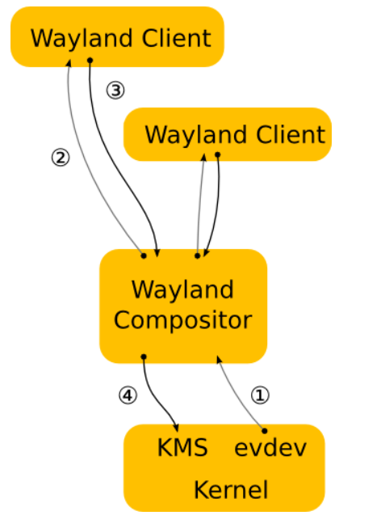
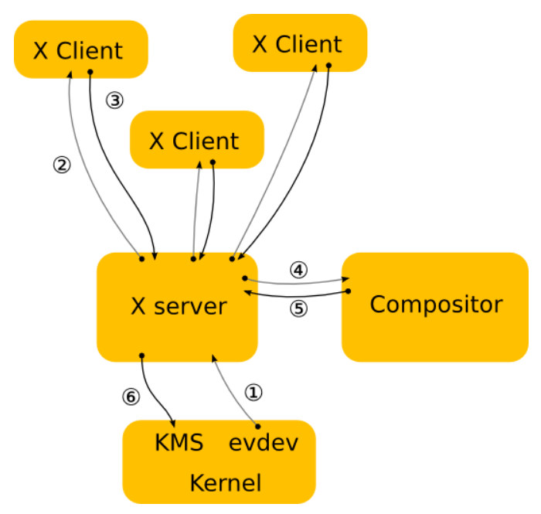
Linux Windows System (3)
Wayland is a replacement for the X11 window system protocol
https://wayland.freedesktop.org/architecture.html

Slide 30
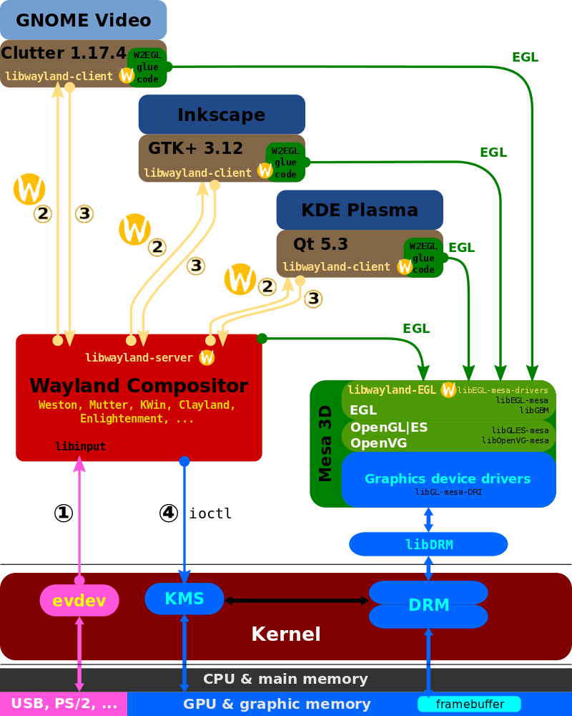
Wayland Display Server and EGL
https://www.wikiwand.com/ja/Wayland

Slide 31
GTK and Gnome
GTK
  GTK (formerly GTK+) is a free and open-source cross-platform widget toolkit for creating graphical user interfaces (GUIs).
GNOME
  GNOME is the default desktop environment of many major Linux distributions
  originally an acronym for GNU Network Object Model Environment
  free and open-source desktop environment for Linux and other Unix-like[10] operating systems
https://en.wikipedia.org/wiki/GNOME
https://en.wikipedia.org/wiki/GTK

Slide 32
OpenGL and EGL
EGL
  EGL Native Platform Graphics Interface is an interface portable layer for graphics resource management.
  works between rendering APIs such as OpenGL ES or OpenVG and the underlying native platform window system
OpenGL
  OpenGL (Open Graphics Library) is a cross-language, cross-platform application programming interface (API) for rendering 2D and 3D vector graphics
Mesa
  Mesa, also called Mesa3D and The Mesa 3D Graphics Library
  it is an open source implementation of OpenGL, Vulkan, and other graphics API specifications
https://en.wikipedia.org/wiki/Mesa_(computer_graphics)
https://en.wikipedia.org/wiki/OpenGL
https://www.khronos.org/egl/

Slide 33
Direct Rendering Manager (DRM)
Direct Rendering Manager
  Management of buffers and free space within that memory.
  Solve Frame buffer driver cannot be used GPU and multi-user process.
DRM consists of
  libdrm
    libdrm provides a user space library for accessing the DRM
  KMS : Kernel Mode Setting
    Change resolution and depth
  DRI : Direct Rendering Infrastructure
    Interfaces to access hardware directly
  GEM : Graphics Execution Manager
    Buffer management
  DRM Driver in kernel side
    Access hardware

Slide 34
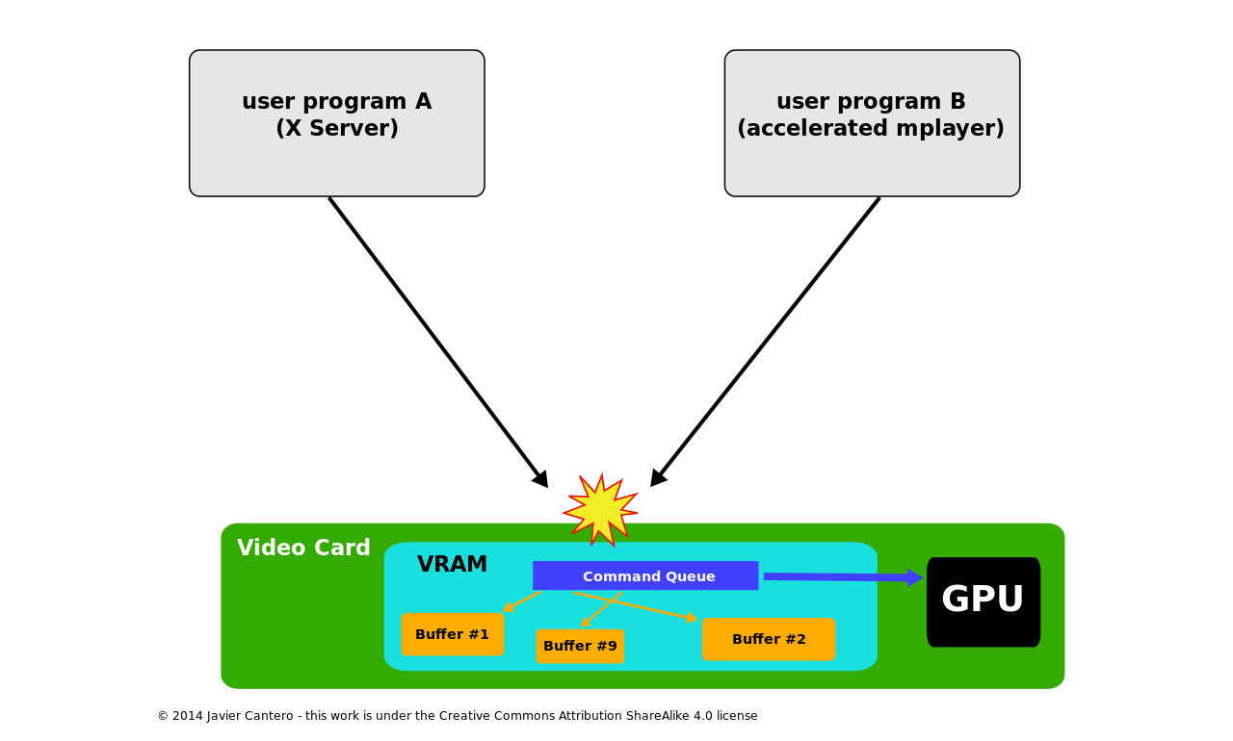
Direct Rendering Manager (DRM)
If no use DRM

Slide 35
Direct Rendering Manager (DRM)
https://upload.wikimedia.org/wikipedia/commons/2/2d/The_Linux_Graphics_Stack_and_glamor.svg

Slide 36
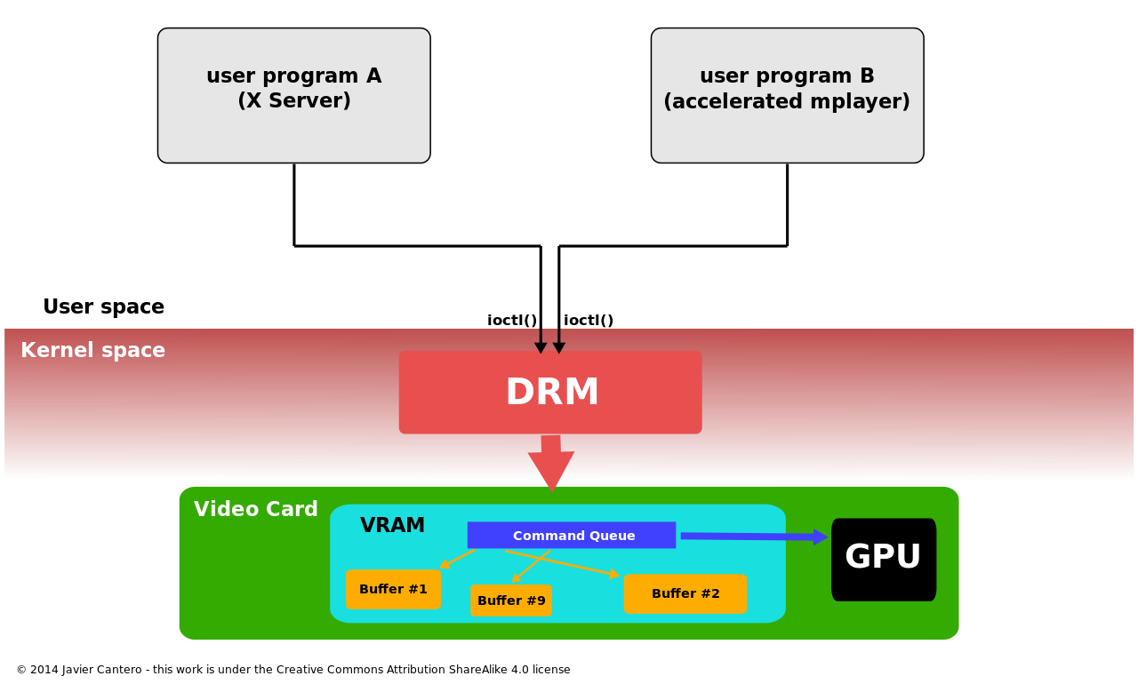
Direct Rendering Manager (DRM)
Use DRM

Slide 37
Kernel Mode Setting (KMS)
KMS device model
  CRTCs
  Connectors
  Encoders
  Planes
Kernel Mode Setting
  screen resolution
  color depth and
  refresh rate

Slide 38
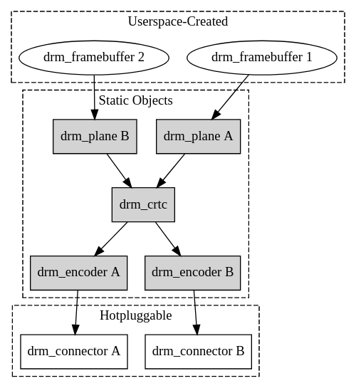
Kernel Mode Setting (KMS)
https://www.kernel.org/doc/html/v4.15/gpu/drm-kms.html

Slide 39
Kernel Mode Setting (KMS)
https://upload.wikimedia.org/wikipedia/commons/2/2d/The_Linux_Graphics_Stack_and_glamor.svg

Slide 40
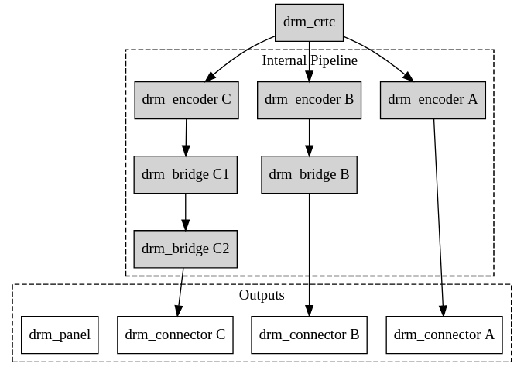
Kernel Mode Setting (KMS)
https://www.kernel.org/doc/html/v4.15/gpu/drm-kms.html

Slide 41

Video Frame Buffer
The frame buffer device provides an abstraction for
the graphics hardware.
Application
memory
User Space
MMAP
Kernel Space
memory
FB Driver

Slide 42
Kernel Mode Setting (KMS)
CRTC
Encode
Connecter
FrameBuffer
Planes

Slide 43
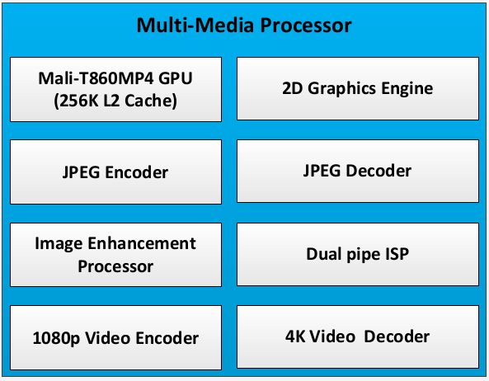
Multi-Media

Slide 44

Gstreamer

Slide 45
Open Source Multimedia Framework
https://gstreamer.freedesktop.org/
Documentation
  Tutorials

Slide 46
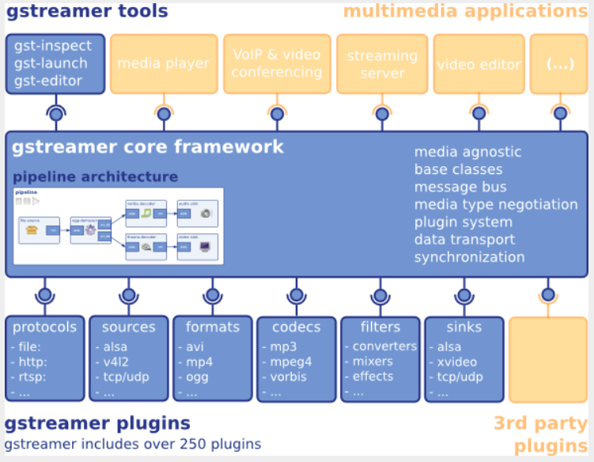
Block Diagram

Slide 47
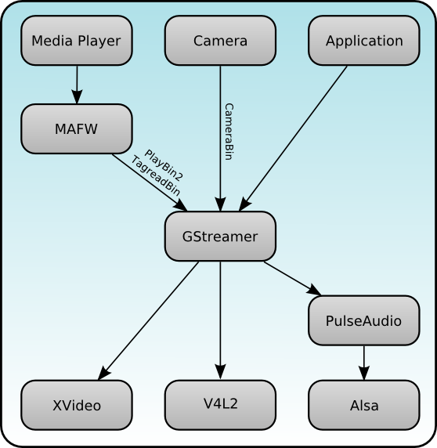
Block Diagram
http://maemo.org/development/sdks/maemo_5_beta_docs/using_multimedia_components/

Slide 48
Overview
GStreamer is a framework for creating streaming media applications
The framework is based on plugins that will provide the various codec and other functionality

Slide 49
Overview
Gst-plugins-base:
an essential exemplary set of elements
Gst-plugins-good:
a set of good-quality plug-ins under LGPL
Gst-plugins-ugly:
a set of good-quality plug-ins that might pose distribution problems
Gst-plugins-bad:
a set of plug-ins that need more quality

Slide 50
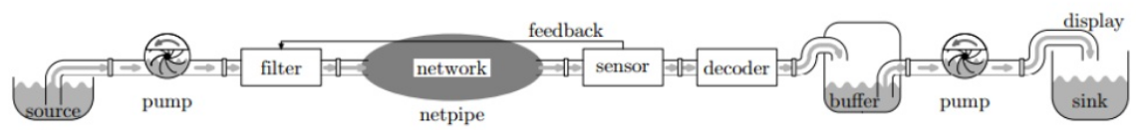
Gstreamer Pipe
A streamer pipe
https://www.slideshare.net/rodrigo_costa/gstreamer-an-overview

Slide 51
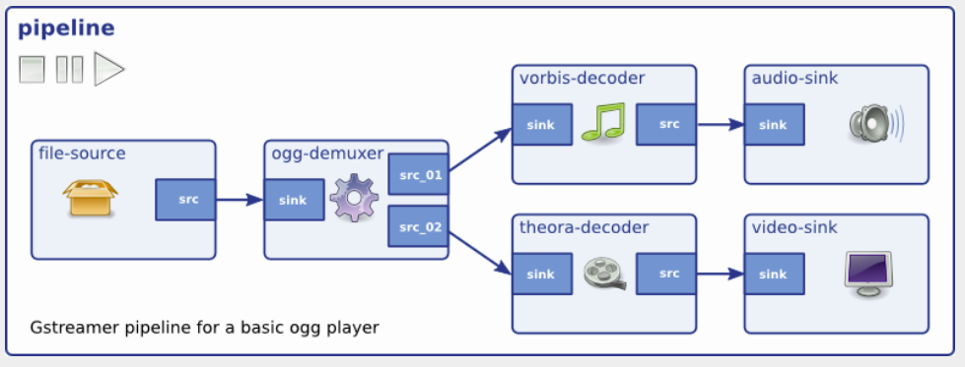
Gstreamer Pipe

Slide 52
Gstreamer - Tool
Gst-inspect-1.0
  Print supported plug-in
Gst-launch-1.0
  Gstreamer tester
Gst-typefind-1.0
  Check file for gstreamer plug-in type

Slide 53
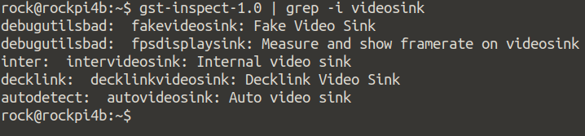
Gstreamer - Tool
Gst-inspect-1.0
  Check what kind of videosink in Rockpi4b
  gst-inspect-1.0 | grep -i videosink

Slide 54
Gstreamer - Tool
Gst-typefind-1.0
  Check Serenity-DVD-320x240.m4v what kind of file type in gstreamer
  gst-typefind-1.0 ./Serenity-DVD-320x240.m4v

Slide 55
Gstereamer - Video
App
gst-launch
Application
Gstreamer
Framework
GPU
KMS
wayland
FBD
Video Sink
GPU : Use OpenGL to Display
KMS : Use Kernel Mode Setting to Display
Wayland : Use Wayland protocol to Display
FBD : Use Frame Buffer device to Display

Slide 56
Play a H.264 video
gst-launch-1.0 filesrc location=/tmp/Serenity-DVD-320x240.m4v ! \
decodebin name=dec ! \
videoconvert ! \
kmssink
Source
Decoder
Format Conver
Sink
File
decodebin
videoconver
kmssink

Slide 57
Play a Audio Test
gst-launch-1.0 audiotestsrc ! audioconvert ! alsasink device-name=rockchipes8316c
Source
Format Convert
Sink
audiotestsrc
audioconver
audiocard

Slide 58
Play a MP3
gst-launch-1.0 filesrc location="/home/cadtc/audio/piano2-CoolEdit.mp3" ! \
mpegaudioparse ! \
mpg123audiodec ! \
audioconvert ! autoaudiosink
Source
Head Parser
Decoder
Format Convert
Sink
File
avdec_mp3
autoaudiosink
mpegaudioparse
audioconver

Slide 59
Audio

Slide 60
ALSA Overview
Advanced Linux Sound Architecture
  Linux kernel
  Software framework
Sound Servers
  PulseAudio, JACK ...
ALSA stream is a data flow representing sound
  PCM (Pulse-code modulation)
https://en.wikipedia.org/wiki/Advanced_Linux_Sound_Architecture

Slide 61
ALSA Overview
Audio Codec
  Audio Codec就是音樂訊號（Audio）壓縮/解壓縮(Compress/DECompress)
  的演算法或程式, 前後加起來就是Audio Codec.
Parameters of the hardware
  sampling rate : 44100 Hz
  sample width : 8 bit, 16 bit, 24 bit
  sample encoding : endianness
  number of channels : 1 channel, 2 channel ...
https://en.wikipedia.org/wiki/Advanced_Linux_Sound_Architecture

Slide 62
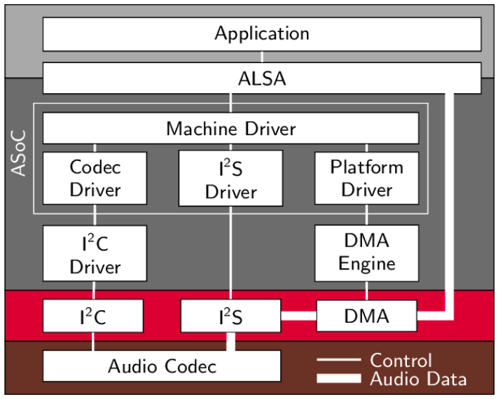
ALSA Overview
https://www.researchgate.net/figure/Structure-of-ASoC-and-the-embedment-into-the-Linux-audio-framework_fig2_262112720

Slide 63
Sound Card in Linux (1)
[CMD] ls /proc/asound/ -l
lrwxrwxrwx 1 root root 5 Apr 30 06:51 HDMICODEC -> card1
dr-xr-xr-x 4 root root 0 Apr 30 06:51 card0
dr-xr-xr-x 3 root root 0 Apr 30 06:51 card1
-r--r--r-- 1 root root 0 Apr 30 06:51 cards
-r--r--r-- 1 root root 0 Apr 30 06:51 devices
-r--r--r-- 1 root root 0 Apr 30 06:51 hwdep
-r--r--r-- 1 root root 0 Apr 30 06:51 pcm
lrwxrwxrwx 1 root root 5 Apr 30 06:51 rockchipes8316c -> card0
dr-xr-xr-x 2 root root 0 Apr 30 06:51 seq
-r--r--r-- 1 root root 0 Apr 30 06:51 timers
-r--r--r-- 1 root root 0 Apr 30 06:51 version

Slide 64
Sound Card in Linux (2)
Sound card 0
[CMD] cat /proc/asound/cards
0 [rockchipes8316c]: rockchip_es8316 - rockchip,es8316-codec
rockchip,es8316-codec
1 [HDMICODEC ]: HDMI-CODEC - HDMI-CODEC
HDMI-CODEC
Sound card 1

Slide 65
Sound Card in Linux (3)
rockchipes8316c
[CMD] ls -l /proc/asound/card0/
-r--r--r-- 1 root root 0 Apr 30 06:59 id
dr-xr-xr-x 3 root root 0 Apr 30 06:59 pcm0c
dr-xr-xr-x 3 root root 0 Apr 30 06:59 pcm0p
capture
playback
[CMD] ls -l /proc/asound/card1/
-r--r--r-- 1 root root 0 Apr 30 07:01 id
dr-xr-xr-x 3 root root 0 Apr 30 07:01 pcm0p

Slide 66
ALSA Tool
ALSA Utile
  aplay
    Play a WAV file
  arecord
    Record a sound
  amixer
    A console tool for adjusting audio gain

Slide 67
ALSA Tool
ALSA Utile
  aplay
    aplay -Dsysdefault:CARD=rockchipes8316c /usr/share/sounds/alsa/Front_Center.wav
    aplay -Dsysdefault:CARD=HDMICODEC /usr/share/sounds/alsa/Front_Center.wav
  arecord
    arecord -Dhw:0,0 -r 44100 -t wav -f CD -d 5 /tmp/test.wav
  amixer
    amixer scontrols | less
    amixer sget 'HP' 0%
    amixer sset 'HP' 0%

