Slide 1
CH4 Linux Generic Tool

Slide 2

Software and Tool
Open Source License
Develop Tool
→ Geany, gedit, vim
→ Git
→ diff, patch
Build Code Tool
→ ARM Toolchain
→ make
→ automake, autoconfig

Slide 3
Software and Tool
Network
→ nmcli, ethtool, wpa_supplicant
→ SSH, SSHFS
→ NFS
Bluetooth
→ hciconfig, bluetoothctl
Media Software
→ gstreamer
→ ALSA Tool - aplay, arecord

Slide 4
Software and Tool
Bus
→ I2C – I2cset, i2cget, i2cdump
→ USB – lsusb

Slide 5

Open Source License
GNU General Public License
→ 只要在一個軟件中使用("使用"指類庫引用，修改後的代碼或者衍生代碼)
GPL 協議的產 品，則該軟件產品必須也採用GPL協議, 既必須也是開源和免費.
這就是所謂的"傳染性"
BSD License
→ 基本上使用者可以"為所欲為",可以自由的使用，修改源代碼,
也可以將修改後的代碼作為開源或者專有軟件再發佈.
LGPL
→ LGPL是GPL的一個為主要為類庫使用設計的開源協議.
LGPL允許商 業軟件通過類 庫引用(link)方式使用LGPL類庫,
而不需要開源商業軟件的代碼.
這使得採用 LGPL協議的開源代碼可以被商業軟件作為類庫引用並發布和銷售.

Slide 6
Package Manage

Slide 7
Debian Package Management
dpkg : command-line tool for handling packages
dpkg --help
→ [CMD] dpkg -i ${PACKAGE_NAME} : install packag_name
→ [CMD] dpkg -r ${PACKAGE_NAME} : remove package_name

Slide 8
Ubuntu Package Management
apt-get : command-line tool for handling packages
apt-get --help
  → [CMD] apt-get update
  → [CMD] apt-get install ${PACKAGE_NAME}
  → [CMD] apt-get remove ${PACKAGE_NAME}
  → [CMD] apt-get clean

Slide 9
Editor

Slide 10
Editor
nano
  [CMD] sudo apt-get install nano
Vim (EVK-Board used)
  [CMD] sudo apt-get install vim

Slide 11
Vim Basic Operators
Open File
[CMD] vim file_name
General Mode
[CMD] :
[CMD] i
[CMD] ESC
Command Mode
Edit Mode
[CMD] wq
Save File

Slide 12
Diff Tool

Slide 13
diff and patch
diff - compare files line by line
  Create a patch file
    diff -Nuar file_a file_b > c.patch
      -N, treat absent files as empty
      -a, --text
      -u, output NUM (default 3) lines of unified context
      -r, recursively compare any subdirectories found
patch - apply a diff file to an original
  apply a patch file
    patch ./hello_1.c < ./tmp.patch
  Reverse a patch file
    patch -R ./hello_1.c < tmp.patch

Slide 14
Source Code Version Control

Slide 15
Git
https://git-scm.com/book/zh-tw/v1/
版本控制
程式回溯
管理多人共同開發

Slide 16
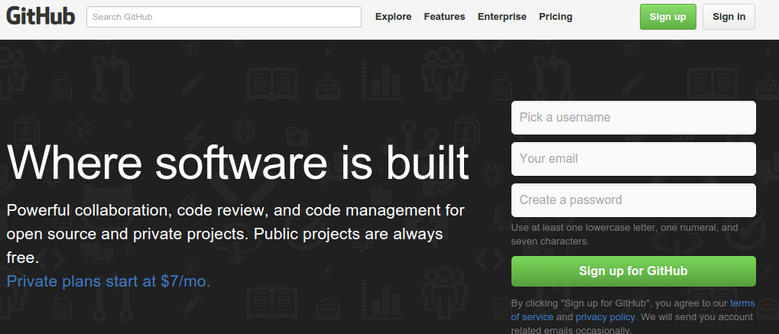
GitHub
https://github.com/

Slide 17
Exercise
0. Create an empty Git repository (In local)
$ git init
1. Clone code to local
$ git clone https://github.com/xlloss/tiny4412-uboot.git
2. modify something
$ gedit README
3. check source status
$ git status
4. use "git add <file>..." to update what will be committed
$ git add ./README
5. check status again
$ git status

Slide 18
Exercise
6. commit code to local repository
$ git commit -a “test”
Or $ git commit
7. check log
$ git log
8. check how many branch in local repository
$ git branch
9. create new branch in local repository
$ git branch “new_branch_name”
$ git branch cadtc_uboot

Slide 19
Exercise
10. check out to new branch
$ git checkout “branch_name”
$ git checkout slash_uboot
11. check branch again
$ git branch
12 . push log branch to remote
$ git push origin slash-uboot
13. check remote branch status
$ git branch origin/ and push tab x2

Slide 20
Exercise
reset your code, but modify code still live
$ git reset commit hash coed
Hard reset your code, all modify code will discard
$ git reset - -hard hash coed
Check log
$ git log
$ git show
Download objects and refs from another repository
$ git fetch [--all]

Slide 21
BASIC Git Command
init Create an empty Git repository
add Add file contents to the index
branch List, create, or delete branches
checkout Checkout a branch or paths to the working tree
clone Clone a repository into a new directory
commit Record changes to the repository

Slide 22
BASIC Git Command
diff Show changes between commits, commit and working tree, etc
rm Remove files from the working tree and from the index
pull Fetch from and merge with another repository or a local branch
push Update remote refs along with associated objects
reset Reset current HEAD to the specified state
cherry-pick apply changes introduced by some existing commits

Slide 23
Makefile

Slide 24
Makefile
Simplify compile command
Automation compile, linker program source
It can update source in accordance with the dependence

Slide 25
Compile a Hello_World
A
B
C
aarch64-linux-gnu-gcc -o helloworld ./hello.c
A : ARM C Compile
B : ARM C Compile Parameter
(Output name)
C : C source code

Slide 26
Another Sample
hello_world_out
hello_world.o
hello_world_2.o
hello_world.c
hello_world.h
hello_world_2.c

Slide 27
Compile Another Sample
Step 1 : gcc -c hello_world.c
Step 2 : gcc -c hello_world_2.c
Step 3 : gcc -o hello_world hello_world.o hello_world_2.o

Slide 28
Another Sample - Makefile
CC=$(CROSS_COMPILE)gcc
all: hello_world
hello_world: hello_world.o hello_world_2.o
$(CC) -o hello_world hello_world.o hello_world_2.o
hello_world.o: hello_world.c
$(CC) -c hello_world.c
hello_world_2.o: hello_world_2.c
$(CC) -c hello_world_2.c
clean:
rm -r *.o
rm hello_world

Slide 29
Rule Syntax
Target
main.o: main.c sum.h
gcc –c main.c
tab
dependency action
Rule
make 在編譯時，若發現 target 比較新，
也就是 dependencies 都比 target 舊，
那麼將不會重新建立 target，如此可以避免不必要的編譯動作

Slide 30
Rule Syntax
CC=$(CROSS_COMPILE)gcc
CFLAGS=-Wl,-Map,out.map -lpthread -lm
all: hello_world
hello_world: hello_world.o hello_world_2.o
$(CC) -o hello_world hello_world.o hello_world_2.o
hello_world.o: hello_world.c
$(CC) $(CFLAGS) -c hello_world.c
hello_world_2.o: hello_world_2.c
$(CC) $(CFLAGS) -c hello_world_2.c
clean:
rm -r *.o
rm hello_world

Slide 31
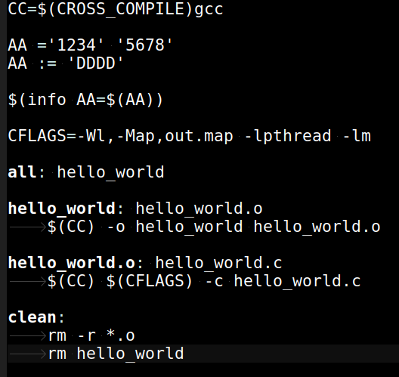
hello_world_ex1
: Tab

Slide 32
Assignment Operators
= 定義一個 需做遞迴展開的 變數型態
:= 定義一個 立即運作的 變數型態
+= 將 指定值, 續加在 原變數中
?= 如果之前 無任何設定該變數, 即現在設定,
否則 跳過設定(就是不做任何事)

Slide 33
Assignment Operators Sample 1
AA ='1234' '5678'
BB = ${AA}
AA = '789'
AA += 'ABCDE'
Output
AA='789' 'ABCDE'
BB='789' 'ABCDE'

Slide 34
Assignment Operators Sample 2
AA ='1234' '5678'
BB := ${AA}
AA = '789'
AA += 'ABCDE'
Output
AA='789' 'ABCDE'
BB='1234' '5678'

Slide 35
Assignment Operators Sample 3
AA ='1234' '5678'
BB := ${AA}
AA = '789'
AA ?= 'ABCDE'
Output
AA='789'
BB='1234' '5678'

Slide 36
The Automatic Variables
$@ The target filename.
$< The first prerequisite.
$^ The list of prerequisites, excluding duplicate
elements.

Slide 37
The Automatic Variables
CC = gcc
CFLAGS = -Wall -g -std=c99
LDFLAGS = -lm
circle : circle.o circulararea.o
$(CC) $(LDFLAGS) -o circle circle.o circulararea.o
circle.o : circle.c
$(CC) $(CFLAGS) -o circle.o -c circle.c
circulararea.o: circulararea.c
$(CC) $(CFLAGS) -o circulararea.o -c circulararea.c

Slide 38
The Automatic Variables
CC = gcc
CFLAGS = -Wall -g -std=c99
LDFLAGS = -lm
circle : circle.o circulararea.o
$(CC) $(LDFLAGS) -o $@ $^
circle.o : circle.c
$(CC) $(CFLAGS) -o $@ -c $<
circulararea.o: circulararea.c
$(CC) $(CFLAGS) -o $@ -c $<

Slide 39
Phony Targets
.PHONY
  Any targets that are prerequisites of .PHONY are always treated as out of date.
#Naming our phony targets
.PHONY: clean install
#Removing the executable and the object files
clean:
rm sample main.o example.o
echo clean: make complete
#Installing the final product
install:
cp sample /usr/local
echo install: make complete

Slide 40
Command-Line Options
-C dir, --directory= dir
  make changes the current working directory to dir before it does anything else. If the command line includes multiple -C options, each directory specified builds on the previous one
-j [ number] , --jobs[= number]
  Run multiple commands in parallel

Slide 41
Docker

Slide 42
What is Docker
https://docs.microsoft.com/zh-tw/dotnet/architecture/containerized-lifecycle/what-is-docker
簡單的說
  Docker : 模擬 作業系統的 “User space”, 沒有底層
  VirtualBox : 模擬 整個 作業系統, 包含 底層 與 硬體
優點
  對於開發 User space 的程式方便交換環境, 快速
缺點
  無法處理 底層 或是 硬體 相關 部份

Slide 43
What is Docker
OS1
OS2
OS3
OS4
VM1
S-VM1
S-VM2
S-VM3
S-VM4
Host

Slide 44
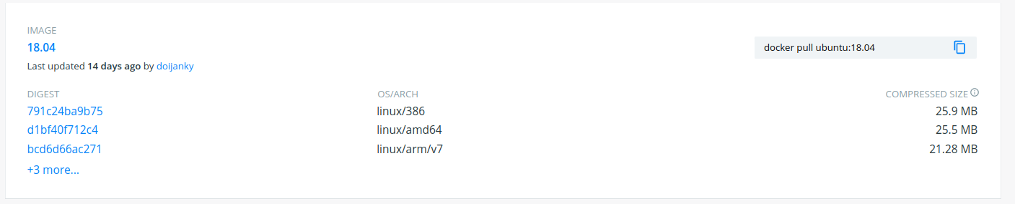
Dicker Hub
https://hub.docker.com/
https://hub.docker.com/_/ubuntu
Ubuntu 官方 已在 Docker Hub 建立不同版本的 docker image
直接從 Docker Hub 下載需要的新環境
  例如 : Ubuntu 1804

Slide 45
Install a Docker in Ubuntu
Install docker in Ubuntu
  $ sudo apt-get install docker
Docker help
  $ docker --help

Slide 46
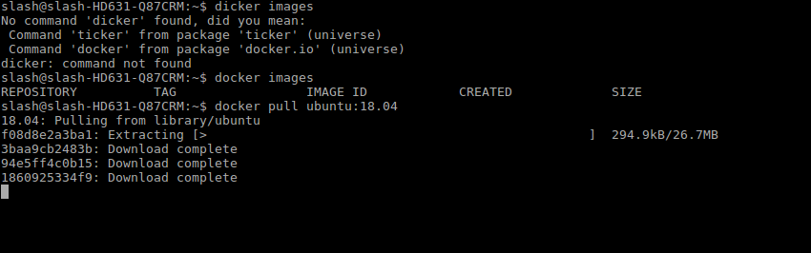
How to use Docker
Pull a Docker image that in Docker Hub
  For example : ubuntu 18.04
  $ docker pull ubuntu:18.04

Slide 47
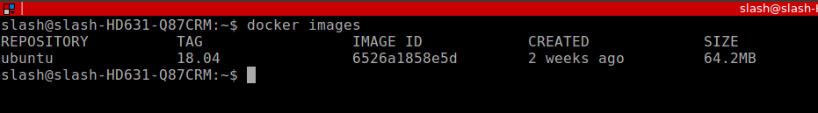
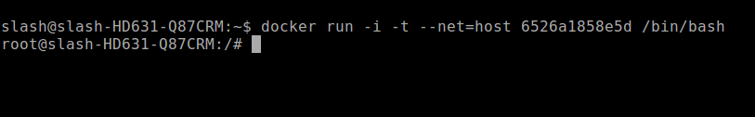
How to use Docker-2
Check docker Image in local
  $ docker images
start to run docker Image in local
  $ docker run --help
  $ docker run --net=host -i -t 6526a1858e5d /bin/bash
Enter docker
content

Slide 48
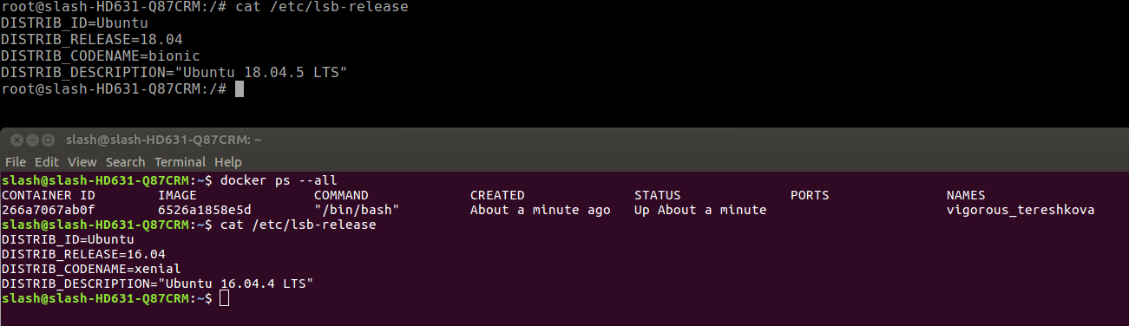
How to use Docker-3
Check docker content with docker command
Docker content (ubuntu 18.04)
Host (ubuntu 20.04)

Slide 49
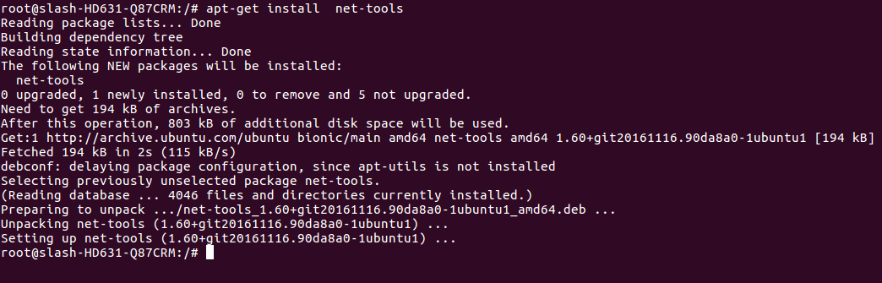
How to use Docker-4
Install package that you want in docker image
  For example
    $ apt-get install net-tools

Slide 50
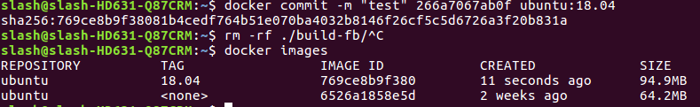
How to use Docker-5
Commit a docker content and push it to Docker Hub
  1. check which docker content that you want to commit
    $ docker ps --all
  2. check REPOSITORY and TAG of docker image current
    $ docker images
  3. commit docker content
    $ docker commit -m "test" 266a7067ab0f ubuntu:18.04

Slide 51
How to use Docker-6
Import a Local Docker Image (Load)
  [CMD] docker load < docker_image_file.tar
Save a Local Docker Image (Export)
  [CMD] docker save ${IMAGE_ID} > docker_image_file.tar

Slide 52
How to use Docker-7
Delete a docker Content
  $ docker ps --all
  $ docker rm ${Content ID}
Delete a docker Image
  $ docker images
  $ docker rmi ${IMAGE ID}

Slide 53
A Sample Docker Usage
docker_info.sh
Set environment variables
  -e --env
  -e DISPLAY
Execute application when login to docker content
  -c --cpu-shares
  -c "${DOCKER_BUILD_CMD}"
Work directory
  -w --workdir
  -w ${DOCKER_WORKDIR}

Slide 54
A Sample Docker Usage
Login with user name
  -u --user
  -u ${DOCKER_LOGIN_ID}
Mount a local disk space in docker content
  -v --volume
  -v ${LOCAL_FOLDER}:${DOCKER_FOLDER}
Allocate a pseudo-TTY
  -t --tty
Keep STDIN open even if not attached
  -i --interactive

