Slide 1
CH5 Cross Compilation Toolchain

Slide 2
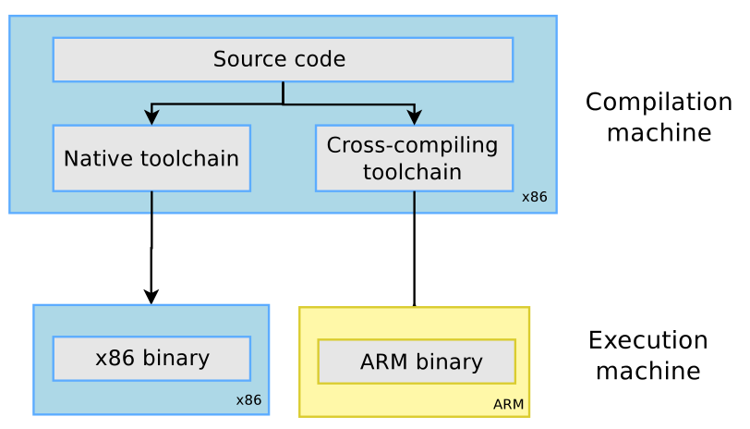
Cross Compilation Tool-chain

Slide 3

GCC Components
The GNU C Compiler
The GNU Compiler Collection
Binutils
Kernel head
C/C++ libraries
GCC compiler
GDB debuger

Slide 4
Binutils
Binutils
  as : the assembler, that generates binary code from
  assembler source code
  ld : the linker
  ar, ranlib : to generate .a archives, used for libraries
  objdump, readelf, size, nm, strings : to inspect binaries
  strip : to strip useless parts of binaries in order to reduce their size

Slide 5
Kernel head
The C library and compiled programs needs to interact with the kernel
Compiling the C library requires kernel headers, and many applications also require them
The kernel to user space ABI is backward compatible

Slide 6
GCC
GCC originally stood for the "GNU C Compiler."
GNU Compiler Collection
  C, C++, Ada, Objective-C, Fortran, JAVA ...
http://gcc.gnu.org/

Slide 7
GCC flag (1)
arm-linux-gnueabihf-gcc –help
  -c : Compile and assemble, but do not link
  -o <file> : Place the output into <file>
  -shared : Create a shared library
  -g : add debug information
  -O : sets the compiler's optimization level

Slide 8
GCC flag (2)
arm-linux-gnueabihf-gcc –help
  -Wall : enables all compiler's warning messages
  -D : defines a macro to be used by the preprocessor
  -I : adds include directory of header files
  -L,-l :
    -L looks in directory for library files
    -l links with a library file

Slide 9
C library
The C library is an essential component of a Linux system
Several C libraries are available:
  glibc, uClibc, eglibc, dietlibc, newlib
The choice of the C library must be made at the time of the cross-compiling toolchain generation, as the GCC compiler is compiled against a specific C library.

Slide 10
sysroot
The sysrootis thethe logical root directory for headers and libraries
GCC look for head and LD look for library
We can assign sysroot locate avoid toolchain change locate
→ --with-sysroot=<locate>

Slide 11
Floating point support
For processors having a floating point unit, the toolchain should generate hard float code, in order to use the floating point instructions directly
For processors without a floating point unit
  Generate hard float code and rely on the kernel to emulate the floating point instructions
  Generate soft float code, so that instead of generating floating point instructions, calls to a user space library are generated

Slide 12
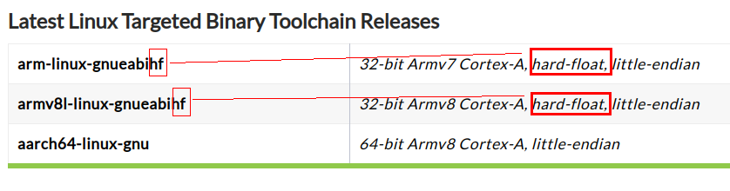
Floating point support
https://www.linaro.org/downloads/
RockPi4 Toolchain
https://releases.linaro.org/components/toolchain/binaries/7.3-2018.05/aarch64-linux-gnu/

Slide 13
Obtain a Toolchain
Building a cross-compiling toolchain by ourself
  Crosstool-NG
  http://crosstool-ng.org/#introduction
Pre-build toolchain
  Linaro - https://www.linaro.org/downloads/
  By Linux distribution -
    sudo apt-get install gcc-arm-linux-gnueabi
  BSP
  CodeSourcery

Slide 14
Installing and using Toolchain
Add the path to toolchain binaries in your PATH: export
  [CMD] PATH=${TOOLCHAIN_PATH}/bin/:$PATH
Compile your applications
  [CMD] ${PREFIX}-gcc -o testme testme.c
PREFIX
  depends on the toolchain configuration

Slide 15
Compile, Assembler, Linker

Slide 16
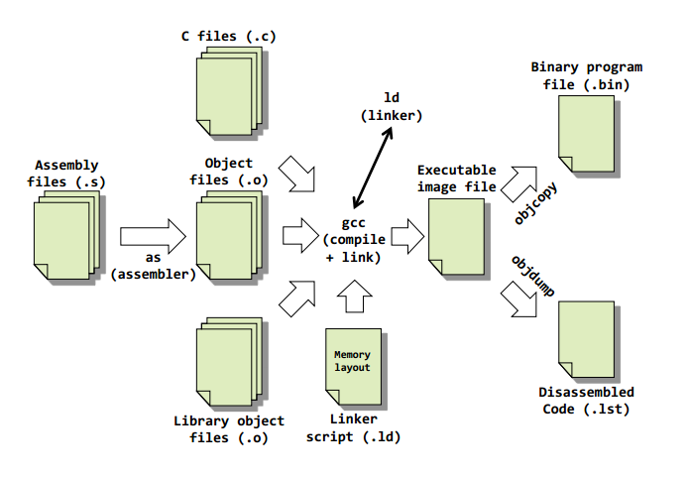
Software Development Tools Overview

Slide 17
Tools Descriptions
Assembler
  Translates Assembly Language Source Files Into Machine Language Object modules
C/C++ compiler
  produces ARM machine code object modules
Linker
  Combines object files into a single executable object module

Slide 18
Create Linux Library

Slide 19
Linux Library
Static Libraries
  statically aware
Dynamically Linked "Shared Object" Libraries
  Dynamically linked at run time

Slide 20
Static Libraries
static_lib_name.a
Create static library with ar
  ar --help
  ar -cvq libctest.a test1.o test2.o
Compile
  gcc -o test main.c libctest.a
  gcc -o test main.c -L/path/to/library-directory -lctest

Slide 21
Dynamically Linked
"Shared Object" Libraries
Dynamic_lib_name.so
Create share library
  gcc -share -Wl,-soname,soname -o libname filelist liblist
  gcc -shared -Wl,-soname,libctest.so.1 -o libctest.so.1.0 test1.o test2.o
  ln -s libctest.so.1.0 libctest.so.1
  ln -s libctest.so.1 libctest.so
gcc -o test main.c -L/library_PATH/ -lctest
export LD_LIBRARY_PATH=LIB_PATH:$LD_LIBRARY_PATH
./test

Slide 22
Dynamically Linked
"Shared Object" Libraries
ldconfig
configure dynamic linker run-time bindings
/etc/ld.so.conf
  1. $ vim /etc/ld.so.conf
    and add LIB in path /usr/local
  2. #ldconfig /usr/local/
    /etc/ld.so.cache

Slide 23
What and Need soname ?
Real-name libctest.so.1.0
Soname libctest.so.1 → libctest.so.1.0
Linkname libctest.so → libctest.so.1
Modify
Real-name libctest.so.1.1
Soname libctest.so.1 → libctest.so.1.1
Linkname libctest.so → libctest.so.1
Real-name libctest.so.1.5
Soname libctest.so.1 → libctest.so.1.5
Linkname libctest.so → libctest.so.1
main.c no need to re-compile
gcc -o test main.c -L/library_PATH/ -lctest

