Slide 1

Gstreamer
Gstreamer
Open Source Multimedia Framework

Slide 2
Open Source Multimedia Framework
https://gstreamer.freedesktop.org/
Documentation
  Tutorials

Slide 3
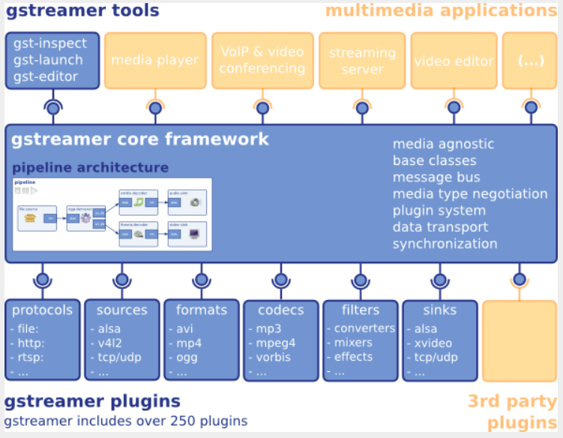
Block Diagram

Slide 4
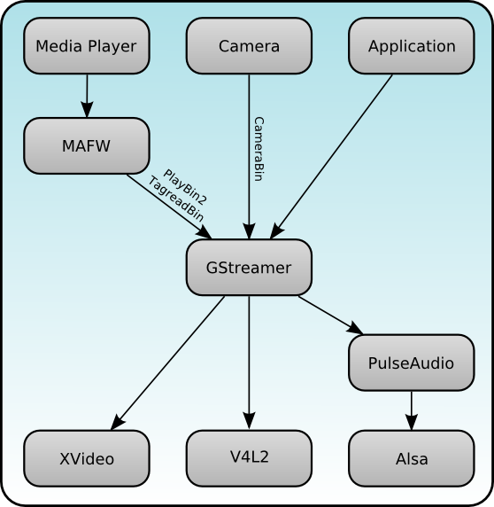
Block Diagram
http://maemo.org/development/sdks/maemo_5_beta_docs/using_multimedia_components/

Slide 5
Overview
GStreamer is a framework for creating streaming media applications
The framework is based on plugins that will provide the various codec and other functionality

Slide 6
Overview
Gst-plugins-base:
an essential exemplary set of elements
Gst-plugins-good:
a set of good-quality plug-ins under LGPL
Gst-plugins-ugly:
a set of good-quality plug-ins that might pose distribution problems
Gst-plugins-bad:
a set of plug-ins that need more quality

Slide 7
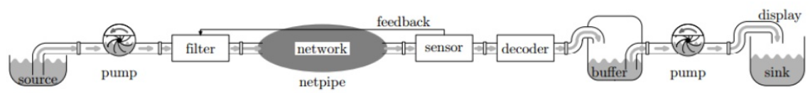
Gstreamer Pipe
A streamer pipe
https://www.slideshare.net/rodrigo_costa/gstreamer-an-overview

Slide 8
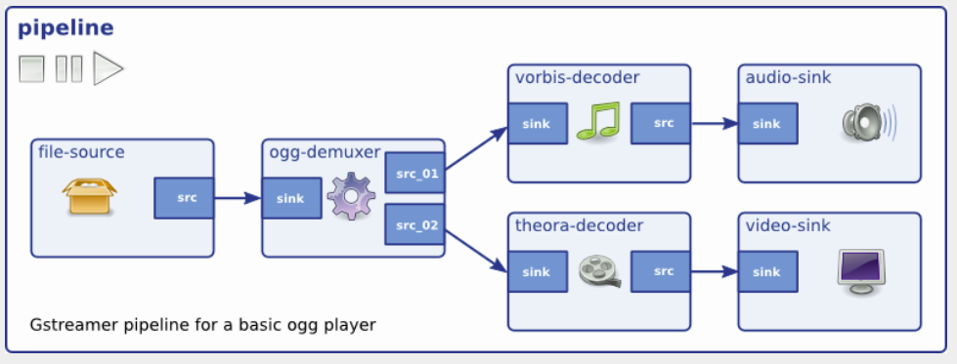
Gstreamer Pipe

Slide 9
Gstreamer - Tool
Gst-inspect-1.0
  Print supported plug-in
Gst-launch-1.0
  Gstreamer tester
Gst-typefind-1.0
  Check file for gstreamer plug-in type

Slide 10
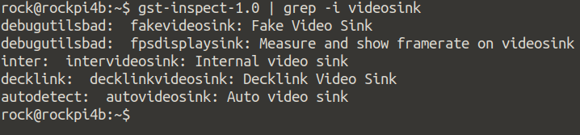
Gstreamer - Tool
Gst-inspect-1.0
  Check what kind of videosink in Rockpi4b
  gst-inspect-1.0 | grep -i videosink

Slide 11
Gstreamer - Tool
Gst-typefind-1.0
  Check Serenity-DVD-320x240.m4v what kind of file type in gstreamer
  gst-typefind-1.0 ./Serenity-DVD-320x240.m4v

Slide 12
Gstereamer - Video
App
gst-launch
Application
Gstreamer
Framework
GPU
KMS
wayland
FBD
Video Sink
GPU : Use OpenGL to Display
KMS : Use Kernel Mode Setting to Display
Wayland : Use Wayland protocol to Display
FBD : Use Frame Buffer device to Display

Slide 13
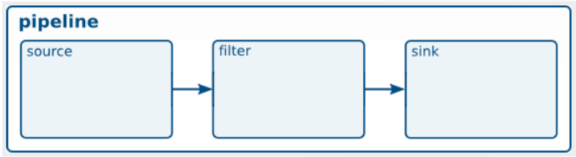
Play Video Test Stream

Slide 14
Play a H.264 video
gst-launch-1.0 filesrc location=/oem/200frames_count.h264 ! \
decodebin name=dec ! \
videoconvert ! \
kmssink
Source
Decoder
Format Conver
Sink
File
decodebin
videoconver
kmssink

Slide 15
Play a Audio Test
gst-launch-1.0 audiotestsrc ! audioconvert ! alsasink device-name=realtekrt5651co
Source
Format Convert
Sink
audiotestsrc
audioconver
audiocard

Slide 16
Play a MP3
gst-launch-1.0 filesrc location="oem/piano2-CoolEdit.mp3" ! \
mpegaudioparse ! \
avdec_mp3 ! \
audioconvert ! \
alsasink device=hw:0
Source
Head Parser
Decoder
Format Convert
Sink
File
avdec_mp3
kmssink
mpegaudioparse
audioconver

