Slide 1
Gstreamer

Slide 2
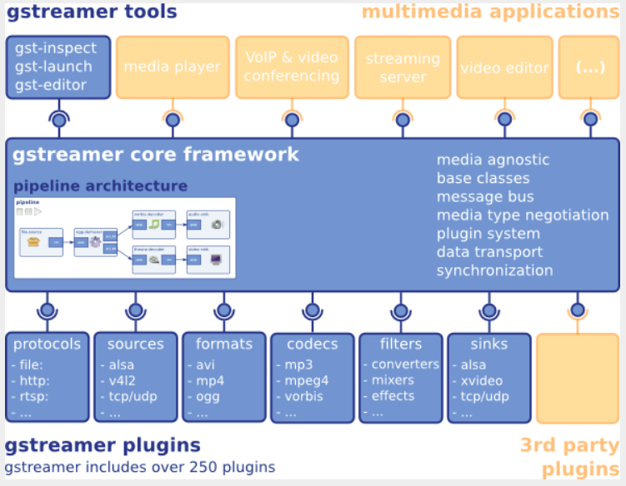

Slide 3
GStreamer is a framework for creating streaming media applications
The framework is based on plugins that will provide the various codec and other functionality

Slide 4
gst-plugins-base: an essential exemplary set of elements
gst-plugins-good: a set of good-quality plug-ins under LGPL
gst-plugins-ugly: a set of good-quality plug-ins that might pose distribution problems
gst-plugins-bad: a set of plug-ins that need more quality

Slide 5
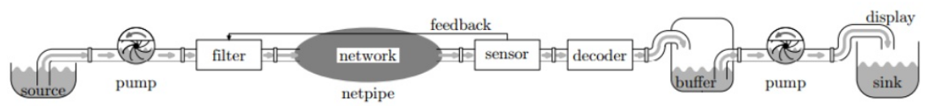
https://www.slideshare.net/rodrigo_costa/gstreamer-an-overview

Slide 6
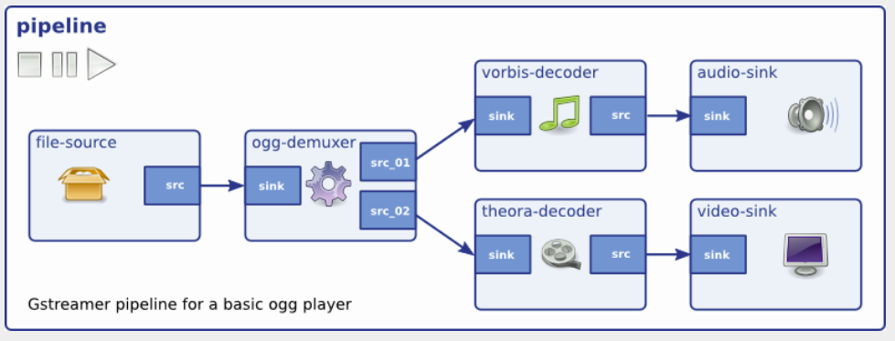

Slide 7
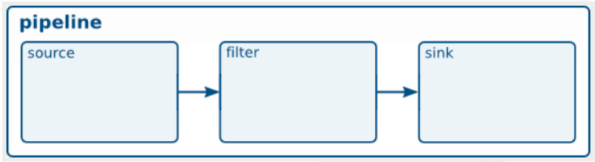
Play Video Test Stream

Slide 8
Play a H.264 video
gst-launch-1.0 filesrc location=/oem/200frames_count.h264 ! \
decodebin name=dec ! \
videoconvert ! \
kmssink
Source
Decoder
Format Conver
Sink
File
decodebin
videoconver
kmssink

Slide 9
Play a Audio Test
gst-launch-1.0 audiotestsrc ! audioconvert ! alsasink device-name=realtekrt5651co
Source
Format Convert
Sink
audiotestsrc
audioconver
audiocard

Slide 10
Play a MP3
gst-launch-1.0 filesrc location="oem/piano2-CoolEdit.mp3" ! \
mpegaudioparse ! \
avdec_mp3 ! \
audioconvert ! \
alsasink device=hw:0
Source
Head Parser
Decoder
Format Convert
Sink
File
avdec_mp3
kmssink
mpegaudioparse
audioconver

Slide 11
Audio

Slide 12
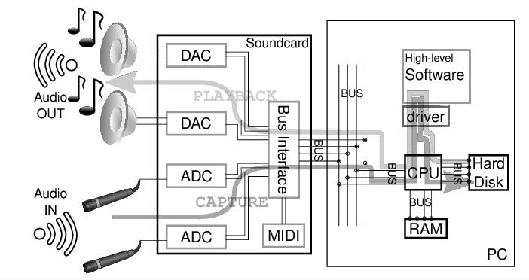
Audio Data Flow
https://www.semanticscholar.org/paper/Minivosc-a-minimal-virtual-oscillator-driver-for-Dimitrov-Serafin/ba2ebdc1f26cf1bfdd12018b79f95ff9fd68067b/figure/0

Slide 13
ALSA
Advanced Linux Sound Architecture
  Linux kernel
  Software framework
sound servers
  PulseAudio, JACK ...
ALSA stream is a data flow representing sound
  PCM (Pulse-code modulation)
Audio Codec
  Audio Codec就是音樂訊號（Audio）壓縮/解壓縮(Compress/DECompress)
  的演算法或程式, 前後加起來就是Audio Codec.
Parameters of the hardware
  sampling rate : 44100 Hz
  sample width : 8 bit, 16 bit, 24 bit
  sample encoding : endianness
  number of channels : 1 channel, 2 channel ...
https://en.wikipedia.org/wiki/Advanced_Linux_Sound_Architecture
AudioCodec

Slide 14
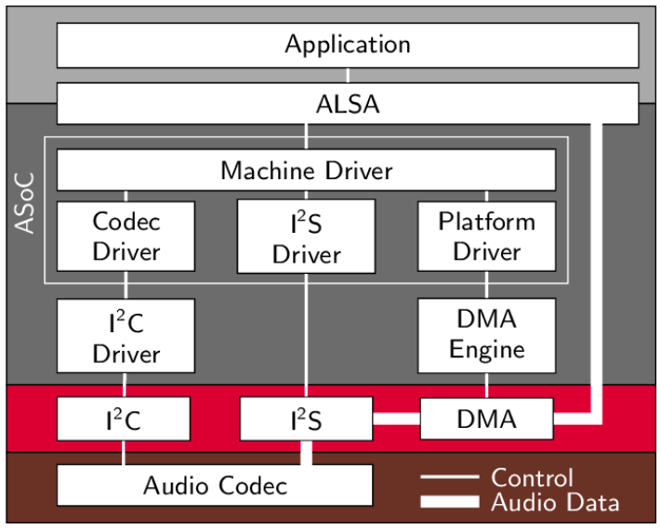
ALSA Overview
https://www.researchgate.net/figure/Structure-of-ASoC-and-the-embedment-into-the-Linux-audio-framework_fig2_262112720

Slide 15
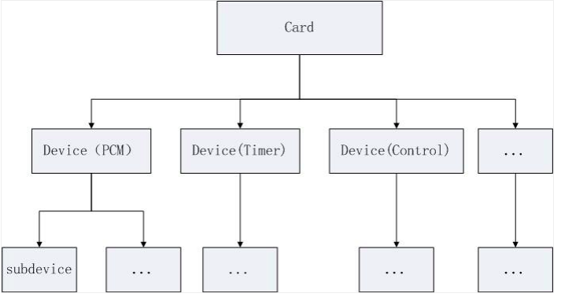
PCM
https://programmersought.com/article/14054396328/

Slide 16
Audio Attribute Under ProcFS
[root@rk3399:/]# ls /proc/asound/ -l
card0
card1
cards
device
pcm
realtekrt5651co -> card0
rockchiphdmi -> card1
seq
timers
version
[root@rk3399:/]# cat /proc/asound/pcm
00-00: ff890000.i2s-rt5651-aif1 rt5651-aif1-0 : : playback 1 : capture 1
01-00: ff8a0000.i2s-i2s-hifi i2s-hifi-0 : : playback 1

Slide 17
PCM Device
00-00 realtekrt5651co
playback 1
capture 1

Slide 18
Audio Attribute Under SysFS
[root@rk3399:/]# ls /sys/class/sound/ -l
card0 -> ../../devices/platform/rt5651-sound/sound/card0
card1 -> ../../devices/platform/hdmi-sound/sound/card1
controlC0 -> ../../devices/platform/rt5651-sound/sound/card0/controlC0
controlC1 -> ../../devices/platform/hdmi-sound/sound/card1/controlC1
pcmC0D0c -> ../../devices/platform/rt5651-sound/sound/card0/pcmC0D0c
pcmC0D0p -> ../../devices/platform/rt5651-sound/sound/card0/pcmC0D0p
pcmC1D0p -> ../../devices/platform/hdmi-sound/sound/card1/pcmC1D0p
seq -> ../../devices/virtual/sound/seq
timer -> ../../devices/virtual/sound/timer

Slide 19
PCM Device
00-00 realtekrt5651co
card0
pcmC0D0p
pcmC0D0c
controlC0

Slide 20
ALSA Tool
Aplay
→ command-line sound player for ALSA sound
Arecord
→ command-line sound record for ALSA sound
Amixer
→ command-line mixer for ALSA soundcard driver
Alsamixer
→ soundcard mixer for ALSA soundcard driver, with ncurses Interface

Slide 21
aplay and arecord (1)
-l, --list-devices
  list all sound cards and digital audio devices
-L, --list-pcms
  list device names
-D, --device=NAME
  select PCM by name

Slide 22
aplay and arecord (2)
-t, --file-type TYPE
  file type (voc, wav, raw or au)
-c, --channels
  channels
-r, --rate=#
  Sample rate
-d, --duration=#
  interrupt after # seconds

Slide 23
amixer (1)
[Commands]
scontrols → show all mixer simple controls
amixer -c realtekrt5651co scontrols
Simple mixer control 'Mono ADC',0
Simple mixer control 'Mono DAC',0
Simple mixer control 'ADC',0
Simple mixer control 'ADC Boost Gain',0
Simple mixer control 'ADC IF2 Data',0
Simple mixer control 'DAC IF2 Data',0
Simple mixer control 'DAC L2 Mux',0
Simple mixer control 'DAC MIXL INF1',0
Simple mixer control 'DAC MIXL Stereo ADC',0
Simple mixer control 'DAC MIXR INF1',0
Simple mixer control 'DAC MIXR Stereo ADC',0
Simple mixer control 'DAC R2 Mux',0
Simple mixer control 'DAC1',0
Simple mixer control 'DAC2',0

Slide 24
amixer (2)
[Commands]
scontents → show contents of all mixer simple controls
amixer -c realtekrt5651co scontents
Simple mixer control 'DAC2',0Simple mixer control 'Mono ADC',0
Capabilities: cvolume
Capture channels: Front Left - Front Right
Limits: Capture 0 - 127
Front Left: Capture 47 [37%] [0.00dB]
Front Right: Capture 47 [37%] [0.00dB]
Simple mixer control 'Mono DAC',0
Capabilities: pvolume
Playback channels: Front Left - Front Right
Limits: Playback 0 - 175
Mono:
Front Left: Playback 175 [100%] [0.00dB]
Front Right: Playback 175 [100%] [0.00dB]

Slide 25
amixer (3)
[Commands]
sget sID → get contents for one mixer simple control
amixer -c realtekrt5651co sget 'HP'
Simple mixer control 'HP',0
Capabilities: pvolume
Playback channels: Front Left - Front Right
Limits: Playback 0 - 39
Mono:
Front Left: Playback 31 [79%] [0.00dB]
Front Right: Playback 31 [79%] [0.00dB]

Slide 26
amixer (4)
[Commands]
sset sID → set contents for one mixer simple control
amixer -c realtekrt5651co sset 'HP' 50%
Simple mixer control 'HP',0
Capabilities: pvolume
Playback channels: Front Left - Front Right
Limits: Playback 0 - 39
Mono:
Front Left: Playback 20 [51%] [-16.50dB]
Front Right: Playback 20 [51%] [-16.50dB]

Slide 27
amixer (5)
[Commands]
controls → show all controls for given card
amixer -c realtekrt5651co controls
numid=11,iface=MIXER,name='Mono ADC Capture Volume'
numid=5,iface=MIXER,name='Mono DAC Playback Volume'
numid=1,iface=MIXER,name='HP Playback Volume'
numid=4,iface=MIXER,name='DAC1 Playback Volume'

Slide 28
amixer (6)
[Commands]
contents → show contents of all controls for given card
amixer -c realtekrt5651co contents
numid=11,iface=MIXER,name='Mono ADC Capture Volume'
; type=INTEGER,access=rw---R--,values=2,min=0,max=127,step=0
: values=47,47
| dBscale-min=-176.25dB,step=3.75dB,mute=0
numid=5,iface=MIXER,name='Mono DAC Playback Volume'
; type=INTEGER,access=rw---R--,values=2,min=0,max=175,step=0
: values=175,175
| dBscale-min=-656.25dB,step=3.75dB,mute=0

Slide 29
amixer (7)
[Commands]
cget cID → get control contents for one control
amixer -c realtekrt5651co cget numid=11
numid=11,iface=MIXER,name='Mono ADC Capture Volume'
; type=INTEGER,access=rw---R--,values=2,min=0,max=127,step=0
: values=47,47
| dBscale-min=-176.25dB,step=3.75dB,mute=0
amixer -c realtekrt5651co cget numid=12
numid=12,iface=MIXER,name='ADC Boost Gain'
; type=INTEGER,access=rw---R--,values=2,min=0,max=3,step=0
: values=0,0
| dBscale-min=0.00dB,step=12.00dB,mute=0

Slide 30
amixer (8)
[Commands]
cset cID → set control contents for one control
amixer -c realtekrt5651co cset numid=11 10
numid=11,iface=MIXER,name='Mono ADC Capture Volume'
; type=INTEGER,access=rw---R--,values=2,min=0,max=127,step=0
: values=10,10
| dBscale-min=-176.25dB,step=3.75dB,mute=0
amixer -c realtekrt5651co cget numid=12 3
; type=INTEGER,access=rw---R--,values=2,min=0,max=3,step=0
: values=3,3
| dBscale-min=0.00dB,step=12.00dB,mute=0

Slide 31
WIFI

Slide 32
wpa_supplicant
wpa_supplicant
  WEP, WPA and WPA2
It is the IEEE 802.1X/WPA component that is used in the client stations

Slide 33
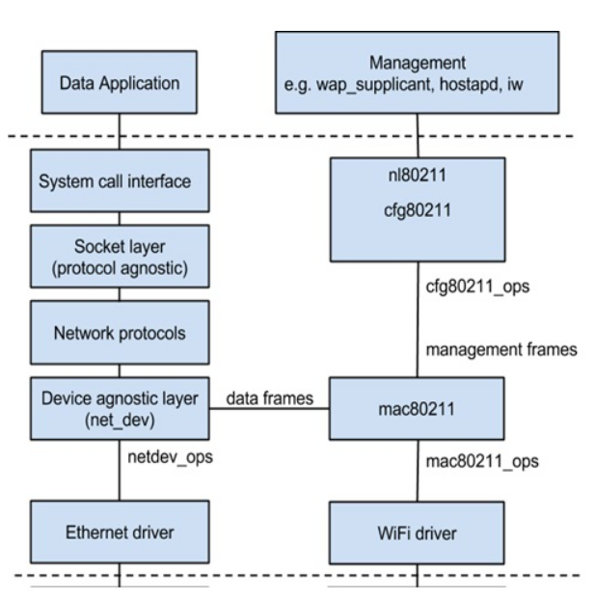
Linux Wireless Networking Architecture
https://www.linux.com/training-tutorials/linux-wireless-networking-short-walk/

Slide 34
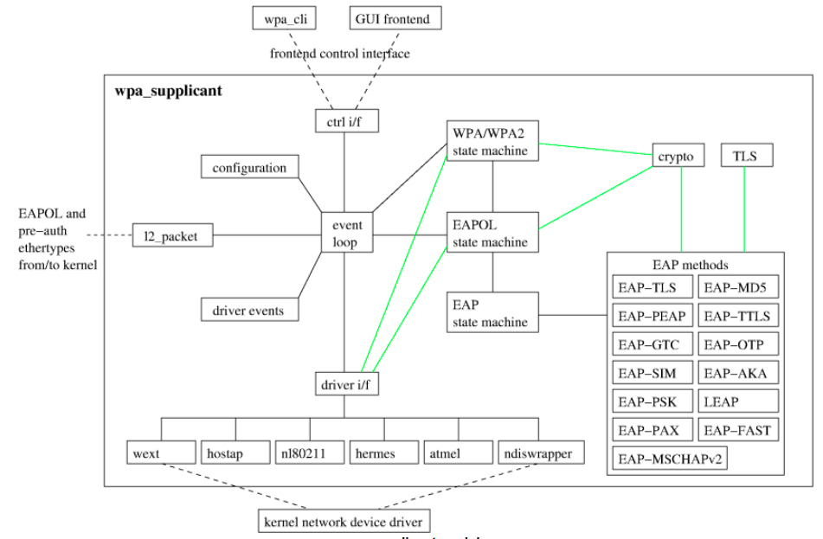
wpa_supplicant
https://w1.fi/wpa_supplicant/devel/

