Slide 1
Makefile

Slide 2
Compile a Hello_World
A
B
C
aarch64-linux-gnu-gcc -o helloworld ./hello.c
A : ARM C Compile
B : ARM C Compile Parameter
(Output name)
C : C source code

Slide 3
Another Sample
hello_world_out
hello_world.o
hello_world_2.o
hello_world.c
hello_world.h
hello_world_2.c

Slide 4
Compile Another Sample
Step 1 : gcc -c hello_world_2.c
Step 2 : gcc -c hello_world_2.c
Step 3 : gcc -o hello_world hello_world.o hello_world_2.o

Slide 5
Another Sample - Makefile
CC=$(CROSS_COMPILE)gcc
all: hello_world
hello_world: hello_world.o hello_world_2.o
$(CC) -o hello_world hello_world.o hello_world_2.o
hello_world.o: hello_world.c
$(CC) -c hello_world.c
hello_world_2.o: hello_world_2.c
$(CC) -c hello_world_2.c
clean:
rm -r *.o
rm hello_world

Slide 6
Rule Syntax
Target
main.o: main.c sum.h
gcc –c main.c
tab
dependency action
Rule
make 在編譯時，若發現 target 比較新，
也就是 dependencies 都比 target 舊，
那麼將不會重新建立 target，如此可以避免不必要的編譯動作

Slide 7
Rule Syntax
CC=$(CROSS_COMPILE)gcc
CFLAGS=-Wl,-Map,out.map -lpthread -lm
all: hello_world
hello_world: hello_world.o hello_world_2.o
$(CC) -o hello_world hello_world.o hello_world_2.o
hello_world.o: hello_world.c
$(CC) $(CFLAGS) -c hello_world.c
hello_world_2.o: hello_world_2.c
$(CC) $(CFLAGS) -c hello_world_2.c
clean:
rm -r *.o
rm hello_world

Slide 8
Rule Syntax Sample 1
hello_world_2.o: hello_world_2.c
$(CC) $(CFLAGS) -c hello_world_2.c
hello_world_2.o depend hello_world_2.c
If hello_world_2.c alive and be update,
it will do command ($(CC) $(CFLAGS) -c hello_world_2.c),
then output hello_world_2.o object file

Slide 9
Rule Syntax Sample 2
hello_world_2.o: hello_world_2.c
$(CC) $(CFLAGS) -c hello_world_2.c
hello_world.o depend hello_world.c
If hello_world.c alive and be update,
it will do command ($(CC) $(CFLAGS) -c hello_world.c),
then output hello_world.o object file.

Slide 10
Rule Syntax Sample 2
hello_world_2.o: hello_world_2.c
$(CC) $(CFLAGS) -c hello_world_2.c
hello_world depend hello_world.o and hello_world_2.o
If hello_world.o and hello_world_2.o alive and be update,
it will do command ($(CC) -o hello_world hello_world.o hello_world_2.o),
then create hello_world execute file

Slide 11
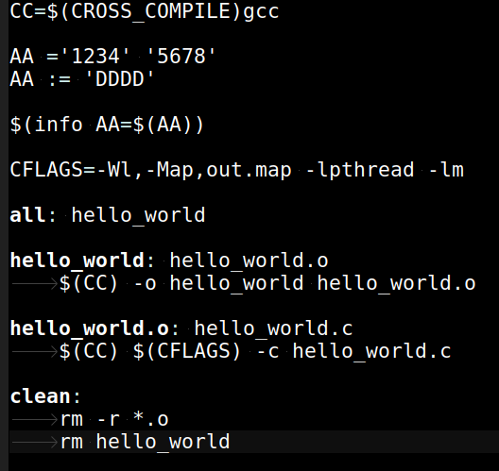
hello_world_ex1
: Tab

Slide 12
Assignment Operators
= Defines a recursively expanded variable
:= Defines a immediately variable
+= Also called the append operator. Appends more
characters to the existing value of a variable
?= The conditional assignment operator. Assigns a value to a variable, but only if the variable has no value,
otherwise keep original value

Slide 13
Assignment Operators
= 定義一個 需做遞迴展開的 變數型態
:= 定義一個 立即運作的 變數型態
+= 將 指定值, 續加在 原變數中
?= 如果之前 無任何設定該變數, 即現在設定,
否則 跳過設定(就是不做任何事)

Slide 14
Assignment Operators Sample 1
AA ='1234' '5678'
BB = ${AA}
AA = '789'
AA += 'ABCDE'
Output
AA='789' 'ABCDE'
BB='789' 'ABCDE'

Slide 15
Assignment Operators Sample 2
AA ='1234' '5678'
BB := ${AA}
AA = '789'
AA += 'ABCDE'
Output
AA='789' 'ABCDE'
BB='1234' '5678'

Slide 16
Assignment Operators Sample 3
AA ='1234' '5678'
BB := ${AA}
AA = '789'
AA ?= 'ABCDE'
Output
AA='789'
BB='1234' '5678'

