Slide 1
Setup Environment

Slide 2
Setup Compilation Environment
Under Ubuntu on a host PC run the following command for buildroot:
sudo apt-get install repo git-core gitk git-gui gcc-arm-linux-gnueabihf u-boot-tools device-tree-
compiler mtools parted libudev-dev libusb-1.0-0-dev python-linaro-image-tools linaro-image-tools autoconf autotools-dev libsigsegv2 m4 intltool libdrm-dev curl sed make binutils build-essential gcc g++ bash patch gzip bzip2 perl tar cpio python unzip rsync file bc wget libncurses5 libqt4-dev libglib2.0-dev libgtk2.0-dev libglade2-dev cvs git mercurial rsync openssh-client subversion asciidoc w3m dblatex graphviz python-matplotlib libc6:i386 libssl-dev texinfo liblz4-tool genext2fs lib32stdc++6 gtkterm geany

Slide 3
Setup Compilation Environment
Under Ubuntu on a host PC run the following command for Debian:
sudo apt-get install repo git-core gitk git-gui gcc-arm-linux-gnueabihf u-boot-tools device-tree-compiler gcc-aarch64-linux-gnu mtools parted libudev-dev libusb-1.0-0-dev python-linaro-image-tools linaro-image-tools gcc-4.8-multilib-arm-linux-gnueabihf gcc-arm-linux-gnueabihf libssl-dev gcc-aarch64-linux-gnu g+conf autotools-dev libsigsegv2 m4 intltool libdrm-dev curl sed make binutils build-essential gcc g++ bash patch gzip bzip2 perl tar cpio python unzip rsync file bc wget libncurses5 libqt4-dev libglib2.0-dev libgtk2.0-dev libglade2-dev cvs git mercurial rsync openssh-client subversion asciidoc w3m dblatex graphviz python-matplotlib libc6:i386 libssl-dev texinfo liblz4-tool genext2fs lib32stdc++6 gtkterm geany

Slide 4


Network Setting
Network Setting
  Link : https://slashembeddedlinux.blogspot.com/p/tmp.html

Slide 5
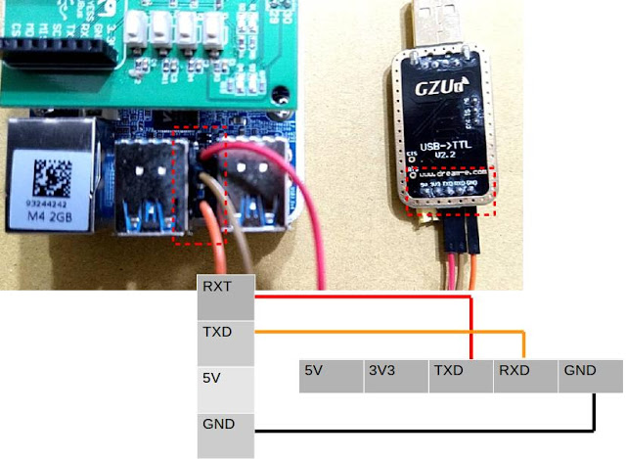

Debug Port Setup
Debug Port

Slide 6
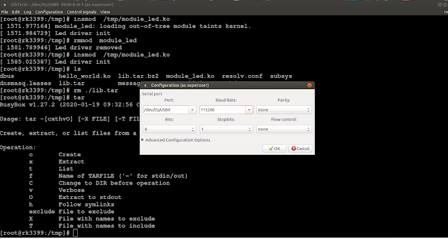
Debug Port Setup
Use gtkterm to watch EVB message

