Slide 1
Update To NanoPi-M4

Slide 2


SD Card Update
Download Pre-build Image
  $ wget sd-fuse_rk3399_slash
Extract sd-fuse_rk3399.tar.bz2
  $ tar -xvjf sd-fuse_rk3399.tar.bz2
https://slashembeddedlinux.blogspot.com/p/rk3399-develop.html

Slide 3
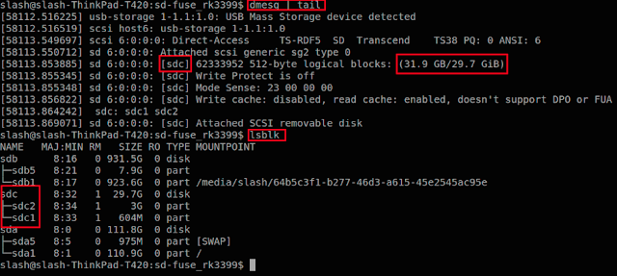
SD Card Update
Search SD Card device
  $ dmesg | tail
  $ lsblk

Slide 4
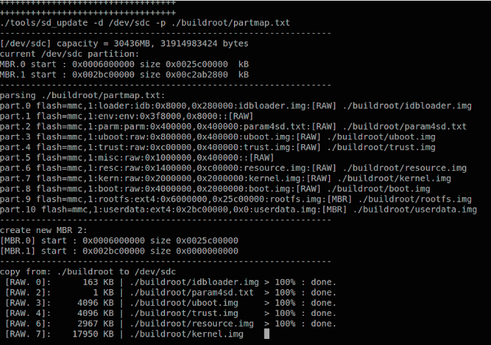
SD Card Update
Write Image to SD Card
  $ sudo fusing.sh /dev/sdX buildroot

Slide 5
SD Card Update
Write Image to SD Card
  $ sudo fusing.sh /dev/sdX debian

Slide 6
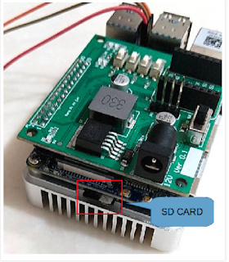
SD Card Update
Insert SD Card into Slot
Power On

Slide 7
Fastboot Update
sudo fastboot -i 0x2207 devices
sudo fastboot -i 0x2207 flash ${PartName} ${Image_Name}

Slide 8
Application Update
scp ${File_Name} root@${Board_IP}:/${Remote_DIR}
  $ scp hello_world root@192168.0.100:/tmp
sshfs [user@]host:[dir] mountpoint [options]
  $ sshfs root@192168.0.100:/tmp ./remote_dir

