Slide 1
WIFI

Slide 2
wpa_supplicant
wpa_supplicant
  WEP, WPA and WPA2
It is the IEEE 802.1X/WPA component that is used in the client stations

Slide 3
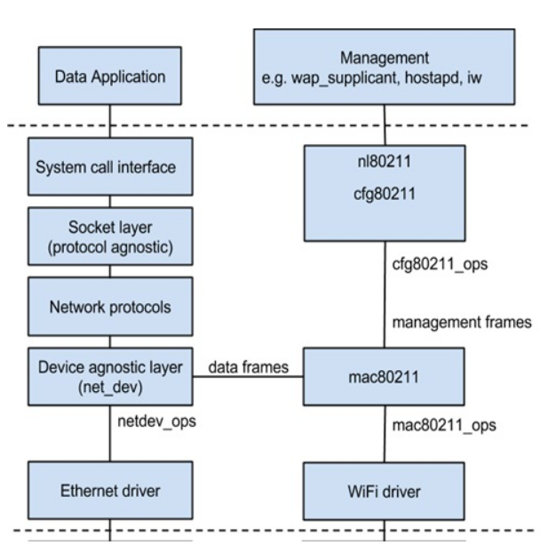
Linux Wireless Networking Architecture
https://www.linux.com/training-tutorials/linux-wireless-networking-short-walk/

Slide 4
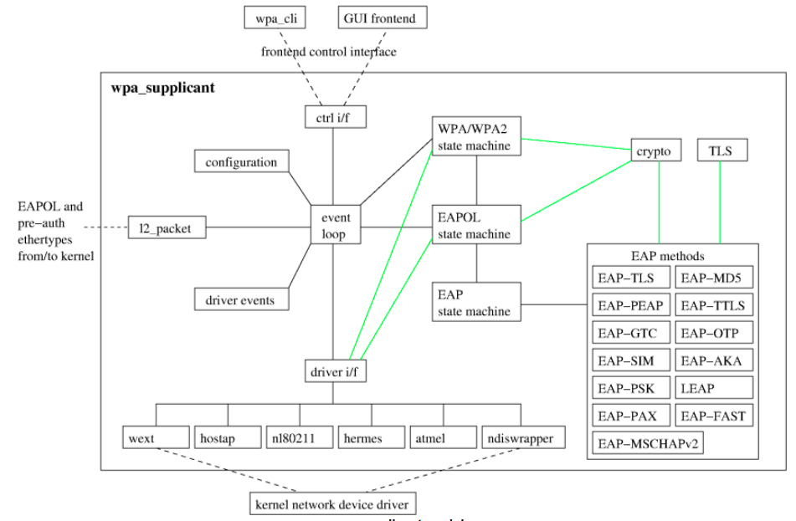
wpa_supplicant
https://w1.fi/wpa_supplicant/devel/

