Slide 1
ALSA
Advanced Linux Sound Architecture

Slide 2
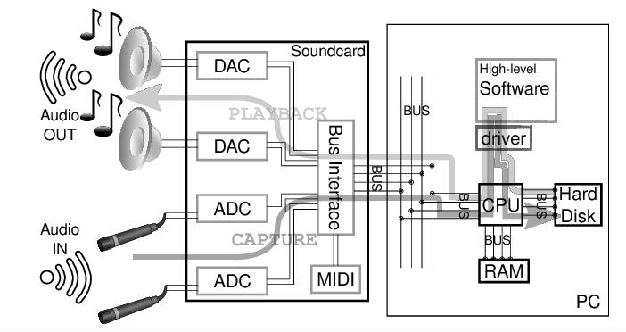
Audio Data Flow
https://www.semanticscholar.org/paper/Minivosc-a-minimal-virtual-oscillator-driver-for-Dimitrov-Serafin/ba2ebdc1f26cf1bfdd12018b79f95ff9fd68067b/figure/0

Slide 3
ALSA Overview
Advanced Linux Sound Architecture
  Linux kernel
  Software framework
Sound Servers
  PulseAudio, JACK ...
ALSA stream is a data flow representing sound
  PCM (Pulse-code modulation)
https://en.wikipedia.org/wiki/Advanced_Linux_Sound_Architecture

Slide 4
ALSA Overview
Audio Codec
  Audio Codec就是音樂訊號（Audio）壓縮/解壓縮(Compress/DECompress)
  的演算法或程式, 前後加起來就是Audio Codec.
Parameters of the hardware
  sampling rate : 44100 Hz
  sample width : 8 bit, 16 bit, 24 bit
  sample encoding : endianness
  number of channels : 1 channel, 2 channel ...
https://en.wikipedia.org/wiki/Advanced_Linux_Sound_Architecture

Slide 5
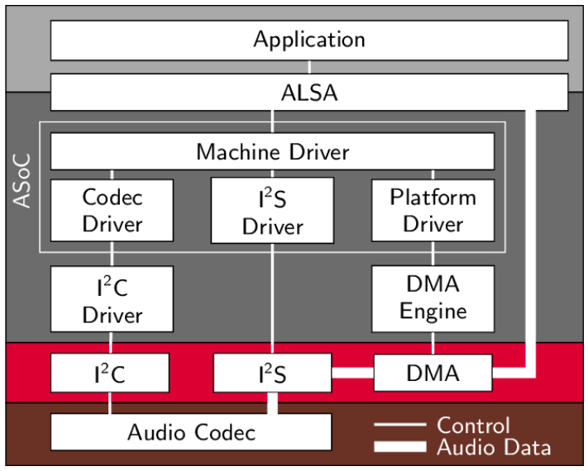
ALSA Overview
https://www.researchgate.net/figure/Structure-of-ASoC-and-the-embedment-into-the-Linux-audio-framework_fig2_262112720

Slide 6
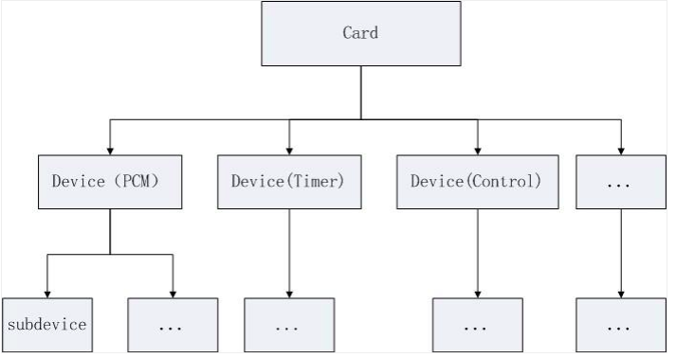
PCM
https://programmersought.com/article/14054396328/

Slide 7
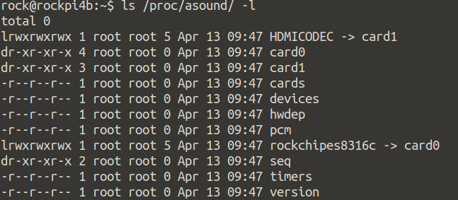
Audio Attribute Under ProcFS
[CMD] ls /proc/asound/ -l
[CMD] cat /proc/asound/pcm

Slide 8
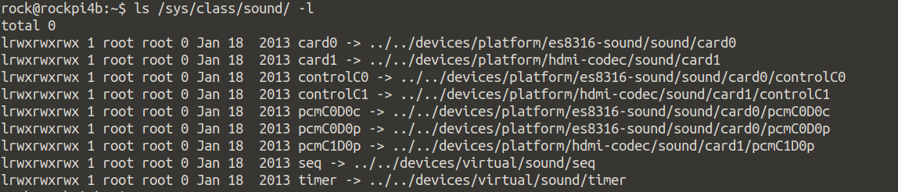
Audio Attribute Under SysFS
[CMD] ls /sys/class/sound/ -l

Slide 9
PCM Device
rockchipes8316c
card0
pcmC0D0p
pcmC0D0c
controlC0

Slide 10
ALSA Tool
Aplay
→ command-line sound player for ALSA sound
Arecord
→ command-line sound record for ALSA sound
Amixer
→ command-line mixer for ALSA soundcard driver
Alsamixer
→ soundcard mixer for ALSA soundcard driver, with ncurses Interface

Slide 11
aplay and arecord (1)
-l, --list-devices
  list all sound cards and digital audio devices
-L, --list-pcms
  list device names
-D, --device=NAME
  select PCM by name

Slide 12
aplay and arecord (2)
-t, --file-type TYPE
  file type (voc, wav, raw or au)
-c, --channels
  channels
-r, --rate=#
  Sample rate
-d, --duration=#
  interrupt after # seconds

Slide 13
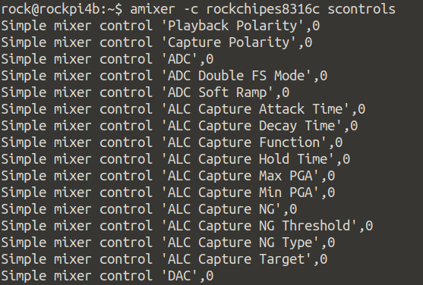
amixer (1)
[Commands]
scontrols → show all mixer simple controls
amixer -c rockchipes8316c scontrols

Slide 14
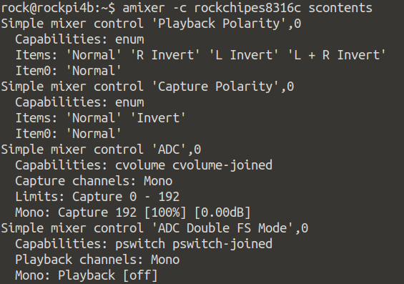
amixer (2)
[Commands]
scontents → show contents of all mixer simple controls
amixer -c rockchipes8316c scontents

Slide 15
amixer (3)
[Commands]
sget sID → get contents for one mixer simple control
amixer -c rockchipes8316c sget 'HP'
Simple mixer control 'HP',0
Capabilities: pvolume
Playback channels: Front Left - Front Right
Limits: Playback 0 - 39
Mono:
Front Left: Playback 31 [79%] [0.00dB]
Front Right: Playback 31 [79%] [0.00dB]

Slide 16
amixer (4)
[Commands]
sset sID → set contents for one mixer simple control
amixer -c rockchipes8316c sset 'HP' 50%
Simple mixer control 'HP',0
Capabilities: pvolume
Playback channels: Front Left - Front Right
Limits: Playback 0 - 39
Mono:
Front Left: Playback 20 [51%] [-16.50dB]
Front Right: Playback 20 [51%] [-16.50dB]

Slide 17
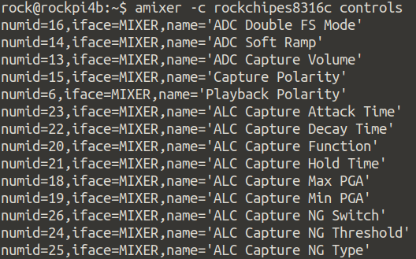
amixer (5)
[Commands]
controls → show all controls for given card
amixer -c rockchipes8316c controls

Slide 18
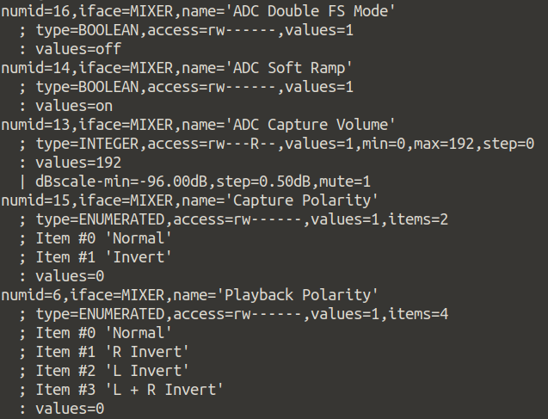
amixer (6)
[Commands]
contents → show contents of all controls for given card
amixer -c rockchipes8316c contents

Slide 19
amixer (7)
[Commands]
cget cID → get control contents for one control
amixer -c realtekrt5651co cget numid=11
numid=11,iface=MIXER,name='Mono ADC Capture Volume'
; type=INTEGER,access=rw---R--,values=2,min=0,max=127,step=0
: values=47,47
| dBscale-min=-176.25dB,step=3.75dB,mute=0
amixer -c realtekrt5651co cget numid=12
numid=12,iface=MIXER,name='ADC Boost Gain'
; type=INTEGER,access=rw---R--,values=2,min=0,max=3,step=0
: values=0,0
| dBscale-min=0.00dB,step=12.00dB,mute=0

Slide 20
amixer (8)
[Commands]
cset cID → set control contents for one control
amixer -c realtekrt5651co cset numid=11 10
numid=11,iface=MIXER,name='Mono ADC Capture Volume'
; type=INTEGER,access=rw---R--,values=2,min=0,max=127,step=0
: values=10,10
| dBscale-min=-176.25dB,step=3.75dB,mute=0
amixer -c realtekrt5651co cget numid=12 3
; type=INTEGER,access=rw---R--,values=2,min=0,max=3,step=0
: values=3,3
| dBscale-min=0.00dB,step=12.00dB,mute=0

