Slide 1
Introduction to
Embedded System

Slide 2
Embedded System
An embedded system
  combination of computer hardware and software
  specifically designed for a particular function
Applications
  Mobile phone
  Digital camera
  Smart TV
  Navigation system

Slide 3
Feature
Designed to do some specific task
  Low power
  Small size
  Special operating ranges
  Low cost
Install OS ?

Slide 4

SOC RK3399
http://wiki.friendlyarm.com/wiki/index.php/NanoPi_M4#Diagram.2C_Layout_and_Dimension

Slide 5
Component of embedded system
Processor
→ ARM, X86, MIPS ….
RAM
→ 8MB ~ 2 GB
Storagee
→ Nand, Nor flash
→ SD/MMC/eMMc
System Bus
→ AMBA, AHB, APB, AXI ...

Slide 6
Component of embedded system
Communication
  I2C, I2S, USB, PCI/PCIe ...
Media system
  JPEG, H.264 ..
System component
  DMA, RTC ..

Slide 7
Embedded Linux ?
Embedded Linux is the usage of the
Linux kernel and various
open-source components in
embedded systems
(from Free Electrons)

Slide 8
Advantages
Re-use components
Quickly design and develop complicated products
No need to re-develop components
→ TCP/IP stack, USB stack, PCI stack ...
Allow you modify components

Slide 9
Embedded Linux System Booting
Boot
Initialize HW
Loader
Load OS to memory
Linux
DTB
OS initial / load driver
RootFS
OS running

Slide 10
Embedded Linux System
Software components
Cross-compilation toolchain
Bootloader
Linux Kernel, DeviceTree
Rootfs
C library
Libraries and applications
BSP (Board Support Package)

Slide 11
Develop Environment

Slide 12
Develop Environment
Host PC
Toolchain
Target EVB (RockPi4)
BSP

Slide 13
BSP
Board Support Package
From chip vendor
  Distribution
    Bootloader
    Linux kernel
    Device driver
    Rootfs

Slide 14
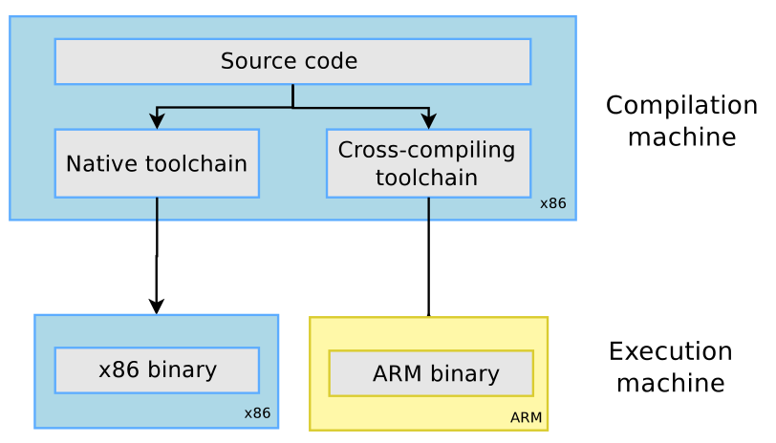
Cross Compilation toolchain

Slide 15
Setup References - 1
Debian Image :
https://github.com/radxa/rock-pi-images-released/releases
Image Write Tool :
https://www.balena.io/etcher/
Install Image to SD Card :
https://wiki.radxa.com/Rockpi4/install/microSD

Slide 16
Setup References - 2
Debug Port :
https://wiki.radxa.com/Rockpi4/dev/serial-console
Linaro ToolChain :
https://releases.linaro.org/components/toolchain/binaries/7.3-2018.05/aarch64-linux-gnu/gcc-linaro-7.3.1-2018.05-x86_64_aarch64-linux-gnu.tar.xz
Install Package :
sudo apt-get install libncurses5 libncurses5-dev build-essential libssl-dev mtools bc python dosfstools liblz4-tool

Slide 17
Setup References - 3
u-boot :
https://wiki.radxa.com/Rockpi4/dev/u-boot
Linux Kernel :
https://wiki.radxa.com/Rockpi4/dev/kernel-4.4
Debian :
https://wiki.radxa.com/Rockpi4/dev/Debian
RockPi4 WiKi :
https://wiki.radxa.com/Rockpi4

