Slide 1
CH3 Basic Software and Tool

Slide 2

Software and Tool
Open Source License
Develop Tool
→ Geany, gedit, vim
→ Git
→ diff, patch
Build Code Tool
→ ARM toolchain
→ make
→ automake, autoconfig

Slide 3
Software and Tool
Network
→ WiFi, Ethernet, Net tool
→ Bluetooth
→ SSH, SSHFS
→ NFS
Media Software
→ gstreamer
→ ALSA Tool - aplay, arecord

Slide 4
Software and Tool
Bus
→ I2C – I2cset, i2cget, i2cdump
→ USB – lsusb

Slide 5

Open Source License
GNU General Public License
→ 只要在一個軟件中使用("使用"指類庫引用，修改後的代碼或者衍生代碼)
GPL 協議的產 品，則該軟件產品必須也採用GPL協議, 既必須也是開源和免費.
這就是所謂的"傳染性"
BSD License
→ 基本上使用者可以"為所欲為",可以自由的使用，修改源代碼,
也可以將修改後的代碼作為開源或者專有軟件再發佈.
LGPL
→ LGPL是GPL的一個為主要為類庫使用設計的開源協議. LGPL允許商 業軟件
通過類 庫引用(link)方式使用LGPL類庫而不需要開源商業軟件的代碼. 這使得採用
LGPL協議的開源代碼可以被商業軟件作為類庫引用並發布和銷售.

Slide 6
Develop Tool

Slide 7
Ubuntu Package Management
apt-get : command-line tool for handling packages
apt-get --help
  → apt-get update
  → apt-get install ${PACKAGE_NAME}
  → apt-get remove ${PACKAGE_NAME}
  → apt-get autoremove
  → apt-get clean

Slide 8
Geany
You can find a good edit for programing
→ Geany
https://www.geany.org/
$ sudo apt-get install geany
→ Vim
$ sudo apt-get install vim
→ gedit

Slide 9

Tracking code command
Linux command
  Filter :
  → grep -r -n “function name”
  Fine special file include “String”
  → find -name “*.c” | xarge grep -n “String”

Slide 10
diff and patch
diff - compare files line by line
  Create a patch file
    diff -Nuar file_a file_b > c.patch
      -N, treat absent files as empty
      -a, --text
      -u, output NUM (default 3) lines of unified context
      -r, recursively compare any subdirectories found
patch - apply a diff file to an original
  apply a patch file
    patch ./hello_1.c < ./tmp.patch
  Reverse a patch file
    patch -R ./hello_1.c < tmp.patch

Slide 11
Git
https://git-scm.com/book/zh-tw/v1/
版本控制
程式回溯
管理多人共同開發

Slide 12

GitHub
https://github.com/

Slide 13
Exercise
0. Create an empty Git repository (In local)
$ git init
1. Clone code to local
$ git clone https://github.com/xlloss/tiny4412-uboot.git
2. modify something
$ gedit README
3. check source status
$ git status
4. use "git add <file>..." to update what will be committed
$ git add ./README
5. check status again
$ git status

Slide 14
Exercise
6. commit code to local repository
$ git commit -a “test”
Or $ git commit
7. check log
$ git log
8. check how many branch in local repository
$ git branch
9. create new branch in local repository
$ git branch “new_branch_name”
$ git branch cadtc_uboot

Slide 15
Exercise
10. check out to new branch
$ git checkout “branch_name”
$ git checkout slash_uboot
11. check branch again
$ git branch
12 . push log branch to remote
$ git push origin slash-uboot
13. check remote branch status
$ git branch origin/ and push tab x2

Slide 16
Exercise
reset your code, but modify code still live
$ git reset commit hash coed
Hard reset your code, all modify code will discard
$ git reset - -hard hash coed
Check log
$ git log
$ git show
Download objects and refs from another repository
$ git fetch [--all]

Slide 17
BASIC Git Command
init Create an empty Git repository
add Add file contents to the index
branch List, create, or delete branches
checkout Checkout a branch or paths to the working tree
clone Clone a repository into a new directory
commit Record changes to the repository

Slide 18
BASIC Git Command
diff Show changes between commits, commit and working tree, etc
rm Remove files from the working tree and from the index
pull Fetch from and merge with another repository or a local branch
push Update remote refs along with associated objects
reset Reset current HEAD to the specified state
cherry-pick apply changes introduced by some existing commits

Slide 19
Build Code Tool

Slide 20
Makefile

Slide 21
Makefile
Simplify compile command
Automation compile, linker program source
It can update source in accordance with the dependence

Slide 22
Compile a Hello_World
A
B
C
aarch64-linux-gnu-gcc -o helloworld ./hello.c
A : ARM C Compile
B : ARM C Compile Parameter
(Output name)
C : C source code

Slide 23
Another Sample
hello_world_out
hello_world.o
hello_world_2.o
hello_world.c
hello_world.h
hello_world_2.c

Slide 24
Compile Another Sample
Step 1 : gcc -c hello_world_2.c
Step 2 : gcc -c hello_world_2.c
Step 3 : gcc -o hello_world hello_world.o hello_world_2.o

Slide 25
Another Sample - Makefile
CC=$(CROSS_COMPILE)gcc
all: hello_world
hello_world: hello_world.o hello_world_2.o
$(CC) -o hello_world hello_world.o hello_world_2.o
hello_world.o: hello_world.c
$(CC) -c hello_world.c
hello_world_2.o: hello_world_2.c
$(CC) -c hello_world_2.c
clean:
rm -r *.o
rm hello_world

Slide 26
Rule Syntax
Target
main.o: main.c sum.h
gcc –c main.c
tab
dependency action
Rule
make 在編譯時，若發現 target 比較新，
也就是 dependencies 都比 target 舊，
那麼將不會重新建立 target，如此可以避免不必要的編譯動作

Slide 27
Rule Syntax
CC=$(CROSS_COMPILE)gcc
CFLAGS=-Wl,-Map,out.map -lpthread -lm
all: hello_world
hello_world: hello_world.o hello_world_2.o
$(CC) -o hello_world hello_world.o hello_world_2.o
hello_world.o: hello_world.c
$(CC) $(CFLAGS) -c hello_world.c
hello_world_2.o: hello_world_2.c
$(CC) $(CFLAGS) -c hello_world_2.c
clean:
rm -r *.o
rm hello_world

Slide 28
Rule Syntax Sample 1
hello_world_2.o: hello_world_2.c
$(CC) $(CFLAGS) -c hello_world_2.c
hello_world_2.o depend hello_world_2.c
If hello_world_2.c alive and be update,
it will do command ($(CC) $(CFLAGS) -c hello_world_2.c),
then output hello_world_2.o object file

Slide 29
Rule Syntax Sample 2
hello_world_2.o: hello_world_2.c
$(CC) $(CFLAGS) -c hello_world_2.c
hello_world.o depend hello_world.c
If hello_world.c alive and be update,
it will do command ($(CC) $(CFLAGS) -c hello_world.c),
then output hello_world.o object file.

Slide 30
Rule Syntax Sample 2
hello_world_2.o: hello_world_2.c
$(CC) $(CFLAGS) -c hello_world_2.c
hello_world depend hello_world.o and hello_world_2.o
If hello_world.o and hello_world_2.o alive and be update,
it will do command ($(CC) -o hello_world hello_world.o hello_world_2.o),
then create hello_world execute file

Slide 31
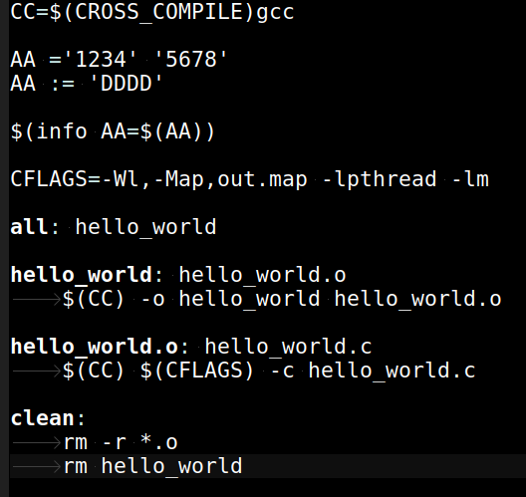
hello_world_ex1
: Tab

Slide 32
Assignment Operators
= 定義一個 需做遞迴展開的 變數型態
:= 定義一個 立即運作的 變數型態
+= 將 指定值, 續加在 原變數中
?= 如果之前 無任何設定該變數, 即現在設定,
否則 跳過設定(就是不做任何事)

Slide 33
Assignment Operators Sample 1
AA ='1234' '5678'
BB = ${AA}
AA = '789'
AA += 'ABCDE'
Output
AA='789' 'ABCDE'
BB='789' 'ABCDE'

Slide 34
Assignment Operators Sample 2
AA ='1234' '5678'
BB := ${AA}
AA = '789'
AA += 'ABCDE'
Output
AA='789' 'ABCDE'
BB='1234' '5678'

Slide 35
Assignment Operators Sample 3
AA ='1234' '5678'
BB := ${AA}
AA = '789'
AA ?= 'ABCDE'
Output
AA='789'
BB='1234' '5678'

Slide 36
The Automatic Variables
$@ The target filename.
$< The first prerequisite.
$^ The list of prerequisites, excluding duplicate
elements.

Slide 37
The Automatic Variables
CC = gcc
CFLAGS = -Wall -g -std=c99
LDFLAGS = -lm
circle : circle.o circulararea.o
$(CC) $(LDFLAGS) -o circle circle.o circulararea.o
circle.o : circle.c
$(CC) $(CFLAGS) -o circle.o -c circle.c
circulararea.o: circulararea.c
$(CC) $(CFLAGS) -o circulararea.o -c circulararea.c

Slide 38
The Automatic Variables
CC = gcc
CFLAGS = -Wall -g -std=c99
LDFLAGS = -lm
circle : circle.o circulararea.o
$(CC) $(LDFLAGS) -o $@ $^
circle.o : circle.c
$(CC) $(CFLAGS) -o $@ -c $<
circulararea.o: circulararea.c
$(CC) $(CFLAGS) -o $@ -c $<

Slide 39
Phony Targets
.PHONY
  Any targets that are prerequisites of .PHONY are always treated as out of date.
#Naming our phony targets
.PHONY: clean install
#Removing the executable and the object files
clean:
rm sample main.o example.o
echo clean: make complete
#Installing the final product
install:
cp sample /usr/local
echo install: make complete

Slide 40
Command-Line Options
-C dir, --directory= dir
  make changes the current working directory to dir before it does anything else. If the command line includes multiple -C options, each directory specified builds on the previous one
-j [ number] , --jobs[= number]
  Run multiple commands in parallel

Slide 41
Media Tool

Slide 42

Gstreamer

Slide 43
Open Source Multimedia Framework
https://gstreamer.freedesktop.org/
Documentation
  Tutorials

Slide 44
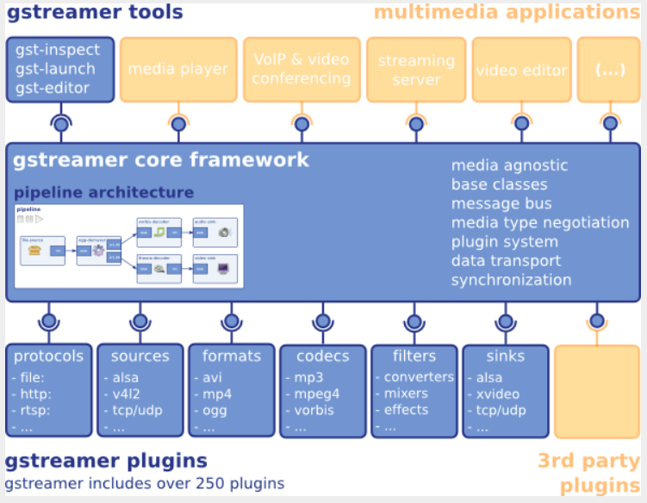
Block Diagram

Slide 45
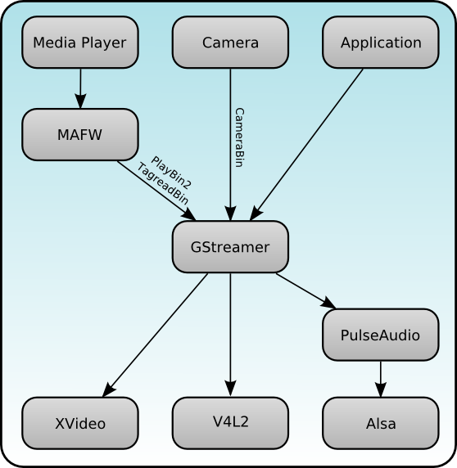
Block Diagram
http://maemo.org/development/sdks/maemo_5_beta_docs/using_multimedia_components/

Slide 46
Overview
GStreamer is a framework for creating streaming media applications
The framework is based on plugins that will provide the various codec and other functionality

Slide 47
Overview
Gst-plugins-base:
an essential exemplary set of elements
Gst-plugins-good:
a set of good-quality plug-ins under LGPL
Gst-plugins-ugly:
a set of good-quality plug-ins that might pose distribution problems
Gst-plugins-bad:
a set of plug-ins that need more quality

Slide 48
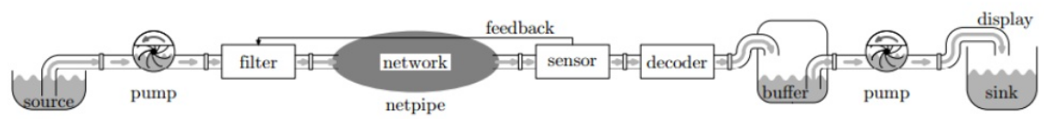
Gstreamer Pipe
A streamer pipe
https://www.slideshare.net/rodrigo_costa/gstreamer-an-overview

Slide 49
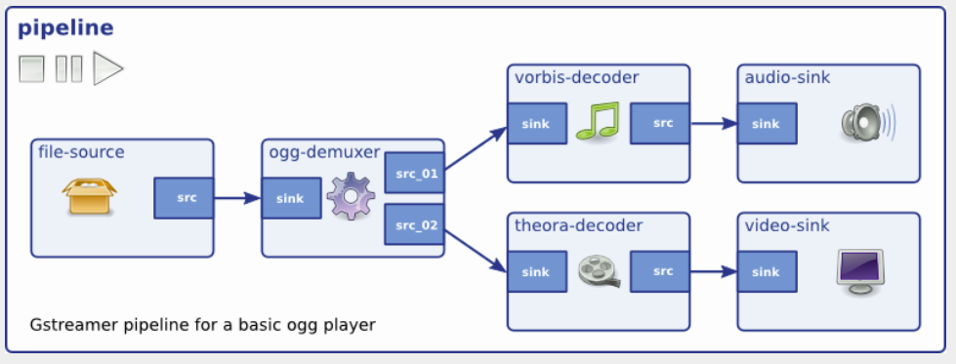
Gstreamer Pipe

Slide 50
Gstreamer - Tool
Gst-inspect-1.0
  Print supported plug-in
Gst-launch-1.0
  Gstreamer tester
Gst-typefind-1.0
  Check file for gstreamer plug-in type

Slide 51
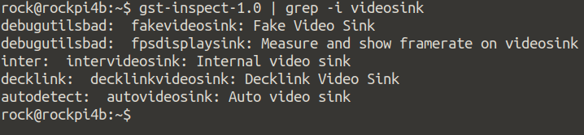
Gstreamer - Tool
Gst-inspect-1.0
  Check what kind of videosink in Rockpi4b
  gst-inspect-1.0 | grep -i videosink

Slide 52
Gstreamer - Tool
Gst-typefind-1.0
  Check Serenity-DVD-320x240.m4v what kind of file type in gstreamer
  gst-typefind-1.0 ./Serenity-DVD-320x240.m4v

Slide 53
Gstereamer - Video
App
gst-launch
Application
Gstreamer
Framework
GPU
KMS
wayland
FBD
Video Sink
GPU : Use OpenGL to Display
KMS : Use Kernel Mode Setting to Display
Wayland : Use Wayland protocol to Display
FBD : Use Frame Buffer device to Display

Slide 54
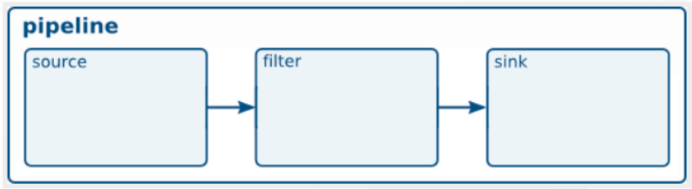
Play Video Test Stream

Slide 55
Play a H.264 video
gst-launch-1.0 filesrc location=/oem/200frames_count.h264 ! \
decodebin name=dec ! \
videoconvert ! \
kmssink
Source
Decoder
Format Conver
Sink
File
decodebin
videoconver
kmssink

Slide 56
Play a Audio Test
gst-launch-1.0 audiotestsrc ! audioconvert ! alsasink device-name=rockchipes8316c
Source
Format Convert
Sink
audiotestsrc
audioconver
audiocard

Slide 57
Play a MP3
gst-launch-1.0 filesrc location="/home/cadtc/audio/piano2-CoolEdit.mp3" ! \
mpegaudioparse ! \
mpg123audiodec ! \
audioconvert ! autoaudiosink
Source
Head Parser
Decoder
Format Convert
Sink
File
avdec_mp3
autoaudiosink
mpegaudioparse
audioconver

Slide 58
ALSA Tool
ALSA Utile
  aplay
    Play a WAV file
  arecord
    Record a sound
  alsamixer
    A graph tool for adjusting audio gain
  amixer
    A console tool for adjusting audio gain

Slide 59
ALSA Tool
ALSA Utile
  aplay
    aplay -Dsysdefault:CARD=rockchipes8316c /usr/share/sounds/alsa/Front_Center.wav
    aplay -Dsysdefault:CARD=HDMICODEC /usr/share/sounds/alsa/Front_Center.wav
  arecord
    arecord -Dhw:0,0 -r 44100 -t wav -f CD -d 5 /tmp/test.wav
  alsamixer
    alasmixer
  amixer
    amixer scontrols | less
    amixer sget 'HP' 0%
    amixer sset 'HP' 0%

Slide 60
WiFi and Network

Slide 61
Basic Network Tool
ifconfig → Network setting check
ping → Network package check
iperf3 → perform network throughput tests
dhcpc → used for automatic retrieving of

Slide 62
WPA/WPA2
iw → Finding the WiFi device name
  Scan SSID
wpa_supplicant
  For connecting to a WPA/WPA2 network

Slide 63
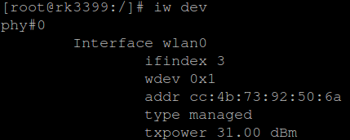
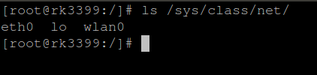
WPA/WPA2 - Device
$ iw dev
$ ls /sys/class/net

Slide 64
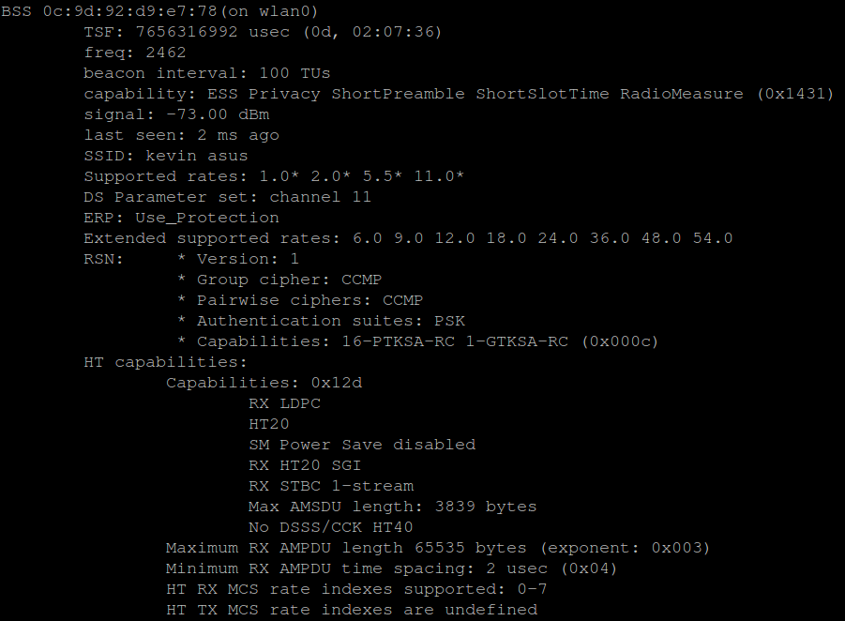
WPA/WPA2 - iw
$ iw wlan0 scan

Slide 65
WPA/WPA2 – SSID and PASSWD
$ wpa_passphrase “SSID” > /etc/wpa_supplicant.conf
ctrl_interface=/var/run/wpa_supplicant
update_config=1
ap_scan=1
network={
ssid="ssid"
#psk="testtest"
psk="password"
}

Slide 66
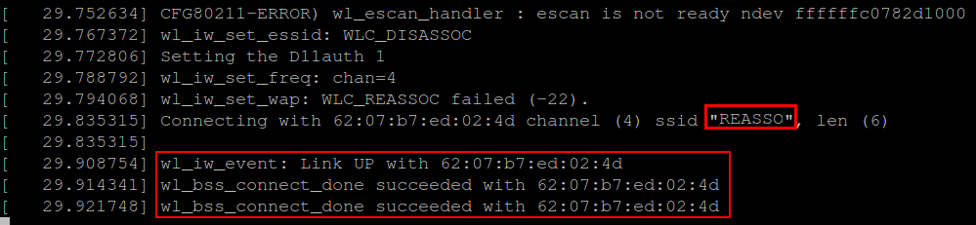
WPA/WPA2 - Connect
$ wpa_supplicant -B -D wext -i wlan0 -c /etc/wpa_supplicant.conf

Slide 67
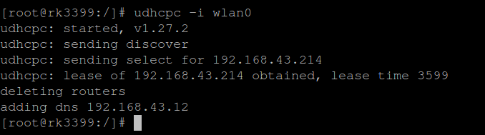
WPA/WPA2 - DHCP
$ udhcpc -i wlan0

Slide 68
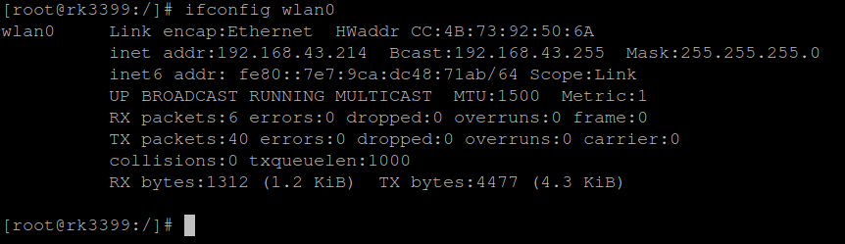
WPA/WPA2 - IP
$ ifconfig wlan0

Slide 69
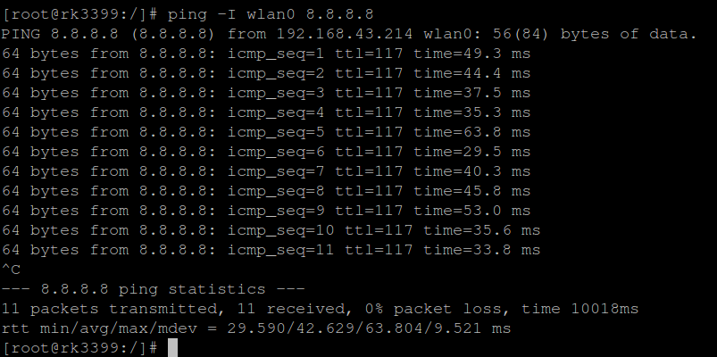
WPA/WPA2 - Ping
$ Ping 8.8.8.8 (Google)

Slide 70
SSH

Slide 71

SSH
Secure SHell protocol
SSH Client
SSH Server
SSH Client
SSH Server

Slide 72
SSH
SSH Client
  # sudo apt-get install ssh
  https://slashembeddedlinux.blogspot.com/p/tmp.html

Slide 73
NFS

Slide 74
NFS
Network File System
NFS Client
NFS Server
NFS Client
NFS Server

Slide 75
NFS
https://slashembeddedlinux.blogspot.com/p/tmp.html

Slide 76
I2C Tool

Slide 77
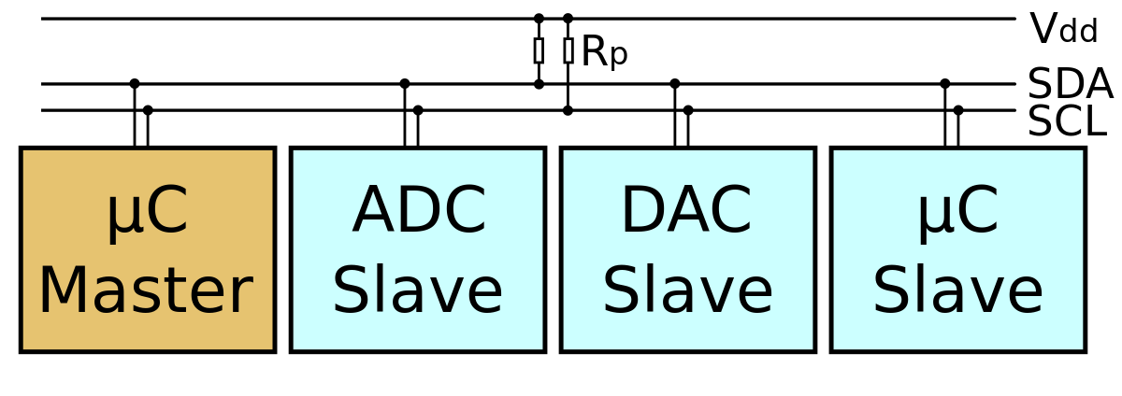
I2C Driver
https://zh.wikipedia.org/wiki/I%C2%B2C

Slide 78
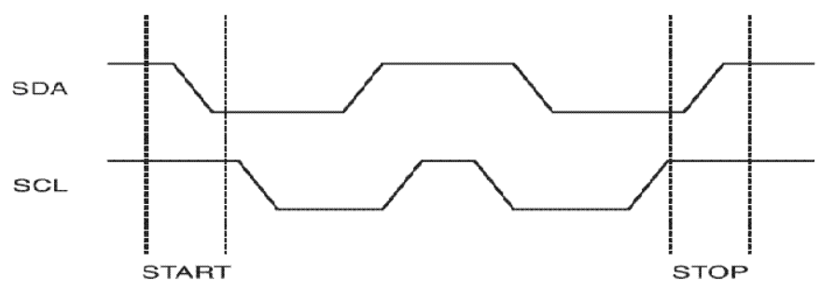
I2C protocol
Serial bus
  SDA data line
  SCL clock line

Slide 79
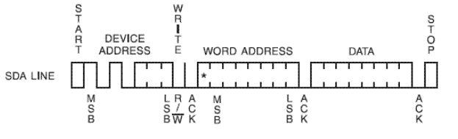
I2C protocol
Write
  byte write
  page write
Device address
Read/write bit : 0
ACK

Slide 80
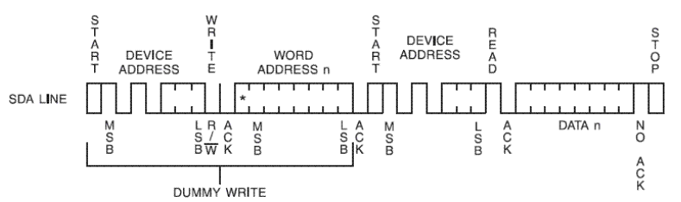
I2C protocol
Read
  byte read
  page read
Device address
Read/write bit : 1
ACK

Slide 81
I2C Dev Interface
i2c tool
  i2cset, i2cget, i2cdump
  i2cdetect -l
/dev/i2c-x
  /dev/i2c-0, /dev/i2c-1, /dev/i2c-2 ...
/sys/class/i2c-dev/
  i2c-0 i2c-1 i2c-2 i2c-3 i2c-7 i2c-8 ...

Slide 82
I2C Dev Interface
Documentation/i2c/dev-interface
i2c-tools
  i2cdump
  i2cdetect
  i2cget
  i2cset

