Slide 1

U-boot

Slide 2

Bootloader
What is bootloader
Boot : short bootstrap
  Initialize basic of SOC (CPU, RAM, CLK)
  BL1, BL2
Loader
  Load OS to RAM(DDR) form storage
  u-boot

Slide 3
Different Embedded Linux bootloader
U-boot
UEFI
Redboot
Stubby (Linaro) …
Anyway, they are same target
  Load and boot OS to RAM from storage

Slide 4
Concepts of the Boot Loader
Boot Loader is varied from CPU to CPU,from board to board.
All the system software and data are stored in some kind of nonvolatile memory.
Operation Mode of Boot Loader
  Boot : Initialize basic of SOC
  Load : load OS to RAM then execute

Slide 5

RK3399 SOC
http://wiki.friendlyarm.com/wiki/index.php/NanoPi_M4#Diagram.2C_Layout_and_Dimension

Slide 6
Embedded Linux System Booting
Boot
Initialize HW
Loader
Load OS to memory
Linux
DTB
OS initial / load driver
RootFS
OS running

Slide 7
Image Partition
partmap.txt – Image layout in SD card
Loader
idbloader.img
0x8000,0x280000
u-boot
Uboot.img
0x800000,0x0400000
Trust
Trust.img
0xC00000,0x0400000
Linux kernel
Linux kernel
SD Card Part List 4
RootFS
rootfs.img
SD Card Part List 5

Slide 8
Boot
Power On BootROM code (work in cache)
  Load BL1
BL1 (work in cache)
  Initial simple exception vectors, PLL (clock)
  Initial Multi-CPU
  Load BL2
BL2 (work in cache)
  Initial DDR memory
  Initial C environment (stack, heap, )
  Load BL31

Slide 9
Boot
BL31 (work in DDR)
  Initial exception vectors
  Load BL32 (u-boot)
BL32 U-boot
  Initial storage device
  Load Linux Kernel
Kernel
  kernel/Documentation/arm64/booting.txt
  Mount RootFS

Slide 10
Introduce U-boot

Slide 11
U-boot
Das U-Boot -- the Universal Boot Loader
http://www.denx.de/wiki/U-Boot
GitHub for u-boot
Open Source follow GPL
Supply many CPU
  PPC, ARM, x86, MIPS, AVR32 …
Supply basic periphery devices
  UART, Flash, SD/MMC ….

Slide 12
u-boot directory structure
Arch → Many types CPU : Arm, mips, i386 ...
Board → Many types develop board : Samsung, ti, davinci ...
Tools → Make Image (u-boot, linux ) or S-Record image tool
Drivers → Some HW control code
Fs → Supply file system : fat, jffs2, ext2, cramfs
Lib → General public library : CRC32/16, bzlib, ldiv ..
Disk→ Supply disk driver and partition handling

Slide 13
u-boot directory structure
Common → Major command and relation environment setting
source code
Api → Implement unrelated hardware code
Example → Standalone application

Slide 14
u-boot directory structure about rk3399
arch/arm/cpu/armv8/
  ARMv8 relate
arch/arm/cpu/armv8/rk33xx/
  rk3399 related
  Clock, i2c, irom, mmc, emmc ...
board/rockchip/rk33xx/
  Board level related
  Peripheral initial

Slide 15
Rk3399 Configure File
Common
  u-boot command related
include/configs/
  config_distro_bootcmd.h
  evb_rk3399.h
  rk3399_common.h

Slide 16
How to Build u-boot
Easy Build :
[CMD] cd ./rockchip-bsp
[CMD] ./build/mk-uboot.sh rockpi4b
Clear :
[CMD] make distclean
Configure :
[CMD] make rock-pi-4b-rk3399_defconfig
Build :
[CMD] make -j4
Create Image :
[CMD] cd rockchip-bsp/rkbin/tool/
[CMD] loaderimage --pack --uboot ../../u-boot/u-boot-dtb.bin /uboot.img

Slide 17
U-boot Configure
Change u-boot about
  Command
    [cmd] help
  Boot parameter
    Kernel load address
  Function
    Enable LED

Slide 18
U-boot Configure
Edit Configure
Method 1
  menuconfig
    [cmd] make menuconfig
Method 2
  Edit configure file
    config_distro_bootcmd.h
    evb_rk3399.h
    rk3399_common.h

Slide 19
U-boot Common Function

Slide 20
Operating U-boot
Understand and use command
Understand and modify parameters

Slide 21
Help
$ help
→ help mm
$ ?
=> help mm
mm - memory modify (auto-incrementing address)
Usage:
mm [.b, .w, .l, .q] address
=>

Slide 22
Help
help
→ print command description/usage
$ help
→ help mm
$ ?
=> help mm
mm - memory modify (auto-incrementing address)
Usage:
mm [.b, .w, .l, .q] address
=>

Slide 23
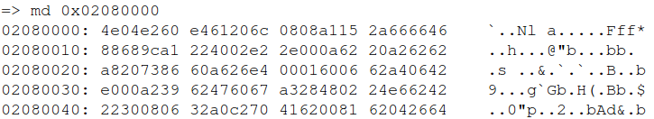
md
md
→ memory display
→ md [.b, .w, .l, .q] address [# of objects]

Slide 24
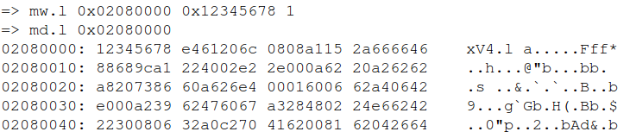
mw
mw
→ memory write
→ mw [.b, .w, .l, .q] address value [count]

Slide 25

mmc
mmc list
→ lists available devices

Slide 26
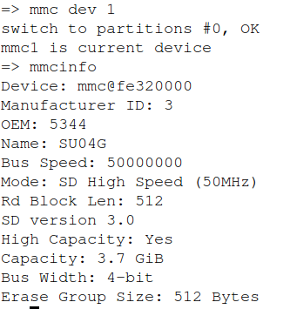
mmc
mmc info
→ display info of the current MMC device

Slide 27
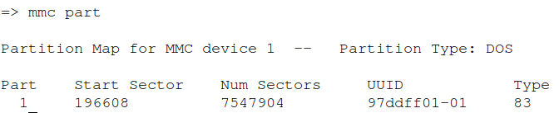
mmc
mmc part
→ lists available partition on current mmc device

Slide 28
mmc
mmc dev
→ show or set current mmc device [partition]
→ mmc dev [dev] [part]

Slide 29
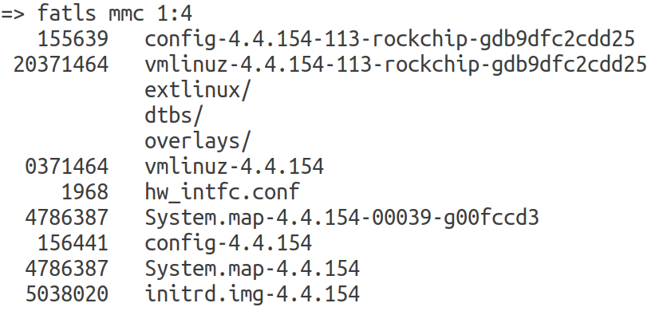
FAT List
fatls
→ list files in a directory
→ fatls <interface> [<dev[:part]>] [directory]
- list files from 'dev' on 'interface' in a 'directory'

Slide 30
FAT Load
fatload
→ fatload - load binary file from a FAT filesystem
→ fatload <interface> [<dev[:part]> [addr [filename [bytes [pos]]]]]
load binary file 'filename' from 'dev' on 'interface'
to address 'addr' from fat filesystem
=> fatload mmc 1:4 ${kernel_addr_r} vmlinuz-4.4.154
reading vmlinuz-4.4.154
20371464 bytes read in 858 ms (22.6 MiB/s)
=> fatload mmc 1:4 ${fdt_addr_r} dtbs/4.4.154/rockchip/rockpi-4b-linux.dtb
reading dtbs/4.4.154/rockchip/rockpi-4b-linux.dtb
94603 bytes read in 15 ms (6 MiB/s)
=> fatload mmc 1:4 ${ramdisk_addr_r} initrd.img-4.4.154
reading initrd.img-4.4.154
5038020 bytes read in 215 ms (22.3 MiB/s)

Slide 31
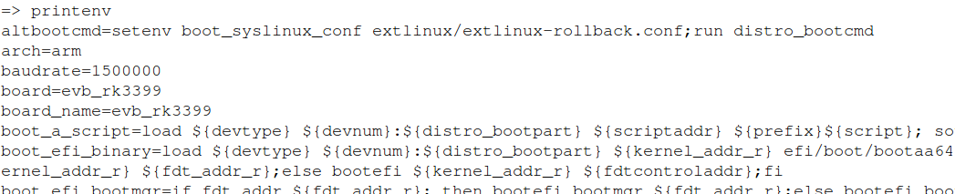
printenv
printenv
→ print environment variables
→ printenv name

Slide 32
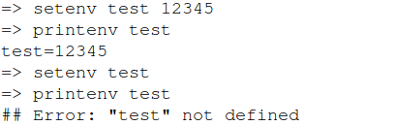
setenv
saveenv
setenv
→ set environment variables
→ setenv name value

Slide 33
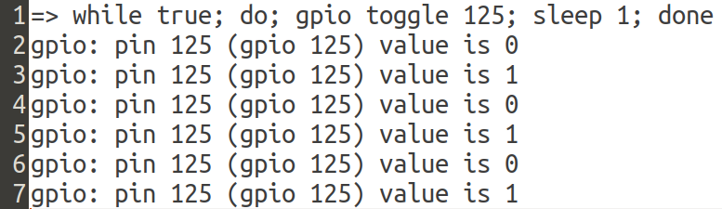
Simple Script
Script
LED Blank

Slide 34
run
run
→ run commands in an environment variable
→ run var [...]
=> run bootcmd
switch to partitions #0, OK
mmc1 is current device
Scanning mmc 1:4...
Found /extlinux/extlinux.conf
pxefile_addr_str = 0x00500000
bootfile = /extlinux/extlinux.conf
Retrieving file: /extlinux/extlinux.conf
reading /extlinux/extlinux.conf
1646 bytes read in 5 ms (321.3 KiB/s)
select kernel
1: kernel-4.4.154
2: kernel-4.4.154-999-rockchip-gcfa47f25e
3: kernel-4.4.154-113-rockchip-gdb9dfc2cdd25
4: kernel-4.4.154-00039-g00fccd3
5: kernel-4.4.154
Enter choice: Retrieving file: /hw_intfc.conf
reading /hw_intfc.conf
1968 bytes read in 4 ms (480.5 KiB/s)
command

Slide 35
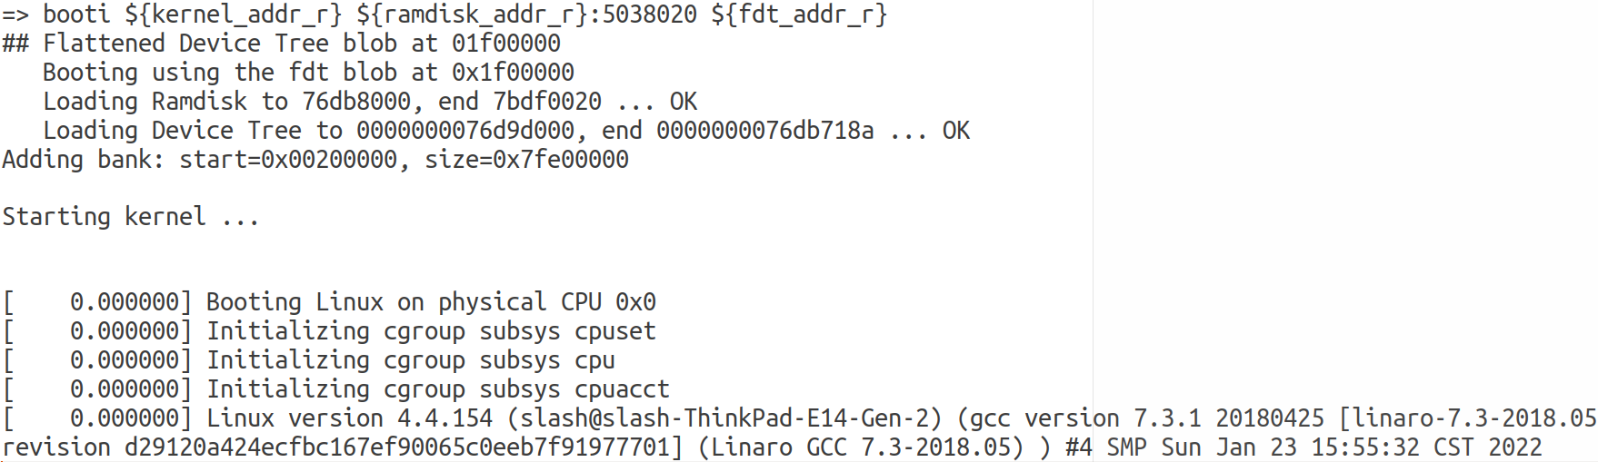
booti
booti
→ booti - boot Linux kernel 'Image' format from memory
→ booti [addr [initrd[:size]] [fdt]]

Slide 36
Boot Linux kernel

Slide 37
System Start Up
ROM Code@RK3399
Read IDB_Loader
Put IDB_Loader to
SRAM
Load BL31
Initial PLL
Initial DDR

Slide 38
System Start Up
Load BL31
Init C Environment
Load U-Boot
Init Periphery
Load Linux Image
To DDR
Load Linux DTB
BOOT Linux Kernel

Slide 39
Boot Linux Kernel Command
bootcmd
  Power On will auto run content of bootcmd
[CMD] printenv bootcmd
bootcmd=run distro_bootcmd;boot_android ${devtype} ${devnum};bootrkp;

Slide 40
Boot OS (Linux) Command
booti
→ boot Linux kernel 64 bit standard kernel image
boota
→ boot android style kernel image
Boot command
→ booti [Kernel image addr] [RAM disk adr ] [DTB addr]
→ $ booti kernel_addr ramdisk_addr DTB_addr

Slide 41
Linux Kernel Command (bootargs)
bootargs
  $ printenv bootargs (Linux kernel command)
  earlycon : earlay console device
  console : Linux console device
  root : RootFS device
Enter Linux kernel to check
  $ cat /proc/cmd
earlyprintk console=ttyFIQ0,1500000n8 rw init=/sbin/init rootfstype=ext4 rootwait root=UUID=a54358ce-55c2-4f4f-bf6d-7106997cfb8f console=ttyS2,1500000n8

Slide 42
How to jump to kernel
Use boot command
→ cmd/cmd_booti.c
Jump to Linux kernel
→ arch/arm/lib/bootm.c
→ boot_os_fn *bootm_os_get_boot_func(int os)
→ int do_bootm_linux(int flag, int argc, char *const argv[],
bootm_headers_t *images)
→ void (*kernel_entry)( void *fdt_addr,
void *res0,
void *res1,
void *res2);

Slide 43
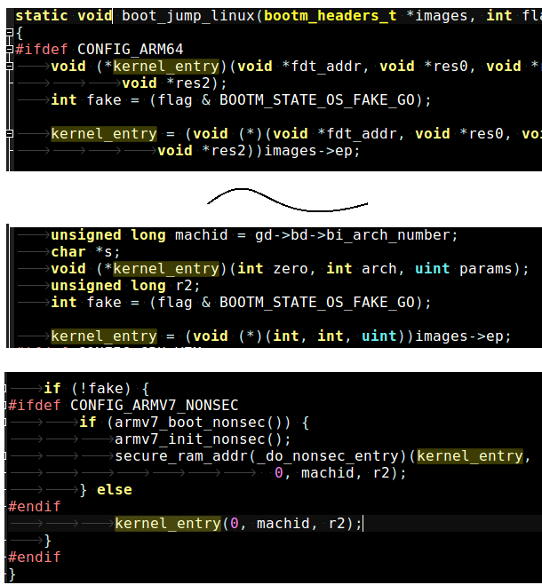
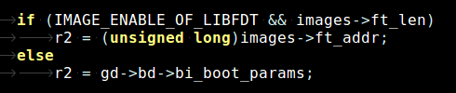
Linux Enter Point
arch/arm/lib/bootm.c
Assign DTB
Start To Kernel

Slide 44
Add Function to Board Setting File

Slide 45
evb-rk3399.c
board/rockchip/evb_rk3399/evb-rk3399.c
Add function to here
diff --git a/board/rockchip/evb_rk3399/evb-rk3399.c b/board/rockchip/evb_rk3399/evb-rk3399.c
index 8e3fce4aa4..e5b4041288 100644
--- a/board/rockchip/evb_rk3399/evb-rk3399.c
+++ b/board/rockchip/evb_rk3399/evb-rk3399.c
@@ -30,6 +30,11 @@ int rk_board_init(void)
struct udevice *pinctrl, *regulator;
int ret;
+ printf("%s\n", __func__);
+
+ /* user2 led power-off */
+ run_command("gpio clear 125", 0);
+
/*
* The PWM does not have decicated interrupt number in dts and can
* not get periph_id by pinctrl framework, so let's init them here.

Slide 46
New a Command

Slide 47
Add Feature
Add command → cmd/
Add driver → driver/
Add application → example/

Slide 48
Add Command
How to create a command ?
Directory
  cmd/ → booti.c , mmc.c, mem.c ...
U_BOOT_CMD(name,maxargs,rep,cmd,usage,help)
  include/command.h

Slide 49
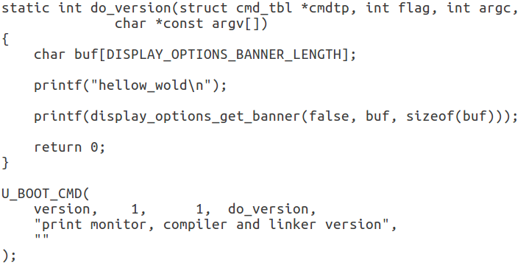
How to Command
cmd/cmd_version.c
Include/command.h
#define U_BOOT_CMD(_name, _maxargs, _rep, _cmd, _usage, _help)

Slide 50
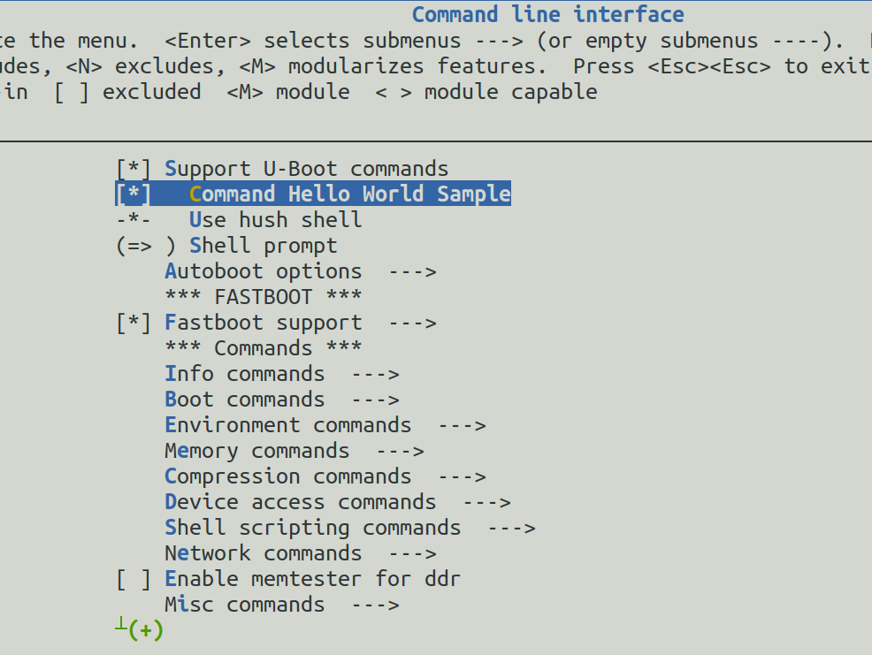
Hello World Command

Slide 51
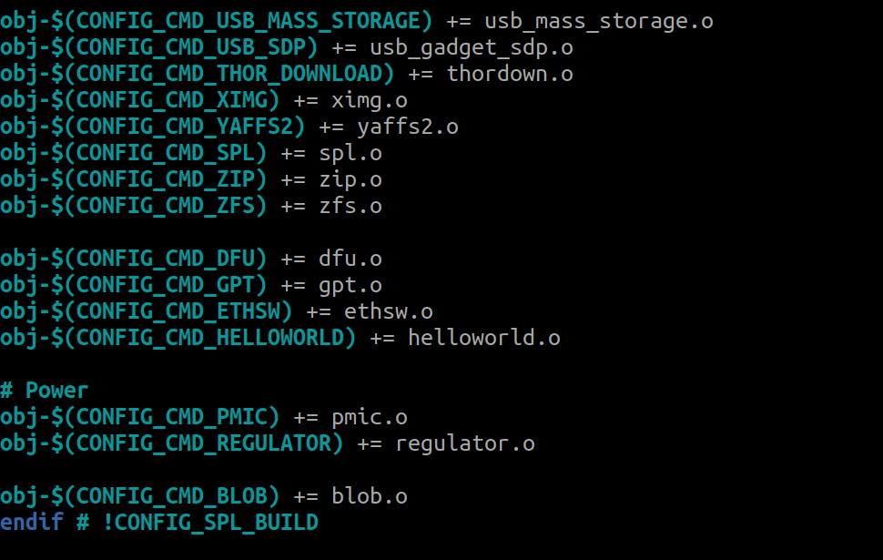
Hello World Command
cmd/Makefile

Slide 52
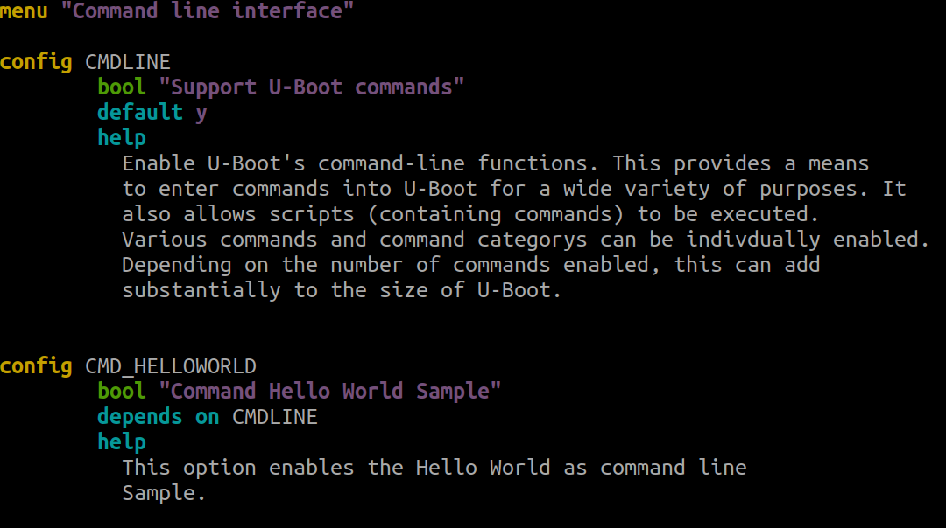
Hello World Command
cmd/Kconfig

