Slide 1

Linux Kernel

Slide 2
Linux kernel key features
Portability and hardware support
Scalability
Compliance to standards and interoperability
Exhaustive networking support
Stability and reliability
Modularity
Easy to program.

Slide 3
Linux Kernel in the System
Application
…..
Application
Library
…..
Library
User Space
C Library
System Call
Linux Kernel
Kernel Space
Hardware

Slide 4
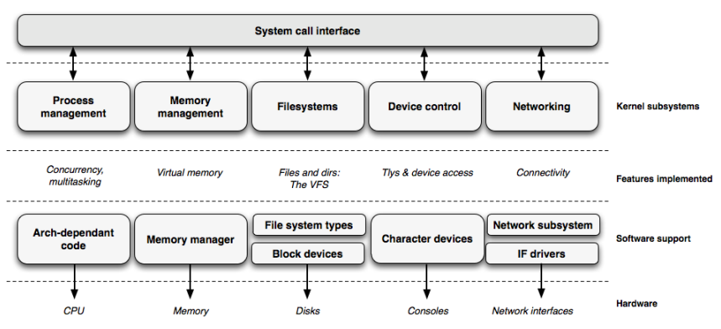
Linux Kernel

Slide 5
Kernel Source
https://www.kernel.org/
Many chip vendors
kernel sub-communities
  Architecture communities
    ARM, MIPS, PowerPC ...
  device drivers communities
    I2C, SPI, USB, PCI, network ...

Slide 6
Programming language
Implemented in C like all Unix systems
A little Assembly is used too
No C++ used
No C library
No floating point computation
Kernel code has to supply its own library implementations
  X : printf(), memset(), malloc(),...
  O: printk(), memset(), kmalloc()

Slide 7
Linux Sources Important Folder
Kernel Image
  arch/<ARCH>/boot/
  Arch/arm64/boot
DTS
  arch/<ARCH>/boot/dts
  Arch/arm64/boot/dts/rockchip/
driver/
Documentation/

Slide 8
Kernel Basic Command

Slide 9
Basic Build Command
$ make
  Build all
$ make dtbs
  Build Device-tree only
$ make modules
  Build kernel modules only
$ make modules_install
  Install all modules to folder

Slide 10
Basic Build Command
[CMD] make modules_install
  Install all modules to INSTALL_MOD_PATH
[CMD] make mrproper
  Remove all generated files (.config)
[CMD] make clean
[CMD] make distclean
  Remove editor backup and patch reject files

Slide 11
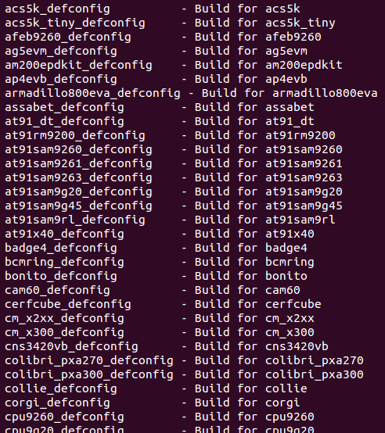
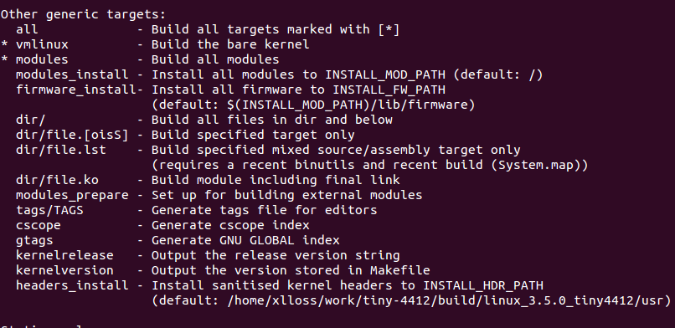
Make Help
[CMD] make help

Slide 12
How to Build Linux Kernel

Slide 13
Specifying Cross-compilation
make ARCH=arm64 CROSS_COMPILE=arm-linux- …
→ [CDM] export ARCH=arm64
→ [CMD] export CROSS_COMPILE=aarch64-linux-gnu-
Add above setting to script
→ [CMD] source $PATH/set_toolchain.sh

Slide 14
set_toolchain.sh
export PATH=/home/cadtc/host_share_folder/toolchain/gcc-linaro-7.3.1-2018.05-x86_64_aarch64-linux-gnu/bin/
# Toolchain path add to environment variable
export ARCH=arm64
# Set SOC architecture type
export CROSS_COMPILE=aarch64-linux-gnu-
#Set compile prefix name
export KERNELDIR=/home/cadtc/rockchip-bsp/kernel
#Set Linux kernel source path

Slide 15
Predefined Configuration Files
Default configuration
  arch/<arch>/configs/
make nanopi4_linux_defconfig
To create your own default configuration file
→ make savedefconfig, to create a minimal configuration file
→ mv defconfig arch/arm64/configs/myown_defconfig

Slide 16
Kernel Compilation
Build kernel Image → make -j4
  To run multiple jobs in parallel if you have multiple CPU cores
Generates Image
  arch/arm64/boot/Image
  → Image for ARM64,
  arch/arm64/boot/dts/rockchip/
  → DTB : rk3399-nanopi4-rev01.dtb
  → DTB : rk3399-nanopi4-rev21.dtb

Slide 17
Kernel Configuration
Kernel source
rockchip_linux_defconfig
Image
Network , File System,
Device Driver, HW SPEC ...
?

Slide 18
Kernel Configuration
Configure Kernel
menuconfig
Make Kernel
Kernel source code
DTS
Output Kernel
Image
DTB
modules

Slide 19
How to Select Feature in Kernel

Slide 20
Kernel Configuration
The kernel configuration and build system is based on multiple Makefiles
The configuration is stored in the .config file at the root of kernel sources
As options have dependencies, typically never edited by hand, but through graphical or text interfaces
  [CMD] make menuconfig → Text
  [CMD] make xconfig → graphical

Slide 21
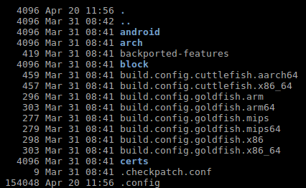
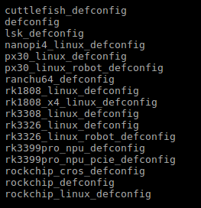
Kernel Configuration
.config
${KERNEL}/arch/arm64/configs/
rockchip_linux_defconfig

Slide 22
Kernel or Module?
The kernel image is a single file, resulting from the linking of all object files that correspond to features enabled in the configuration
Some features (device drivers, file-system, etc.) can however be compiled as modules

Slide 23
Menuconfig

Slide 24
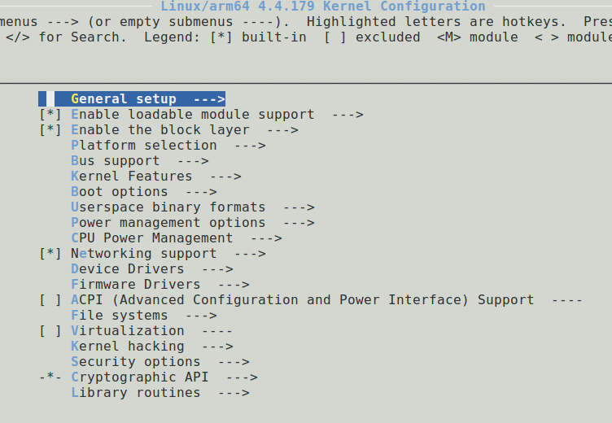
menuconfig

Slide 25
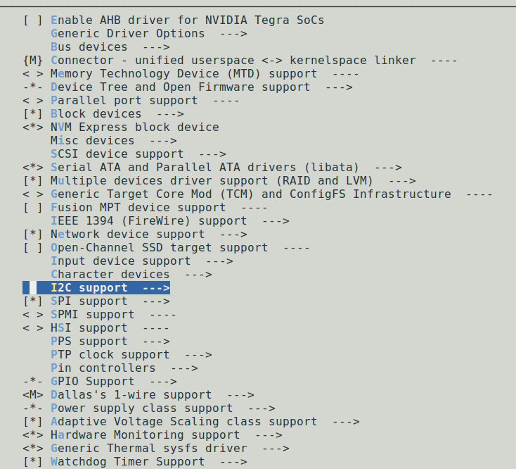
Kernel Configuration Options

Slide 26
Configuration
make menuconfig
.config
make
../include/generated/autoconf.h
Makefile
module

Slide 27
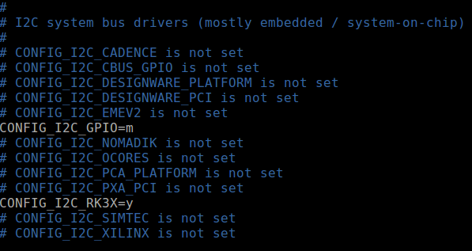
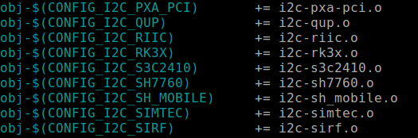
Corresponding .config File Excerpt
.config
$(KERNEL_PATH)/drivers/i2c/buses/
Makefile

Slide 28
Linux Kernel Booting

Slide 29
Linux Kernel Booting
Bootloader run kernel with parameters
  x0 = DTB (Device Tree Blob)
  r1 = NULL
  r2 = NULL

Slide 30
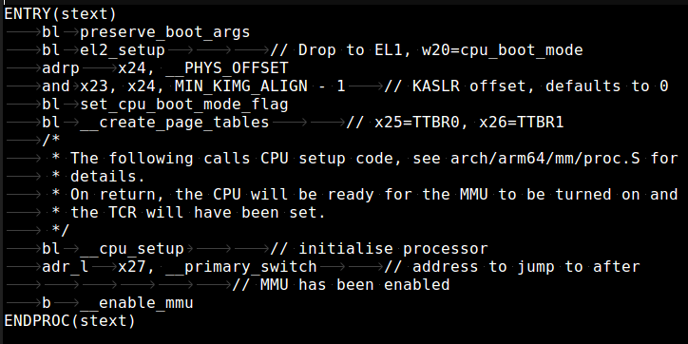
Kernel Startup Entry Point
arch/arm64/kernel/head.S

Slide 31
Linux Kernel Booting
Image
Sub System
arch/arm64/kernel/head.S
Load device
driver
ARM-specific
kernel code
arch/arm64/kernel/head.S
mount RootFS
Processor
independent
kernel code
Environment
initialize
init/main.c: start_kernel

