Slide 1
CH9 Linux User Land

Slide 2
Linux kernel
Usr App
Library
C library
User Space
System Call
Linux kernel
Device driver
Kernel Space
Hard ware

Slide 3
Sys Filesystem
Allows kernel code to export information to user processes
SysFS is an in-memory filesystem
It provides two components
  A kernel programming interface for exporting these items via sysfs
  User interface to view and manipulate these items that maps back to the kernel objects which they represent

Slide 4
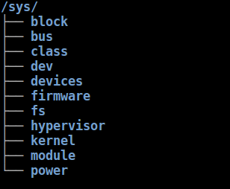
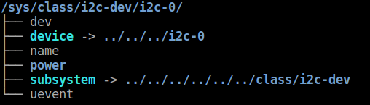
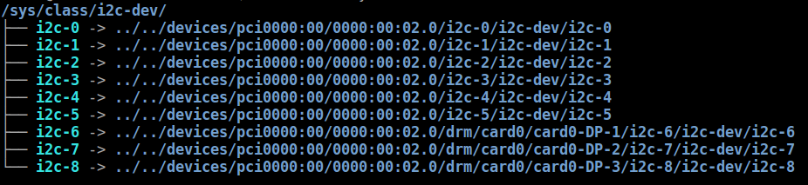
Sys File System
# tree -L 1 /sys/
# tree -L 1 /sys/class/i2c-dev/i2c-0/
# tree -L 1 /sys/class/i2c-dev

Slide 5
User land and Driver
Test Application
User Space
Device Node
Linux Driver
Kernel Space
Hardware
Device

Slide 6
LED Drivers

Slide 7
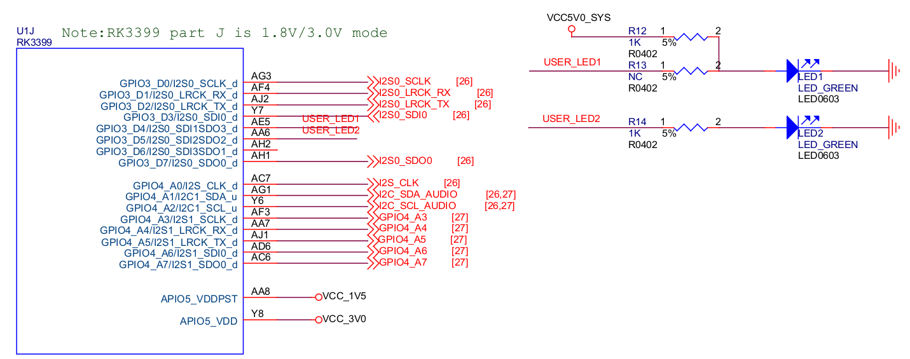
LED Schematic
GPIO3_D4/I2S0_SDI1SDO3_d → LED1
GPIO3_D5/I2S0_SDI2SDO2_d → LED2

Slide 8
LED Subsystem
Control LED convenient with SysFS
  For example
    echo 1 > /sys/class/leds/user-led2/shot
Switch different LED trigger type in SysFS
  For example
    echo "gpio" > /sys/class/leds/user-led2/trigger
    echo "1" > /sys/class/leds/user-led2/brightness
    echo "0" > /sys/class/leds/user-led2/brightness

Slide 9
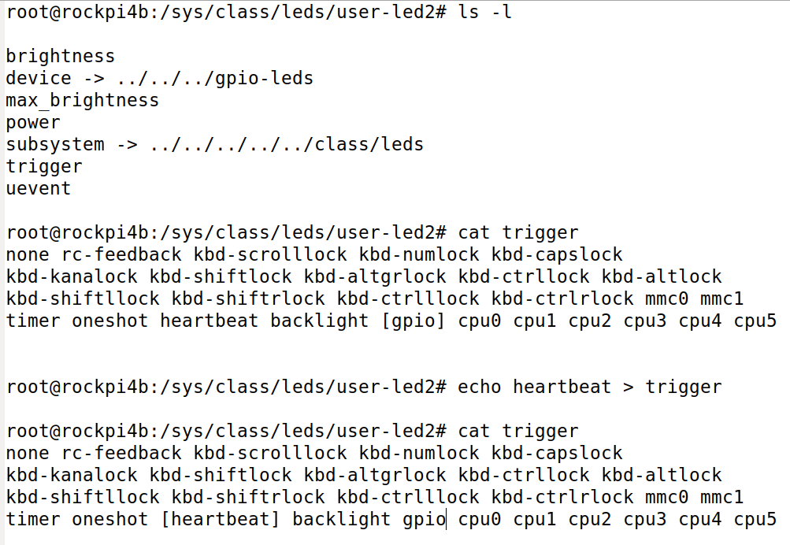
LED SysFS
Check trigger type
Switch trigger type

Slide 10
GPIO Control

Slide 11
Driver LED in User Space
Paths in Sysfs
/sys/class/gpio:
  Control interfaces used to get userspace control over GPIOs;
  GPIOs themselves
  GPIO controllers("gpio_chip" instances)
/sys/class/gpio/
  "export" : ask the kernel to export GPIO to userspace by writing
    "echo 19 > export"
    create a "gpio19" node in /sys/class/gpio
  "unexport" : Reverses the effect of exporting to userspace
    "echo 19 > unexport"
    remove "gpio19" node from /sys/class/gpio

Slide 12
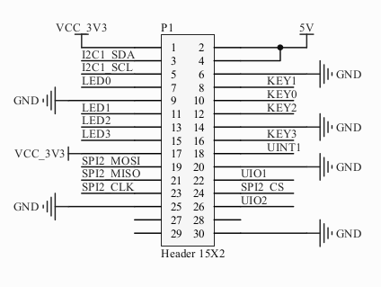
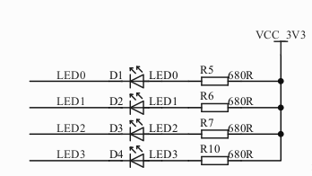
Cadtc Ext Board LED

Slide 13
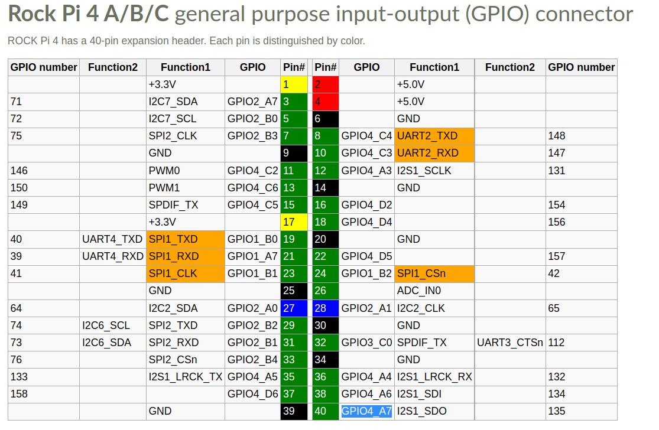
RockPi4B HEAD

Slide 14
PWM Sub System

Slide 15
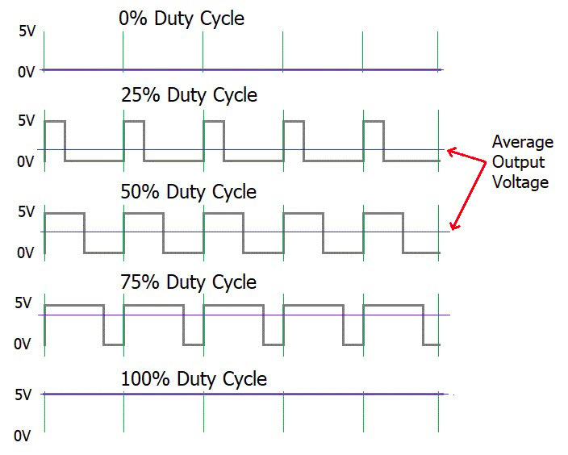
PWM
PWM : Pulse Width Modulation
https://circuitdigest.com/tutorial/what-is-pwm-pulse-width-modulation

Slide 16
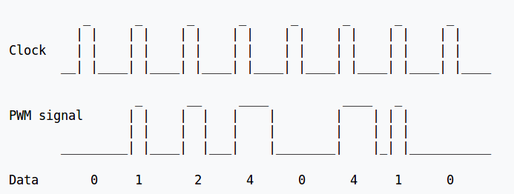
PWM
https://en.wikipedia.org/wiki/Pulse-width_modulation

Slide 17
PWM Parameter in Linux
Period
  The total period of the PWM signal
  Value is in nanoseconds
  sum of the active and inactive time of the PWM
duty_cycle
  The active time of the PWM signal
  Value is in nanoseconds
  must be less than the period.

Slide 18

PWM Parameter in Linux
Polarity
  The polarity of the PWM signal
Enable

Slide 19
PWM Driver
$(KERNEL_SRC)/Documentation/pwm.txt
Platform Driver
  drivers/pwm/
  drivers/pwm/core.c
  drivers/pwm/pwm-rockchip.c

Slide 20
PWM Subsystem
Application 1
Application 2
User Space
/sys/class/pwm
/dev/dev-mg996rs
Kernel Space
core.c
cadtc_mg996r.c
Callback implement
and register
pwm-rockchip.c
MG996R

Slide 21
RockPi4B HEAD

Slide 22
PWM SYSFS
/sys/class/pwm/pwmchip0
device export npwm power subsystem uevent unexport
echo 0 > export
capture enable polarity uevent duty_cycle period power
echo “20000000” > period
//20ms, 50 Hz
echo "2000000" > duty_cycle
//2ms
echo 1 > enable
//Enable

Slide 23
PWM DoReMi
 | Frequency (Hz)
C4 | 261.63
C4# | 277.18
D4 | 293.66
D4# | 311.13
E4 | 329.63
F4 | 349.23
F4# | 369.99
G4 | 392.00
G4# | 415.30
A4 | 440.00
A4# | 466.16
B4 | 493.88
C5 | 523.25

Slide 24
Hwmon Subsystem

Slide 25
Hwmon Subsystem
User
SysFS
attr_show
Hwmon.c
attr_store
Hwmon driver
Kernel
Hardware
Hwmon driver

Slide 26
SHT21
Simple interface
Bus interface
  I2C, GPIO, SPI
Sensors
  Temperature
  Voltage
  Humidity
  Fan speed
  PWM control

Slide 27
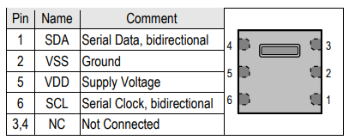
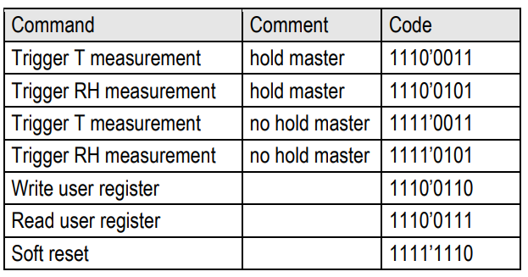
SHT21
SHT21
RockPi4B

Slide 28
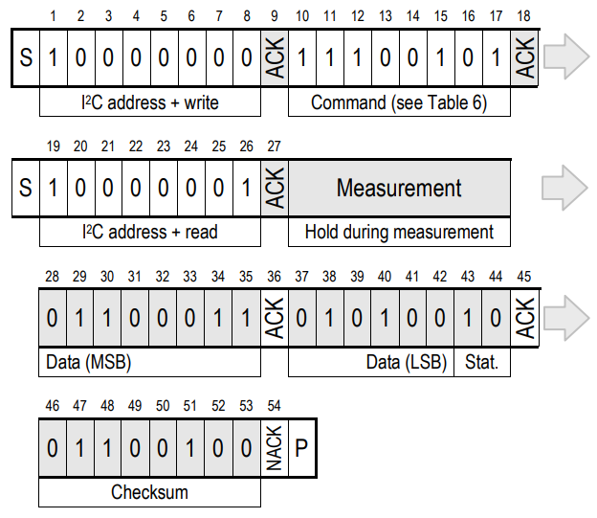
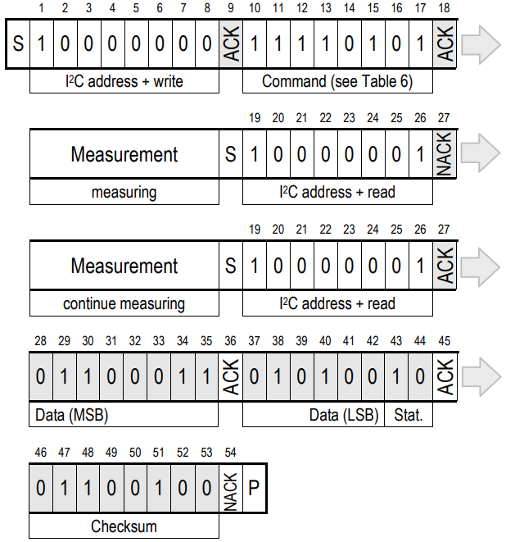
SHT21
Hold master communication sequence
No Hold master communication sequence

Slide 29
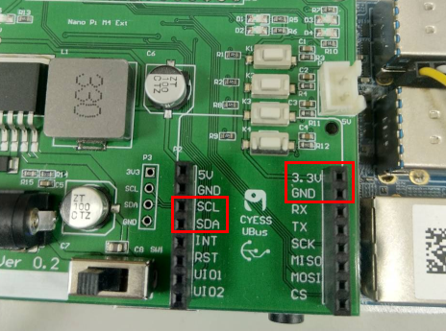
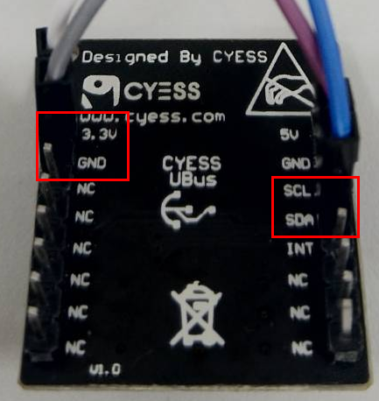
SHT21
I2C
I2C

Slide 30
SHT21
Hwmon Sysfs
# ls /sys/class/hwmon/hwmon0
device name subsystem uevent
humidity1_input power temp1_input
temperature
# cat /sys/class/hwmon/hwmon0/temp1_input
32279
humidity
# cat /sys/class/hwmon/hwmon0/humidity1_input
34512

Slide 31
IIO Subsystem

Slide 32
IIO Introduction
IIO - The Industrial I/O
support for devices that in some sense
  analog to digital (ADC)
  digital to analog converters (DAC)
Devices that fall into this category are
  ADCs
  Accelerometers
  Gyros
  DAC
  Pressure Sensors

Slide 33
IIO Introduction
Fill the gap between the somewhat similar hwmon and input subsystems
Hwmon is very much directed at low sample rate sensors used in applications
  fan speed control
  temperature measurement.
Input is, as it's name suggests focused on human interaction input devices

Slide 34
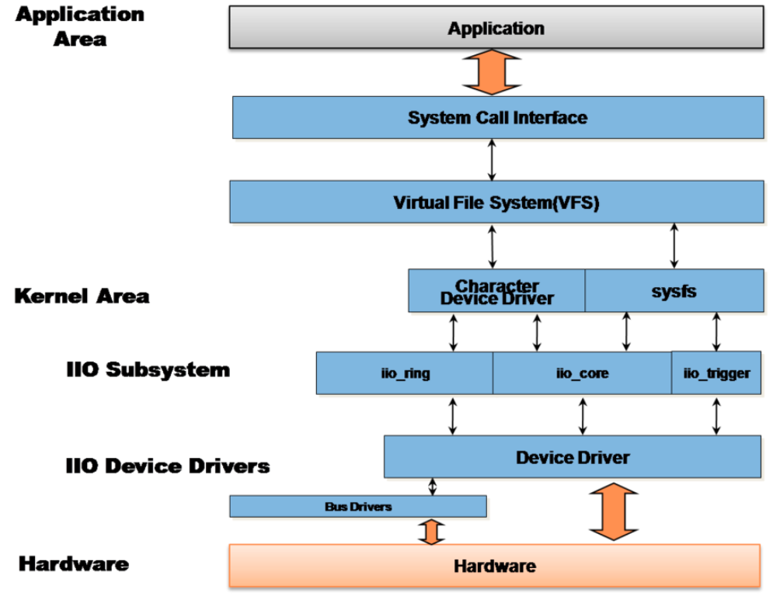
IIO Introduction

Slide 35
IIO Interface
There are 2 ways for a user space application
to interact with an IIO driver
/sys/bus/iio/iio:deviceX/
  data channels
/dev/iio:deviceX
  buffered data transfer
  events information

Slide 36
ISL29023
I2C

