Slide 1
CH9 Linux Device Driver

Slide 2


Introduction
Device drivers
  Black boxes to hide details of hardware devices
  Use standardized calls
Task 2
Task 1
Task 3

Slide 3
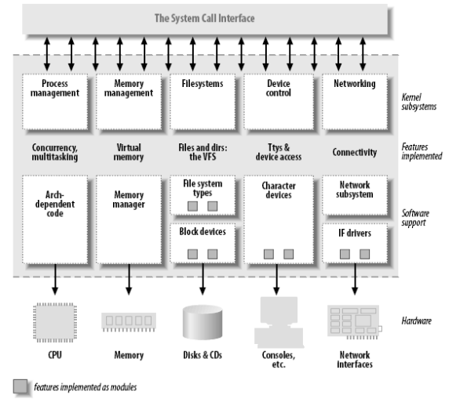
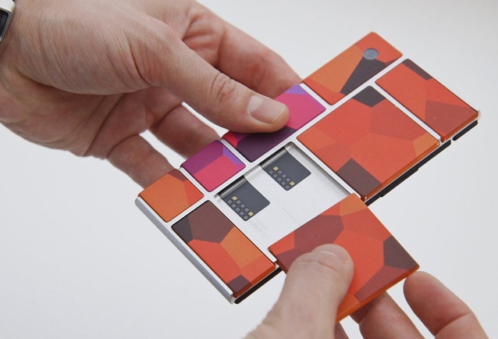
Kernel Modularization

Slide 4
Example
[CMD] make
[CMD] sudo insmod simple.ko
[CMD] dmesg | tail
[CMD] lsmod | grep simple
[CMD] sudo rmmod simple

Slide 5
Classes of Devices Driver
Char module
  simple
  access stream of bytes
Block module
  block and char devices differ only in the
  way data is managed internally by the
  kernel
Network module
  Manage network data packets

Slide 6
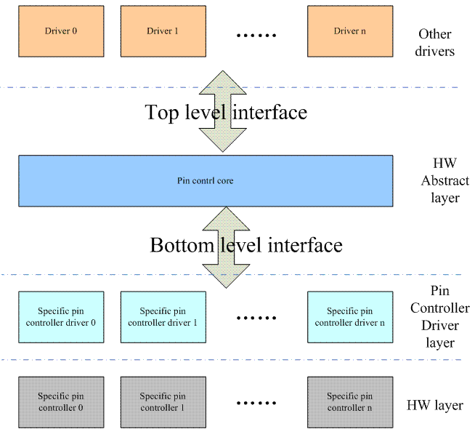
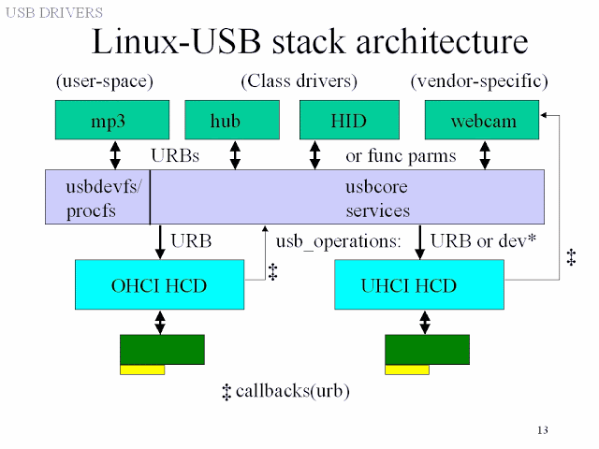
Subsystem
DRM Subsystem
GPIO Subsystem
I2C Subsystem
SPI Subsystem
MTD Subsystem
http://abhishekkd.blogspot.com/2013/03/usb-and-mmc.html
https://0uyangsheng.github.io/2018/06/08/Linux-GPIO-Pinctrl-Subsystem/

Slide 7
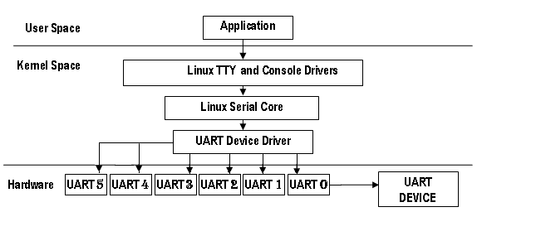
TTY Sub-system

Slide 8
Where are Modules in Kernel
${KERNEL}/drivers
→ ${KERNEL}/drivers/chars
→ ${KERNEL}/drivers/i2c
→ ${KERNEL}/drivers/gpio
→ Module aliases for module loading utilities.
Kernel build configure
→ ${KERNEL}/.config
Kconfig
→ ${KERNEL}/drivers/chars/Kconfig
[CMD] make menuconfig

Slide 9
Build Modules
Build modules
→ [CMD] make modules
Add install patch
→ [CMD] export INSTALL_MOD_PATH=../modules
Install module to INSTALL_MOD_PATH
→ [CMD] make modules_install
→ Installs all modules in /lib/modules/<version>

Slide 10
Module Deploy
modules_install
→ modules.alias : Module aliases for module loading utilities.
→ modules.dep : Module dependencies
→ modules.symbols : Tells which module a given symbol

Slide 11

Install Module
Install module
→ $ modprob ${module_name}
→ $ insmode ${module_name}
Remove moudle
→ $ modprob -r ${module_name}
→ $ rmmod

Slide 12
modprobe depmod
modprobe
→ /lib/modules/'uname -r'
Depmod
→ creates a list of module dependencies /lib/modules/version

