Slide 1
Linux Basic Command

Slide 2
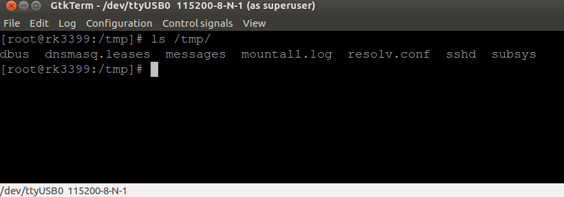
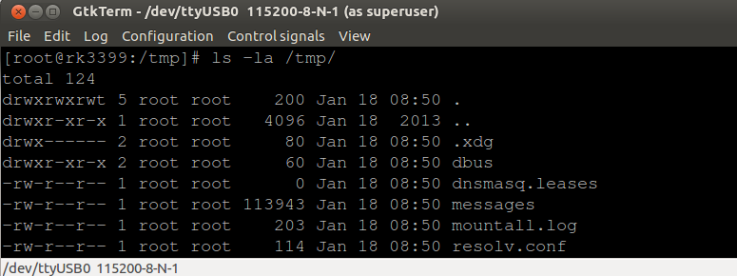
Command - ls

Slide 3
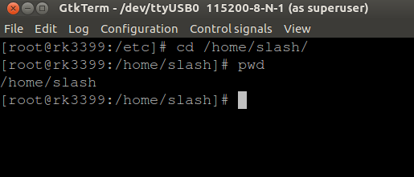
Command - cd

Slide 4
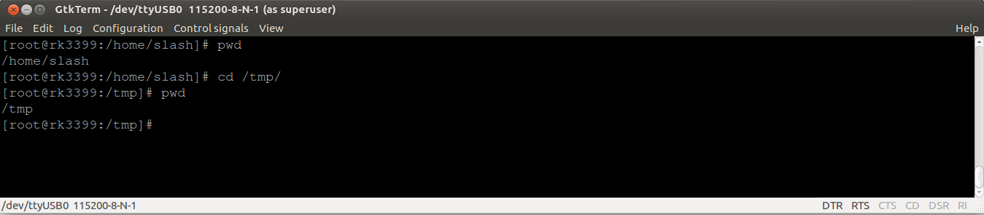
Command – pwd

Slide 5
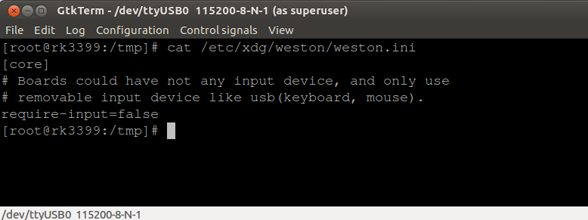
Command - cat

Slide 6
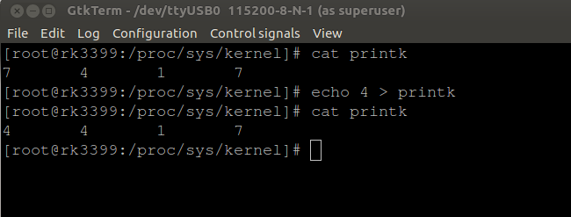
Command - echo

Slide 7
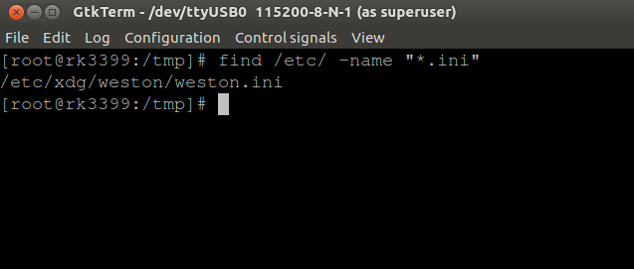
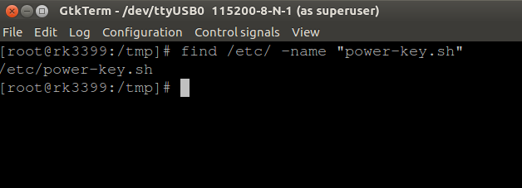
Command - find

Slide 8
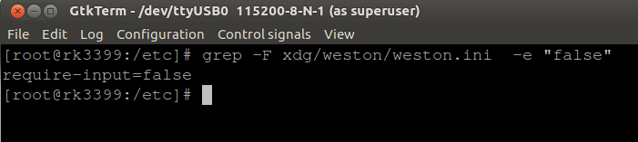
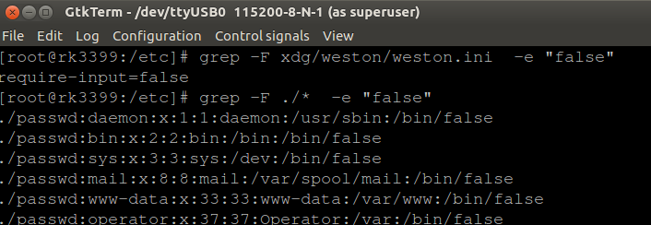
Command - grep

Slide 9
Command - dd

Slide 10
Command - scp

Slide 11
Command - sudo

Slide 12

Command - apt
apt-get install package-name
apt-cache search package-name
apt-get remove package-name

