Slide 1
A Simple Docker Summary
Slash 2022-04-15

Slide 2
What is Docker
https://docs.microsoft.com/zh-tw/dotnet/architecture/containerized-lifecycle/what-is-docker
簡單的說
  Docker : 模擬 作業系統的 “User space”, 沒有底層
  VirtualBox : 模擬 整個 作業系統, 包含 底層 與 硬體
優點
  對於開發 User space 的程式方便交換環境, 快速
缺點
  無法處理 底層 或是 硬體 相關 部份

Slide 3
What is Docker
OS1
OS2
OS3
OS4
VM1
S-VM1
S-VM2
S-VM3
S-VM4
Host

Slide 4
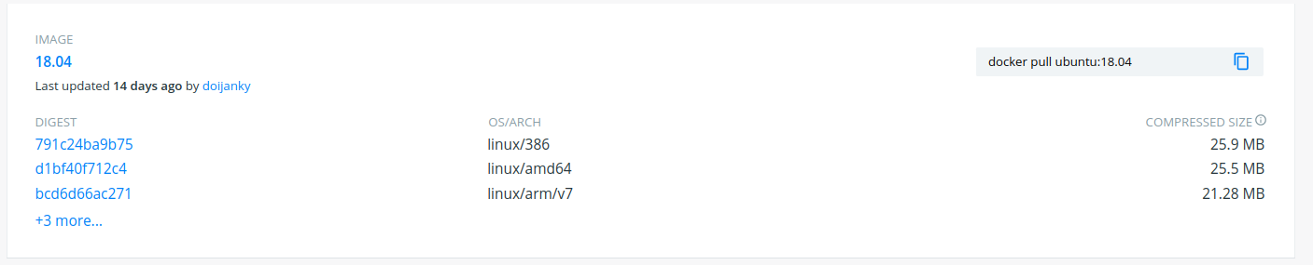
Dicker Hub
https://hub.docker.com/
https://hub.docker.com/_/ubuntu
Ubuntu 官方 已在 Docker Hub 建立不同版本的 docker image
直接從 Docker Hub 下載需要的新環境
  例如 : Ubuntu 1804

Slide 5
Install a Docker in Ubuntu
Install docker in Ubuntu
  $ sudo apt-get install docker
Docker help
  $ docker --help

Slide 6
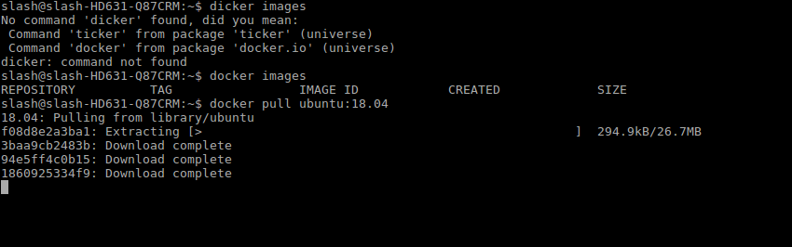
How to use Docker
Pull a Docker image that in Docker Hub
  For example : ubuntu 18.04
  $ docker pull ubuntu:18.04

Slide 7
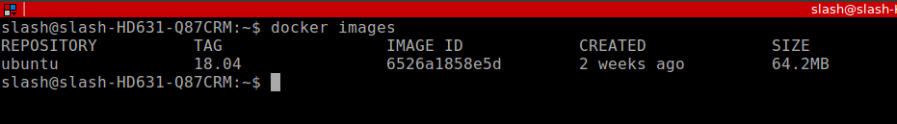
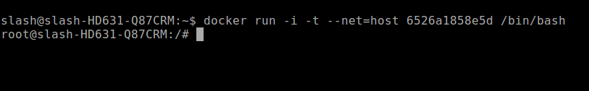
How to use Docker-2
Check docker Image in local
  $ docker images
start to run docker Image in local
  $ docker run --help
  $ docker run --net=host -i -t 6526a1858e5d /bin/bash
Enter docker
content

Slide 8
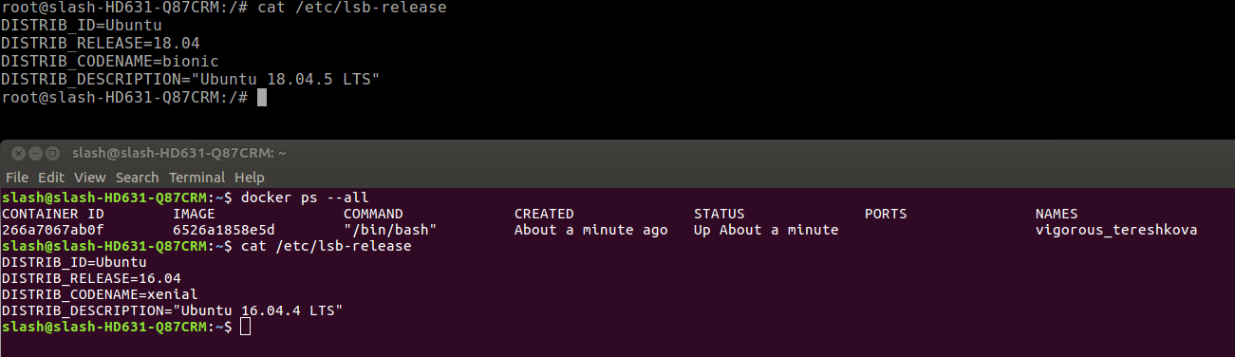
How to use Docker-3
Check docker content with docker command
Docker content (ubuntu 18.04)
Host (ubuntu 16.04)

Slide 9
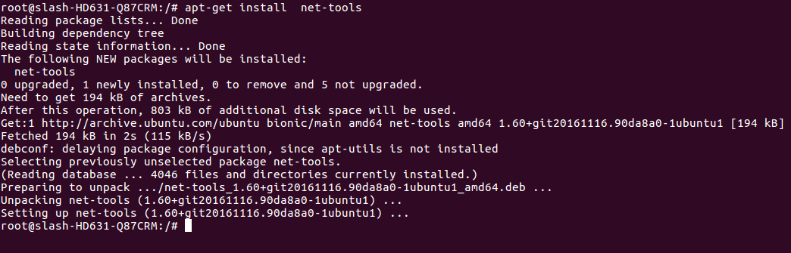
How to use Docker-4
Install package that you want in docker image
  For example
    $ apt-get install net-tools

Slide 10
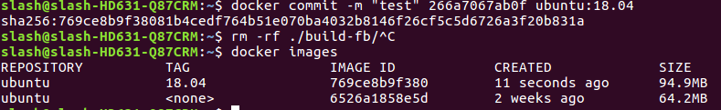
How to use Docker-5
Commit a docker content and push it to Docker Hub
  1. check which docker content that you want to commit
    $ docker ps –all
  2. check REPOSITORY and TAG of docker image current
    $ docker images
  3. commit docker content
    $ docker commit -m "test" 266a7067ab0f ubuntu:18.04

Slide 11
How to use Docker-6
Delete a docker Content
  $ docker ps --all
  $ docker rm ${Content ID}
Delete a docker Image
  $ docker images
  $ docker rmi ${IMAGE ID}

Slide 12
A Sample Docker Usage
imx8_docker_build.sh
Execute application when login to docker content
  -c "${DOCKER_BUILD_CMD}"
Work directory
  -w ${DOCKER_WORKDIR}
Login with user name
  -u ${DOCKER_LOGIN_ID}
Mount a local disk space in docker content
  -v ${LOCAL_FOLDER}:${DOCKER_FOLDER}

