Slide 1
Buildroot
https://buildroot.org/

Slide 2
Buildroot quick start
From the buildroot directory
  $ make menuconfig
To start the build process
  $ make

Slide 3
Buildroot quick start
The make command will generally perform the following steps
  1. download source files (as required);
  2. configure, build and install the cross-compilation toolchain,
  or simply import an external toolchain;
  3. configure, build and install selected target packages;
  4. build a kernel image, if selected;
  5. build a bootloader image, if selected;
  6. reate a root filesystem in selected formats.

Slide 4
Buildroot quick start
Buildroot output is stored in a single directory
  output/
    images/
    build/
    host/
    staging/
    target/
https://buildroot.org/downloads/manual/manual.html#_getting_started

Slide 5
init system
The first solution is BusyBox
The second solution is systemV
The third solution is systemd

Slide 6
General Buildroot usage
$ make help
busybox
  busybox-menuconfig
Linux
  linux-menuconfig
  linux-savedefconfig
U-boot
  uboot-menuconfig
  uboot-savedefconfig

Slide 7
How to rebuild packages
make <package>-dirclean
make <package>-rebuild
make <package>-reconfigure

Slide 8
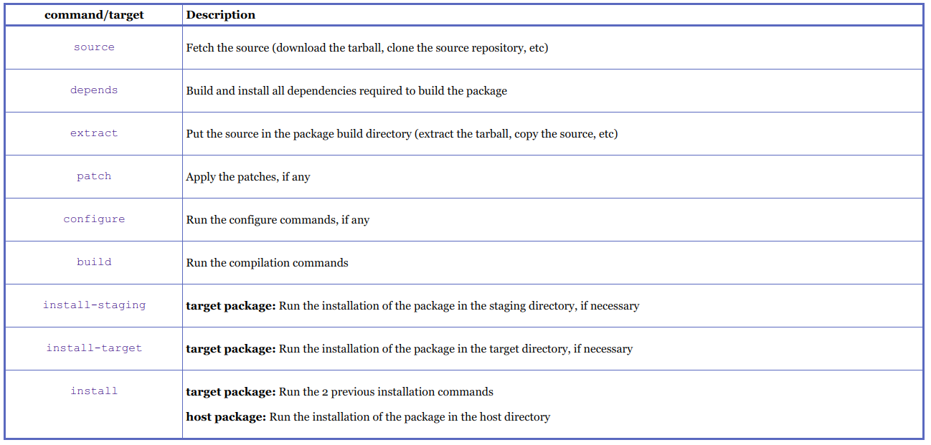
How to rebuild packages

Slide 9
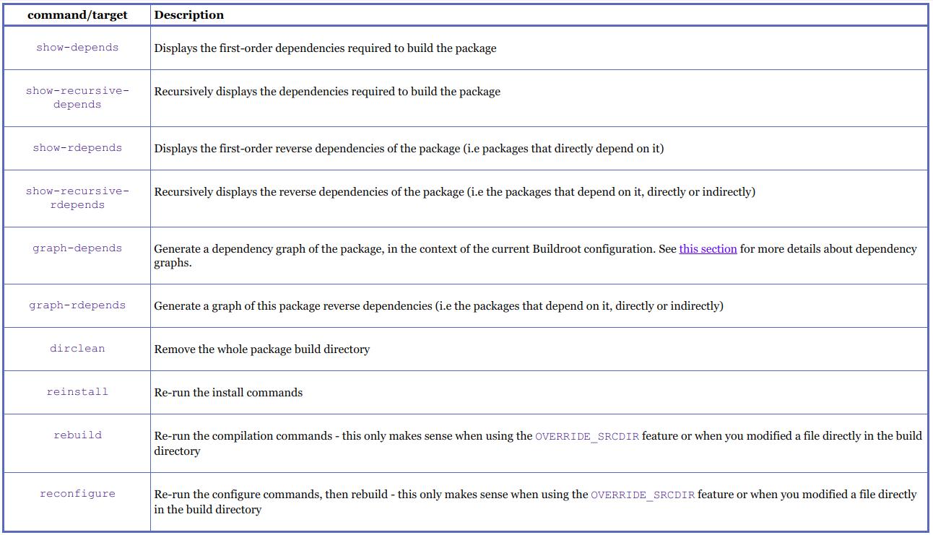
How to rebuild packages

Slide 10
Building out-of-tree
make O=/tmp/build

Slide 11
Graphing the dependencies
make graph-depends
make <pkg>-graph-depends

Slide 12
kmscute - Config.in
package/kmscube/
├── Config.in
├── kmscube.hash
└── kmscube.mk
config BR2_PACKAGE_KMSCUBE
bool "kmscube"
# requires libgbm from mesa3d
depends on BR2_PACKAGE_MESA3D_OPENGL_EGL
depends on BR2_PACKAGE_MESA3D_OPENGL_ES
help
kmscube is an application to test kms/drm drivers.
https://cgit.freedesktop.org/mesa/kmscube/

Slide 13
kmscute - kmscute.mk
################################################################################
#
# kmscube
#
################################################################################
KMSCUBE_VERSION = 6cbd03ab94066dddbba7bedfde87c7c4319c18d5
KMSCUBE_SITE = https://cgit.freedesktop.org/mesa/kmscube/snapshot
KMSCUBE_LICENSE = MIT
KMSCUBE_DEPENDENCIES = host-pkgconf mesa3d libdrm
KMSCUBE_AUTORECONF = YES
$(eval $(autotools-package))

Slide 14
kmscute
make menuconfig O=output/rockchip_rk3399/
Target packages
  → Graphic libraries and applications
  → kmscube

Slide 15
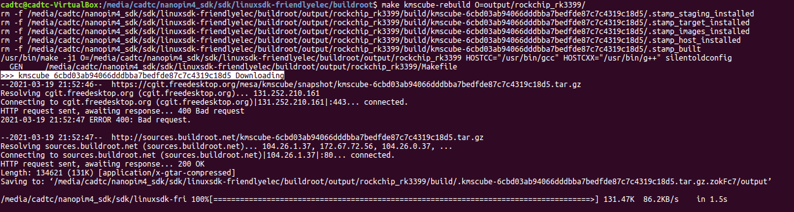
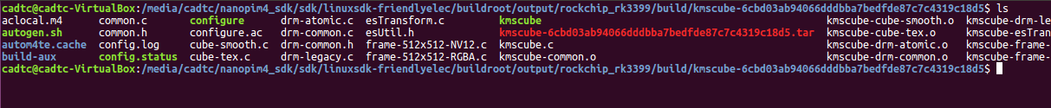
kmscute

Slide 16
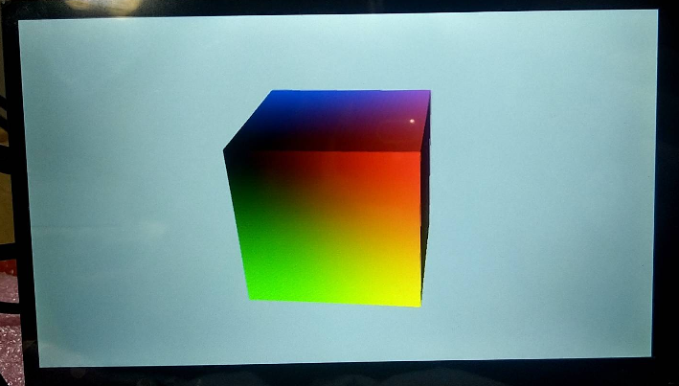
kmscute

