Slide 1
Git

Slide 2
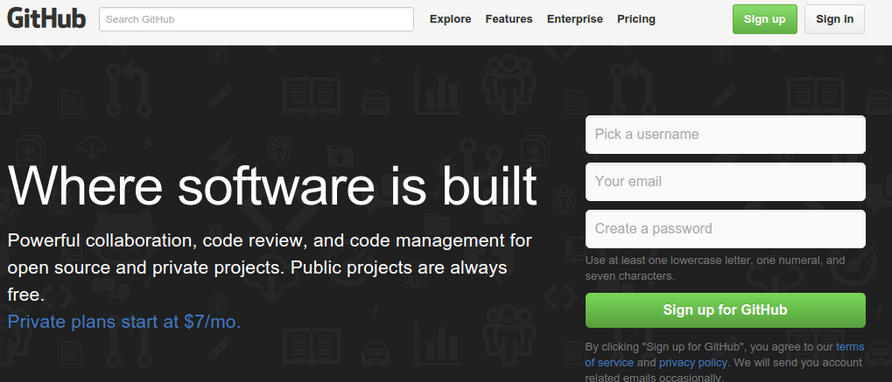
GitHub
http://www.slideshare.net/pokaichang72/git-42427674?related=1
https://github.com/

Slide 3
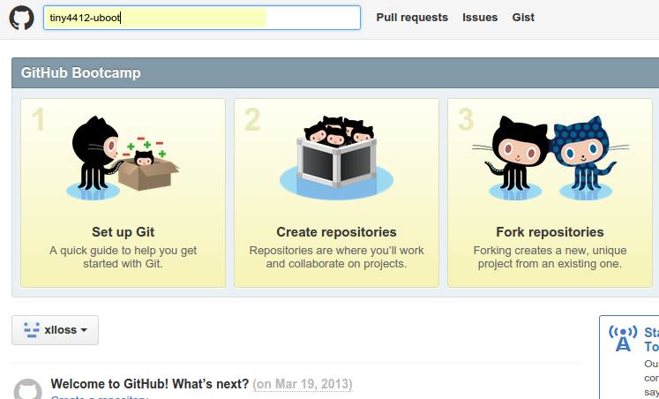
GitHub

Slide 4
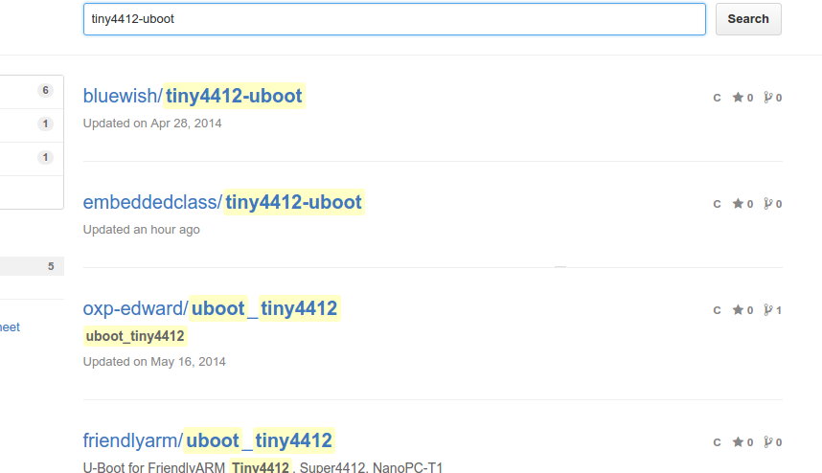
GitHub

Slide 5
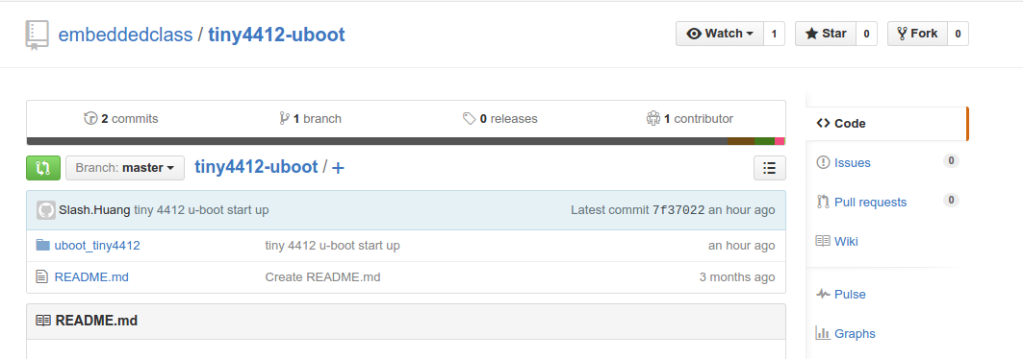
GitHub

Slide 6
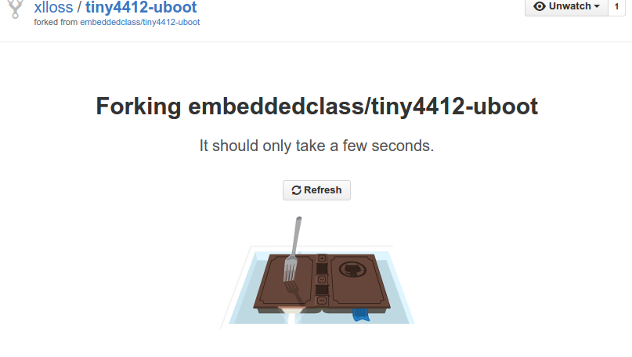
GitHub

Slide 7
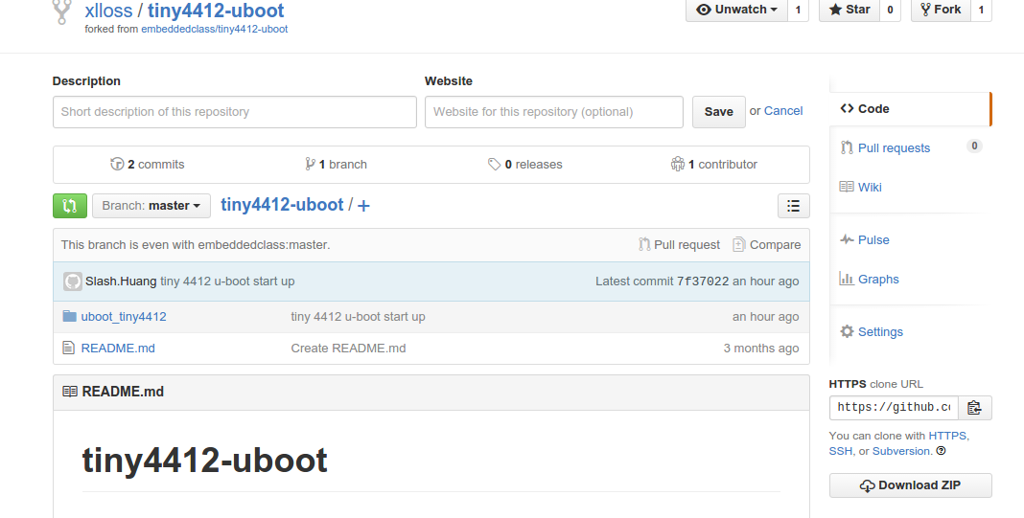
GitHub

Slide 8
Git command
add Add file contents to the index
branch List, create, or delete branches
checkout Checkout a branch or paths to the working tree
clone Clone a repository into a new directory
commit Record changes to the repository
diff Show changes between commits, commit and working tree, etc
rm Remove files from the working tree and from the index

Slide 9
Git command
pull Fetch from and merge with another repository or a local branch
push Update remote refs along with associated objects
rebase Forward-port local commits to the updated upstream head
reset Reset current HEAD to the specified state

Slide 10
show Show various types of objects
status Show the working tree status
tag Create, list, delete or verify a tag object signed with GPG
fetch Download objects and refs from another repository
grep Print lines matching a pattern
init Create an empty git repository or reinitialize an existing one
log Show commit logs
merge Join two or more development histories together
mv Move or rename a file, a directory, or a symlink

Slide 11
Exercise
1. Clone code to local
  #git clone https://github.com/xlloss/tiny4412-uboot.git
2. modify something
  #gedit README
3. check source status
  #git status
4. use "git add <file>..." to update what will be committed
  git add ./README
5. check status again
  git status

Slide 12
Exercise
6. commit code to local repository
  #git commit -a “test”
  Or #git commit
7. check log
  #git log
8. check how many branch in local repository
  #git branch
9. create new branch in local repository
  #git branch “new_branch_name”
  #git branch slash_uboot

Slide 13
Exercise
10. check out to new branch
  #git checkout “branch_name”
  #git checkout slash_uboot
11. check branch again
  #git branch
12 . push log branch to remote
  git push origin slash-uboot
13. check remote branch status
  #git branch origin/ and push tab x2

Slide 14
Exercise
reset your code, but modify code still live
  #git reset commit hash coed
Hard reset your code, all modify code will discard
  #git reset - -hard hash coed
Check log
  #git log
  #git show
Download objects and refs from another repository
  #git fetch [--all]

