Slide 1
I2C in User Space
Kernel/Documentation/dev-interface
C program in user space
  #include <linux/i2c-dev.h>
Kernel i2c driver
  drivers/i2c
    i2c-core.c
    i2c-dev.c
    busses/i2c-rk3x.c

Slide 2
I2C in User Space
decide which adapter you want to access
  /sys/class/i2c-dev/
  i2cdetect -l

Slide 3
I2C in User Space
SM Bus Protocol
open the device file
int file;
int adapter_nr = 2; /* probably dynamically determined */
char filename[20];
snprintf(filename, 19, "/dev/i2c-%d", adapter_nr);
file = open(filename, O_RDWR);
if (file < 0) {
/* ERROR HANDLING; you can check errno to see what went wrong */
exit(1);
}

Slide 4
I2C in User Space
specify device address you want to communicate
int addr = 0x40; /* The I2C address */
if (ioctl(file, I2C_SLAVE, addr) < 0) {
/* ERROR HANDLING; you can check errno to see what went wrong */
exit(1);
}

Slide 5
I2C in User Space
SM Bus
__u8 reg = 0x10; /* Device register to access */
__s32 res;
char buf[10];
/* Using SMBus commands */
res = i2c_smbus_read_word_data(file, reg);
if (res < 0) {
/* ERROR HANDLING: i2c transaction failed */
} else {
/* res contains the read word */
}

Slide 6
I2C in User Space
Plain I2C
  Using I2C Write, equivalent of
  i2c_smbus_write_word_data(file, reg, 0x6543)
buf[0] = reg;
buf[1] = 0x43;
buf[2] = 0x65;
if (write(file, buf, 3) != 3) {
/* ERROR HANDLING: i2c transaction failed */
}
/* Using I2C Read, equivalent of i2c_smbus_read_byte(file) */
if (read(file, buf, 1) != 1) {
/* ERROR HANDLING: i2c transaction failed */
} else {
/* buf[0] contains the read byte */
}

Slide 7
I2C in User Space
ioctl(file, I2C_SLAVE, long addr)
  Change slave address
ioctl(file, I2C_FUNCS, unsigned long *funcs)
  Gets the adapter functionality and puts it in *funcs.
ioctl(file, I2C_RDWR, struct i2c_rdwr_ioctl_data *msgset)
  Do combined read/write transaction without stop
struct i2c_rdwr_ioctl_data {
struct i2c_msg *msgs; /* ptr to array of simple messages */
int nmsgs; /* number of messages to exchange */
}

Slide 8
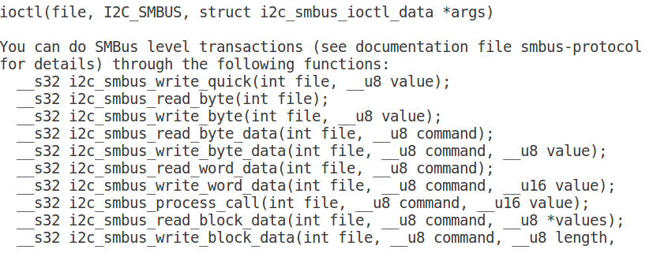
I2C in User Space

