Slide 1
Linux Display Subsystem

Slide 2
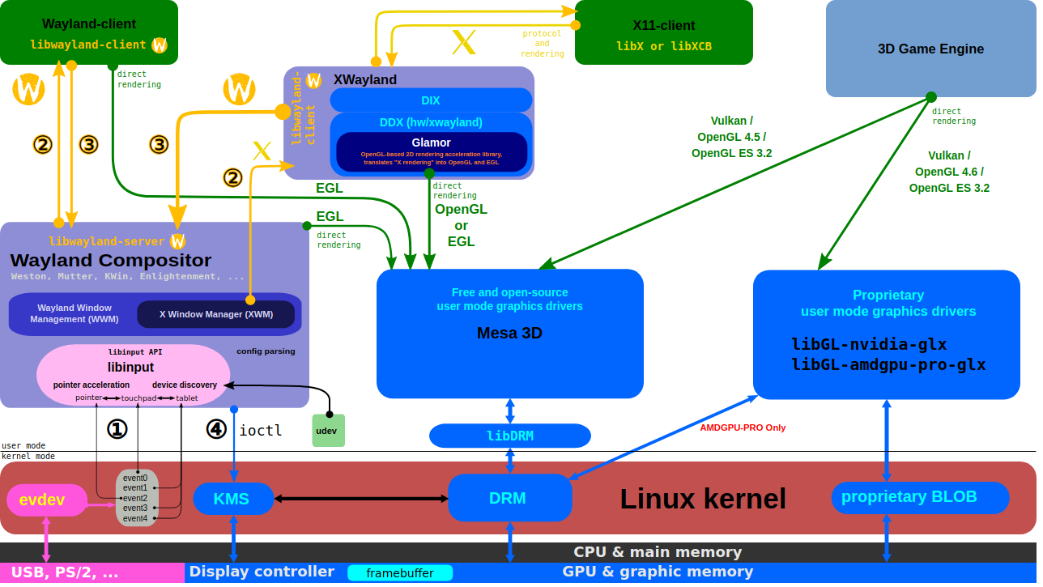
X Server and Wayland Compositor
https://upload.wikimedia.org/wikipedia/commons/2/2d/The_Linux_Graphics_Stack_and_glamor.svg

Slide 3
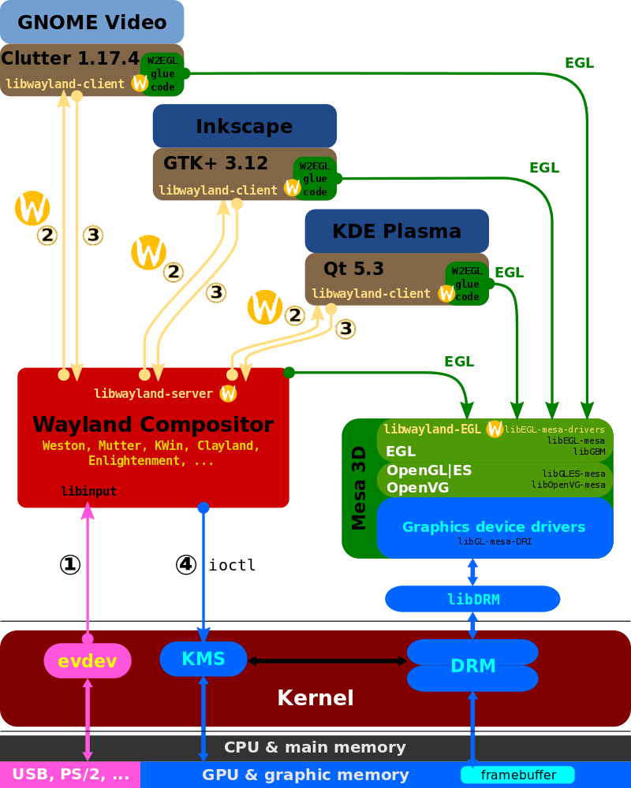
Wayland Display Server and EGL
https://www.wikiwand.com/ja/Wayland

Slide 4
Direct Rendering Manager (DRM)
Direct Rendering Manager
  Management of buffers and free space within that memory.
  Solve Frame buffer driver cannot be used GPU and multi-user process.
DRM consists of
  KMS : Kernel Mode Setting
    Change resolution and depth
  DRI : Direct Rendering Infrastructure
    Interfaces to access hardware directly
  GEM : Graphics Execution Manager
    Buffer management
  DRM Driver in kernel side
    Access hardware

Slide 5
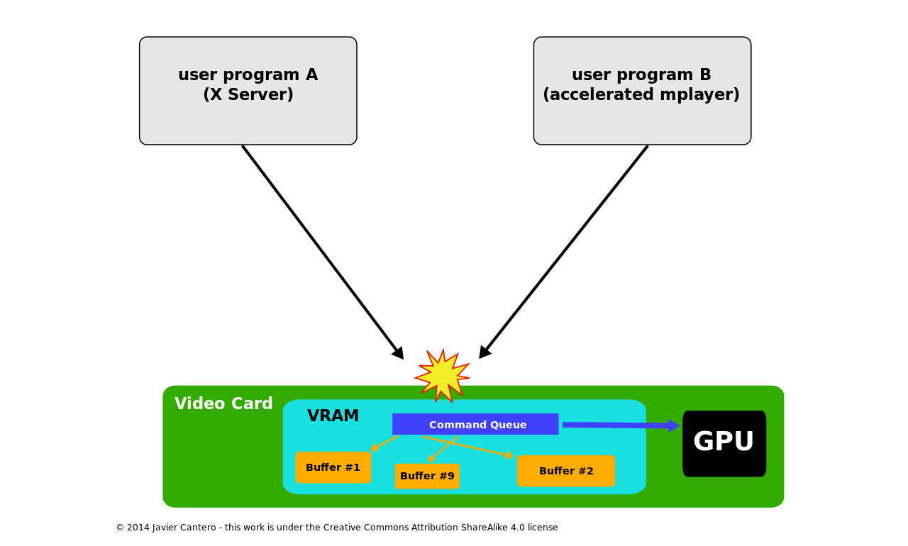
Direct Rendering Manager (DRM)
If no use DRM

Slide 6
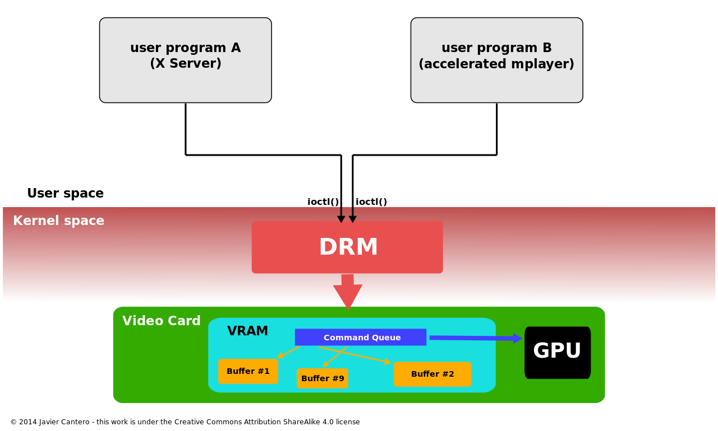
Direct Rendering Manager (DRM)
Use DRM

Slide 7
Kernel Mode Setting (KMS)
KMS device model
  CRTCs
  Connectors
  Encoders
  Planes
Kernel Mode Setting
  screen resolution
  color depth and
  refresh rate

Slide 8
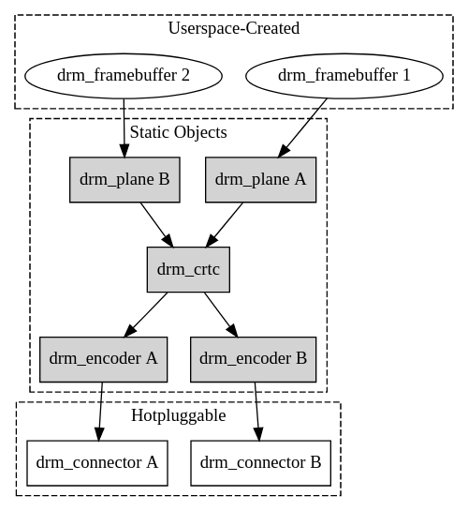
Kernel Mode Setting (KMS)
https://www.kernel.org/doc/html/v4.15/gpu/drm-kms.html

Slide 9
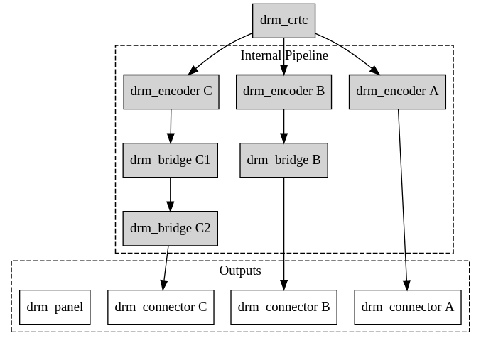
Kernel Mode Setting (KMS)
https://www.kernel.org/doc/html/v4.15/gpu/drm-kms.html

Slide 10

Video Frame Buffer
The frame buffer device provides an abstraction for
the graphics hardware.
Application
memory
User Space
MMAP
Kernel Space
memory
FB Driver

Slide 11
Kernel Mode Setting (KMS)
CRTC
Encode
Connecter
FrameBuffer
Planes

Slide 12
LCD Parameters
VBPD : vertical back porch
VFBD : vertical front porch
VSPW : vertical sync pulse width
HBPD : horizontal back porch
HFPD : horizontal front porth
HSPW : horizontal sync pulse width

Slide 13
LCD Display Parameters
Dotclock
  The video hardware draws pixels on the display speed
dotclock = (X-resolution + left margin +
right Margin + HSYNC length) *
(Y-resolution + upper margin +
lower margin + VSYNC length) * refresh rate
pixclock = 1/dotclock

Slide 14
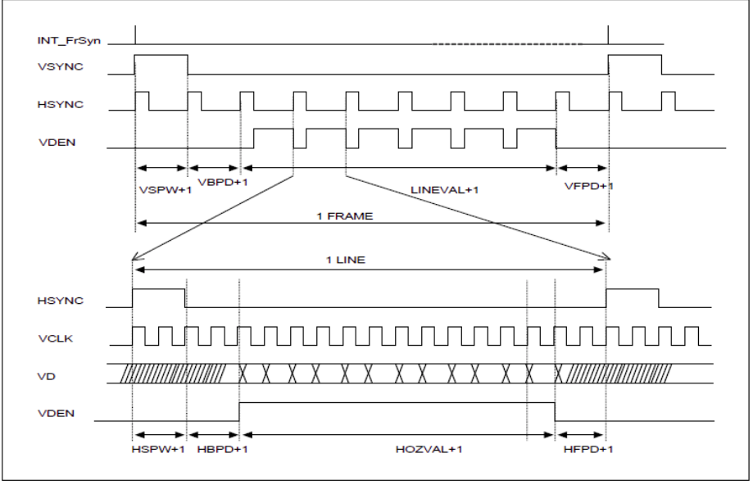
LCD Display Parameters

Slide 15
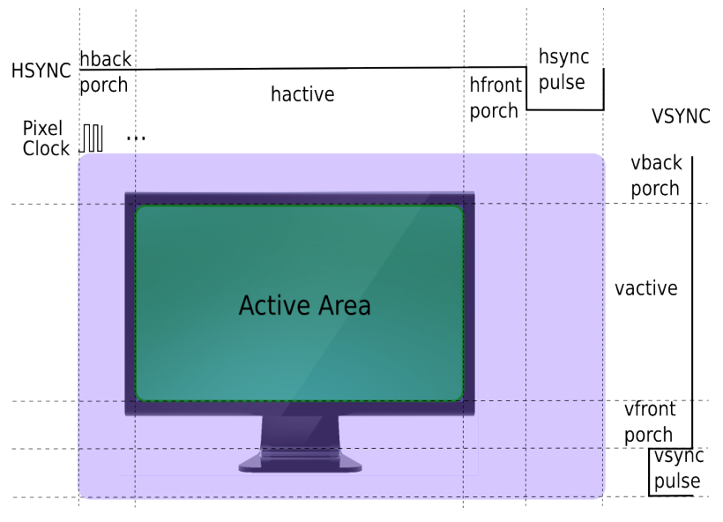
LCD Display Parameters

Slide 16
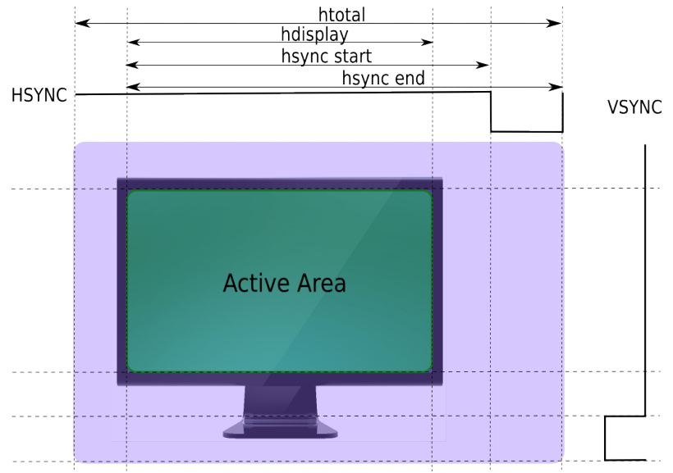
LCD Display Parameters

Slide 17
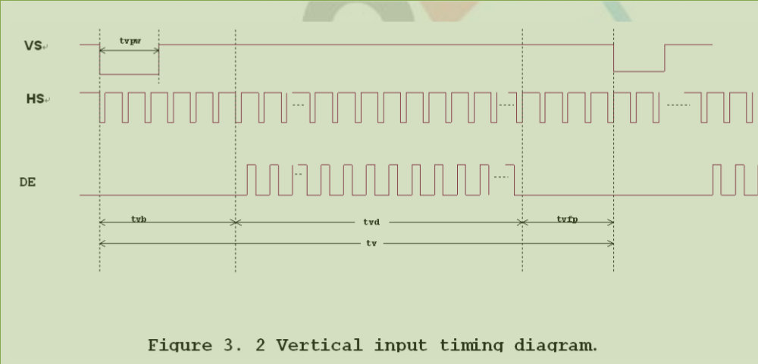
LCD Display Parameter

Slide 18
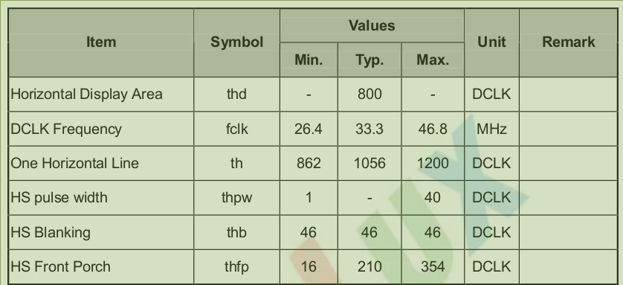
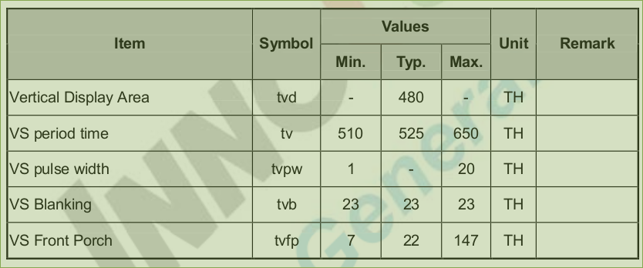
LCD Display Parameter

