Slide 1
LED Command
https://github.com/xlloss/rockchip-rk3399-nanopi-m4-uboot.git
0001-add-led-cmd-for-rk.patch

Slide 2
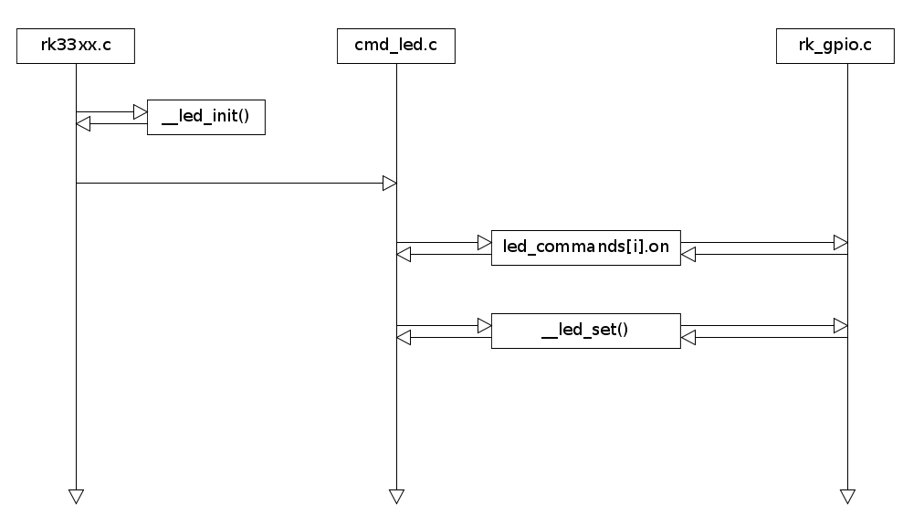
LED Command

Slide 3
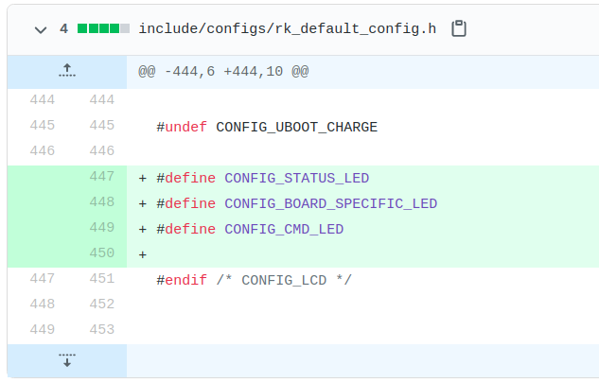
LED Command

Slide 4
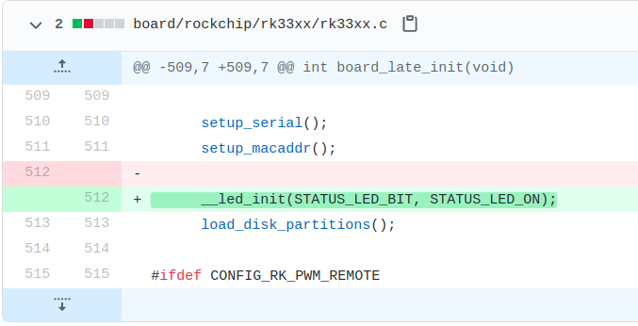
LED Command

Slide 5
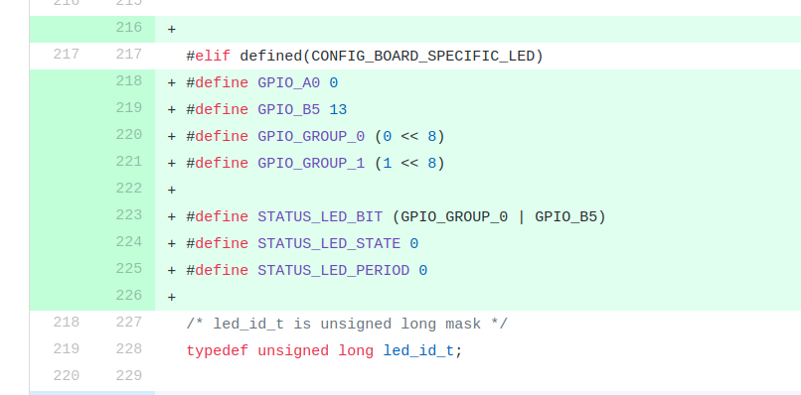
LED Command

Slide 6
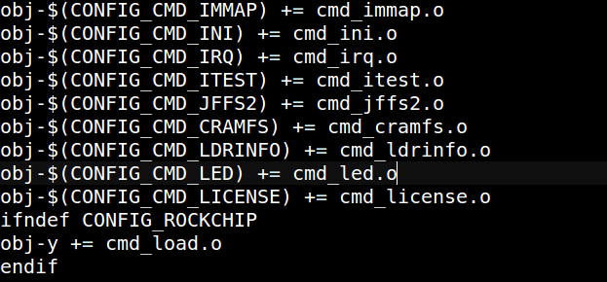
LED Command
common/Makefile

Slide 7
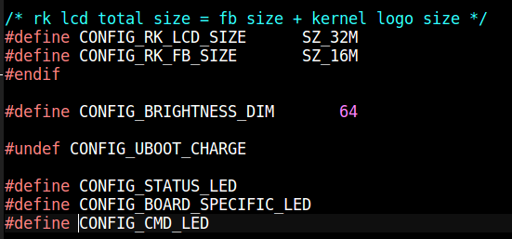
LED Command
common/cmd_led.c

Slide 8
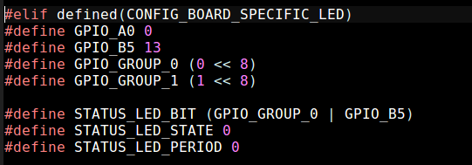
LED Command
include/status_led.h

