Slide 1
Character Drivers

Slide 2
Driver Type 1
Application
User-Land
Driver
Kernel
Hardware
Hardware

Slide 3
Driver Type 2
Application
User-Land
Subsystem API
Driver
Kernel
Hardware
Hardware

Slide 4
Driver Type 3
Application
User-Land
Sub-System Stack
Driver
Kernel
Hardware
Hardware

Slide 5
Simple Walk Through
App
User Space
DevNode
Kernel Space
Char Device Driver
Open
Write
Read
Close
IOCTL
Physical
Hardware

Slide 6
LED Control Driver
ledtest
User Space
test-led
Kernel Space
Led Char Driver
Open
Write
Read
Close
Physical
Hardware LED

Slide 7
Character Driver
User space needs
  Use /dev to interact with kernel
  open, read, write, close
Character device name
  tty0, ttyUSB, i2c …
The kernel needs
  major/minor number
  open, read, write, close

Slide 8
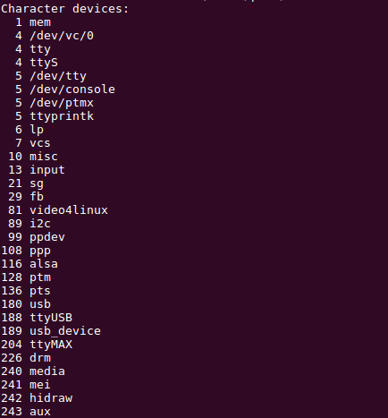
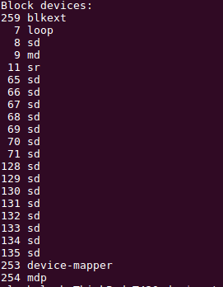
Character Driver
[CMD] cat /proc/devices

Slide 9

Character Device Node
Char drivers are
identified by a “c”
Major numbers
>cd /dev
Device node
>ls –l
crw------- 1 root root 5, 1 Apr 12 16:50 console
brw-rw---- 1 awang floppy 2, 0 Apr 12 16:50 fd0
brw-rw---- 1 awang floppy 2, 84 Apr 12 16:50 fd0u1040
Minor numbers
Block drivers are
identified by a “b”
72

Slide 10
Major and Minor Numbers

Slide 11

Major & Minor Numbers
kernel use major-minor number to identify
device
  Major (12 bits) : identify the driver
  Minor (20 bits) : identify the devices
https://elixir.bootlin.com/linux/v4.4.179/source/include/linux/kdev_t.h

Slide 12
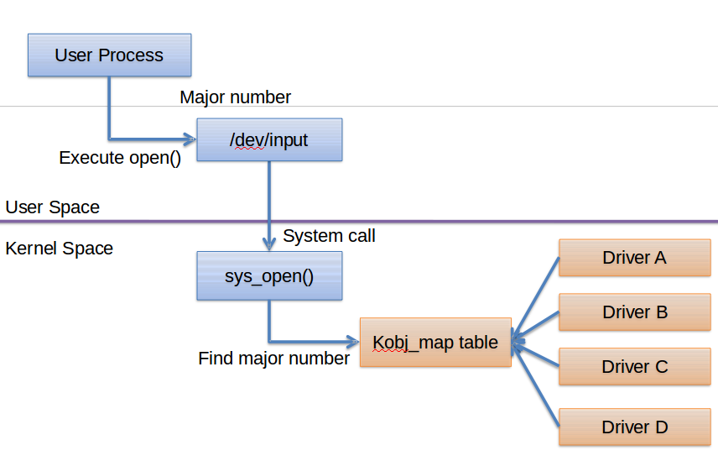
Major Numbers

Slide 13
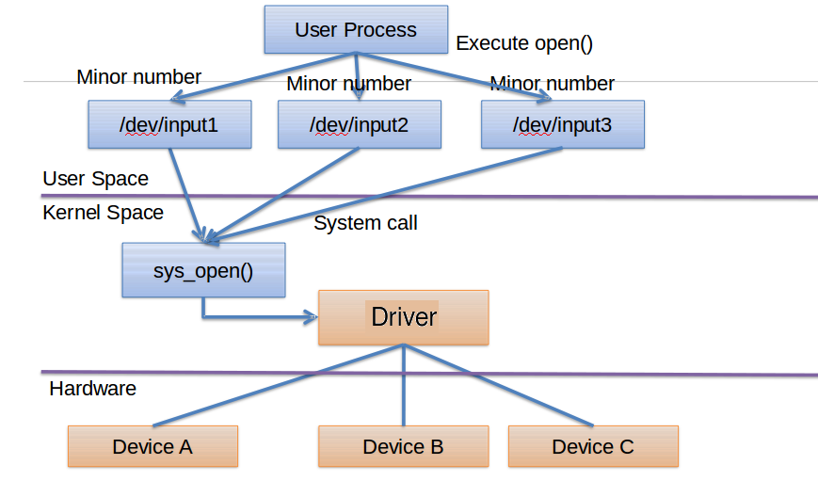
Minor Numbers

Slide 14
Character Drivers Model and API

Slide 15
Character Driver Mode
struct cdev {
struct kobject kobj;
struct module *owner;
const struct file_operations *ops;
struct list_head list;
dev_t dev;
unsigned int count;
} __randomize_layout;

Slide 16
Char Device API (1)
Register a range of char device numbers
int alloc_chrdev_region(dev_t *dev, unsigned baseminor,
unsigned count, const char *name)
Unregister a range of device numbers
void unregister_chrdev_region(dev_t from,
unsigned count)

Slide 17
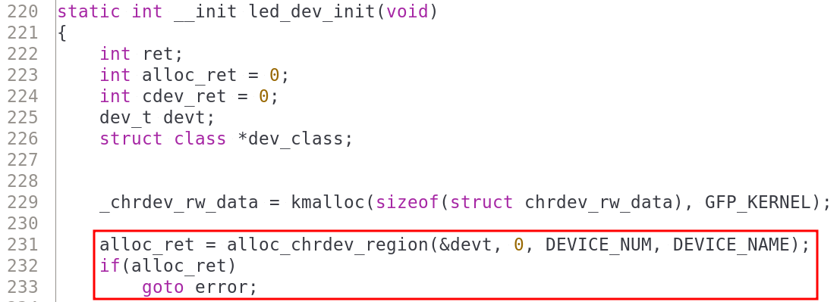
Driver LED
Register Char Device
Register a cdev structure

Slide 18
Char Device API (2)
initialize a cdev structure
void cdev_init(struct cdev *cdev, struct file_operations*fp)
allocate a cdev to system
int cdev_add(struct cdev *p, dev_t dev, unsigned count)
remove cdev from the system
void cdev_del(struct cdev *dev)

Slide 19
Char Device Initialize
There are two method to initialize char driver
/* first way */
struct cdev *my_cdev = cdev_alloc();
my_cdev->ops = &my_fops;
/* second way, for embedded cdev structure, call this function*/
struct cdev my_cdev;
void cdev_init(&my_cdev, &my_fops);

Slide 20
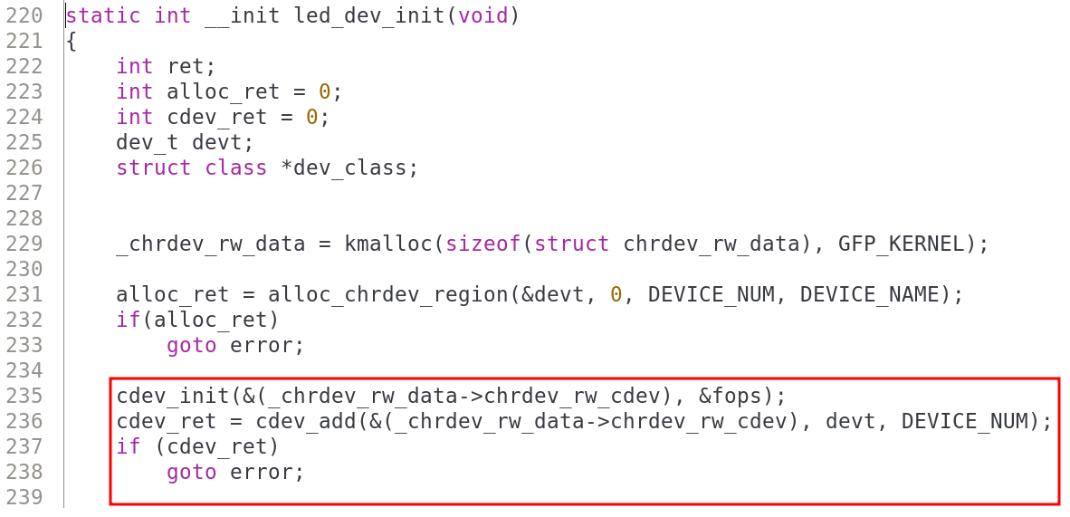
Driver LED
initialize a cdev structure
allocate a cdev structure

Slide 21
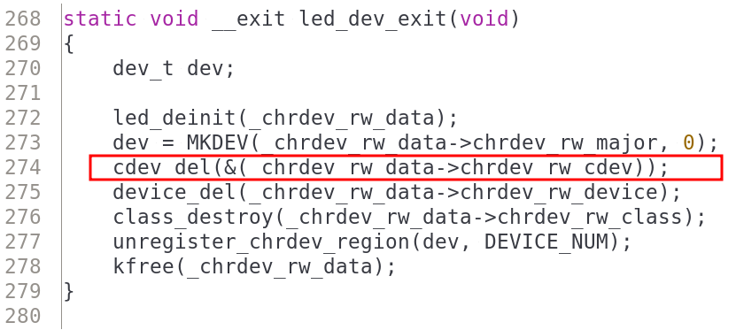
Driver LED
remove cdev from the system

Slide 22
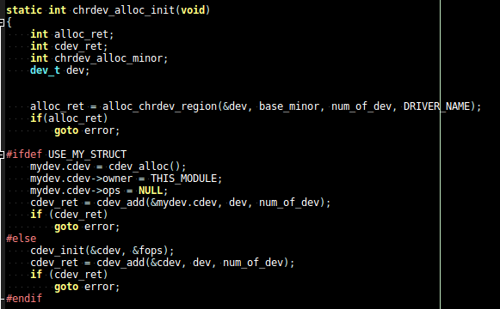
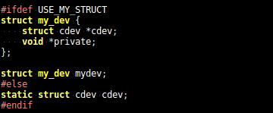
Another Sample – chrdev_alloc (1)
register a range of char device numbers
allocate a cdev
structure
add a char device to the system
initialize a cdev structure

Slide 23
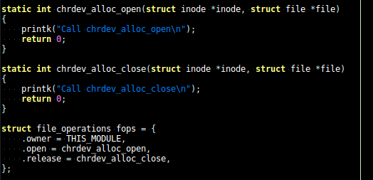
Another Sample – chrdev_alloc (2)

Slide 24
File Operator of Character Drivers

Slide 25
Led Char Driver Test
App
User Space
/dev/DEV_NODE
Kernel Space
Led Char Driver
File Operator
Open File
Close File
Read/WriteFile
IOCTL
Hardware LED

Slide 26
Led Char Driver Test
ledtest
User Space
/dev/test-led
Kernel Space
Led Char Driver
File Operator
chrdev_rw_open
chrdev_rw_close
chrdev_rw_write
chrdev_rw_read
Hardware LED

Slide 27
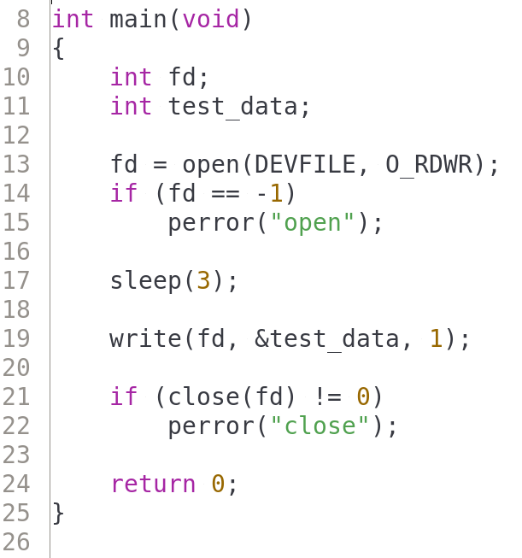
Userland of chrdev_alloc
2-1-1-chrdev_alloc/test_code
User-space
Kernel Driver
chrdev_alloc_open
chrdev_alloc_write
chrdev_alloc_close

Slide 28
File Operation Structure
Char Driver Mode
struct cdev {
struct kobject kobj;
struct module *owner;
const struct file_operations *ops;
struct list_head list;
dev_t dev;
unsigned int count;
} __randomize_layout;

Slide 29
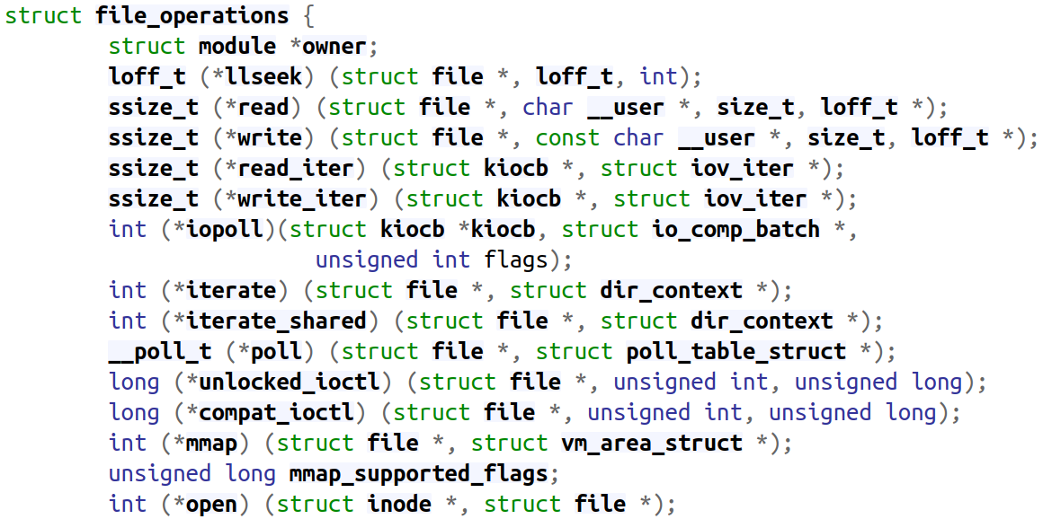
File Operation Structure
struct file_operations *ops

Slide 30
Char Driver Function Pointer
Character driver has some functions
  we need to implement in kernel
These functions used for response user land
program

Slide 31
Basic of Char Driver Function Pointer
https://elixir.bootlin.com/linux/v4.20.7/source/include/linux/fs.h#L1777
int (*open) (struct inode *, struct file *);
ssize_t (*write) (struct file *, const char __user *, size_t, loff_t *);
ssize_t (*read) (struct file *, char __user *, size_t, loff_t *);
int (*release) (struct inode *, struct file *);
long (*unlocked_ioctl) (struct file *, unsigned int, unsigned long);

Slide 32
Driver LED
Write callback function declare
struct file_operations fops = {
.owner = THIS_MODULE,
.open = chrdev_rw_open,
.release = chrdev_rw_close,
.read = chrdev_rw_read,
.write = chrdev_rw_write,
};
callback function
implement
callback function implement
Write callback function register
cdev_init(&(_chrdev_rw_data->chrdev_rw_cdev), &fops);
cdev_ret = cdev_add(&(_chrdev_rw_data->chrdev_rw_cdev), devt, DEVICE_NUM);
if (cdev_ret)
goto error;

Slide 33
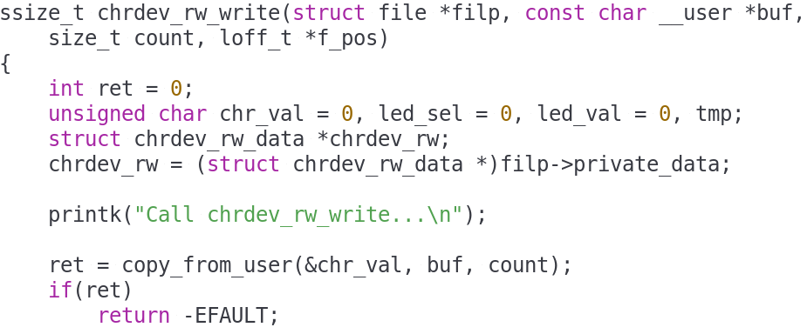
Driver LED
2-1-2-chrdev_rw
Write callback
function

Slide 34
Read and Write of Character Drivers

Slide 35
About read & write (1)
ssize_t (*read) (struct file *filp, char __user *buff,
size_t count, loff_t *offp);
ssize_t (*write) (struct file *filp, const char __user *buff,
size_t count, loff_t *offp);
filp : file pointer
buff : a user-space pointer
count : size of requested transfer
offp : file position pointer

Slide 36
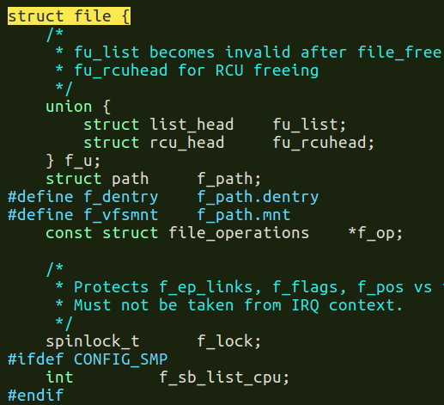
About read & write (2)
ssize_t (*read) (struct file *filp, char __user *buff, size_t count, loff_t *offp);
Buffer
Copy To User
Buffer
Kernel Space
User Space

Slide 37
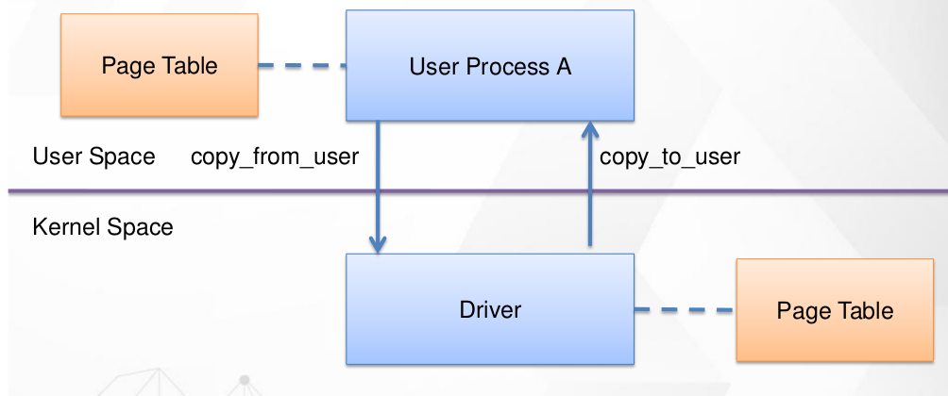
CopyToUser & CopyFromUser (1)
Example
CH2/CH2-1-Char_Drivers/2-1-3-at24cxx/

Slide 38
About read & write (3)
To safely access user-space buffer
  Use kernel-provided functions
    unsigned long copy_to_user(void __user *to,
    const void *from,
    unsigned long count);
    unsigned long copy_from_user(void *to,
    const void __user *from,
    unsigned long count);
      Check whether the user-space pointer is valid
      Return the amount of memory still to be copied

Slide 39
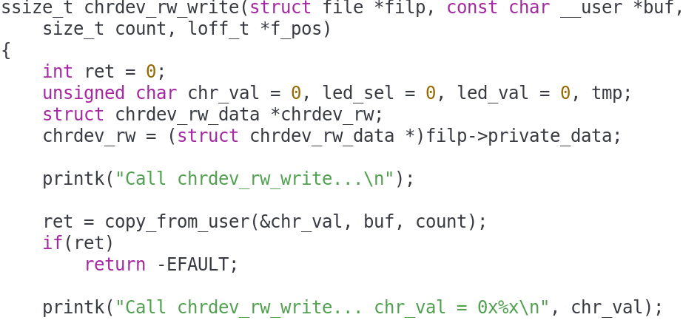
Write Case
user space
kernel space

Slide 40
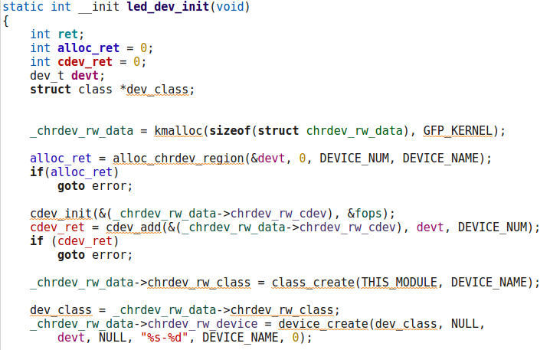
Sample – LED (1)
2-1-led

Slide 41
Supplement – SysFS

Slide 42
Sysfs Filesystem
Allows kernel code to export information to user processes
sysfs is an in-memory filesystem
It provides two components
  a kernel programming interface for exporting these items via sysfs
  user interface to view and manipulate these items that maps back to the kernel objects which they represent

Slide 43
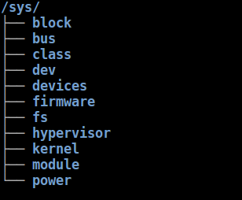
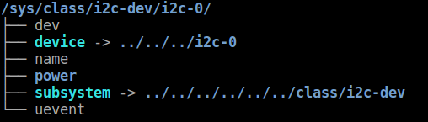
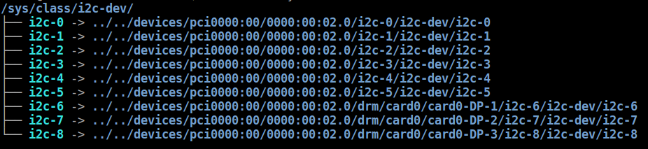
Sysfs Filesystem
# tree -L 1 /sys/
# tree -L 1 /sys/class/i2c-dev/i2c-0/
# tree -L 1 /sys/class/i2c-dev

Slide 44
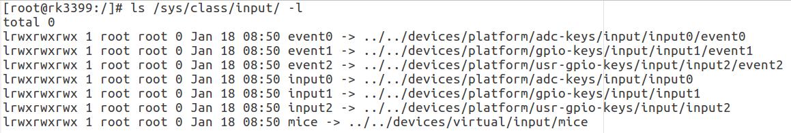
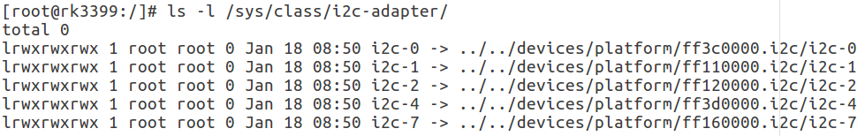
Sysfs Filesystem – info 1

Slide 45
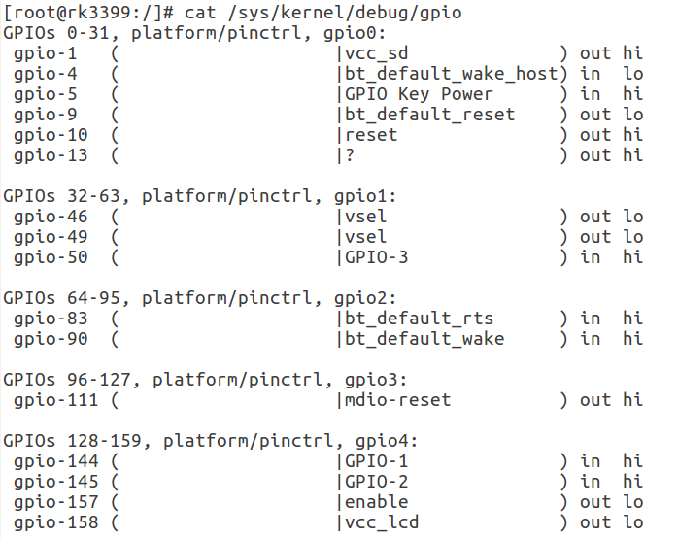
Sysfs Filesystem – info 2

Slide 46
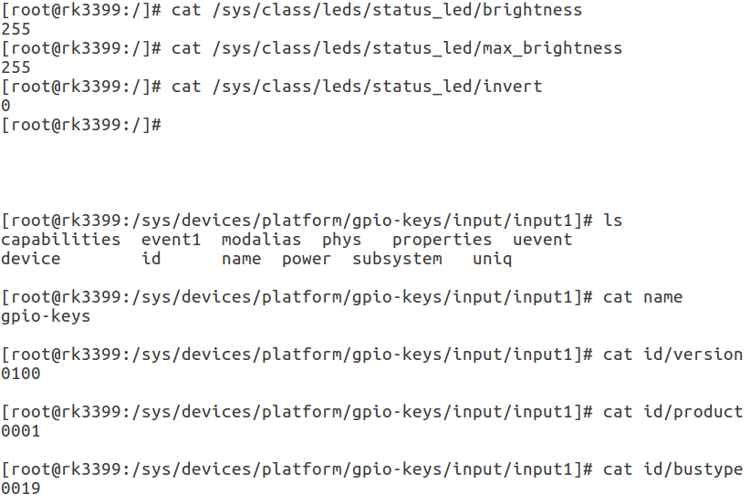
Sysfs Filesystem - Attributes

Slide 47
Sysfs Filesystem – Attributes API
sysfs_attr_init(struct device_attribute attr)
  initialize a dynamically allocated sysfs attribute
  attr : struct attribute to initialize
sysfs_attr_init(&device_id_attr.attr);
device_id_attr.attr.name = "id";
device_id_attr.attr.mode = S_IRUGO | S_IWUSR;
device_id_attr.show = device_id_show;
device_id_attr.store = device_id_store;

Slide 48
SysFS Sample – Add Attributes 1
2-1-4-chrdev_sys
struct device_attribute device_id_attr;
static int chrdev_sys_init(void)
{
[...]
sysfs_attr_init(&device_id_attr.attr);
device_id_attr.attr.name = "id";
device_id_attr.attr.mode = S_IRUGO | S_IWUSR;
device_id_attr.show = device_id_show;
device_id_attr.store = device_id_store;

Slide 49
SysFS Sample - Add Attributes 2
static ssize_t device_id_show(struct device *class_dev,
struct device_attribute *attr,
char *buf)
{
return snprintf(buf, strlen(id_string), "%s\r\n", id_string);
}
static ssize_t device_id_store(struct device *dev, struct device_attribute *attr,
const char *buf, size_t count)
{
if (strlen(buf) < 50) {
strcpy(id_string, buf);
}
return count;
}

